Slide 1

Health and Demographic Surveillance Sites (HDSS) in Ethiopia: A Scoping Review of Infrastructure and Gaps for Longitudinal Studies on Health and Aging
36 ^{th} GRAL CONFERENCE
PHOENIX, ARIZONA , USA
JANUARY 29 to 31, 2025
Muluken Azage Yenesew
Muluken Azage Yenesew^{1,2},Janina Krell-Roesch³, Aklilu Endalamaw⁴, Mintesnot Tenkir⁵, Dabere Nigatu², Alemtsehay Mekonnen², Mulugeta Biyadgie⁶, Eyaya Misgan⁶, Awoke Derbie⁷, Tsion Zewdu Minas⁸, Getahun Abate⁹, Daniel A Enquobahrie¹⁰, Tesfaye B Mersha¹¹, Yonas E. Geda¹².
¹Global Brain Health Institute, UCSF, San Francisco, CA, USA, ²School of Public Health, CMHS, Bahir Dar University, Bahir Dar, Ethiopia,

Slide 2
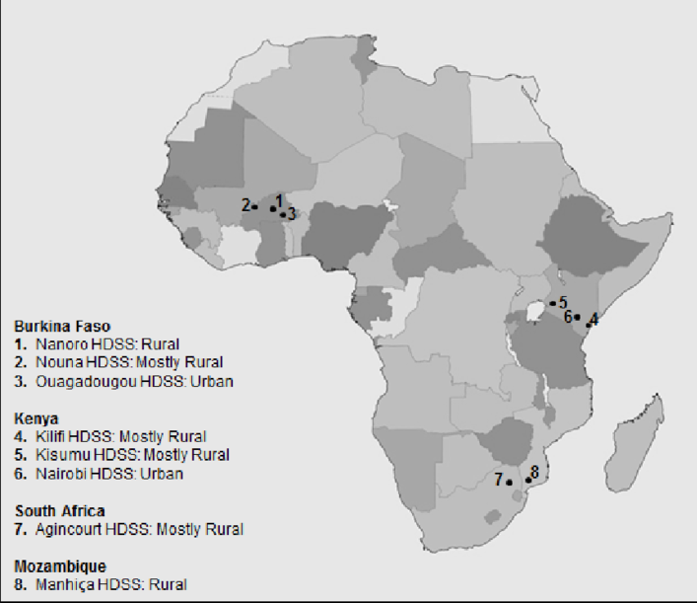

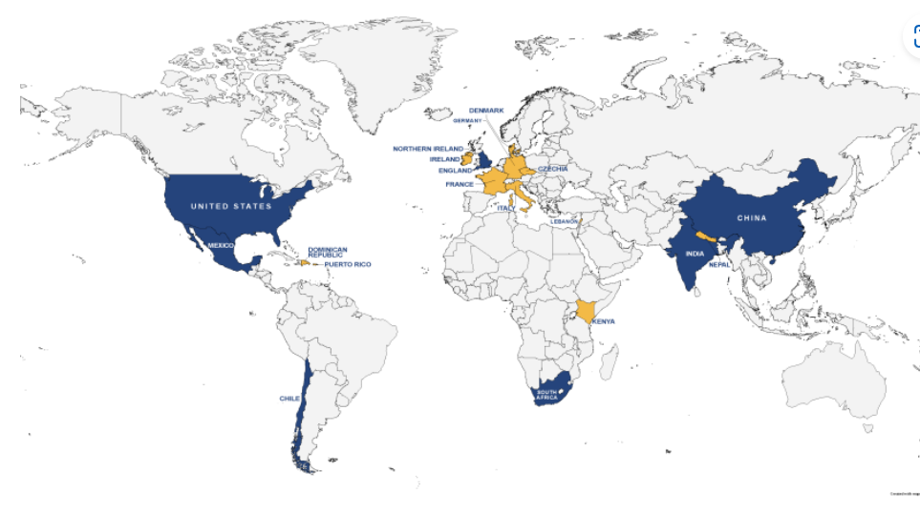

Introduction
HDSS in LMIC generates valuable data for
(Asefa, 2008).
1
GBD and identify risk factors
2
Global and super-regional DALY counts and age-standardised DALY rates by Level 1 (A) and Level 2 causes (B), 1990–2050
GBD collaborators . Lancet. 2024
HAALSI
HCAP
Notes:
HDSS in LMIC generate valuable data for
global health research,
enhancing the understanding of health burdens and health issues.
developing effective health planning and intervention,
building resilient health systems, and
improving population health outcomes.
Accurate and reliable data from health and demographic surveillance sites (HDSS) are crucial for
Chile, China, England, India, Mexico, South Africa, and the United States. (HCAP)

Slide 3
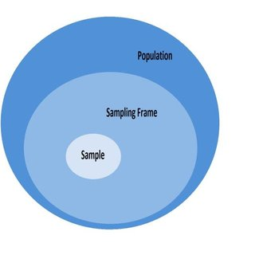
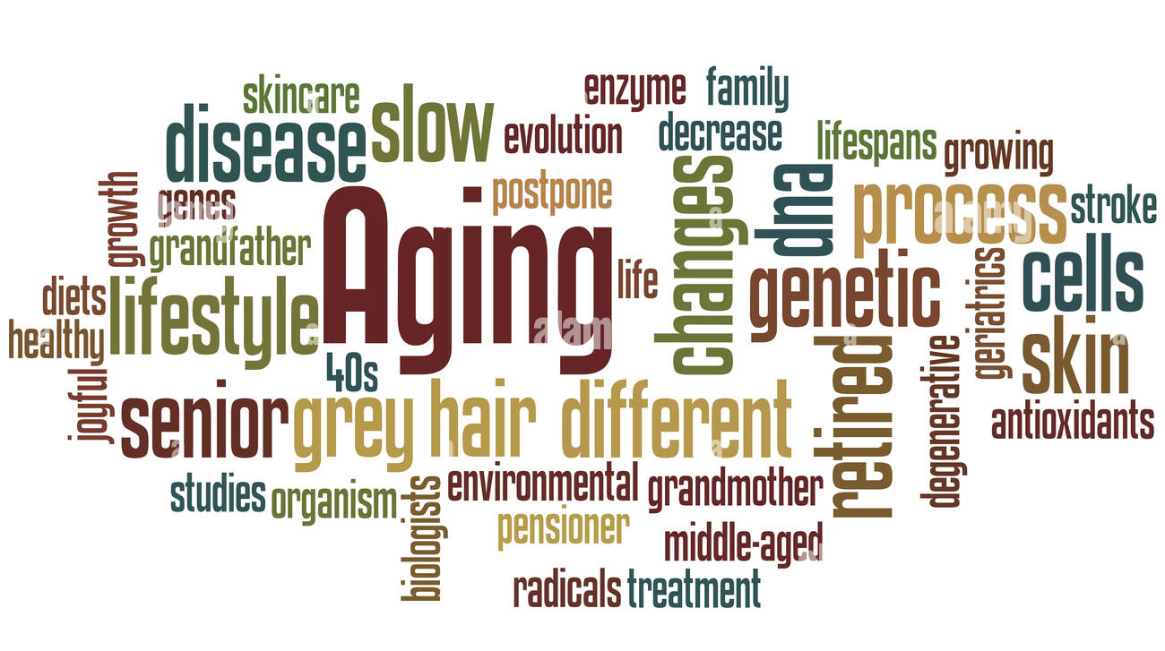
Introduction
HDSS may serve as potential infrastructure to generate sampling frame.
There is lack of compressive information about HDSS in Ethiopia
Characterizing this infrastructure and acknowledging research gaps in Ethiopia may also provide information for researcher to conduct heath and aging studies

Slide 4
Objectives
This review has the following three specific objectives:
  1) characterize the HDSS in Ethiopia
  2) identify gaps in research and infrastructure and
  3) estimate the sampling frame of the older adult population (≥ 40 years, ≥ 60 years, and ≥ 65 years) of HDSS for conducting ADRD study in Ethiopia.

Slide 5
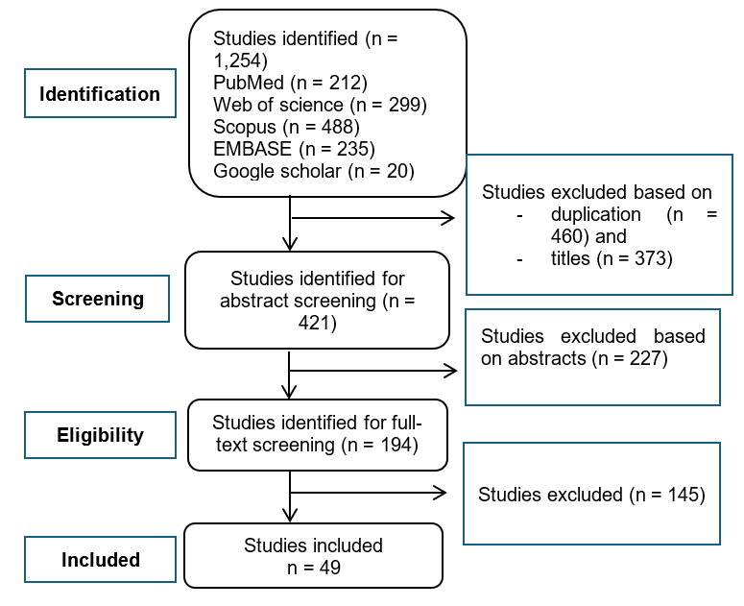
Methods
Scoping review
  PubMed,
  Web of Science,
  Scopus, Embase, and
  Google Scholar
HDSS, regions and Ethiopia
Data synthesis
  (1) HDSS, affiliated institutions,
  (2) included kebeles, number of households and population size of HDSS at specified times;
  (3) demographic characteristics of HDSS;
  (4) projection of adult population (aged ≥ 40 years) for the respective HDSS
Figure 1: Flow chart of the selection process for the studies included in the scoping review
Notes:
We conducted a scoping review and PubMed, Web of Science, Scopus, Embase, and Google Scholar were used to identify relevant publications, and by using a variation of different search terms (e.g., HDSS, epidemiological field survey OR field research survey AND Ethiopia).
Name of regions were also used as search term

Slide 6
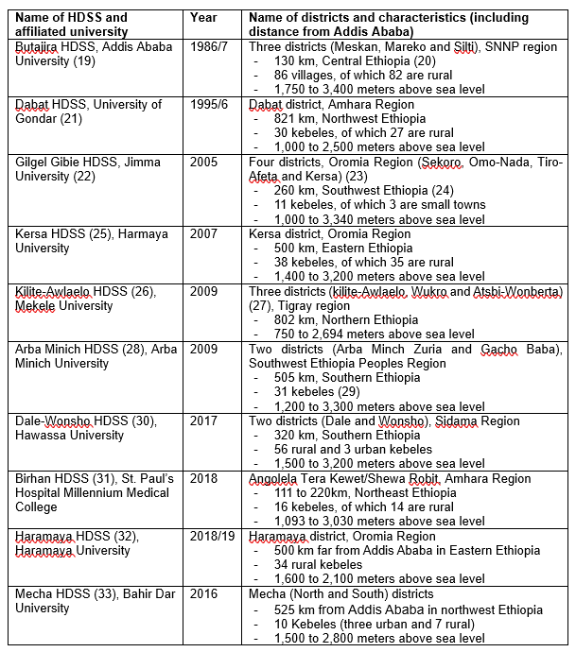
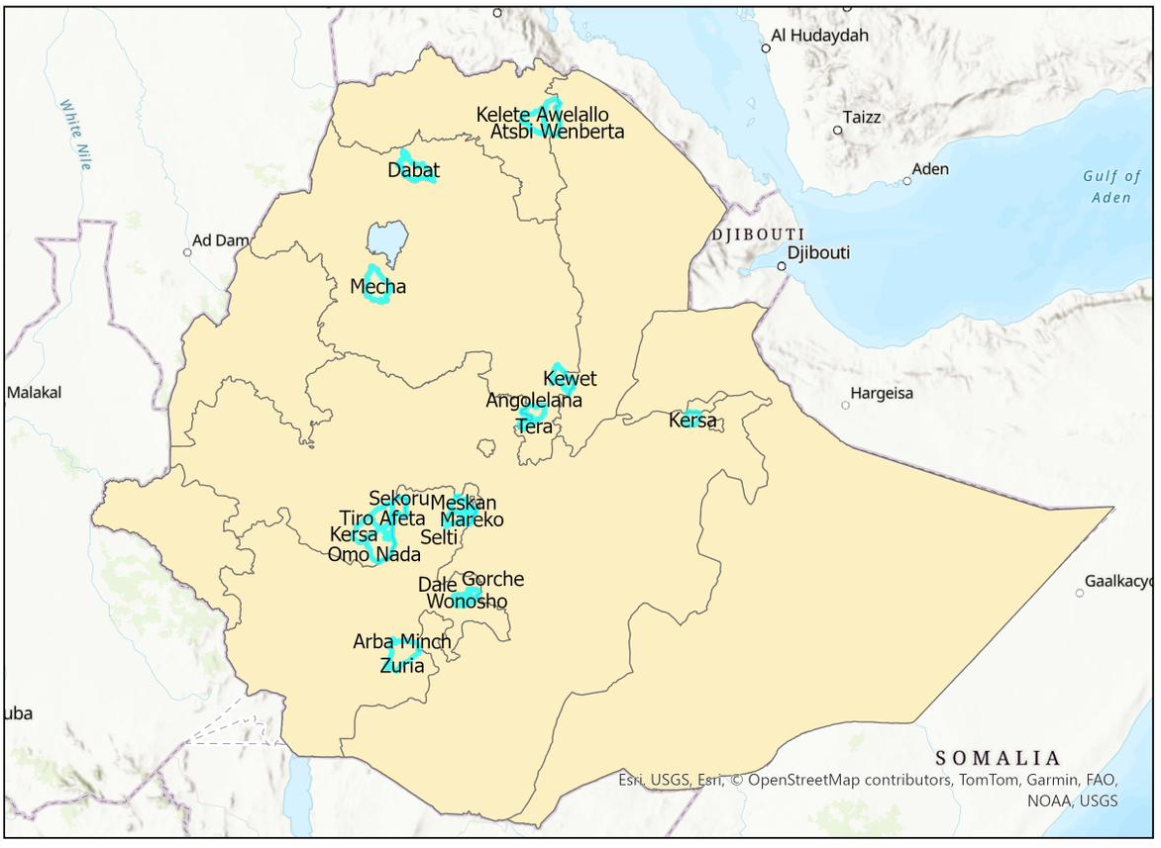
Results
Characteristics of HDSS in Ethiopia
10 HDSS
Open cohort
Unique Characteristics
Figure 2: Locations of HDSS in regions of Ethiopia
Notes:
there are 10 active HDSS (Figure 2).
Amhara and Oromia regions have three HDSS each.
All HDSS have ongoing open cohort studies.
The number of HDSS in Ethiopia is increasing.

Slide 7
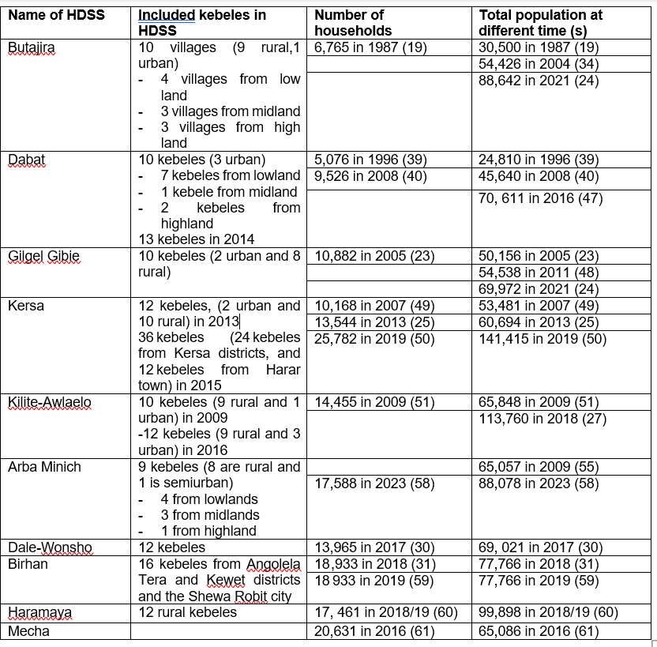
Results
Table: Number of HHs and Population at Different Time in HDSS Ethiopia
9 kebeles
>13,500 HHs
>70,000 population

Slide 8
Results
Population characteristics of HDSS by age
  The projected increase may vary by age (Figure 3).
Year | All age | >=40 yrs | >60yrs | >=65yrs
2024 | 897,540 | 176,287 | 45,482 | 28,948
2037 | 924,266 | 251,299 | 67,392 | 43,157
  The projected population varies by age (Figure 3).
Notes:
In 2024, the estimated total population in the ten HDSS in Ethiopia was approximately 897,540, with an expected steady increase each year, projected to reach 924,266 by 2037.
The projected increase may vary by age (Figure 3).

Slide 9


Results
the identified Gaps
Limited geographic coverage across regions
Limited scope on the surveillance data,
lack of technological infrastructure,
lack of clear national guidelines and
Resource constraints
Notes:
In 2024, the estimated total population in the ten HDSS in Ethiopia was approximately 897,540, with an expected steady increase each year, projected to reach 924,266 by 2037.
The projected increase may vary by age (Figure 3).

Slide 10
Conclusion
Major cities and some regions are lacking HDSS
HDSS are expected to rise in the coming year.
HDSS can serve as an important infrastructure for
  designing and conducting studies on ADRD
  any other national population-based studies
The identified gaps are the areas that require intervention to enhance the efficacy of HDSS.
Notes:
Major cities and regions lacking HDSS require this infrastructure to generate nationally representative data.
Over time, HDSS are expected to witness an increase in the number of older adults.
Thus, HDSS can serve as an important infrastructure for designing and conducting studies on ADRD in the future.
Furthermore, these platforms may also provide a sampling frame for any other national population-based studies examining various health-related outcomes, including but not limited to ADRD.
The identified gaps are the areas that require intervention to enhance the efficacy of HDSS.

Slide 11
References
Teutsch SM, Thacker SB. Planning a public health surveillance system. Epidemiol Bull. 1995 Mar;16(1):1–6.
2. German RR, Horan JM, Lee LM, Milstein B, Pertowski CA. Updated guidelines for evaluating public health surveillance systems; recommendations from the Guidelines Working Group. 2001;
3. Adnyana IMDM, Utomo B, Eljatin DS, Setyawan MF. Developing and Establishing Attribute-based Surveillance System: A Review. Preventive Medicine: Research & Reviews [Internet]. 2024;1(2). Available from: https://journals.lww.com/pmrr/fulltext/2024/01020/developing_and_establishing_attribute_based.5.aspx
4. Wilkins K, Nsubuga P, Mendlein J, Mercer D, Pappaioanou M. The Data for Decision Making project: assessment of surveillance systems in developing countries to improve access to public health information. Public Health. 2008 Sep;122(9):914–922.
5. Nilashi M, Keng Boon O, Tan G, Lin B, Abumalloh R. Critical Data Challenges in Measuring the Performance of Sustainable Development Goals: Solutions and the Role of Big-Data Analytics. Harvard Data Science Review [Internet]. 2023 Jul 27 [cited 2024 Sep 20];5(3). Available from: https://hdsr.mitpress.mit.edu/pub/9n4uzkg3
6. Hellenthal G, Bird N, Morris S. Structure and ancestry patterns of Ethiopians in genome-wide autosomal DNA. Hum Mol Genet. 2021 Apr 26;30(R1):R42–R48.
7. López S, Tarekegn A, Band G, et al. Evidence of the interplay of genetics and culture in Ethiopia. Nat Commun. 2021 Jun 11;12(1):3581.
8. Geldsetzer P, Manne-Goehler J, Marcus M-E, et al. The state of hypertension care in 44 low-income and middle-income countries: a cross-sectional study of nationally representative individual-level data from 1·1 million adults. The Lancet. 2019 Aug;394(10199):652–662.
9. Boerma JT, Sommerfelt AE. Demographic and health surveys (DHS): contributions and limitations. World Health Stat Q. 1993;46(4):222–226.
10. Riley L, Guthold R, Cowan M, et al. The World Health Organization STEPwise Approach to Noncommunicable Disease Risk-Factor Surveillance: Methods, Challenges, and Opportunities. Am J Public Health. 2016 Jan;106(1):74–78.
11. Asefa M. Assessment of Universities Field Research Sites for Establishing National Surveillance Database. Ethiopian Journal of Health Sciences. 2008;18(1).
12. Prina AM, Mayston R, Wu Y-T, Prince M. A review of the 10/66 dementia research group. Soc Psychiatry Psychiatr Epidemiol. 2019 Jan;54(1):1–10.
13. Akinyemi RO, Yaria J, Ojagbemi A, et al. Dementia in Africa: Current evidence, knowledge gaps, and future directions. Alzheimers Dement. United States; 2022 Apr;18(4):790–809.
14. Livingston G, Huntley J, Liu KY, et al. Dementia prevention, intervention, and care: 2024 report of the Lancet standing Commission. The Lancet. Elsevier; 2024 Aug 10;404(10452):572–628.
15. Yenesew MA, Krell-Roesch J, Fekadu B, et al. Prevalence of Dementia and Cognitive Impairment in East Africa Region: A Scoping Review of Population-Based Studies and Call for Further Research. J Alzheimers Dis. Netherlands; 2024;100(4):1121–1131.
16. NIH. HRS International Family of Studies and the Harmonized Cognitive Assessment Protocol [Internet]. [cited 2024 Sep 20]. Available from: https://www.nia.nih.gov/research/dbsr/global-aging/hrs-international-family-studies-and-harmonized-cognitive-assessment-protocol
17. CSA. Population projections for Ethiopia 2007–2037. Federal Democratic Republic of Ethiopia, Population Census Commission Addis. 2013;
18.
Notes:
In 2024, the estimated total population in the ten HDSS in Ethiopia was approximately 897,540, with an expected steady increase each year, projected to reach 924,266 by 2037.
The projected increase may vary by age (Figure 3).

Slide 12



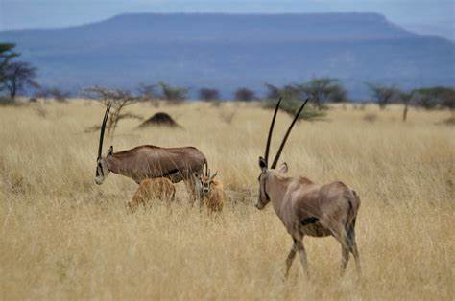


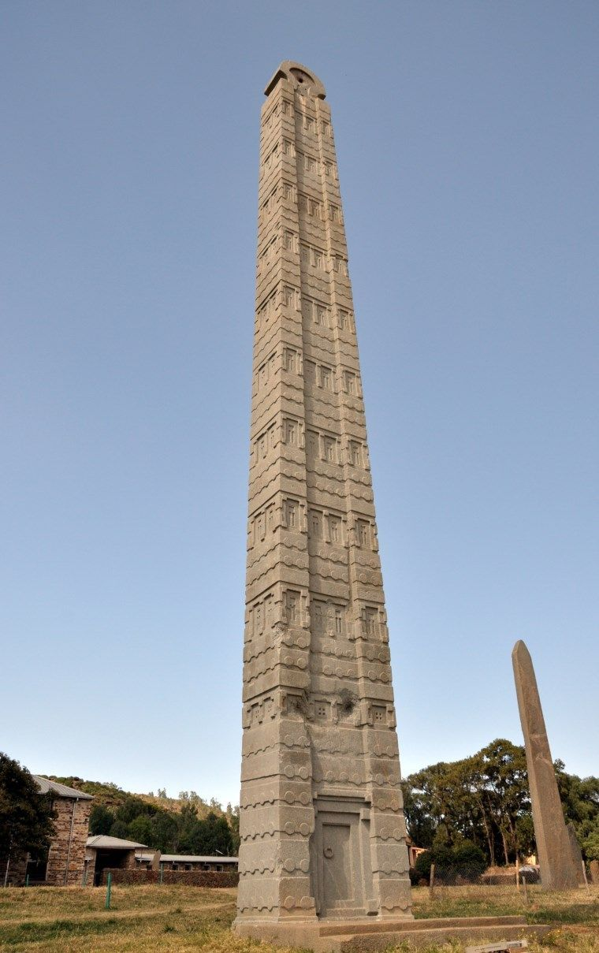

Thank you/ አመሰግናለሁ!
Notes:
In 2024, the estimated total population in the ten HDSS in Ethiopia was approximately 897,540, with an expected steady increase each year, projected to reach 924,266 by 2037.
The projected increase may vary by age (Figure 3).

