Slide 1


The birth of Neuroscience in Ethiopia : The pioneering Legacy
Introducing Eka Kotebe General Hospital as the 1st Neuroscience Institute in Ethiopia
Muluken Tesfaye , MD, Consultant Psychiatrist
CEO, EKGH
36th Annual GRAL Conference ,BNI, Phoenix, USA
January 29-31

Slide 2
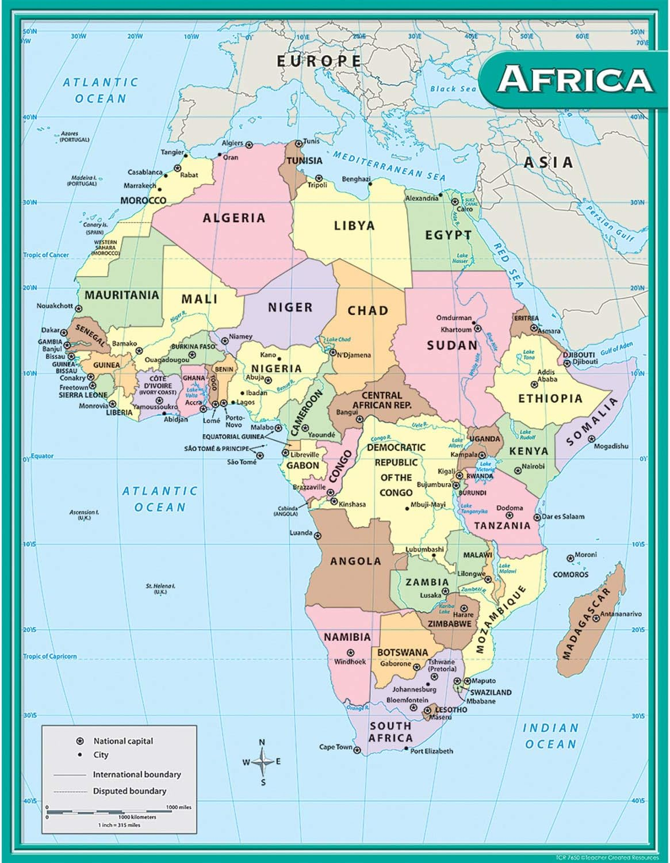

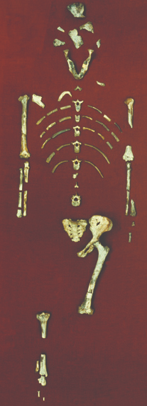
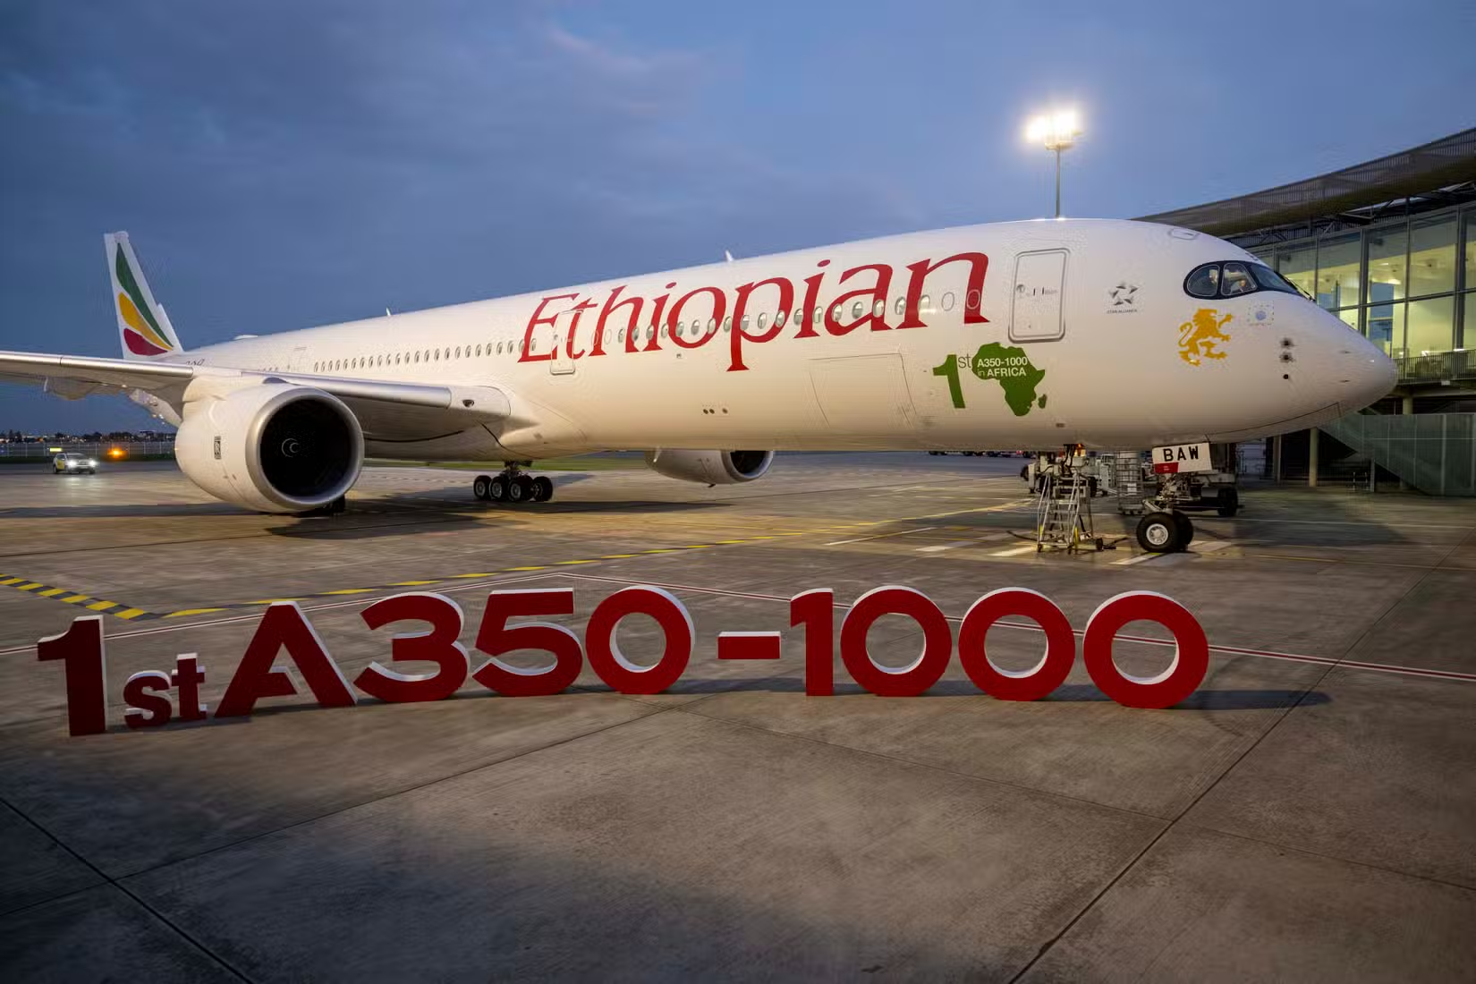
Ethiopia

Slide 3

Health care Landscape
Tertiary Hospitals
General Hospitals
Primary Hospitals
Health centers
Health Post
Notes:
350 bed capacity
1200 staff- 60 specialists and 500 health
Service Provided
Mental health service-Psychiatry , Psychotherapy, social work, Forensic psychiatry,
General medical service-Int medicine,Surgery,Gyn-obs,Pediatrics,Dental,Opthalmology,dermatology,Neurology
Outreach medical service and
Training and research service

Slide 4

Introduction
One of the Five Federal Hospital Under FMOH
The Hospital Governing board approved ENI
The FMOH strong support
On Major renovation

Slide 5


2024
2025
2026
Neuroscience institute
Neurology, Neurosurgery and Psychiatry
Model for integration and quality care
2023
Resume regular service
Our Destination
2022
Advanced trauma Center
2020
2020
2017
Legal autonomy
National COVID center
HOSPITAL START SERVICE
Our Journey…

Slide 6

The Need for a Specialized Neuroscience Institute in Ethiopia
Growing Burden of NCD:
The pooled burden of hemorrhagic were 46.42%
Ischemic stroke 51.40%

Slide 7
The Need for a Specialized Neuroscience Institute in Ethiopia…
Growing Burden of NCD:
The overall in-hospital mortality of stroke in Ethiopia was 18%

Slide 8

The Need for a Specialized Neuroscience Institute in Ethiopia…
Enhance Quality of Care :
Surveillance
Prevention
Acute care
Rehabilitation
295
228 %
Notes:
The four pillars of the quadrangle to tackle the burden of stroke:

Slide 9

Capacity Building:
The Need for a Specialized Neuroscience Institute in Ethiopia…
Healthcare Disparities:
Capacity building
Limited Access:
Impact on Public Health:
Public Awareness and Education:
295
228 %

Slide 10
The Need for a Specialized Neuroscience Institute in Ethiopia…
Multidisciplinary Approach:
Research and Innovation :
Impact on Public Health:
Cross cultural understanding
295
228 %

Slide 11
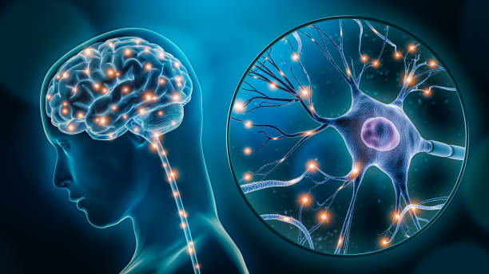
Major Activities and Achievements

Slide 12
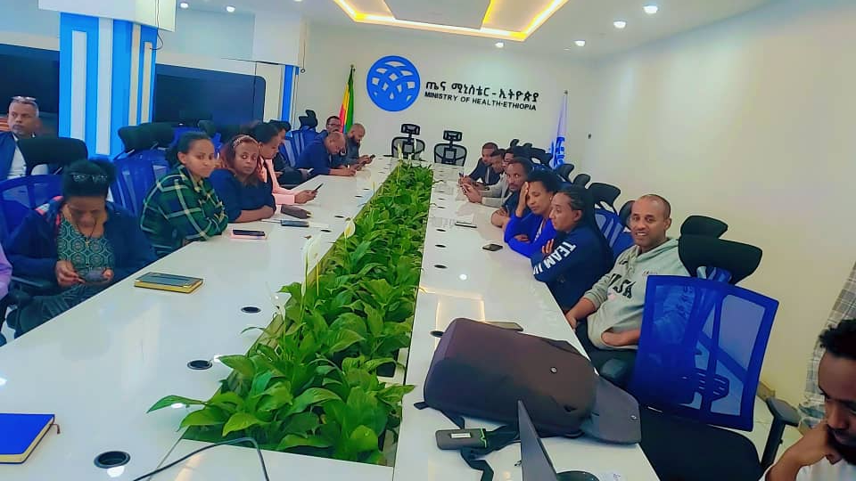
Strategic Direction owned by relevant stakeholders

Slide 13
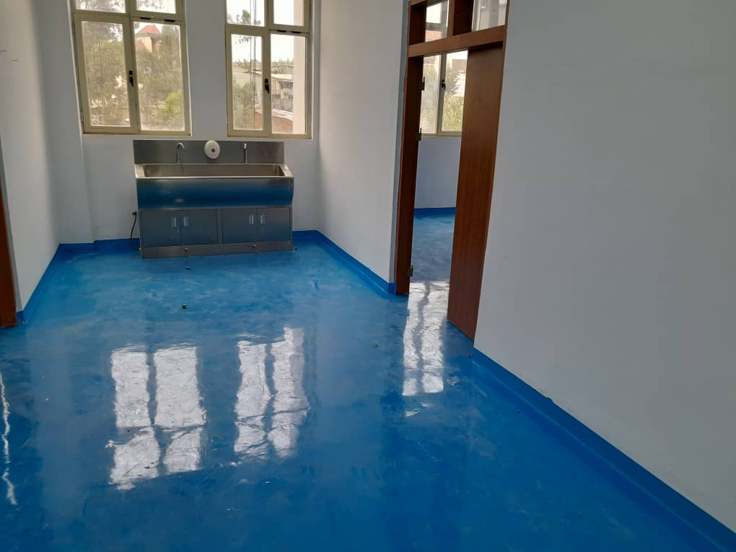
Renovation of the Hospital facility and Digitalization

Slide 14
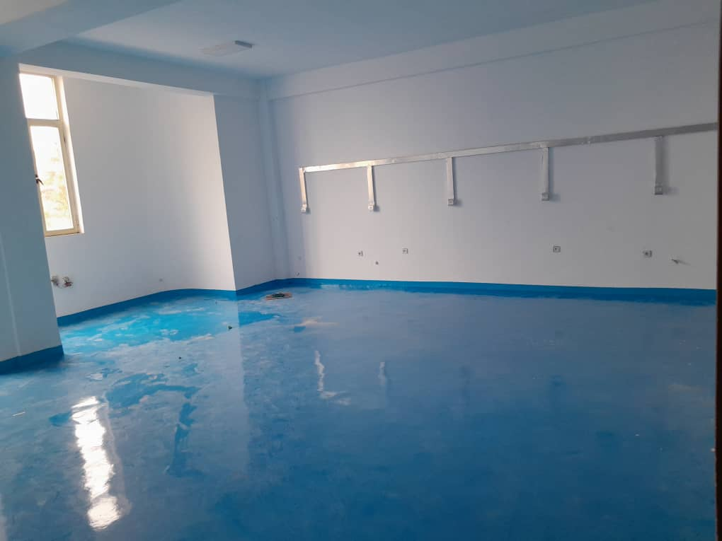
Renovation of the Hospital Facility and Digitalization

Slide 15
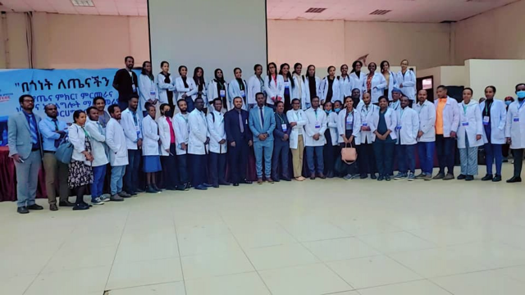
Recruitment of staff

Slide 16
Research Directorate Strategic Affairs Directorate Separate Budget code for Research
Redesigning the Hospital Administrative Structure

Slide 17
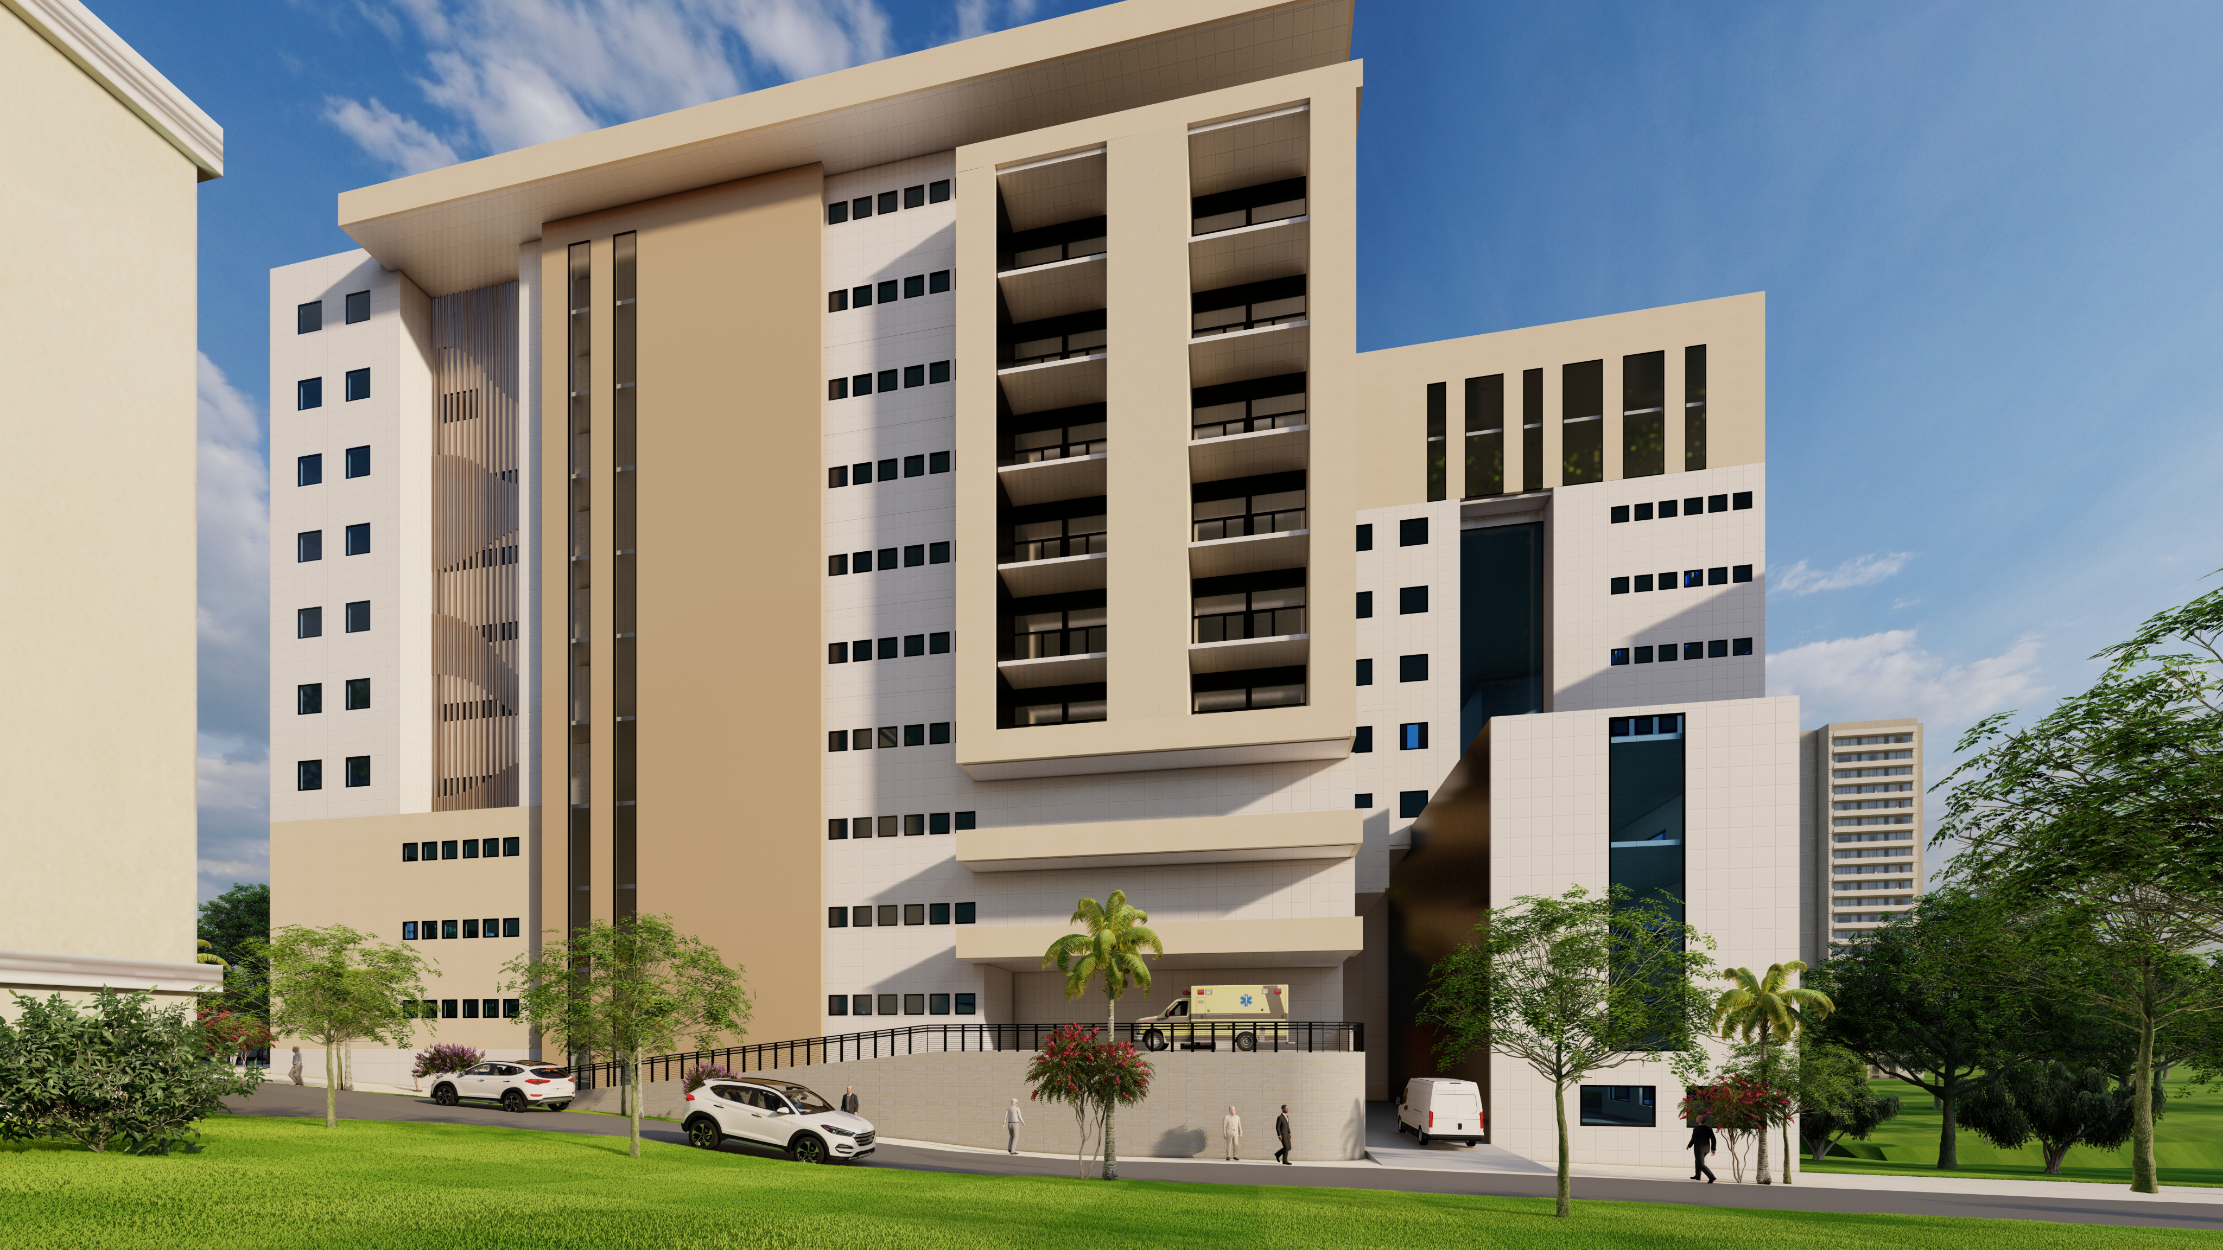
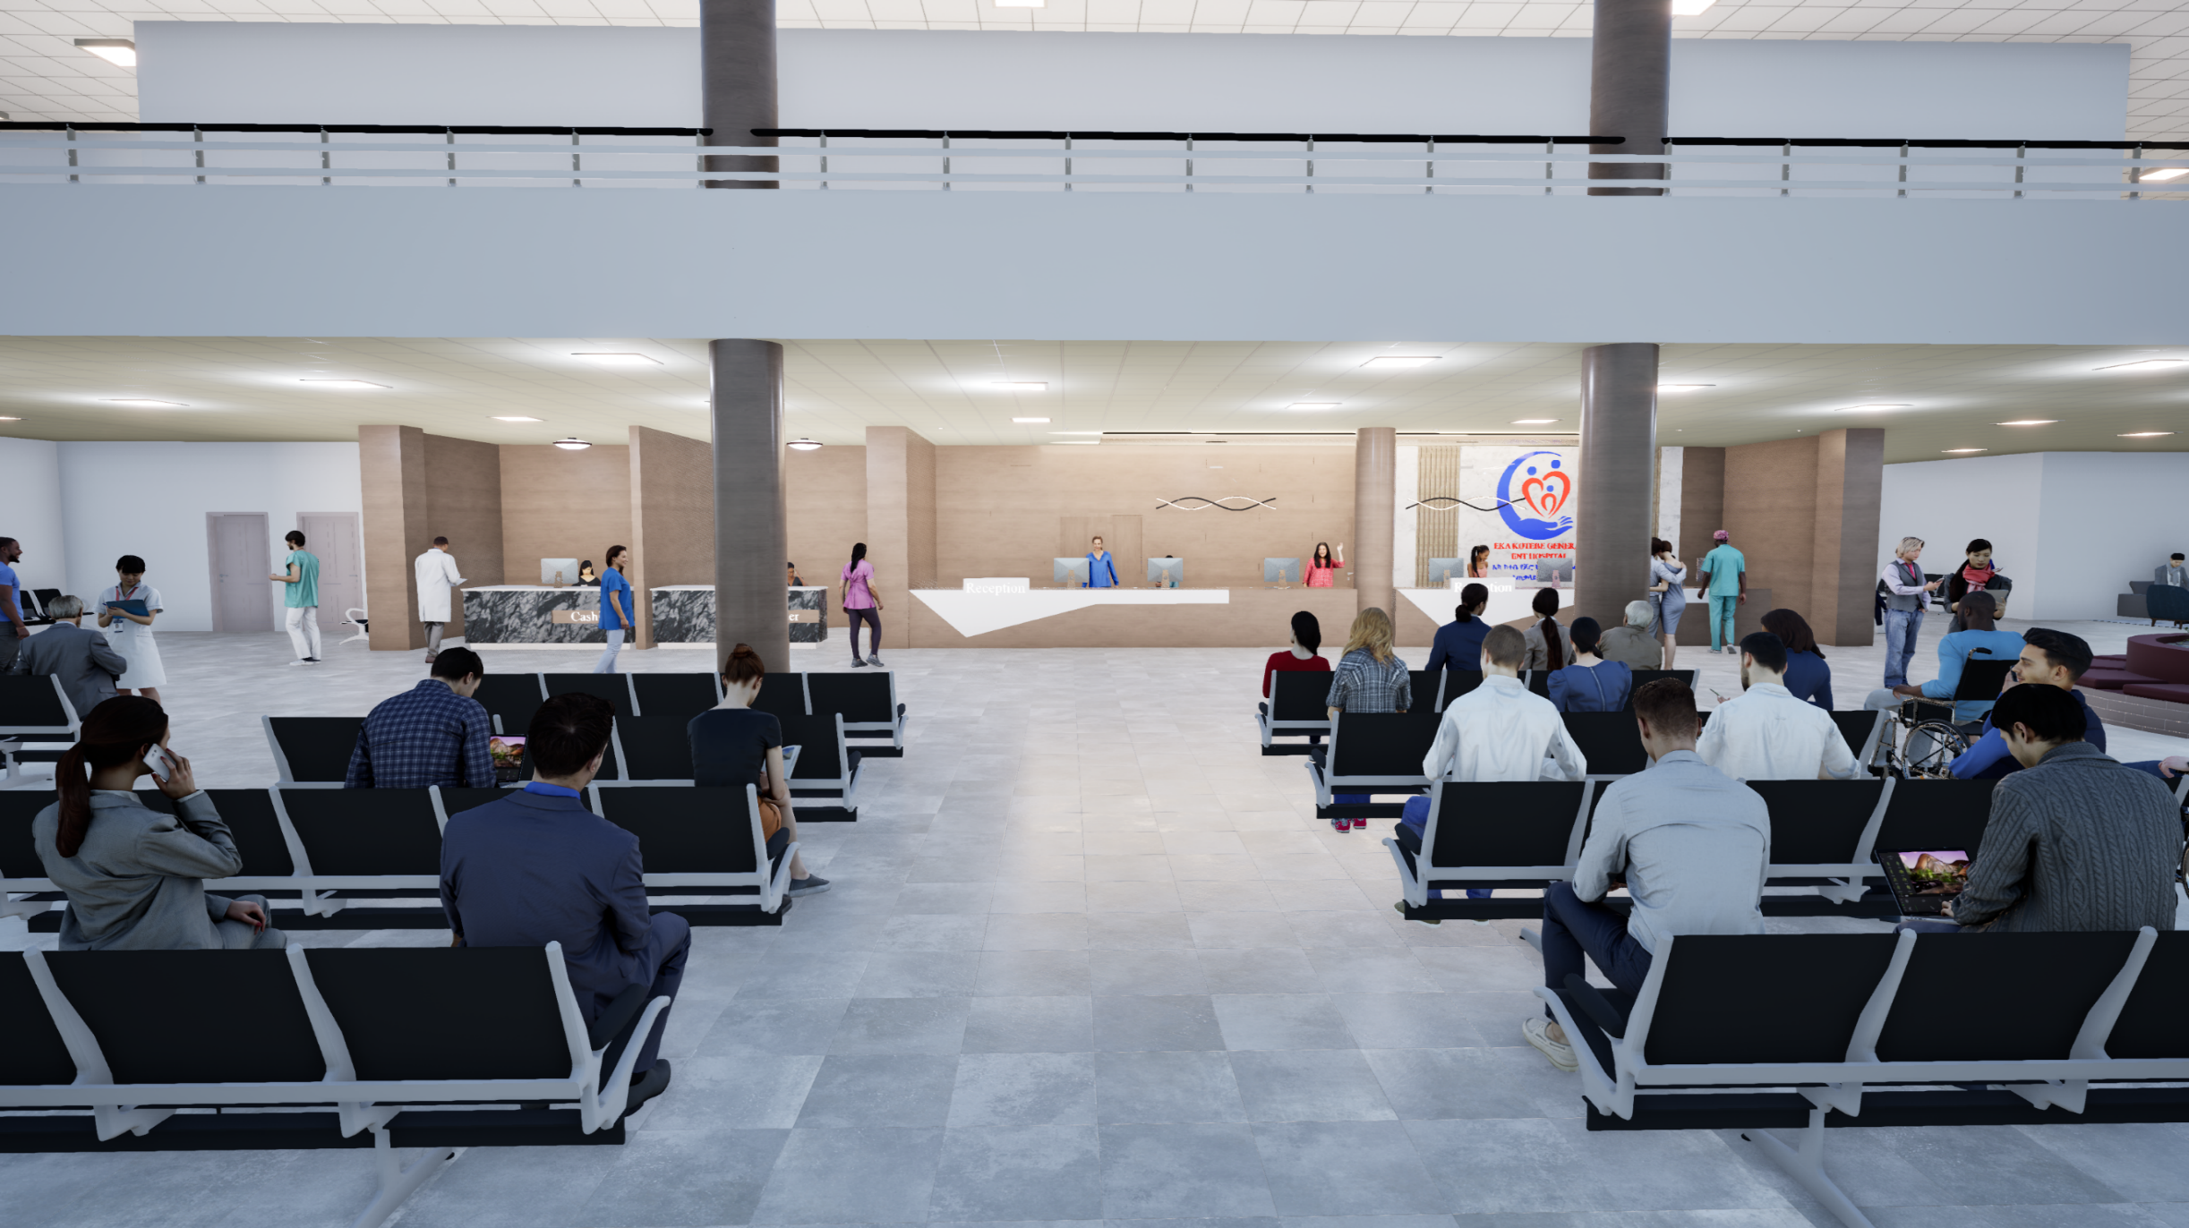
Initiation of Hospital branch construction- Emergency Center

Slide 18
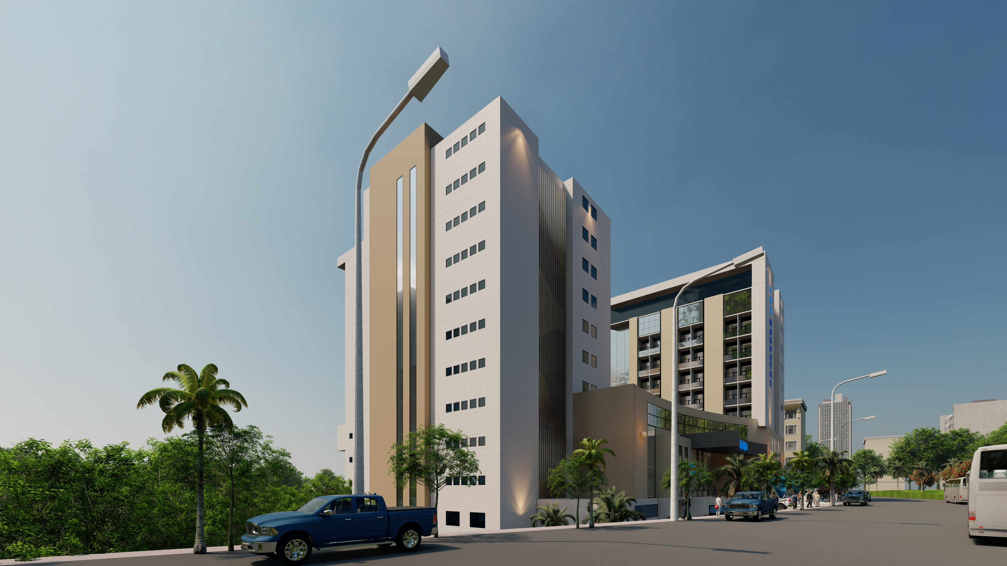
Initiation of Hospital branch construction- Emergency Center

Slide 19
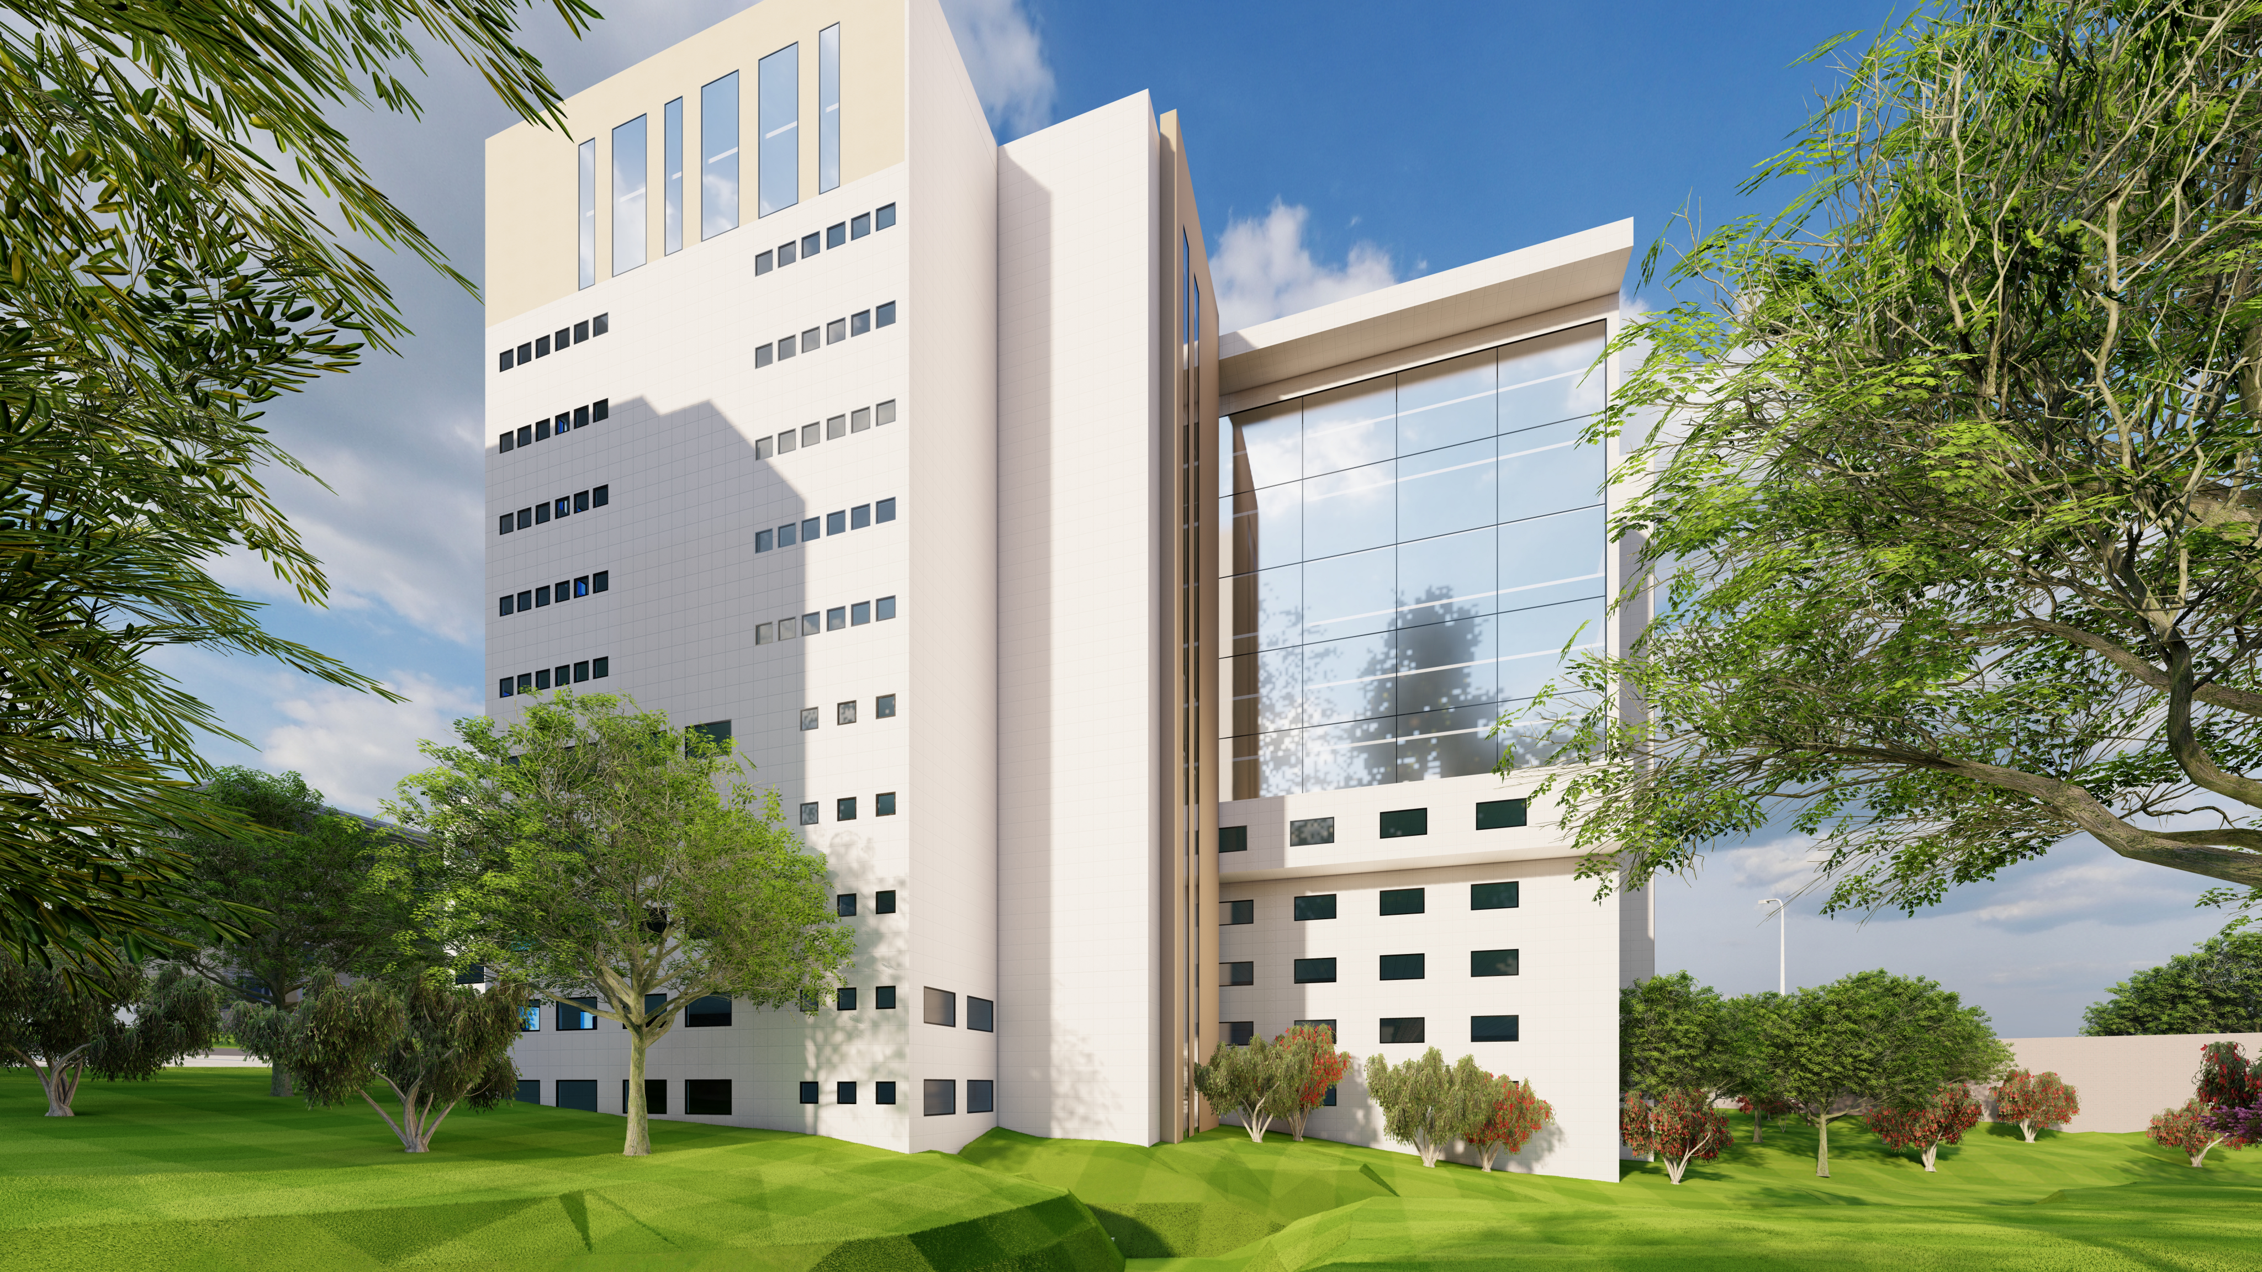
Initiation of Hospital branch construction- Emergency Center

Slide 20
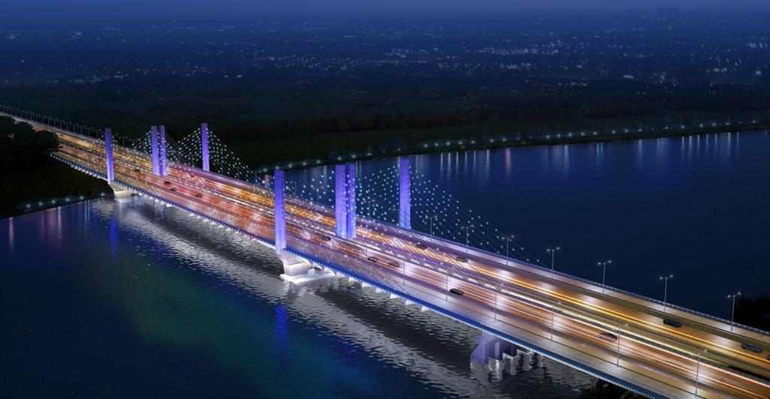



Collaboration: Local institutions

Slide 21
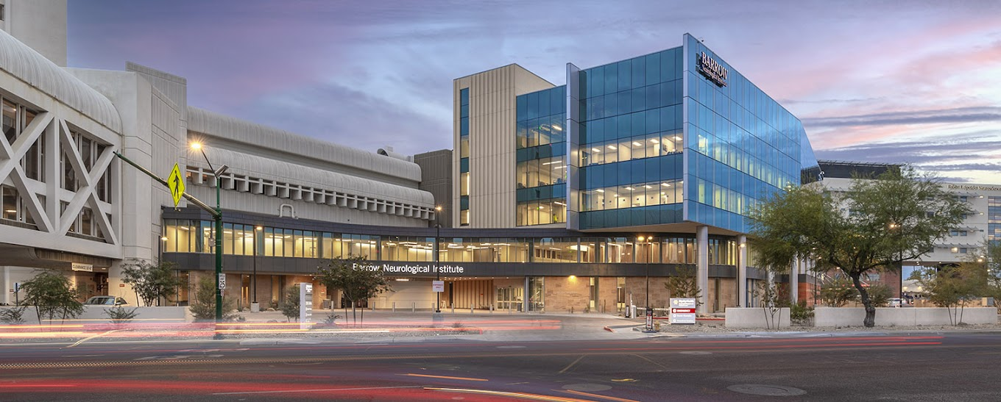
International Institutions:
Barrow neurological institute- USA

Slide 22
Areas for International collaboration
1. Medical service
Neurology, Neurosurgery, Psychiatry, Critical care
2. Research
3. Training and education

Slide 23
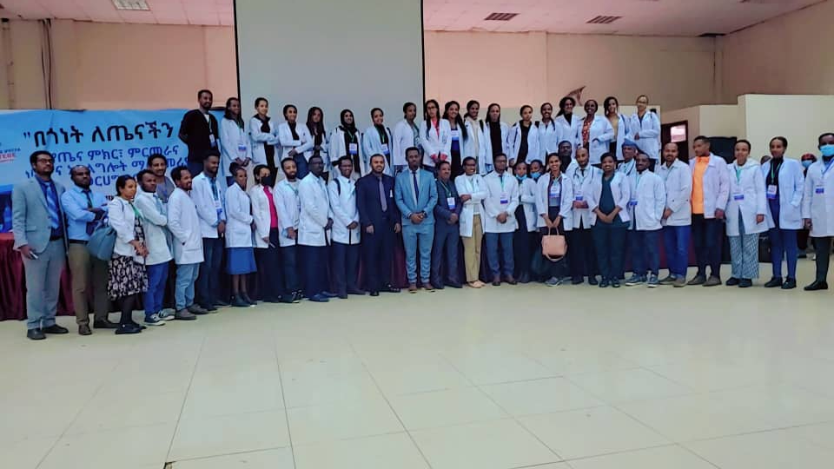

Slide 24
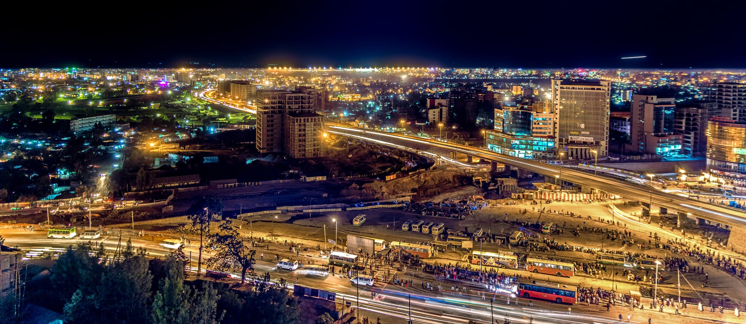
አመሰግናለሁ
Email: mulathea18@gmail.com

