Slide 1
Aging with Epilepsy:
Chronic Effects of Seizures, Medications,
and Neurosurgeries on Cognition
Wil Schultz, PhD, ABPP-CN
January 30, 2025

Slide 2
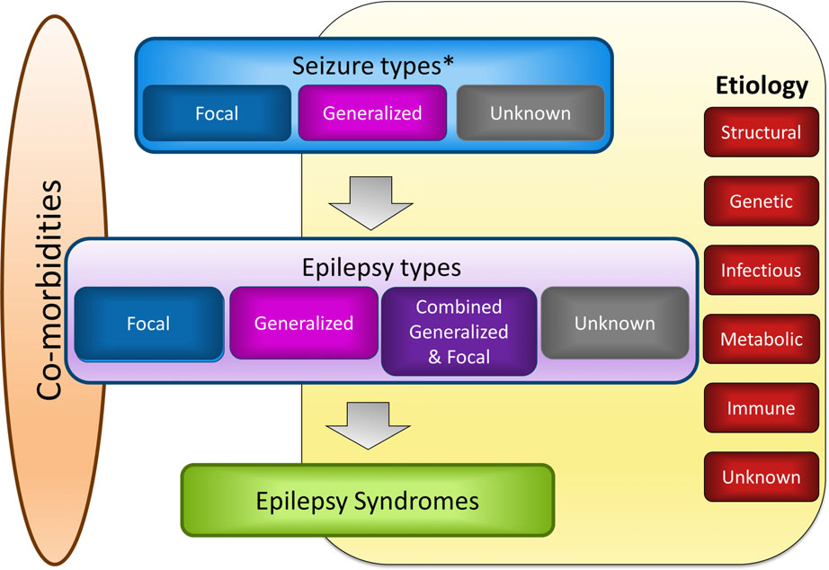
Epilepsy is a Broad Diagnosis
International League Against Epilepsy Classifications (2017)
Aging with Epilepsy will depend on:
Type of seizures
Type of epilepsy
Epilepsy syndrome
Age of onset
Etiology
Duration
Comorbidities
Scheffer et al. 2017

Slide 3
Some Seizures are Intractable, Some Resolve
International League Against Epilepsy (2014)
Operational (practical) clinical definition of epilepsy
  “Epilepsy is a disease of the brain defined by any of the following conditions
    1. At least two unprovoked (or reflex) seizures occurring >24 hours apart
    2. One unprovoked (or reflex) seizure and a probability of further seizures similar to the general recurrence risk (at least 60%) after two unprovoked seizures, occurring over the next 10 years
    3. Diagnosis of an epilepsy syndrome”
  “Epilepsy is considered to be resolved for individuals who had an an age-dependent epilepsy syndrome but are now past the applicable age or those who have remained seizure-free for the last 10 years, with no seizure medicines for the last 5 years.”
Fisher et al. 2014

Slide 4
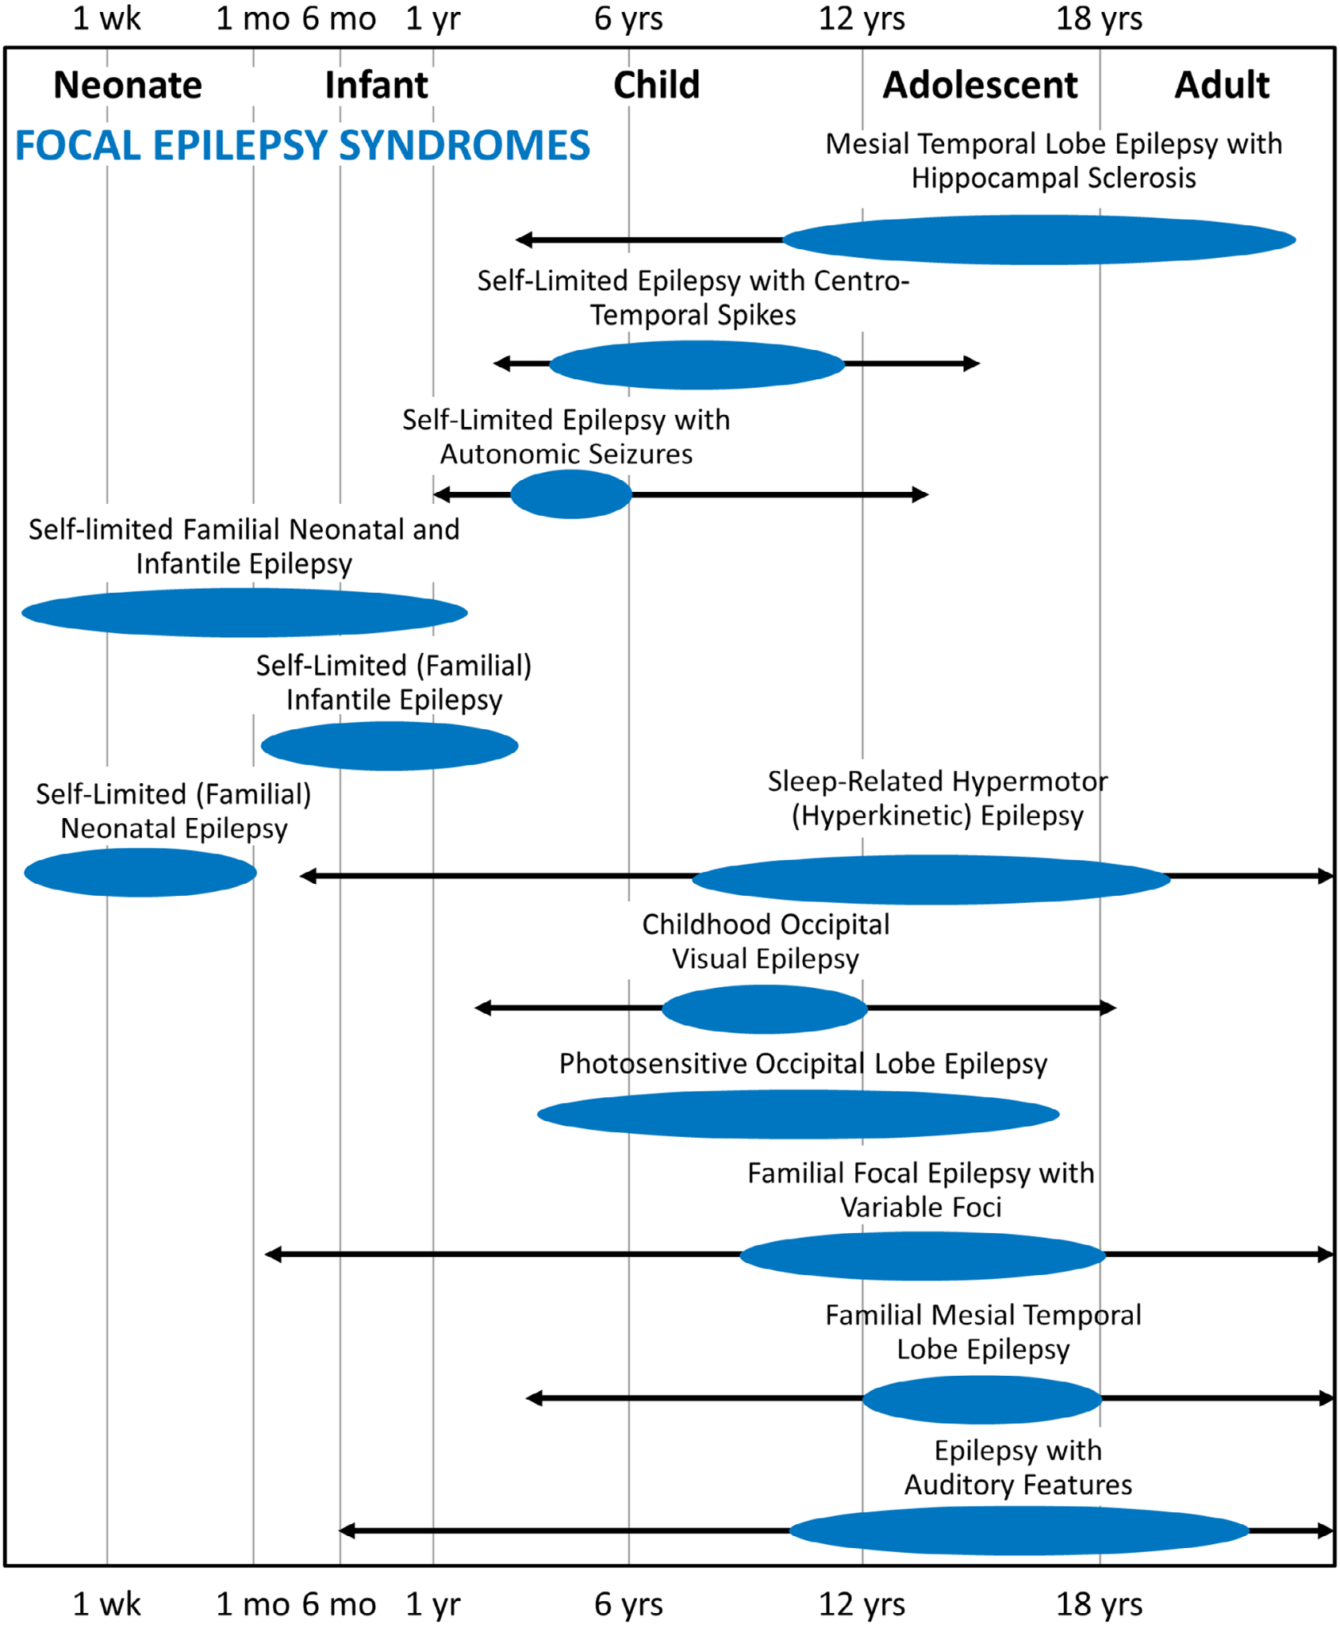
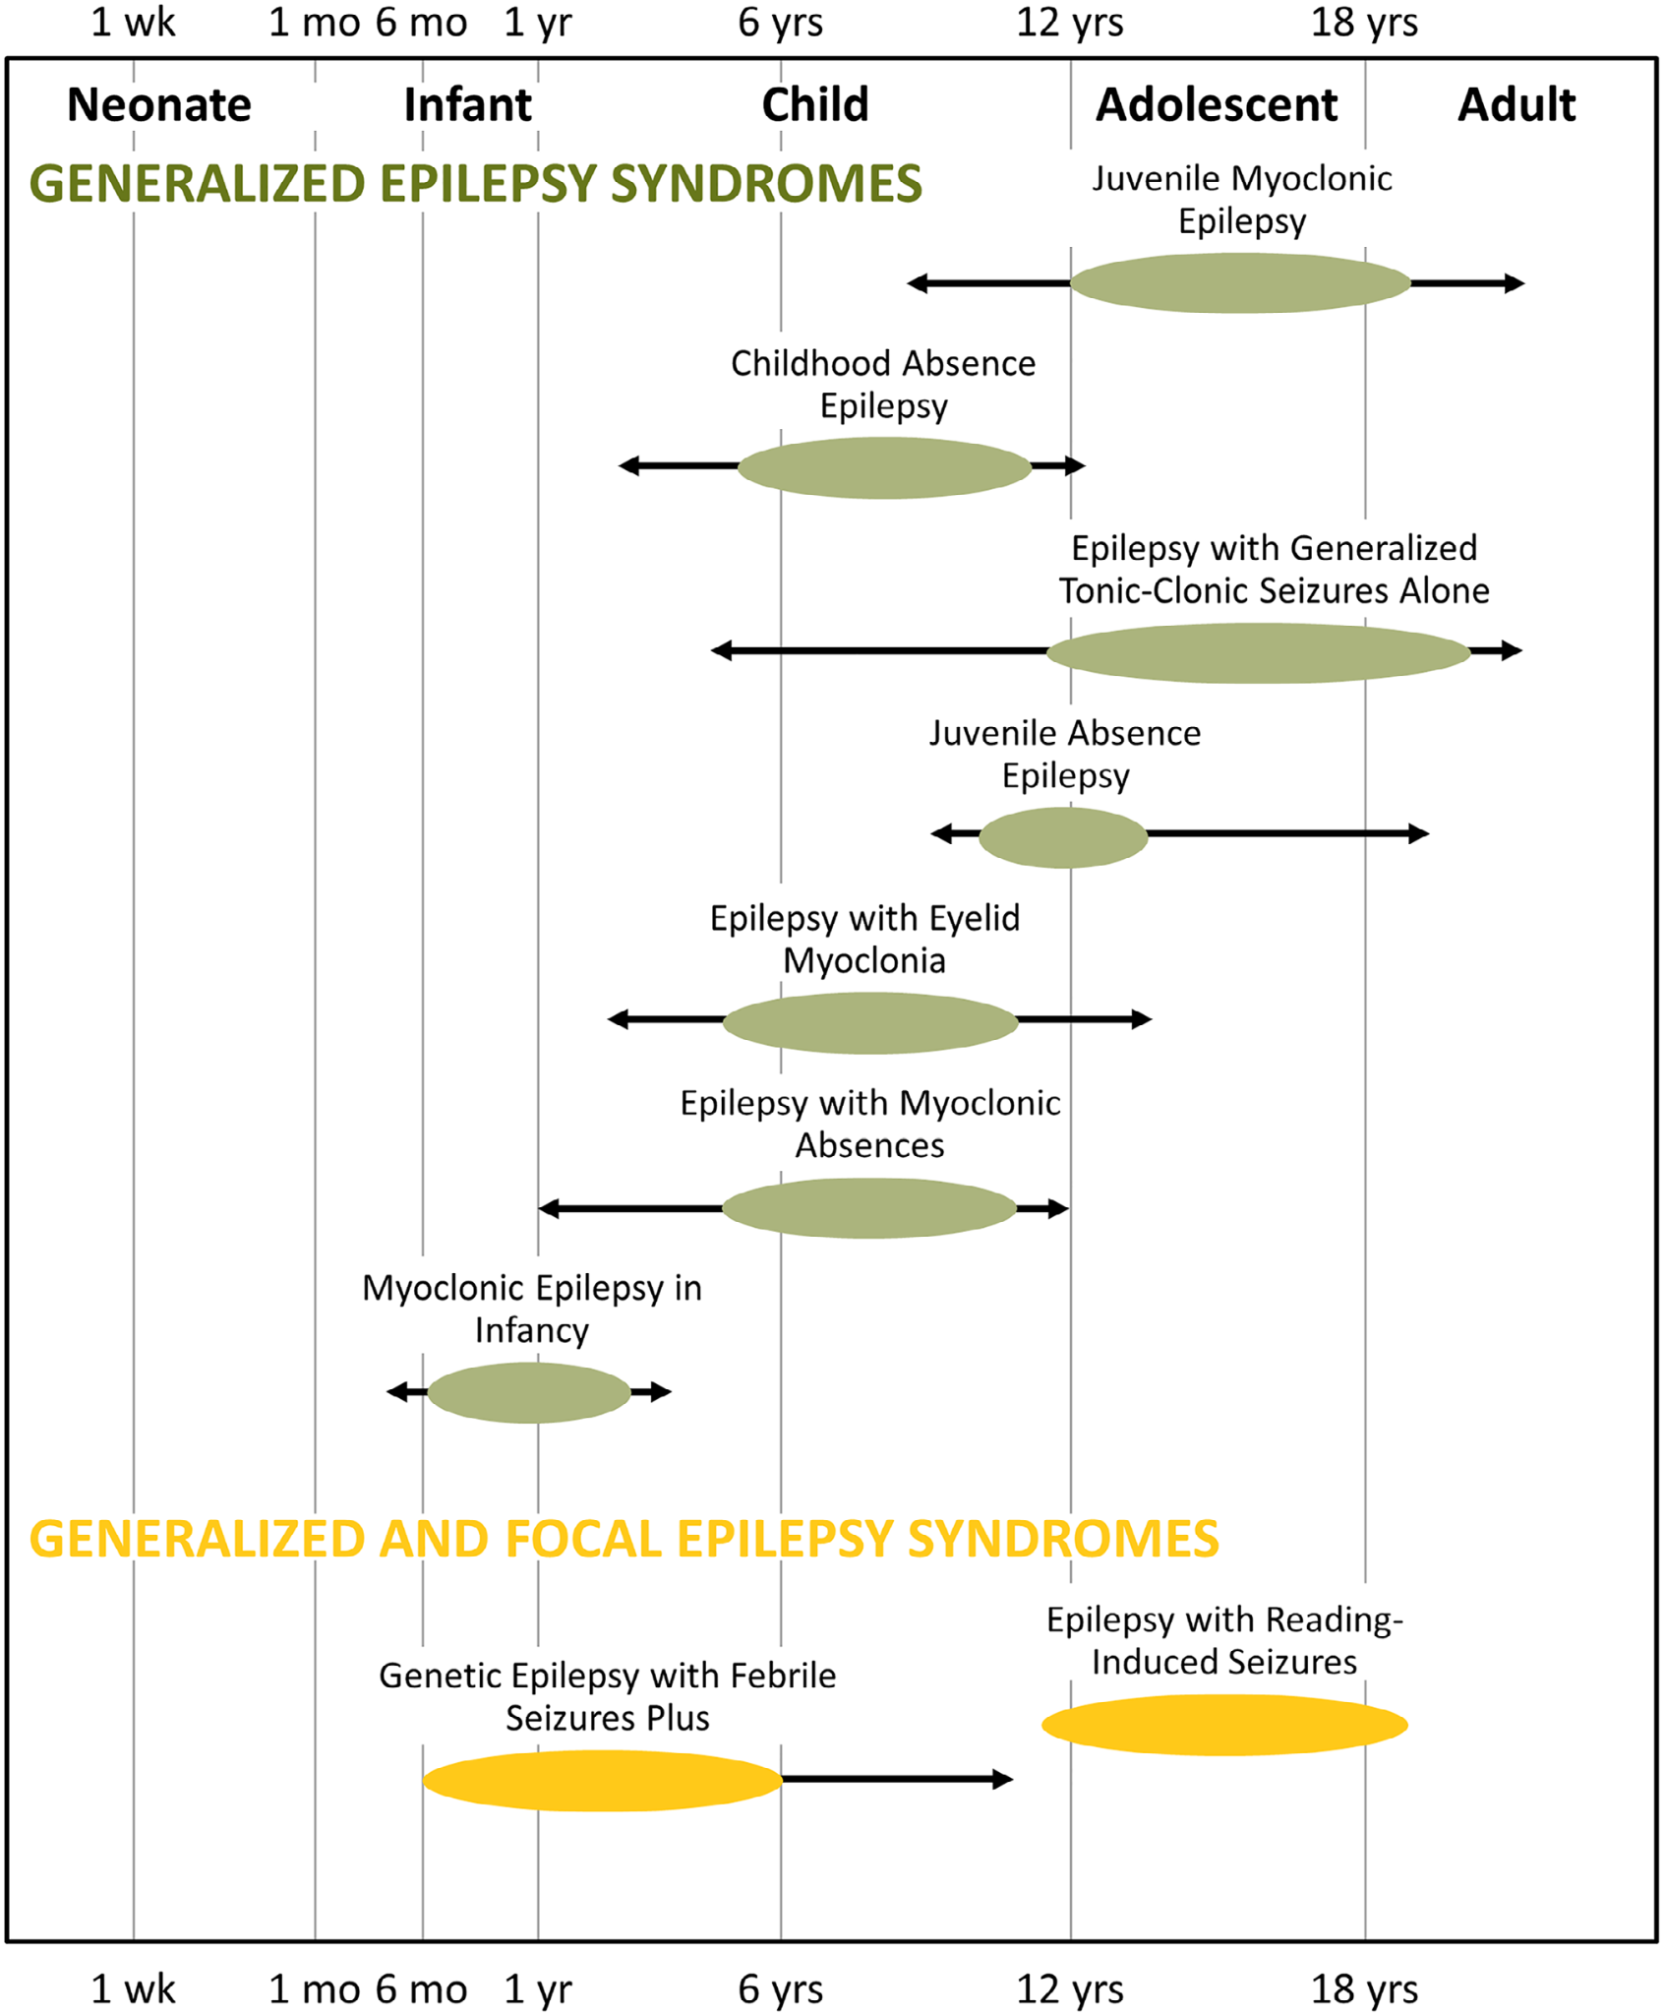
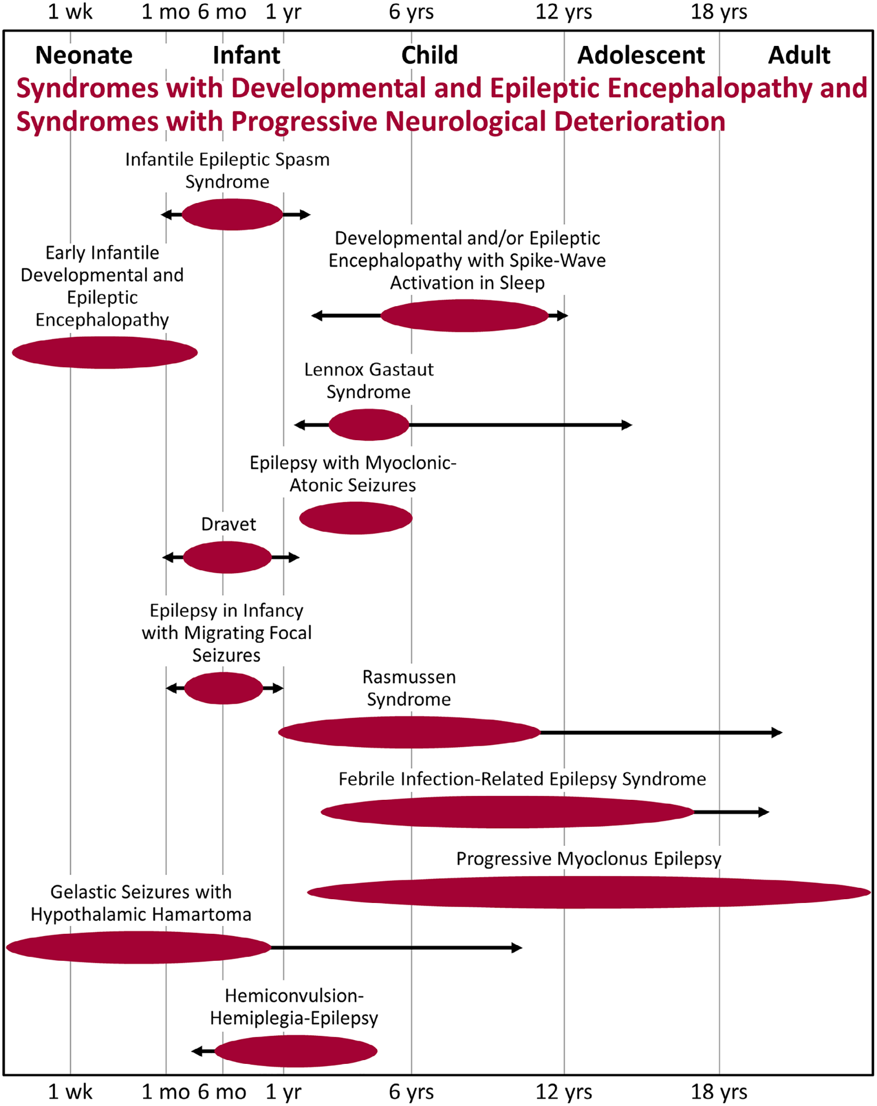
Epilepsy Syndromes Typically Begin In Childhood
Wirrell et al. 2022

Slide 5
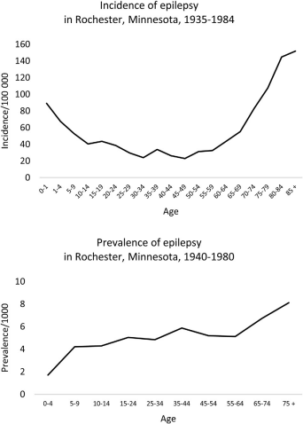
Epilepsy Across the Lifespan:
At What Age Do Seizures Begin?
The “U-shaped” curve for new-onset of seizures across the lifespan is well-known.
While seizure syndromes typically begin in childhood, people in old age are at a greater risk for a new onset of seizures.
Lesaic et al. 2020

Slide 6
Seizures Become More Common Past Middle Age
The number of people who have seizures increases substantially starting in the 50s and increases with age.
Lezaic et al. 2020

Slide 7
Types of Patients to Consider in Epilepsy Across the Lifespan
Childhood onset seizures, resolve with age (no longer need medications)
Childhood onset seizures, well-controlled with medications
Childhood onset seizures, related to obvious neuropathology
Childhood onset seizures, with associated developmental or seizure syndrome
Adult with genetic generalized epilepsy, continuing seizures
Adult with focal epilepsy, neurosurgical resection or laser ablation
Adult with multifocal epilepsy, neuromodulation surgery
Adult with seizures secondary to TBI, stroke, or brain tumor
Senior with childhood epilepsy whose seizures returned in old age
Senior with new onset seizures secondary to alcohol or medication withdrawal
Senior with new onset seizures with concurrent dementia
Senior with new onset seizures after TBI, stroke, or brain tumor

Slide 8
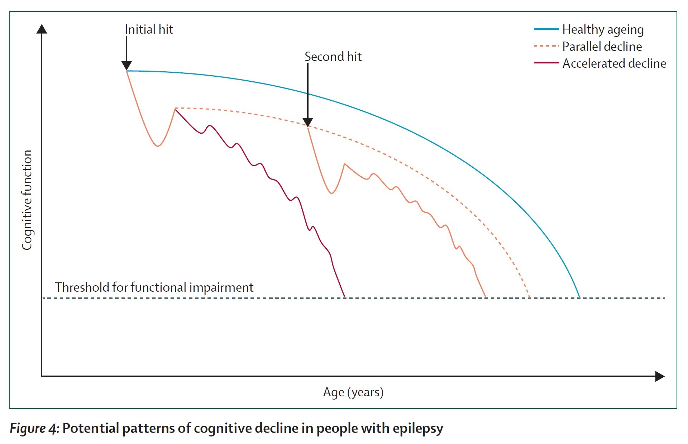
Competing Thoughts on Cognitive Aging with Epilepsy
Some argue that epilepsy causes accelerated cognitive aging
Others maintain that after an initial “hit” to the brain (e.g., TBI, stroke), cognitive decline parallels normal aging
Still others suggest that later development of epilepsy reflects a “second hit” to cognitive function
Sen et al. 2020

Slide 9
A 5-Decade Prospective Cohort Study of People with Childhood Epilepsy
Baseline study in 1964 of children living near Turku University Hospital in Finland
In 1964, 199 participants <16 years of age, met criteria for epilepsy (2+ unprovoked seizures), comprehensive medical evaluation at 5-year intervals
In 1992, 176 survived and had sufficient data for evaluation, divided into 2 groups
  Uncomplicated epilepsy - no neurological impairment at onset
  Those who had any major neurological impairment at baseline
  99 uncomplicated participants were matched to controls (from nationwide population registry)
In 2012, uncomplicated epilepsy participants and controls were invited to take Finnish versions of well-established and validated neuropsychological tests
  51 of remaining 73 uncomplicated participants, 52 of 78 controls
Compared 48 epilepsy to 48 controls after excluding stroke and schizophrenia
Epilepsy group further divided into
  Continuing seizure activity (within past 5 years and/or anti-seizure drug use)
  No seizure activity within the past 5 years and no anti-seizure drug use
Karrasch et al. 2017

Slide 10
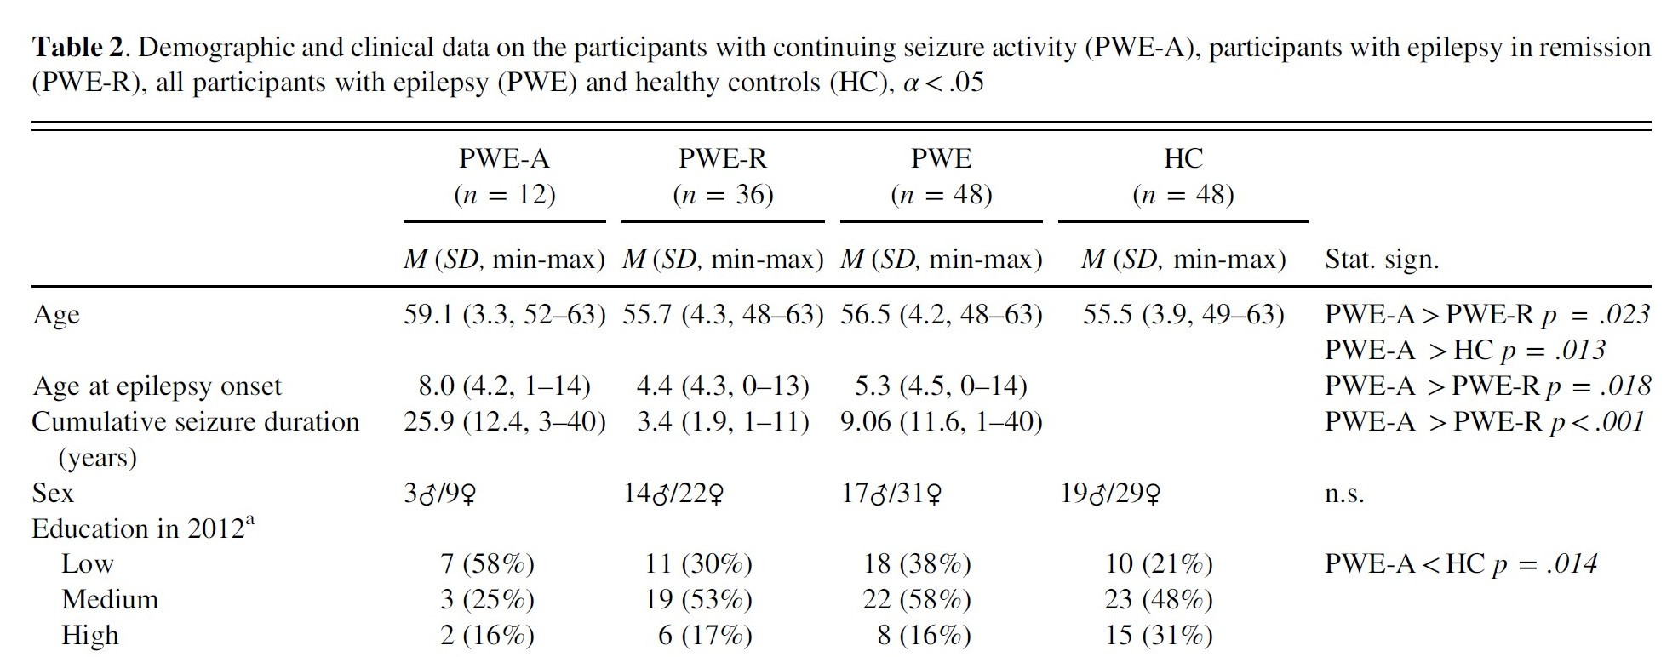
A 5-Decade Prospective Cohort Study of People with Childhood Epilepsy
Primary school
Middle/comp. school
HS, college, univ
Karrasch et al. 2017

Slide 11
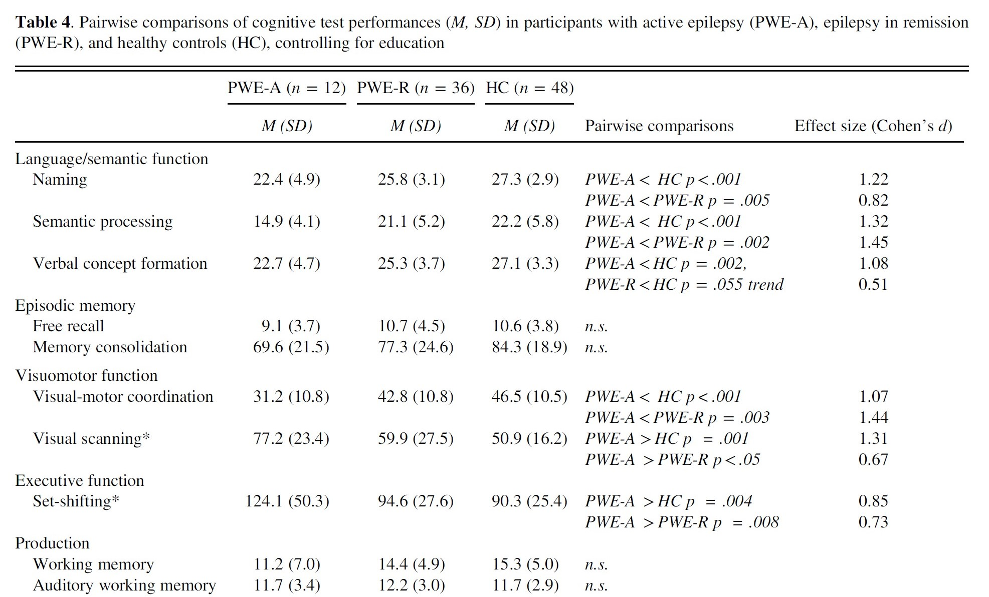
A 5-Decade Prospective Cohort Study of People with Childhood Epilepsy
Boston Naming
Animals
WAIS-R Similarities
WMS-R Logical Memory - Immediate, Delay
WAIS-R Digit Symbol
Trail Making A
Trail Making B
Karrasch et al. 2017
WAIS-R Digit Span

Slide 12
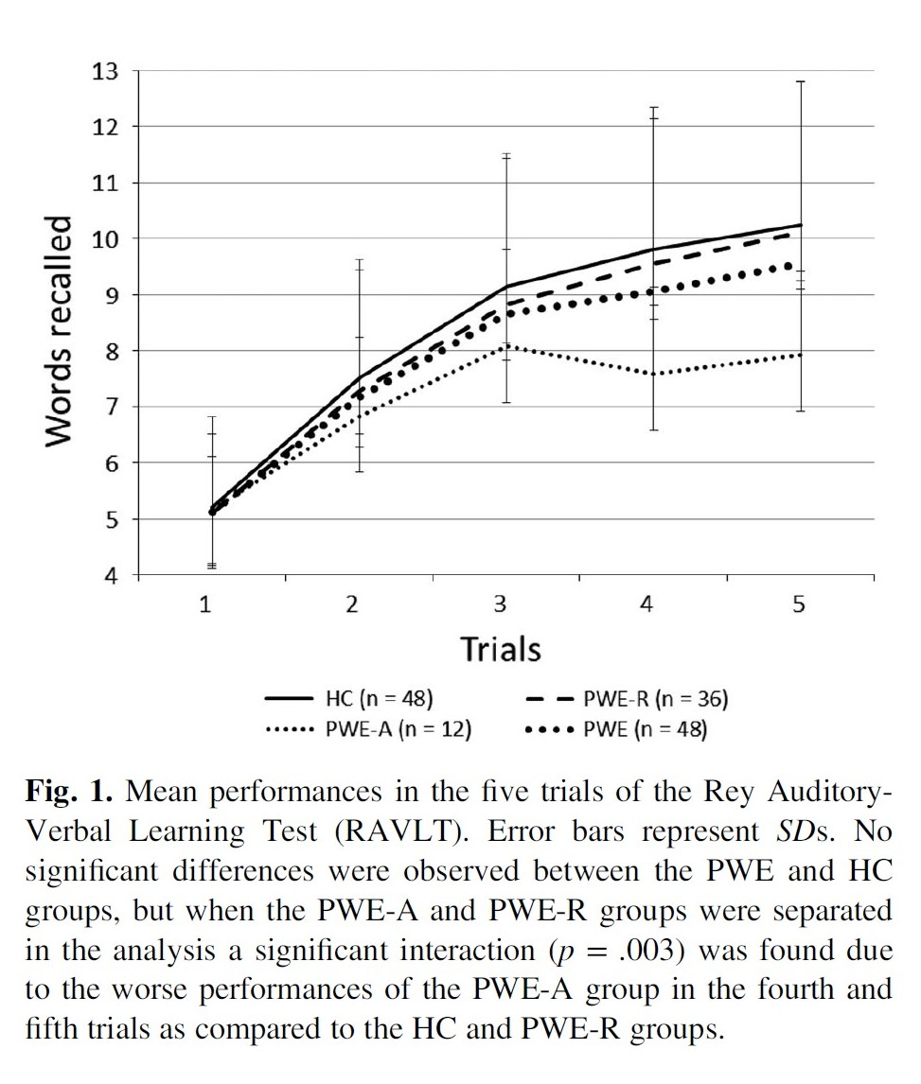
A 5-Decade Prospective Cohort Study of People with Childhood Epilepsy
Karrasch et al. 2017

Slide 13
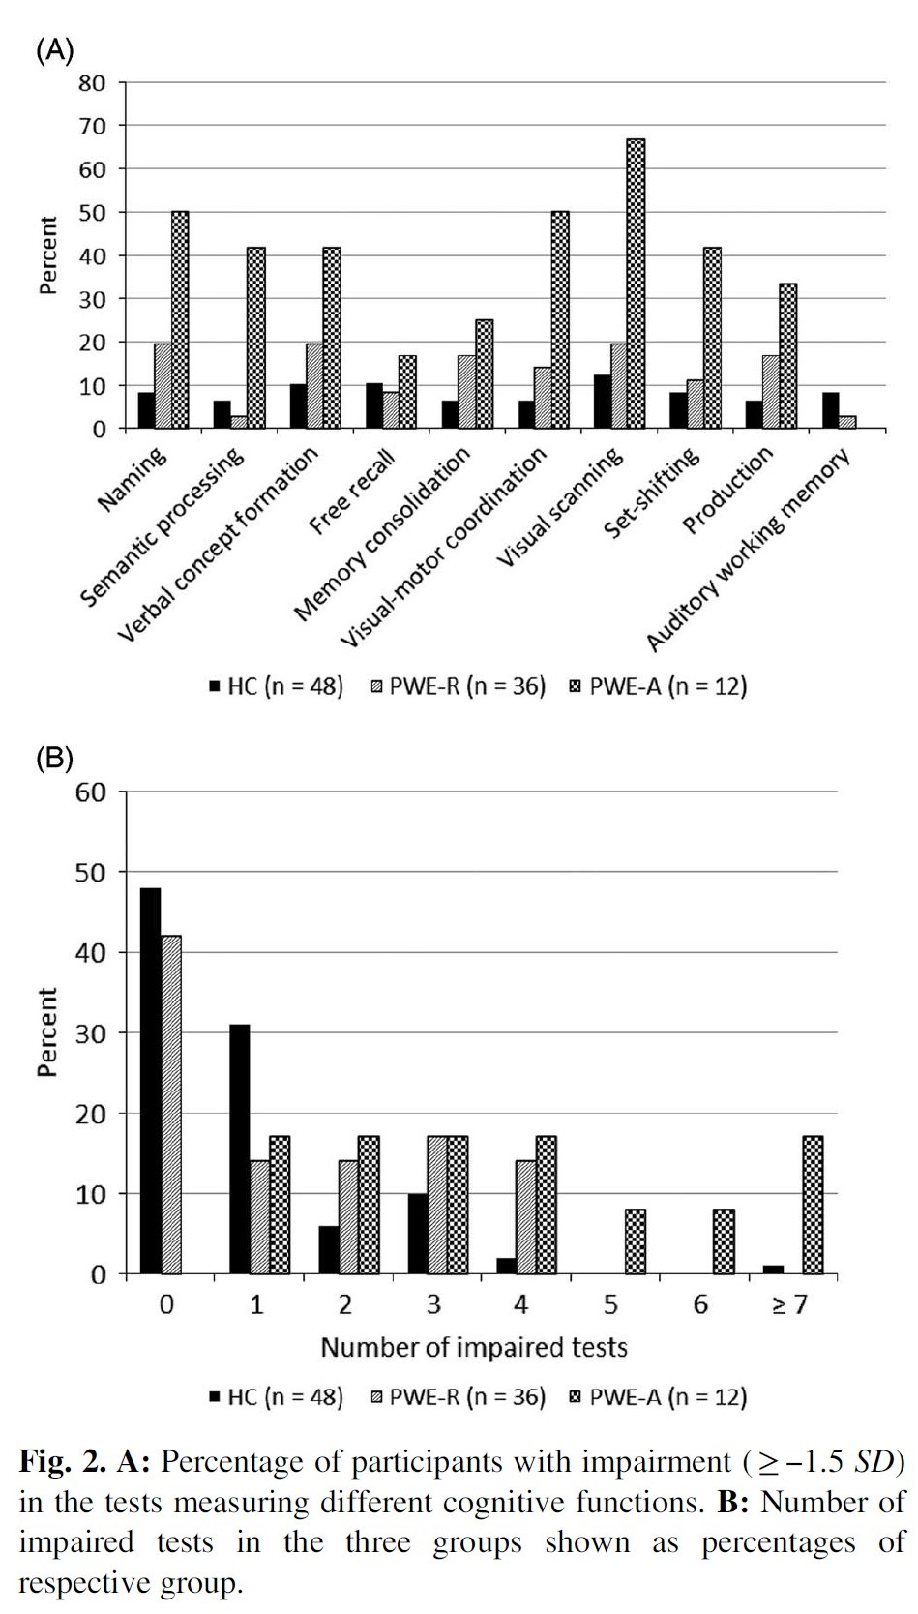
A 5-Decade Prospective Cohort Study of People with Childhood Epilepsy
Karrasch et al. 2017

Slide 14
A 5-Decade Prospective Cohort Study of People with Childhood Epilepsy
The authors concluded that for people with childhood epilepsy, now in late middle age
Those in remission had near-normal cognitive function
  If seizures remit early on, risk for cognitive impairment is low
  However, risk for cognitive impairment was greater than for healthy controls
Those who continued to have seizures and/or need anti-seizure drugs
  Show significantly increased risk for cognitive impairment
  Enter old age at a distinct cognitive disadvantage, less cognitive reserve
Some aspects of cognitive impairment in those with active epilepsy are likely developmental in nature
  Lower educational attainment
  Low memory performance may be partly mediated by low attention
Karrasch et al. 2017

Slide 15
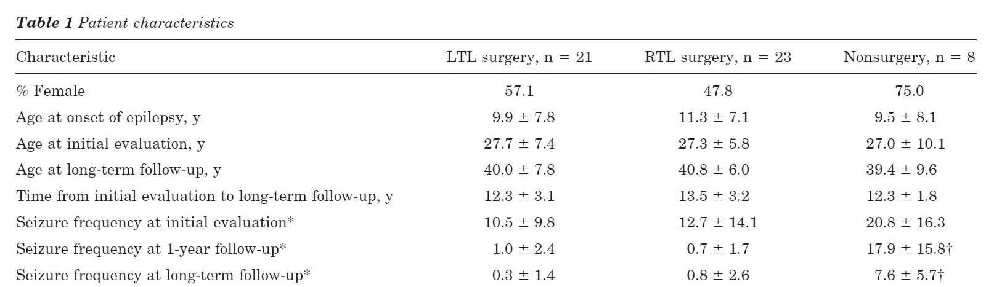
Late Cognitive Changes After Temporal Lobectomy
52 patients at UCLA with intractable focal unaware seizures arising from the temporal lobe
At least 16 years old at initial evaluation, WAIS IQ >70, left language dominant
Underwent standard en bloc temporal lobe resection
Neuropsychological evaluation at initial surgical evaluation, 1 year post surgery, and >9 years post surgery (mean 12.8 years)
Rausch et al. 2003

Slide 16
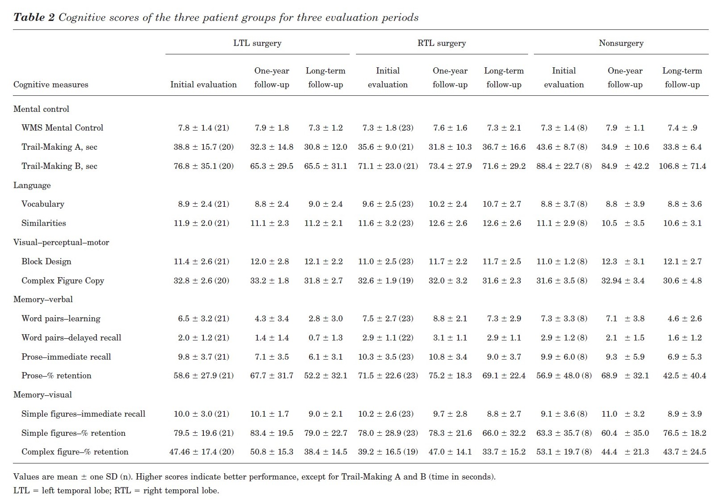
Late Cognitive Changes After Temporal Lobectomy
Rausch et al. 2003

Slide 17
Late Cognitive Changes After Temporal Lobectomy
Rausch et al. 2003

Slide 18
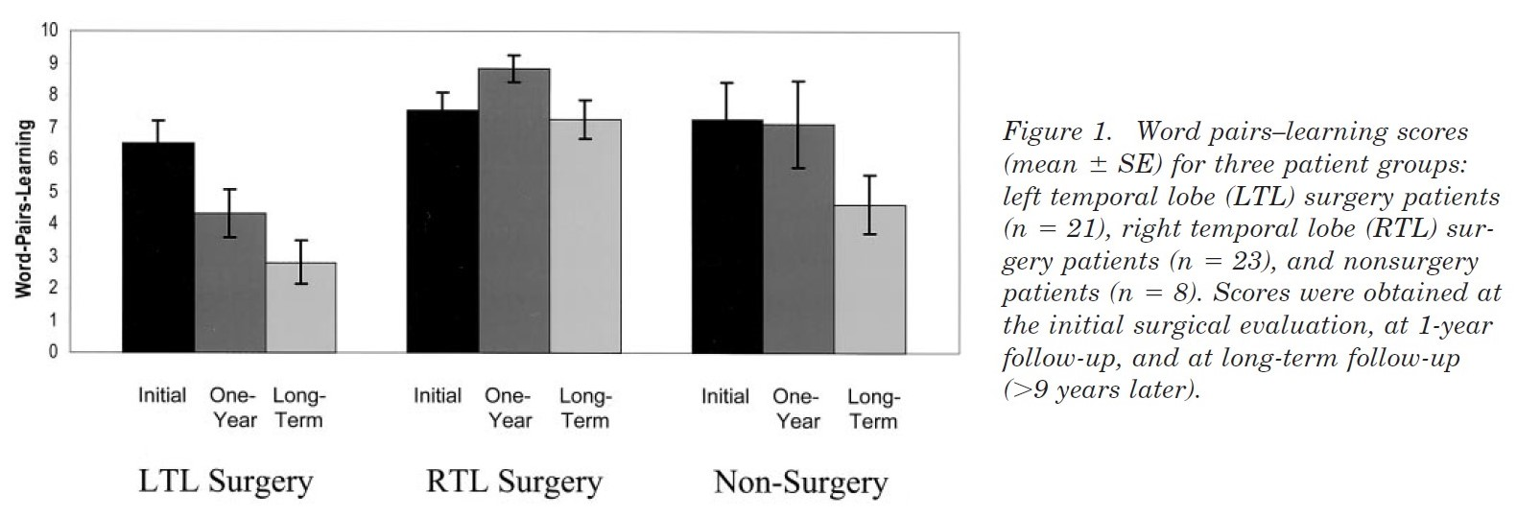
Late Cognitive Changes After Temporal Lobectomy
Rausch et al. 2003

Slide 19
Late Cognitive Changes After Temporal Lobectomy
The authors concluded
One year after surgery, left temporal lobe, but not right temporal lobe resection show decrease in verbal memory scores
Long-term declines in most memory scores was not limited to left temporal lobe resection patients, but also in right temporal lobe and no surgery patients
Left temporal lobe surgery was an independent predictor of late decline in recalling word pairs
  Different rates of late cognitive decline in left vs. right temporal lobe surgery
Most non-memory scores remained stable long-term in all groups
On a Quality of Life Measure, at long-term follow-up
  Seizure frequency accounted for 27% of the QOL score
  Verbal memory score accounted for only 15% of variance
Rausch et al. 2003

Slide 20
Epilepsy in Middle Age and Older Age
People with epilepsy still experience normal aging processes
Those who have had epilepsy for years have additional risks
  Head injury
  Status epilepticus
  Frequent tonic-clonic seizures
  Sequelae of epilepsy surgery
  Adverse effects of anti-seizure medications
  Psychiatric comorbidities
Most common causes of epilepsy in older age
  Vascular disease
  Degenerative disease
Neuropsychological evaluation at time of diagnosis, ideally before start of anti-seizure drugs, can inform adverse effects of medications as well as provide a baseline to assess future cognitive decline
Heerwig et al. 2022

Slide 21
Epilepsy in Middle Age and Older Age
Bidirectional relationship between epilepsy in older age and accelerated cognitive aging
  People between ages 50-75 are at increased risk for dementia
  People with Alzheimer’s disease and vascular dementia have increased risk of seizures
People with chronic epilepsy are more likely to
  Be overweight
  Less physically active, reduced muscle strength/endurance
  Fewer social contacts and networks
  Reduced mental acuity
Treatment with phenytoin, phenobarbital, carbamazepine, or valproate may increase vascular risk factors
  Hypertension, diabetes, high cholesterol, inflammation
Heerwig et al. 2022

Slide 22
Epilepsy in Middle Age and Older Age
Increased risk of drug interactions in older age, especially in polytherapy
Older people are more vulnerable to adverse drug effects
  Cognitive - carbamazepine, clobazam, eslicarbazepine, oxcarbazepine, phenytoin, topiramate, zonisamide
  Mental well-being - clobazam, levetiracetam, lacosamide, perampanel, phenytoin, topiramate, zonisamide
Possible stabilizing effect on mood
  Carbamazepine, lamotrigine, gabapentin, pregabalin, valproate
Heerwig et al. 2022

Slide 23
Contributors to New-Onset Seizures in Older Adults
After stroke and dementia, epilepsy is the third most common neurological disorder in people over 65 years
Causes of new onset seizures can be similar to younger people
  Hyponatremia from medications, excessive alcohol use, TBI, meningitis
Cerebrovascular disease is the most common cause in older people (>1/3)
  Factors associated with late-onset epilepsy include hypertension, diabetes, APOE e4, and stroke
  Risk is lower with higher amounts of physical activity and moderate alcohol consumption (1-7 drinks weekly)
Seizures are more likely to be extra-temporal in onset, diverse semiology, rarely convulsive compared to younger people
New onset genetic generalized epilepsy is rare in older people
Sen et al. 2020

Slide 24
Do Seizures Cause Dementia? Does Dementia Cause Seizures?
Older adults with epilepsy have increased risk of dementia
  Score lower on a range of cognitive domains compared to healthy controls
  Especially verbal and visual memory, executive functioning, processing speed
  Regardless of whether seizures started at a younger age or late in life
In patients with epilepsy
  Accelerated long-term forgetting in those with temporal lobe epilepsy
  Duration of epilepsy is important in progression of cognitive impairment
  Increased cerebrovascular disease compared to healthy controls
  Possible effects on cognition of vascular pathology, continued seizures, interictal discharges
In patients with dementia
  Alzheimer’s disease associated with significantly increased risk for seizures, especially in familial autosomal dominant early-onset compared to typical late-onset
  Epilepsy in late-onset AD may be associated with faster progression of cognitive decline
  Vascular dementia also shows increased risk for seizures
Sen et al. 2018

Slide 25
Do Seizures Cause Dementia? Does Dementia Cause Seizures?
Should epilepsy be considered a symptom rather than a distinct disease?
  Seizures may be one possible manifestation of underlying neuropathology
Do epilepsy and dementia just share common risk factors, or is there a bidirectional relationship?
Do seizures make the brain more vulnerable to developing dementia?
Could modifying cerebrovascular risk factors earlier in life prevent later dementia in patients with epilepsy?
Sen et al. 2018

Slide 26
Conclusions
Epilepsy is a broad diagnosis, with no “one size fits all” template for aging
  With some epilepsy syndromes, neurodegenerative change can be present in childhood
In uncomplicated epilepsy, cognitive change depends on seizure control
  Continued seizures, use of medications increase risk of cognitive decline
  People with resolved epilepsy still score a little lower than healthy controls on cognitive tests
  Demographic considerations such as less formal education may play a role in lower cognitive scores
Temporal lobe epilepsy presents unique challenges
  Left resection more likely to result in memory change following surgery
  Right resection and no resection patients also show change over long time
There is shared pathology between epilepsy and dementia
  People with epilepsy have increased risk of cerebrovascular disease
  Cerebrovascular disease is most common cause of new-onset seizures in old age
  Possibly reflects a bidirectional relationship
Might improved management of cerebrovascular risk factors decrease risk of dementia in middle-aged epilepsy patients, decrease risk of seizures in older patients?

Slide 27
References
Fisher, R.S., Acevedo, C., Arzimanoglou, A., Bogacz, A., Cross, H., et al. (2014). A practical clinical definition of epilepsy. Epilepsia 55(4), 475-482.
Heerwig, C., Moller, H., & Bruckner, K. (2022). Neuropsychology of epilepsy in old age. Epileptologie 35, S73-S77.
Hermann, B., Seidenberg, M., Sager, M., Carisson, C., Gidal, B., et al. (2008). Growing old with epilepsy: The neglected issue of cognitive and brain health in aging and elder persons with chronic epilepsy. Epilepsia 49(5), 731-740.
Karrasch, M., Tiitta, P., Hermann, B., Joutsa, J., Shinnar, S., et al. (2017). Cognitive outcome in childhood-onset epilepsy: A five-decade prospective cohort study. Journal of the International Neuropsychological Society 23, 332-340.
Lezaic, N., Roussy, J., Masson, H., Jette, N., & Keezer, M.R. (2020). Epilepsy in the elderly: Unique challenges in an increasingly prevalent population. Epilepsy & Behavior 102, 106724.
Rausch, R., Kraemer, S., Pietras, C.J., Le, M., Vickrey, B.G., et al. (2003). Early and late cognitive changes following temporal lobe surgery for epilepsy. Neurology 60, 951-959.
Scheffer, I.E., Berkovic, S., Capovilla, G., Connolly, M.B., French, J., et al. (2017). ILAE classification of the epilepsies: Position paper of the ILAE commission for classification and terminology. Epilepsia 58(4), 512-541.
Sen, A., Capelli, V., & Hussain, M. (2018). Cognition and dementia in older patients with epilepsy. Brain 141, 1592-1608.
Sen, A., Jette, N., Husain, M., & Sander, J.W. (2020). Epilepsy in older people. The Lancet 395, 735-748.
Wirrell, E.C., Nabbout, R., Scheffer, I.E., Alsaadi, T., Bogacz, A., et al. (2022). Methodology for classification of epilepsy syndromes with lost of syndromes: Report of the ILAE task force on nosology and definitions. Epilepsia 63, 1333-1348.

