Slide 1
Drugs in Development for Alzheimer’s Disease Marwan Noel Sabbagh MD, FAAN, Moreno Family Chair for Alzheimer's Research Vice Chairman for Research and Professor Department of Neurology Barrow Neurological Institute

Slide 2
Second Generation Anti-amyloid Therapies

Slide 3
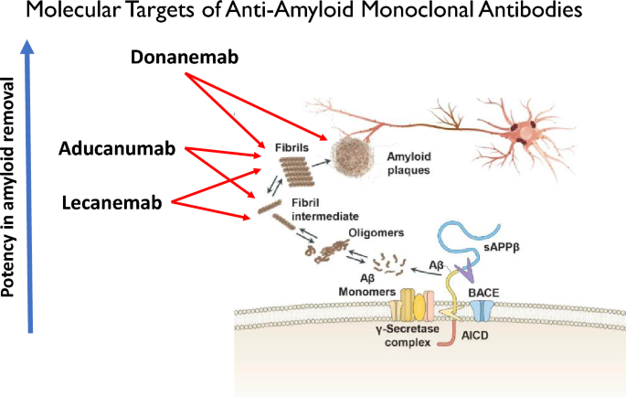

Slide 4
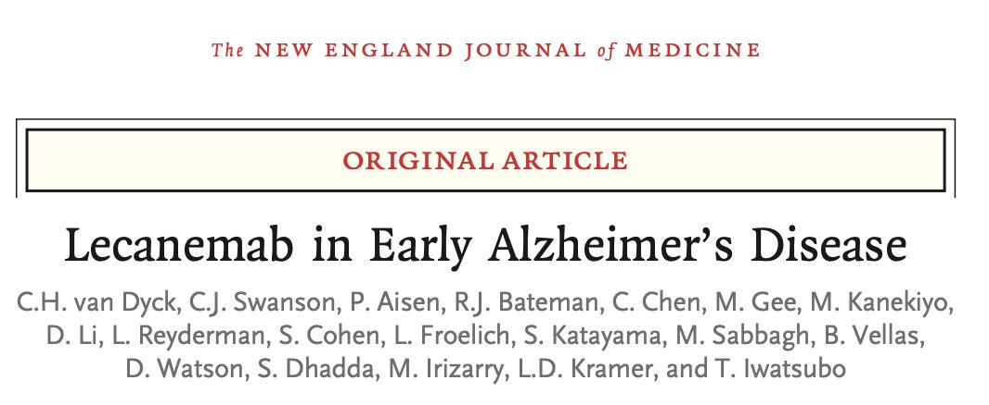
BNI investigators involved in AD advances

Slide 5
Clarity AD: Lecanemab Slows Disease Progression on CDR-SB
Lecanemab’s 3-Year Impact on Cognitive Decline in Early Alzheimer’s Disease
Month | Early start (n) | Delayed start (n) | ADNI (n)
0 | 875 | 859 | 436
3 | 849 | 824 | -
6 | 828 | 798 | 410
9 | 813 | 779 | -
12 | 779 | 765 | 401
15 | 767 | 738 | -
18 | 757 | 714 | 121
24 | 662 | 659 | 301
30 | 602 | 613 | 173
36 | 549 | 569 | 173
0
Core
OLE
Worsening
0.4
0.8
1.2
Difference of
-0.45 (P=0.00005) at 18 months
1.6
2
Adjusted Mean Change from Baseline (±SE) in CDR-SB
2.4
2.8
3.09
3.2
3.6
At 36 months, lecanemab reduced cognitive decline by -0.95 compared to ADNI group
4
4.4
4.8
0
3
6
9
12
15
18
24
30
36
Visit (Months)
Early start
Delayed start
ADNI
CDR-SB, Clinical Dementia Rating-Sum of Boxes; OLE, open label extension; ADNI, Alzheimer’s Disease Neuroimaging Initiative.
In an optional tau PET substudy, more than 50% of patients who started lecanemab treatment in the earliest stage of AD continued to show improvement after three years
Eisai. Published 7/30/24. Accessed 8/7/24. https://www.multivu.com/players/English/9282551-eisai-leqembi-clinical-data-aaic-2024-alzheimers/
Notes:
In the core study, the mean change from baseline between the lecanemab treated group and the placebo group was -0.45 (P=0.00005) on the primary endpoint of the Clinical Dementia Rating-Sum of Boxes (CDR-SB) global cognitive and functional scale.
Over three years of treatment across the core study and continue in the open-label extension study , lecanemab reduced cognitive decline on the CDR-SB by -0.95 compared to the expected decline based on the Alzheimer’s Disease Neuroimaging Initiative (ADNI)** group
The Clarity AD study included an optional tau PET substudy and used the tau PET probe MK6240 to identify patients with no tau or a low accumulation of tau in the brain
After 3 years of lecanemab treatment:
On the CDR-SB, 59% of these patients (24/41) showed improvement or no decline, and 51% (21/41) showed improvement from baseline
On the ADAS-Cog14 measurement scale, 63% of patients showed improvement or no decline and 61% showed improvement
On the ADCS MCI-ADL, 63% of patients showed improvement or no decline and 59% showed improvement

Slide 6
Clarity AD: Lecanemab Reduces Fibrillar Amyloid Burden
Amyloid Burden on PET
10
Placebo
Baseline 75.0
Month | Lecanemab (N) | Placebo (N)
0 | 354 | 344
3 | 296 | 303
6 | 275 | 286
12 | 276 | 259
18 | 210 | 205
0
-10
****
Less Amyloid
Adjusted mean change from baseline (±SE) in amyloid PET using Centiloids
-20
Mean <30 Centiloids for lecanemab at 18 months*
-30
****
-40
****
Lecanemab
Baseline 77.9
-50
****
Difference of -59.1 Centiloids at 18 months
**** P < 0.0001
-60
0
3
6
12
18
Visit (months)
*After 18 months of treatment, the average amyloid level was 23 Centiloids in the lecanemab treatment group in the amyloid PET substudy, which is below the threshold for amyloid positivity of approximately 30 Centiloids above which participants are considered to have elevated brain amyloid levels
** 73 subjects were not included at 18 months (per statistical analysis plan) since their PET assessments were performed after receiving lecanemab in the extension phase
Note: Based on pharmacodynamic analysis population (amyloid PET substudy population);djusted mean change from baseline, standard error (SE) and P-value are derived using mixed model repeated measures (MMRM) with treatment group, visit, treatment group by visit interaction, clinical subgroup, use of Alzheimer’s disease symptomatic medication at baseline, ApoE4 carrier status, region, baseline value by visit interaction as fixed effects, and baseline value as covariate
PET, positron emission tomography; SE, standard error
Lecanemab significantly reduced fibrillar amyloid burden at all time points beginning at 3 months
van Dyck. N Engl J Med. 2023;388(1):9-21.

Slide 7
Clarity AD: Lecanemab Slows Disease Progression on ADCS MCI-ADL
ADCS-MCI-ADL Score
0
Month | Lecanemab (N) | Placebo (N)
0 | 783 | 796
6 | 756 | 783
12 | 716 | 739
18 | 676 | 707
-1
**
-2
****
Worsening
Adjusted Mean Change from Baseline (±SE) in ADCS MCI-ADL
Lecanemab
-3
****
LS mean difference at 18 months: 2.013
-4
37% slowing by lecanemab at 18 months
-5
Placebo
* P <.05; ** P <.01; *** P <.001; **** P <.0001
-6
0
6
12
18
Visit (months)
Note: Based on modified intention-to-treat analysis population. Adjusted mean change from baseline, SE and p-value are derived using mixed model repeated measures (MMRM) with treatment group, visit, treatment group by visit interaction, clinical subgroup, use of Alzheimer’s disease symptomatic medication at baseline, ApoE4 carrier status, region, baseline value by visit interaction as fixed effects, and baseline value as covariate.
ADCS ADL-MCI, Alzheimer's Disease Cooperative Study/Activities of Daily Living scale adapted for mild cognitive impairment (MCI) subjects; LS, least squares; SE, standard error
Lecanemab significantly slowed disease progression on ADCS MCI-ADL by 37% at 18 months and at all time points beginning at 6 months
van Dyck. N Engl J Med. 2023;388(1):9-21.

Slide 8
Study 201: Progression of AD After Stopping Lecanemab
Rate of Decline in Patients Who Stopped Therapy as Measured by CDR-SB
4
Core
F/Up
Gap
(no treatment)
OLE
(lecanemab 10 mg/kg bi-Weekly)
Differences in CDR-SB were maintained for approximately 2 years off lecanemab
Placebo
3
10 mg bi-Weekly
2
Observed Mean Change (±SE) from Core Baseline
1
0
0
3
6
9
12
15
18
6M
12M
18M
F/Up
OLE Baseline
Core Treatment
Placebo
10 bi-Weekly
Visit (Months)
40
31
40
31
39
30
39
30
39
29
35
29
35
29
35
29
40
31
37
30
33
27
29
24
AD, Alzheimer’s disease; CDR-SB, Clinical Dementia Rating-Sum of Boxes; OLE, open label extension; F/Up, follow-up; SE, standard error.
Even after Aβ plaque is removed, AD continues to progress and reverts to the placebo rate of decline when lecanemab is stopped
Eisai. Published 7/30/2024. Accessed 8/7/2024. https://www.multivu.com/players/English/9282551-eisai-leqembi-clinical-data-aaic-2024-alzheimers/

Slide 9
Phase 3 Trailblazer-ALZ2: Donanemab
Trial Participants
Select Outcomes
1,736 participants with early symptomatic AD (MCI/mild dementia)
Donanemab = 860
Placebo = 876
Inclusion
Amyloid and low/medium or high tau pathology based on PET
Primary
Change in iADRS score from baseline to 76 weeks (range, 0–144; lower scores indicate greater impairment)
Secondary
Change in the sum of boxes of the CDR-SB score (range, 0–18; higher scores indicate greater impairment), and others
MCI, mild cognitive impairment; AD, Alzheimer’s disease; PET, positron emission tomography; iADRS, Integrated Alzheimer's Disease Rating Scale; CDR-SB, Clinical Dementia Rating scale Sum of Boxes
*Not FDA-approved for AD-related treatment.
CDR-SB = Clinical Dementia Rating-Sum of Boxes; iADRS = integrated Alzheimer Disease Rating Scale.
Sims. JAMA. 2023;330(6):512-527.

Slide 10
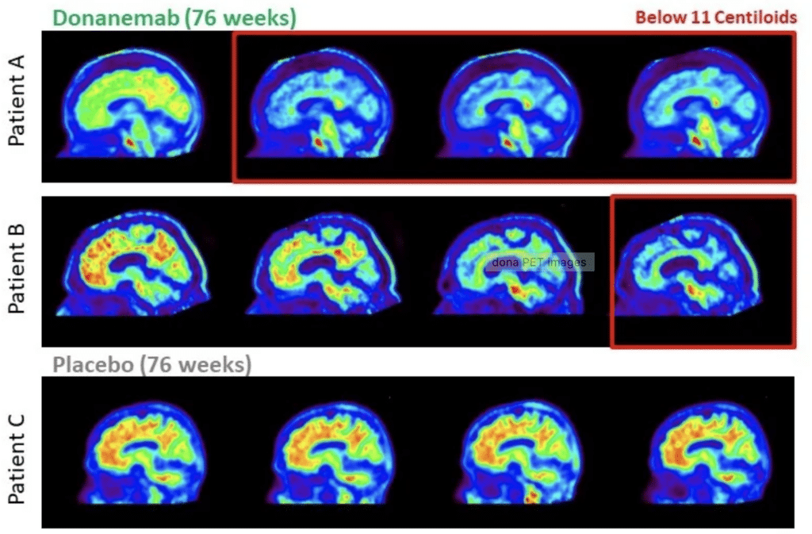

Slide 11
Trailblazer-ALZ2: Donanemab Efficacy by CDR-SB
0
CDR-SB in Low/Medium Tau Population
Month | Donanemab (N) |  | Placebo (N)
0 | 546 |  | 569
12 | 530 |  | 561
24 | 499 |  | 540
36 | 471 |  | 516
52 | 451 |  | 486
64 | 418 |  | 461
76 | 424 |  | 459
Least-squares mean difference from placebo (95% CI) | -0.67 (-0.95 to -0.40)
Donanemab
Worsening
Adjusted mean change (95% CI) in CDR-SB
1
2
Placebo
3
0
12
24
36
52
64
76
Time after baseline (week)
CDR-SB in Combined Population
Month | Donanemab (N) |  | Placebo (N)
0 | 794 |  | 838
12 | 774 |  | 825
24 | 731 |  | 784
36 | 682 |  | 752
52 | 650 |  | 713
64 | 603 |  | 678
76 | 598 |  | 672
Least-squares mean difference vs placebo (95% CI) | -0.70 (-0.95 to -0.45)
0
Worsening
Adjusted mean change (95% CI) in CDR-SB
Donanemab
1
2
Placebo
3
0
12
24
36
52
64
76
Time after baseline (week)
CDR-SB, Clinical Dementia Rating scale Sum of Boxes; CI, confidence interval
Donanemab slowed disease progression by 36.0% in the low/medium Tau population and 28.9% in the combined population
Sims J, et al. JAMA. 2023;330(6):512-527.
Sims. JAMA. 2023;330(6):512-527.
Notes:
Article here (Figure 2): https://www.ncbi.nlm.nih.gov/pmc/articles/PMC10352931/
Perhaps put A and B on one slide and C and D on another for fit?

Slide 12
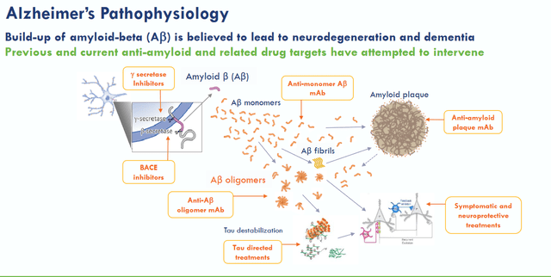
Treatment will need to be a multidrug regimen hitting different targets

Slide 13
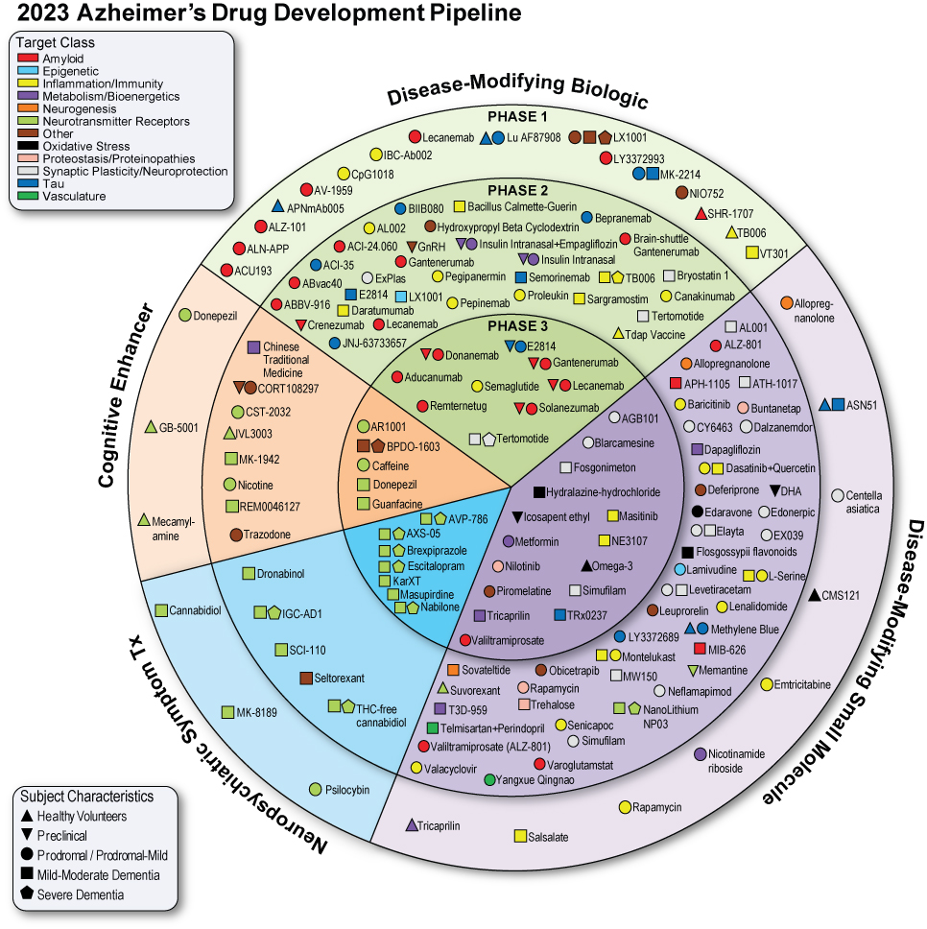
Universe of Drugs in the 2023 Alzheimer’s Drug Development Pipeline
141 unique drugs
78% disease modifying treatments
35% biologics
Notable Phase 1
44% DMT small molecules
11% cognitive enhancers
11% drugs for behavioral symptoms
Notable Phase 3 activity
28% repurposed agents

Slide 14

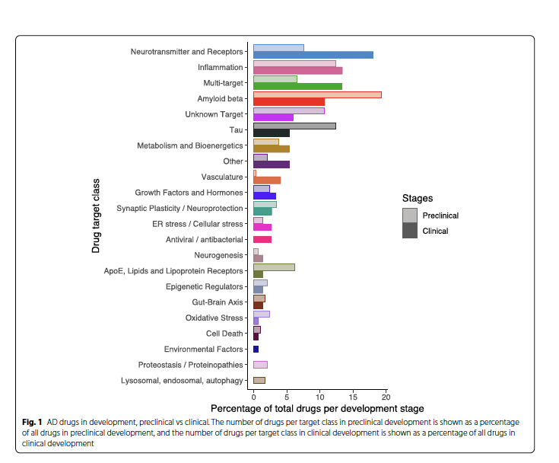
Van Bokhoven 2022

Slide 15
Third Generation anti-amyloid monoclonal antibodies could clear amyloid more efficiently

Slide 16
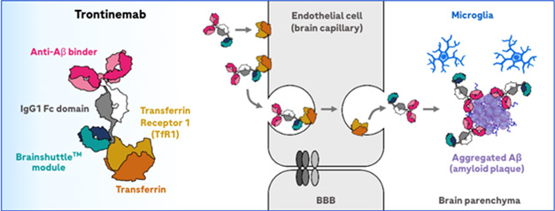
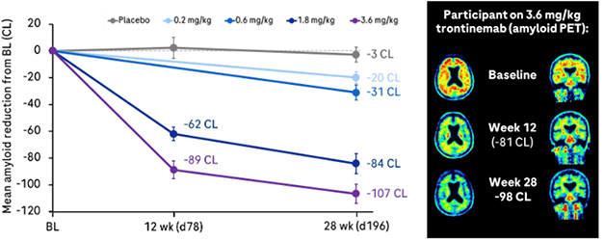

Slide 17
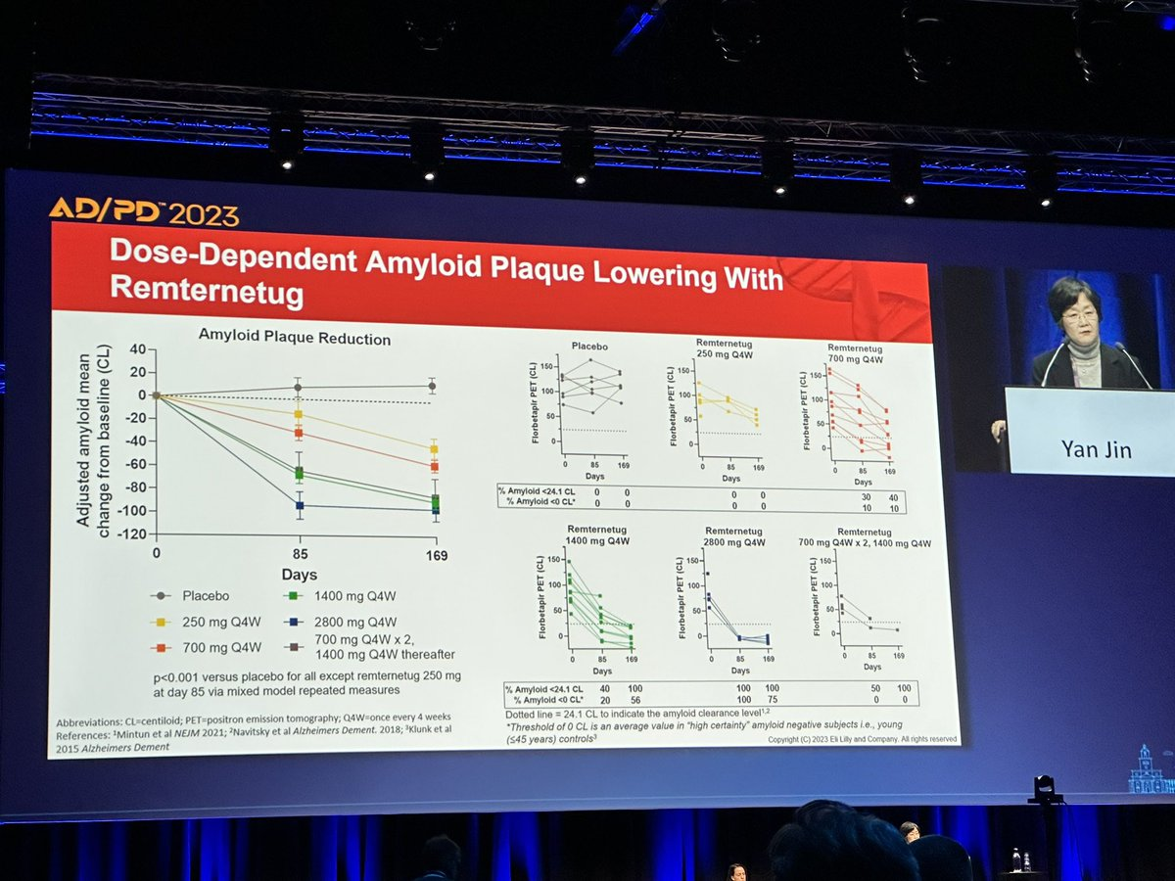
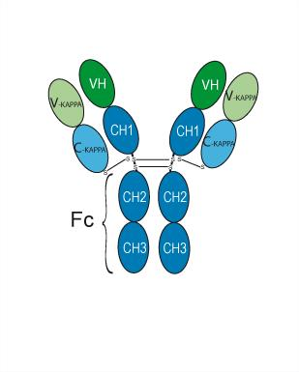
Remtemetug

Slide 18
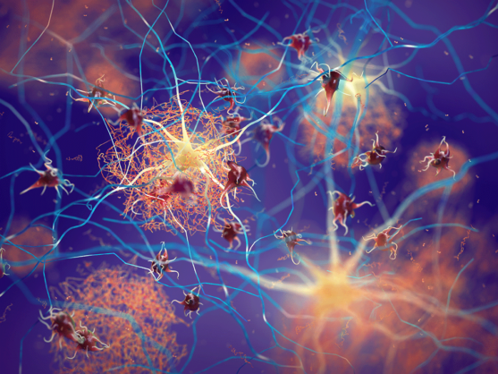
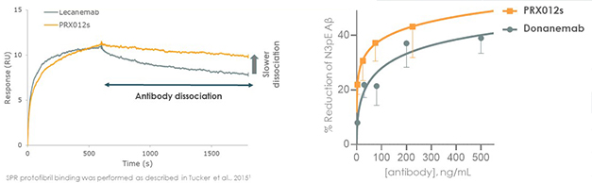
PRX-012 Preclinical surrogate of PRX-012 binds to toxic Aβ protofibrils and clears N3pE-Aβ in AD brain tissue

Slide 19
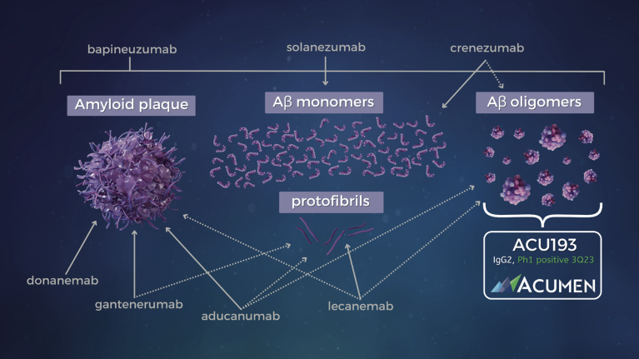
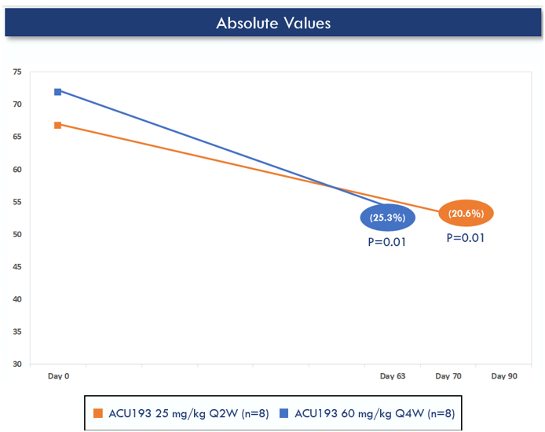
ACU193

Slide 20
Anti-tau approaches

Slide 21
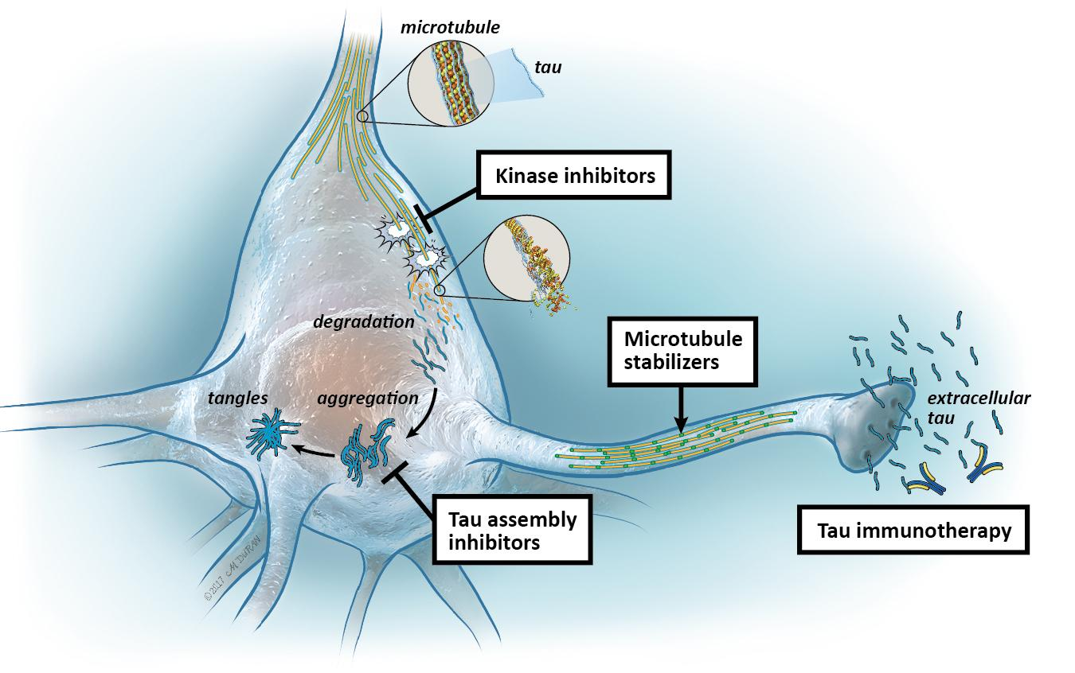
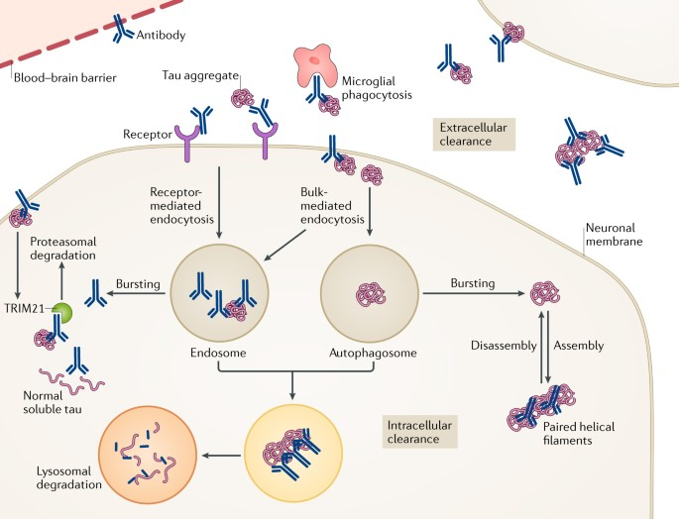
Many mABs and aggregation inhibitors have failed but ASO might work.

Slide 22
Autophagy

Slide 23
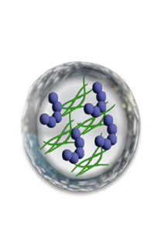

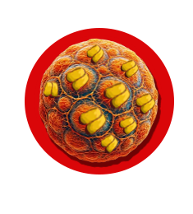




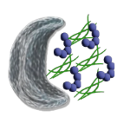
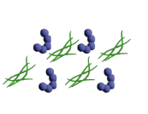
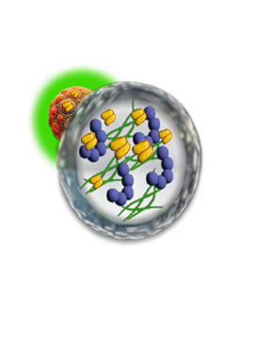
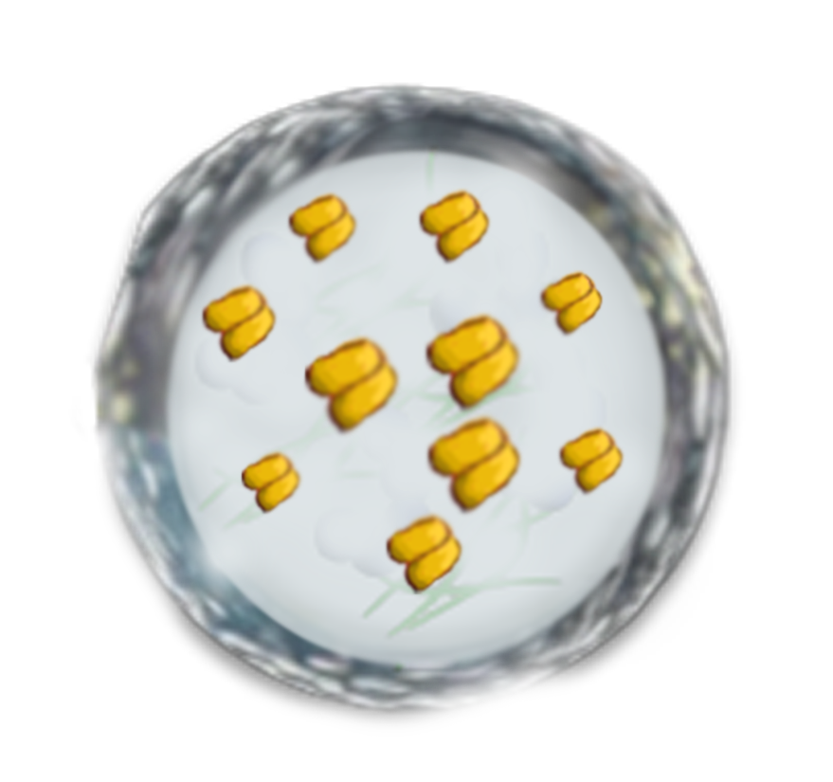
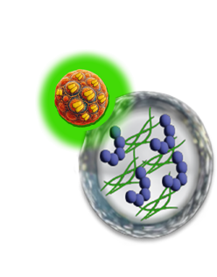




Blarcamesine Improves Upstream Autophagy and
Clearance of Misfolded Proteins in AD
Amyloid-β
Tau
Lysosomal enzyme
Neurotoxicity
SIGMAR1/sigma-1 receptor
Lysosomal dysfunction
(no fusion)
Blarcamesine
Cell stress
Accumulation of protein aggregates
Neuroprotection
Vesicle formation
Maturation
Protein aggregates
Blarcamesine (oral drug)
SIGMAR1 activation
Autolysosome
Degradation
Docking
Recycling
Functional lysosomes
(fusion)
Schematic representation.
Christ, MG, et al. Sigma-1 receptor activation induces autophagy and increases proteostasis capacity in vitro and in vivo. Cells. 2019;8(3):211.
Yang H, et al. SIGMAR1/sigma-1 receptor ablation impairs autophagosome clearance. Autophagy. 2019;15(9):1539-1557.
Lee JH, et al. Faulty autolysosome acidification in Alzheimer's disease mouse models induces autophagic build-up of Aβ in neurons, yielding senile plaques. Nature Neuroscience. 2022;25(6):688-701.

Slide 24
AD-004 Phase IIb/III Early Alzheimer's Disease Trial
Global, multicenter, randomized, double-blind, placebo-controlled, parallel group, 48-week trial evaluating
blarcamesine (ANAVEX®2-73) once-daily oral capsules
Blarcamesine target 50 mg (n=168)
Randomization (1:1:1)
Blarcamesine target 30 mg (n=170)
Placebo (n=170)
Screening
Titration² and maintenance (48 weeks)
n=508
Open-label extension period
(96 weeks)
Key eligibility criteria:
Met the NIA-AA 2011 criteria for diagnosis of early-stage mild dementia or MCI due to AD
Aged 60 to 85 years
MMSE score 20-28
Confirmation of AD via amyloid or FDG PET, CT, or MRI scan, or CSF (amyloid or tau)¹
Coprimary endpoints*
ADAS-Cog13
ADCS-ADL
Other endpoints
Structural and functional MRI
Biomarkers: Aβ₄₂/Aβ₄₀, p-tau (181), p-tau (231), Nf-L
CGI-I
Key secondary endpoint
CDR-SB
ATTENTION-AD study
*With the March 2024 FDA Guidance for Early AD, a sole cognitive measure can serve as the primary endpoint for early AD trials
¹AD status supported by the elevated baseline levels of plasma p-tau(181) and p-tau(231).
²Titration occurred from days 1-21.
AD, Alzheimer’s disease; ADAS-Cog13, a 13-item cognitive subscale of the Alzheimer’s Disease Assessment Scale; ADCS-ADL, AD Cooperative Study-Activities of Daily Living Scale; CDR-SB, Clinical Dementia Rating-Sum of Boxes; MCI, mild cognitive impairment; MMSE, Mini-Mental State Examination; NIA-AA, National Institute on Aging-Alzheimer’s Association; Nf-L, neurofilament light chain.
Notes:
Eligibility:
Age 60-85 years
Meets NIA-AA 2011 criteria for early-stage mild dementia due to AD or MCI due to AD
One of the following:
CSF assessment compatible with AD (Aβ42, t-tau, p-tau, Aβ42/40)
Amyloid or FDG PET
Historic CT or MRI scan within 18 months of screening consistent with AD
Titration:
Initially titration was over 2 weeks; this was later modified to 3 weeks via a protocol amendment. Titration occurred weekly to the assigned target dose.

Slide 25
Coprimary Endpoint: ADAS-Cog13
ADAS-Cog13
Blarcamesine 30 mg
ADAS-Cog13
Blarcamesine 50 mg
Δ-1.934
P=0.026
Δ-2.149
P=0.021
Participants (n):
Blarcamesine 30 mg | 154 | 130 | 117 | 108 | 108
Placebo | 164 | 147 | 127 | 122 | 122
Participants (n):
Blarcamesine 50 mg | 144 | 111 | 91 | 79 | 83
Placebo | 164 | 147 | 127 | 122 | 122
Clinical efficacy endpoints were analyzed using mixed model for repeated measures (MMRM) estimates for the least-squares mean change from baseline at 12, 24, 36, and 48 weeks, with error bars representing standard error (SE).
Macfarlane S, Grimmer T, Teo K, O'Brien TJ, Woodward M, Grunfeld J, Mander A, Brodtmann A, Brew BJ, Morris P, Short C, Kurrle S, Lai R, Bharadwaj S, Drysdale P, Sturm J, Lewis SJG, Barton D, Kalafatis C, Sharif S, Perry R, Mannering N, MacSweeney JE, Pearson S, Evans C, Krishna V, Thompson A, Munisamy M, Bhatt N, Asher A, Connell S, Lynch J, Rutgers SM, Dautzenberg PL, Prins N, Oschmann P, Frölich L, Tacik P, Peters O, Wiltfang J, Henri-Bhargava A, Smith E, Pasternak S, Frank A, Chertkow H, Ingram J, Hsiung GR, Brittain R, Tartaglia C, Cohen S, Villa LM, Gordon E, Jubault T, Guizard N, Tucker A, Kaufmann WE, Jin K, Chezem WR, Missling CU, Sabbagh MN. Blarcamesine for the treatment of Early Alzheimer's Disease: Results from the ANAVEX2-73-AD-004 Phase IIB/III trial. J Prev Alzheimers Dis. 2025 Jan;12(1):100016. doi: 10.1016/j.tjpad.2024.100016. Epub 2025 Jan 1. PMID: 39800452.

Slide 26
Key Secondary Endpoint: CDR-SB
CDR-SB
Blarcamesine 30 mg
CDR-SB
Blarcamesine 50 mg
Δ-0.502
P=0.020
Δ-0.465
P=0.045
Participants (n):
Blarcamesine 30 mg | 154 | 128 | 117 | 108 | 107
Placebo | 164 | 146 | 128 | 121 | 126
Participants (n):
Blarcamesine 50 mg | 144 | 108 | 91 | 81 | 84
Placebo | 164 | 146 | 128 | 121 | 126
Clinical efficacy endpoints were analyzed using mixed model for repeated measures (MMRM) estimates for the least-squares mean change from baseline at 12, 24, 36, and 48 weeks, with error bars representing standard error (SE).

Slide 27
GLP 1 RAs

Slide 28
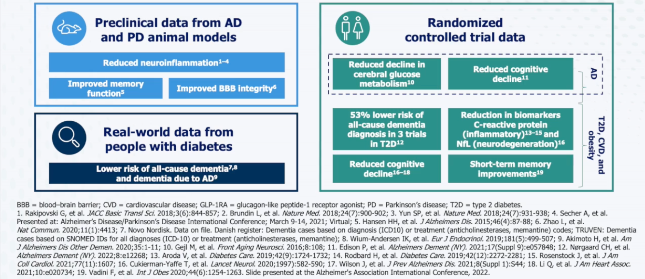
Evidence That GLP-1 Agonists Can Benefit Patients With AD

Slide 29
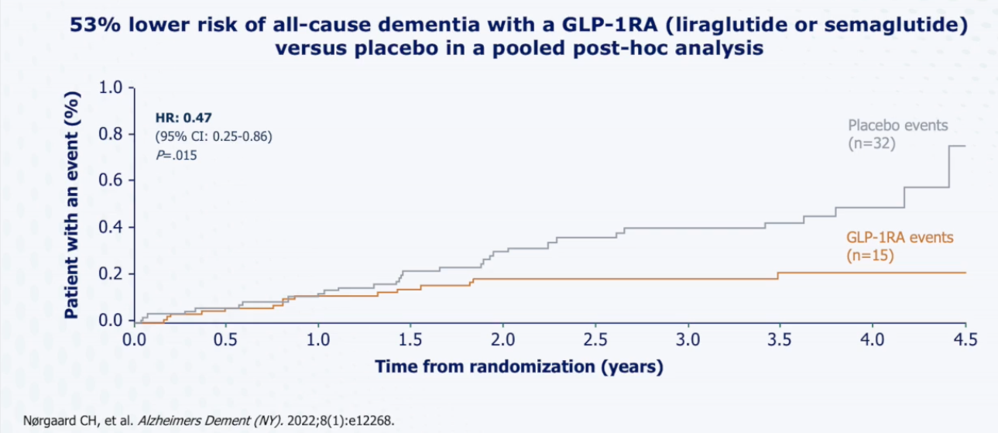
Time to Dementia Diagnosis in Patients With T2DM

Slide 30
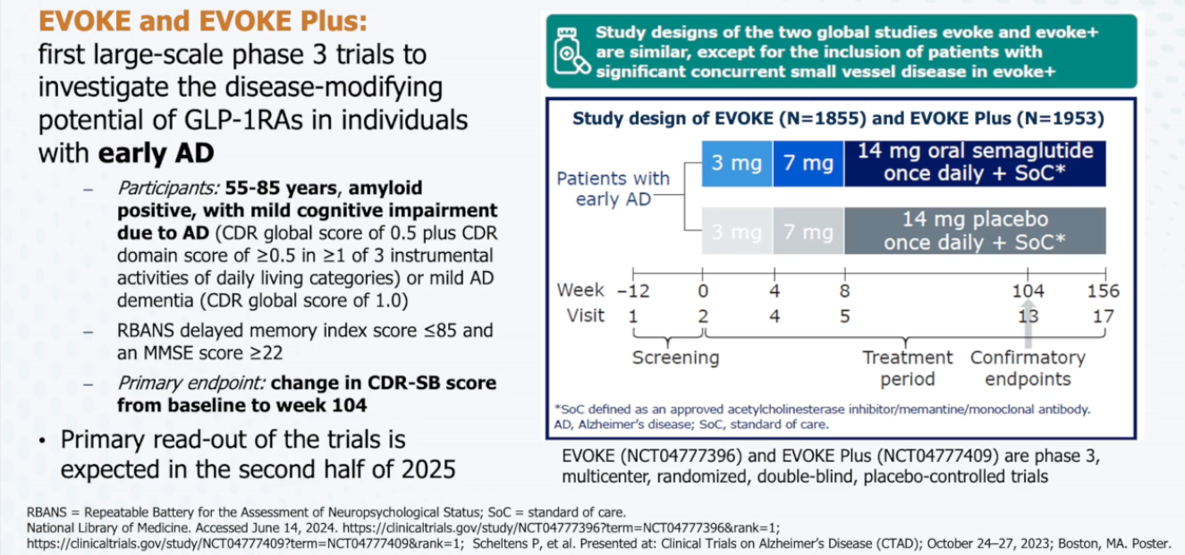
Phase 3 EVOKE and EVOKE Plus Trials: Oral Semaglutide in Patients With Early AD

Slide 31
Other targets of neuro-inflammation

Slide 32
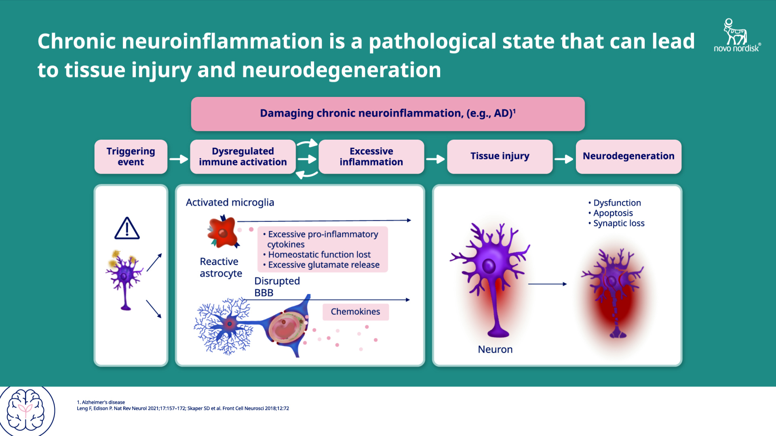
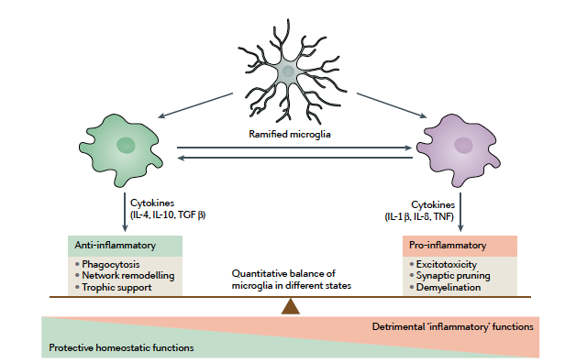
Microglia and Astrocytes Can Become Dysregulated, Resulting in a Damaging, Chronic, Neuroinflammatory State¹
Different Phenotypes of Microglia
M2 Microglia
M1 Microglia
Microglia and astrocytes can shift their phenotype from a "resting" state to an "activated" state due to injury, infection, or neurodegenerative disease, which contributes to chronic neuroinflammation
Physiological Changes in Activated Microglia
Lose homeostatic functions
Reduce secretion of neurotrophic factors
Increase production of pro-inflammatory molecules (eg, TNF, IL-1, NF-κB, reactive oxygen species, nitric oxide, IL-6, IFN-γ) which leads to neuronal dysfunction and damage
Directly eliminate synaptic structures
Cross-talk with peripheral, adaptive immune cells
Physiological Changes in Activated Astrocytes
Lose homeostatic functions
Reduce secretion of neurotrophic factors
Increase production of pro-inflammatory cytokines and chemokines, which leads to neuronal dysfunction and damage
Upregulate GFAP
Disrupt the blood-brain barrier
Aged microglia can undergo phenotypic changes, from M2 (anti-inflammatory phenotype) to M1 (pro-inflammatory phenotype), resulting in a loss of homeostasis and chronic neuroinflammation in the brain
1. Leng F & Edison P. Nat Rev Neurol. 2021;17(3):157-172.

Slide 33
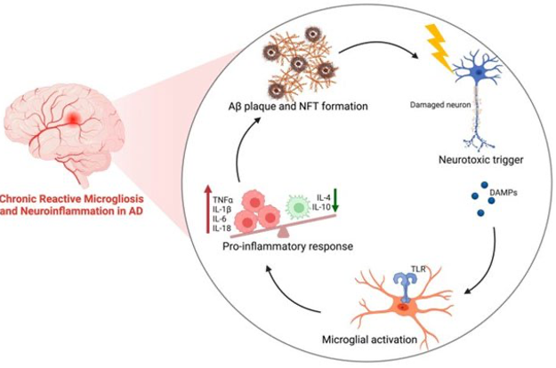
Chronic Microglial Activation and Neuroinflammation Can Cause a Positive Feedback Loop That Facilitates the Onset and Progression of AD¹⁻³
The accumulation of extracellular Aβ plaques and intraneuronal NFTs is closely linked to neuroinflammation
However, inflammation appears much earlier than protein aggregate deposition, suggesting that neuroinflammation may play a large role in the initiation of AD as well as its progression
Once AB plaques and tau tangles start to develop, a self-perpetuating cycle is generated that further accelerates degenerative processes, with inflammation assuming a central role in AD progression
The cycling inflammatory cascade also outpaces the capacity of microglial cells to surround and phagocytize Aβ plaques and reestablish homeostasis.
1. Hickey JP et al. Curr Issues Mol Biol. 2024;46(5):4379-4402. 2. Kinney JW et al. Alzheimer's Dement: Transl Res Clinl Interv. 2018;4(1):575-590. 3. Kiraly M et al. J Prev Alzheimers Dis. 2023;10(4):686-698.

Slide 34
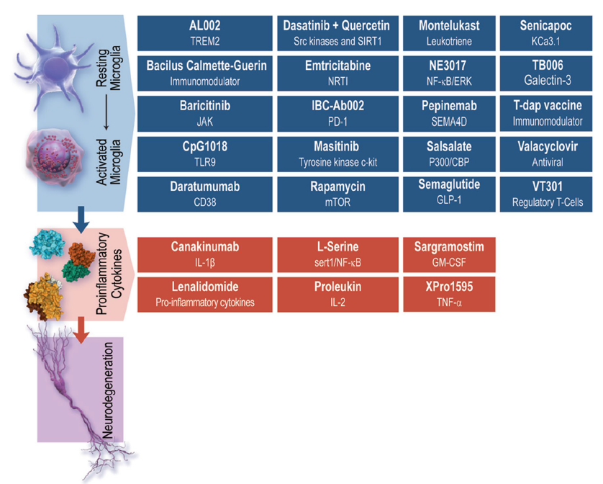
Inflammation-related drugs and the targets of agents currently in development¹
Mechanisms for action include:
Vaccines for bacterial infections (eg, BCG, a tuberculosis vaccine, and Tdap)
Treatments for viral infections (eg, valacyclovir)
Drugs targeting pro-inflammatory cytokines (eg, proleukin, IL-2, TNF-𝞪)
And many others
1. Cummings JL et al. Drugs. 2023;83:1387-1408

Slide 35
Aggregation inhibitors

Slide 36
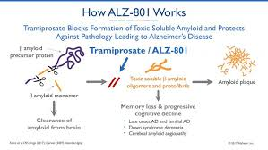
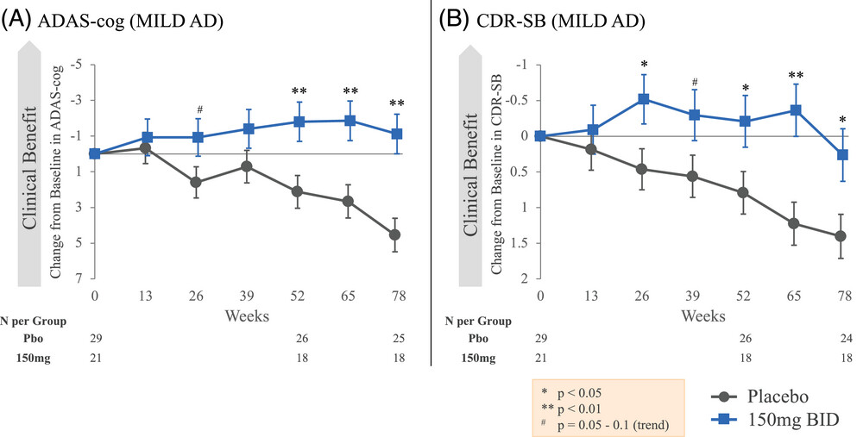
ALZ801- Phase II data. Results from APOLLO-E4 expected soon

Slide 37
Conclusion: 120 drugs in development for AD with multiple targets
Treatment will need to be a multidrug regimen hitting different targets

