Slide 1

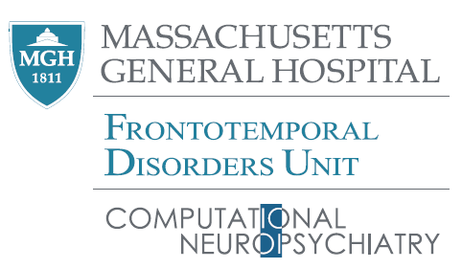

Computational Analysis of Language for Diagnosing
Alzheimer’s Disease
Neguine Rezaii
Assistant Professor of Neurology
Director, Computational Neuropsychiatry Program at MGH FTD Unit
Massachusetts General Hospital
Harvard Medical School
@NeguineR

Slide 2


Talking is one of the easiest tasks for humans
We talk effortlessly, expending little energy, often without much thought—almost as naturally as breathing
Yet, embedded within our speech lies a wealth of information that goes beyond the intended message
Through our words, we reveal information into our mental health, physical well-being, and even the environmental clues surrounding us, such as the room temperature
@NeguineR

Slide 3
When describing a picture, we make many implicit choices:
The specific words we use,
The length and structure of our message,
The rise and fall of our tone
These choices convey a lot of information beyond the direct intended message
For instance, being in pain, sitting in a hot room, or speaking on an empty stomach unconsciously affects our speech
Can we retrieve the state of talking, such as mental health, through language analysis?
@NeguineR

Slide 4
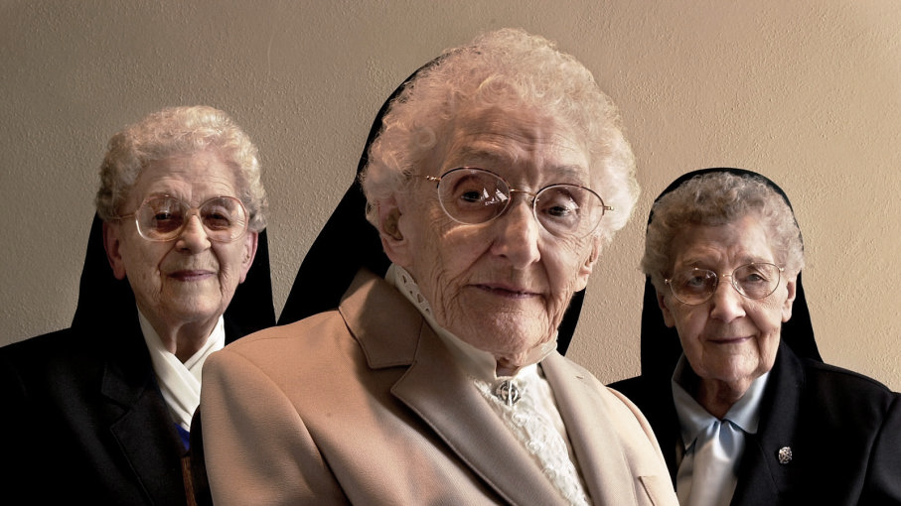
Neurodegenerative disorders
The nun study
Nuns with a mean age of 22 years were followed for about 60 years
They had the habit of writing their diaries
Seven of 93 developed Alzheimer’s disease
Those who developed Alzheimer’s had lower idea density
Their language was empty
Even though they possessed the ability to talk, no clear message could be conveyed to their listener
Snowdon et al. 1996, JAMA

Slide 5

Old approaches
I really don't know because they haven't gotten things turned up right.
Not in this one.
Maybe under this right here. No it isn't.
Looks like this is a kind of thing that whoever.
She's cleaning.
Looking to see what they have so they can get it ready for bed I guess.
His hair is down.
It's fallen down a lot.
Idea density
The number of verbs, adjectives, adverbs, and prepositional phrases within every 10 words of a text
Two problems
It is not sensitive to the topic
A sentence such as “I so very much like it here” gets a high score
@NeguineR

Slide 6
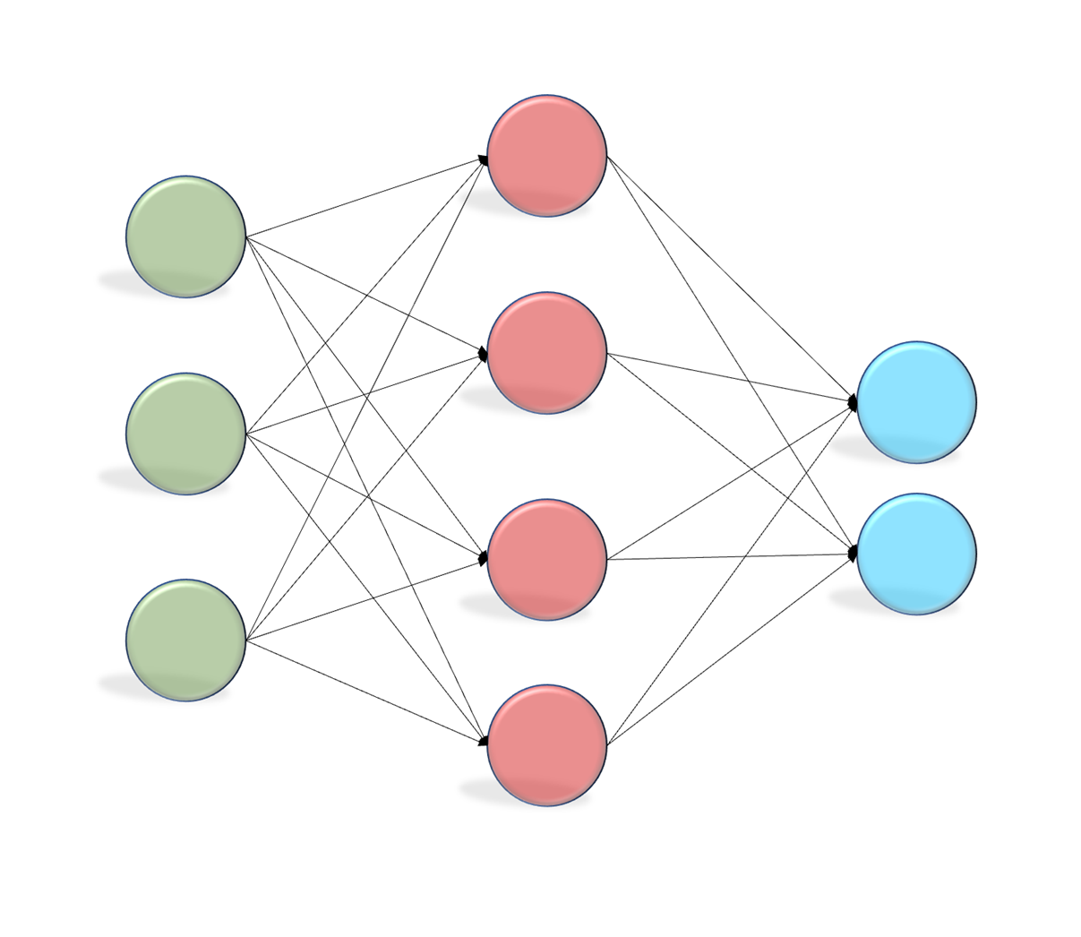
Typical language abnormalities indicative of AD in English include using
More of pronouns and less nouns
More demonstratives
Shorter sentences
More adverbs
Non-specific words
→ A machine learning classifier
I really don't know because they haven't gotten things turned up right.
Not in this one.
Maybe under this right here. No it isn't.
Looks like this is a kind of thing that whoever.
She's cleaning.
Looking to see what they have so they can get it ready for bed I guess.
His hair is down.
It's fallen down a lot.
Rezaii et al. Brain 2024
@NeguineR

Slide 7
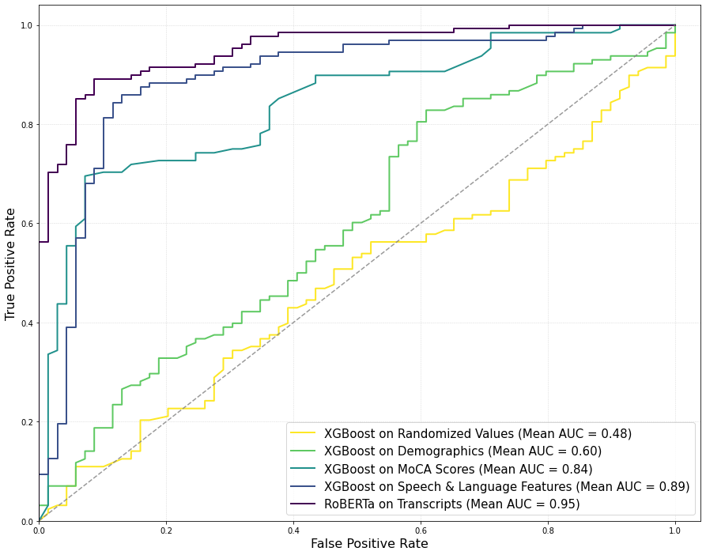
@NeguineR

Slide 8
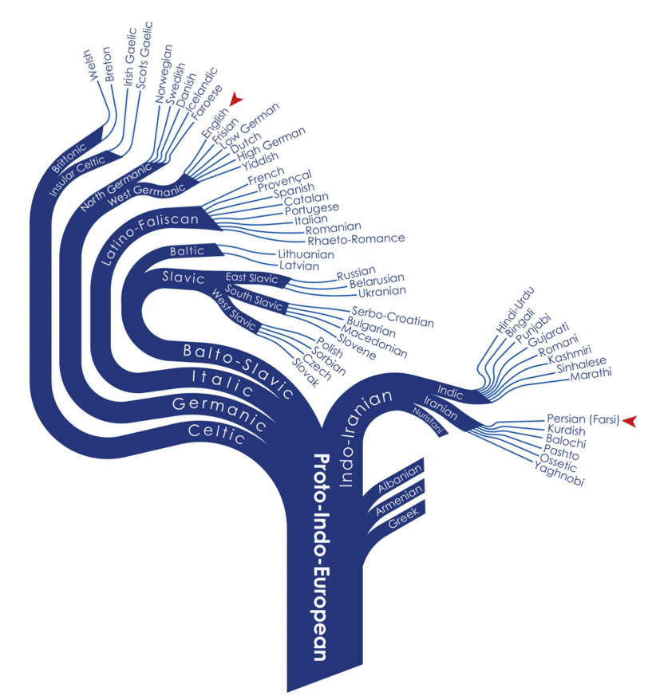
Book
Livre
Libro
کتاب
Rezaii et al. Annals of Clinical and Translational Neuroscience 2024

Slide 9
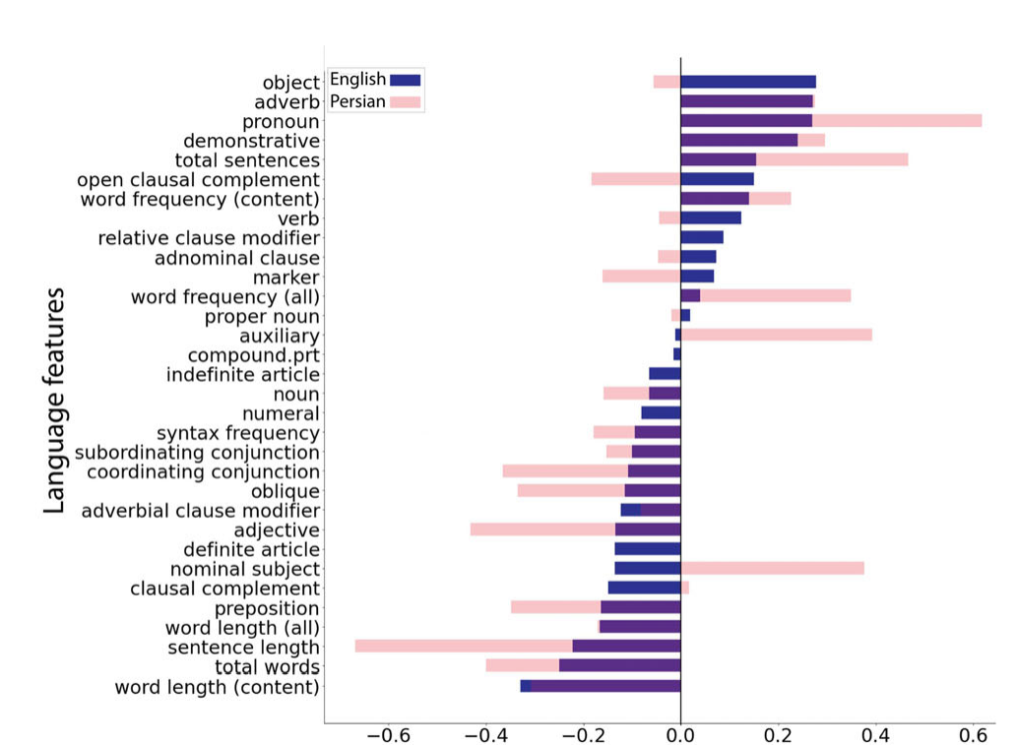

Slide 10

Use Large Language Models (LLM) directly on language samples without making any assumptions
GPT, LLaMA, Mistral, DeepSeek
@NeguineR

Slide 11
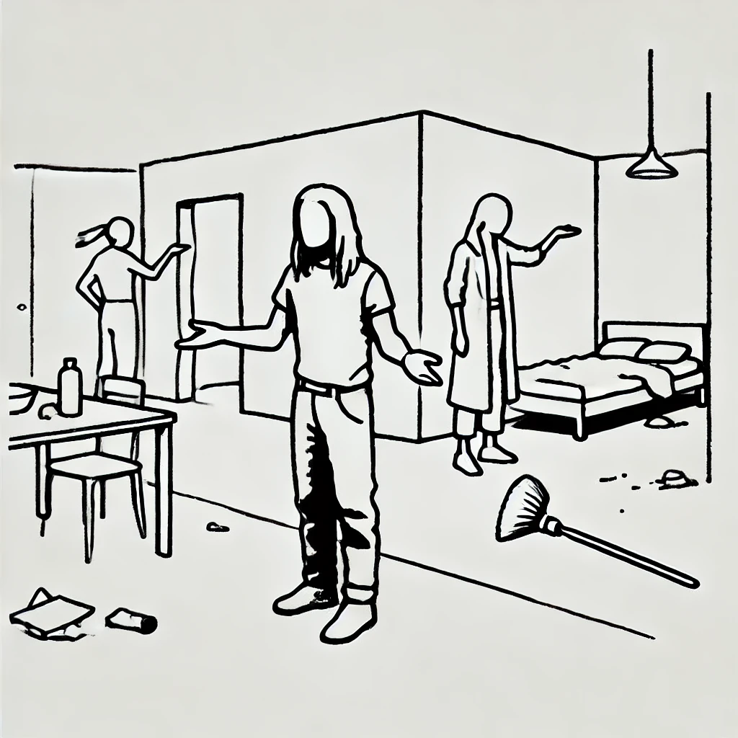
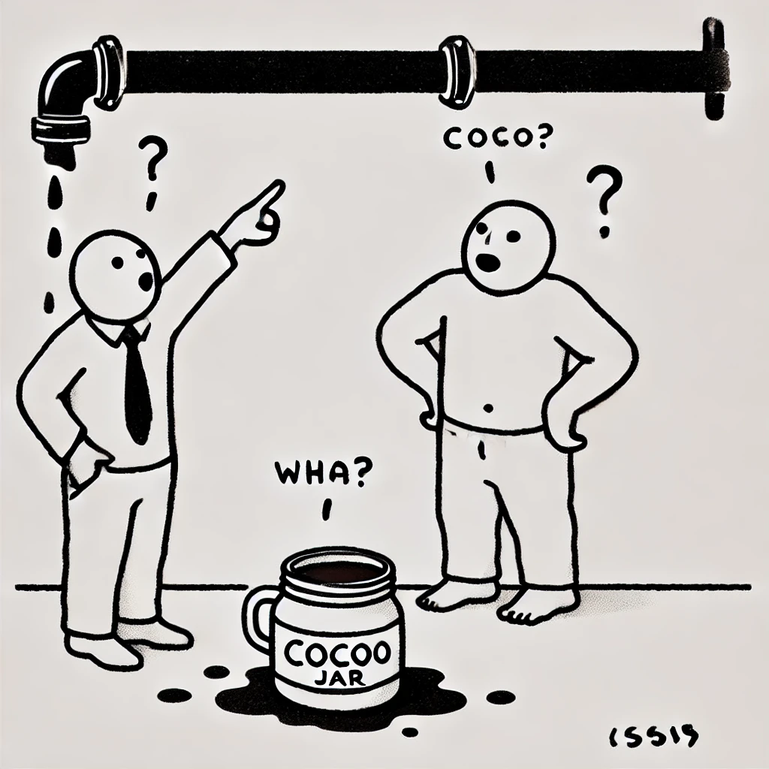
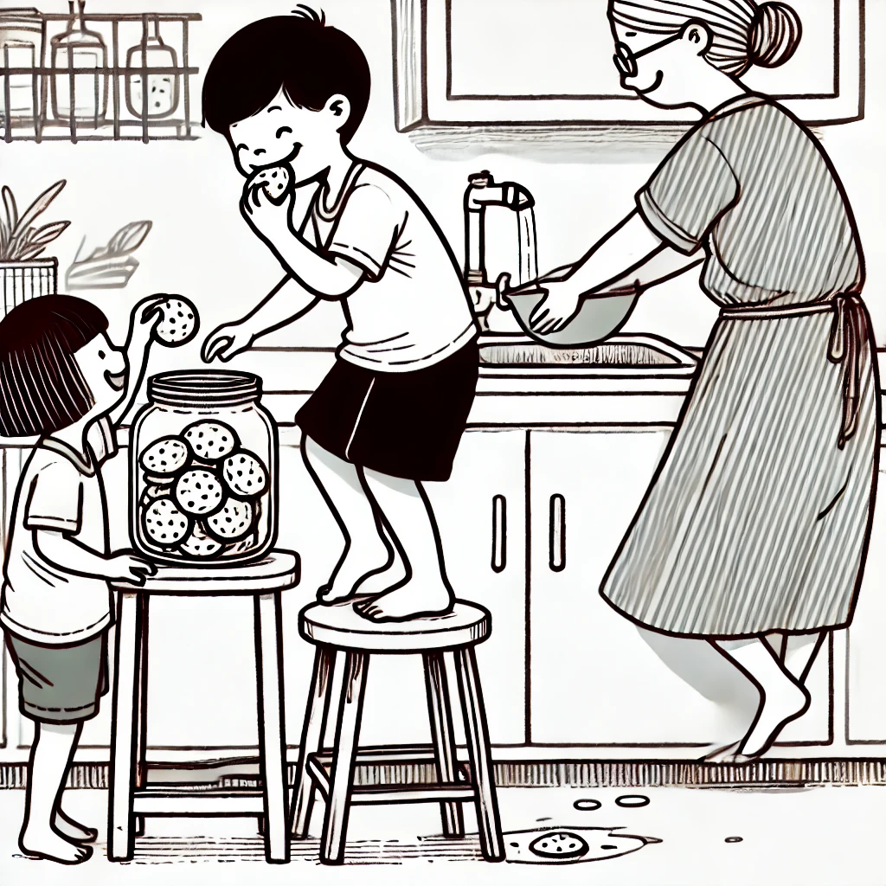
I really don't know because they haven't gotten things turned up right.
Not in this one.
Maybe under this right here. No it isn't.
Looks like this is a kind of thing that whoever.
She's cleaning.
Looking to see what they have so they can get it ready for bed I guess.
His hair is down.
It's fallen down a lot.
The water? There's something has to be where the water goes down over. There's probably something that's. Or they don't have it open or something might have. What? When the water goes down what do you call that? This here. Right here. This. What do you call that? What is that? That's what I'm saying. I don't know what that is. Water pipe. there must be things in there that the water will not go down. I don't know what's going on.
He's probably getting. What's this here? Cocoa jar? He's getting it out.
The boy is standing on a stool that is starting to fall over. He's taking cookies out of the cookie jar. The girl is like snickering at what's happening to him in a sense. So she's reaching up to take a cookie from his hand. The woman the mother is drying a dish. The sink is overflowing. That's all that's in a way of movement but there's dishes on the sink.

Slide 12
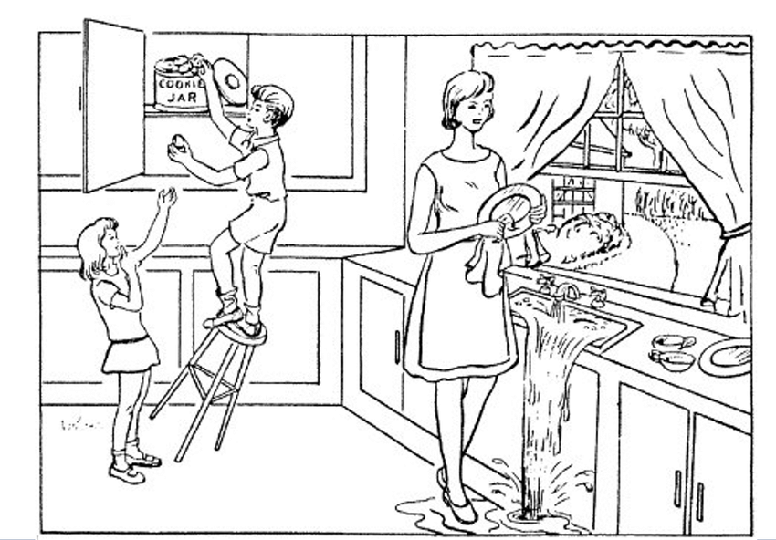

Slide 13
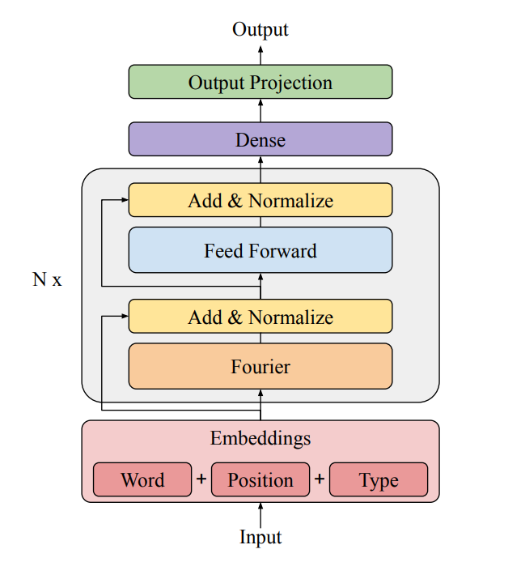

AD
%
Non-AD
@NeguineR

Slide 14
@NeguineR

Slide 15

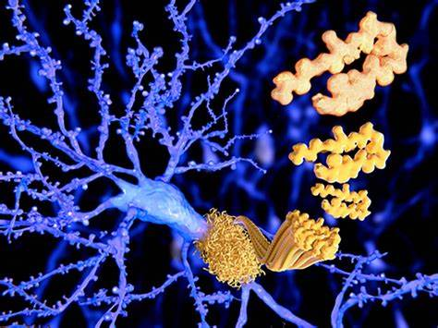
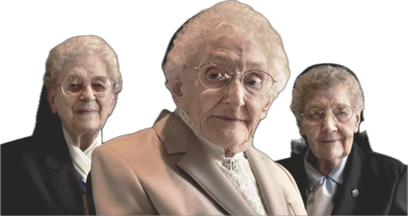
Applications
Diagnosis
> 95%
Pathology
> 90%
Prediction
> 80%
@NeguineR

Slide 16

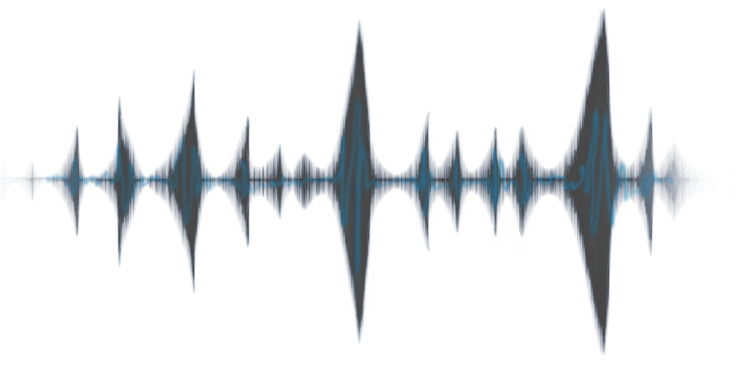
Diagnosis Prediction Pathology
Rezaii, Wolff, Price, British Journal of Psychiatry 2022
@NeguineR

Slide 17
Conclusions
Language contains implicit and often overlooked signals about our present and future health status
AI allows us to uncover such hidden clues
This approach can be extended to a wide range of medical conditions to diagnose, make predictions and outline treatment plans based on the nuances specific to each unique individual
AI’s ability to work across languages and cultures makes it a scalable solution for diagnosing and predicting diseases in diverse populations worldwide.

Slide 18

Special Thanks to Dr. Bruce Price
@NeguineR

Slide 19

Thanks
for your attention
My drawing of runaway letters in Persian, cuneiform, and cave letters

