Slide 1

Motor and Non-Motor Correlates of Finger Tapping Variability in Subjective Memory Complaints, Mild Cognitive Impairment and Alzheimer’s Disease
George P. Prigatano, Ph.D.
Barrow Neurological Institute
Groupe de Recherche sur la Maladie d’ Alzheimer (GRAL) Conference
January 29-31 , 2025

Slide 2
Recognition of colleagues who have substantially contributed to this presentation
At the Barrow Neurological Institute
Ashley Stokes, Ph.D., Assistant Professor of Neuroimaging Research
Anna Burke, M.D., Director of the Alzheimer and Memory Disorder Program
Lori Steffes, R.N., Research Nurse Co-coordinator
Molly McElvogue, M.S. Statistical Analyses
Katelyn Coddaire, PsyD., Post Doctoral Resident in Clinical Neuropsychology
At the SARAH Network of Rehabilitation Hospitals
Lucia Willadino Braga, Ph.D.

Slide 3
Plan of the Presentation
Review a few facts about aging and motor slowing.
Demonstrate the potential diagnostic value of abnormal finger tapping behaviors when neuropsychologically evaluating older patients with memory complaints.
Consider the theoretical and clinical implications of the motor and non-motor correlates of finger tapping abnormalities in the aging population.

Slide 4
Aging and Motor Slowing
Generally speaking, older individuals (ages 65+) perform motor tasks more slowly than younger individuals (ages 18-25 years) (National Institute on Aging).
Multiple factors may contribute to this phenomenon. They are often attributed to conservation of energy (i.e., older people often tire quickly), slower metabolism, brain volume loss, sensory decline and muscle and joint pain.
Common neuropsychological changes associated with aging are: (1) slowness in finding words and remembering names; (2) enhanced difficulties with multitasking; and (3) experienced decline in the ability to focus and sustain attention (National Institute on Aging).

Slide 5
Brain Changes with Aging
Healthy older adults are known to have a loss of neurons in the substantia nigra. It has been postulated that dopamine depletion may contribute to reduced speed of initiation of motor acts (Buchman et al., 2012) (also see Lamb et al., 2016).
Corpus callosum size decreases with age and has been linked to slow and variable reaction times (RT) in older individuals compared to younger individuals (Anstey et al., 2007).
Hemispheric specialization for cognitive and motor functions may decrease with age (Cabeza, 2002), thus resulting in less efficient functioning in multiple domains.

Slide 6
Brain Changes and Motor Performance with Aging
Heilman and colleagues (i.e., Lamb et al, 2016) note that: “ ….studies of patients with left hemisphere strokes and a lesion of the corpus callosum suggest that the left hemisphere is critical for performing precise movements for both hands.” (pg. 107)
“Since with aging there is a reduction of the corpus callosum, it is also possible that with aging the left hand will show more changes than the right hand.” (pg. 107)

Slide 7
Finger Tapping Speeds and Alzheimer’s Dementia (AD): Early Observations Using the Halstead Finger Tapping Test
Persons with mild AD were slower on all motor measures (e.g., gait velocity, reaction time, movement time) except for finger tapping compared to healthy age matched controls (Goldman et al., 1999).
Hom (1992) and Grace et al. (2005) also reported that performance on the Halstead Finger Tapping Test (HFTT) was not different in AD patients compared to age matched controls.

Slide 8
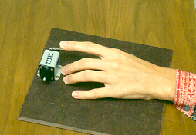
Scoring Instructions May have Contributed to these Early Negative Findings
The Halstead Finger Oscillation (Tapping) Test – “This test determines the maximum rate at which the subject can oscillate the extended index finger of the dominant hand by requiring him to activate the lever arm of a mechanical counter. Five trials are given and averaged.”

Slide 9
Reitan’s (1955) instructions: “Five 10-second trials are given for each hand except when the results are too variable from one trial to another. Specifically, the test procedure calls for five consecutive trials with each hand that are within a 5-point range from fastest to slowest. This procedure is used in order to avoid instances in which a single deviant score unduly influences the total performance.” (p. 48).

Slide 10
New Findings using Finger Tapping that did not employ the HFTT
Roalf et al. (2018), using an experimental computerized finger tapping task, reported that finger tapping variability (inter trial variability) was greater in the AD (p=.04) and MCI groups (p=.04) compared to normal age matched controls.
Variability of finger tapping was not different between AD and MCI groups.
This study emphasized the potential diagnostic significance of finger tapping variability versus mean number of taps.

Slide 11
New Findings using Finger Tapping that did not employ the HFTT
Koppelmans et al. (2023), using a computerized finger tapping test that measured mean speed and variability of finger tapping, reported better performance in cognitively normal older individuals versus age matched persons with amnestic MCI and AD.
They report that “while AD subjects performed worse on both the dominant and non-dominant hand tapping tests, amnestic MCI subjects only performed worse than controls when using their non-dominant hand.” (pg. 1245).
There was no clear explanation of their findings.

Slide 12
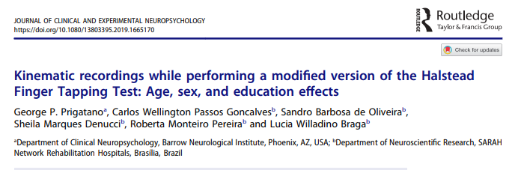

Slide 13
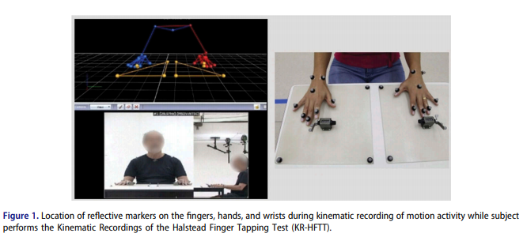

Slide 14
Six features of finger tapping behaviors were studied in 107 normal functioning adults from ages 21-80 at the SARAH Network of Rehabilitation Hospitals.
The number of valid tapping responses recorded over 7 trials each lasting 10 seconds.
The number of invalid tapping responses when performing this task.
The variability of the finger tapping movements (time between taps which included both valid and invalid taps).
The number of failures of selective motor inhibition of adjacent fingers when performing the task.
“Learning” effects when performing the task.
“Fatigue” effects when performing the task.

Slide 15
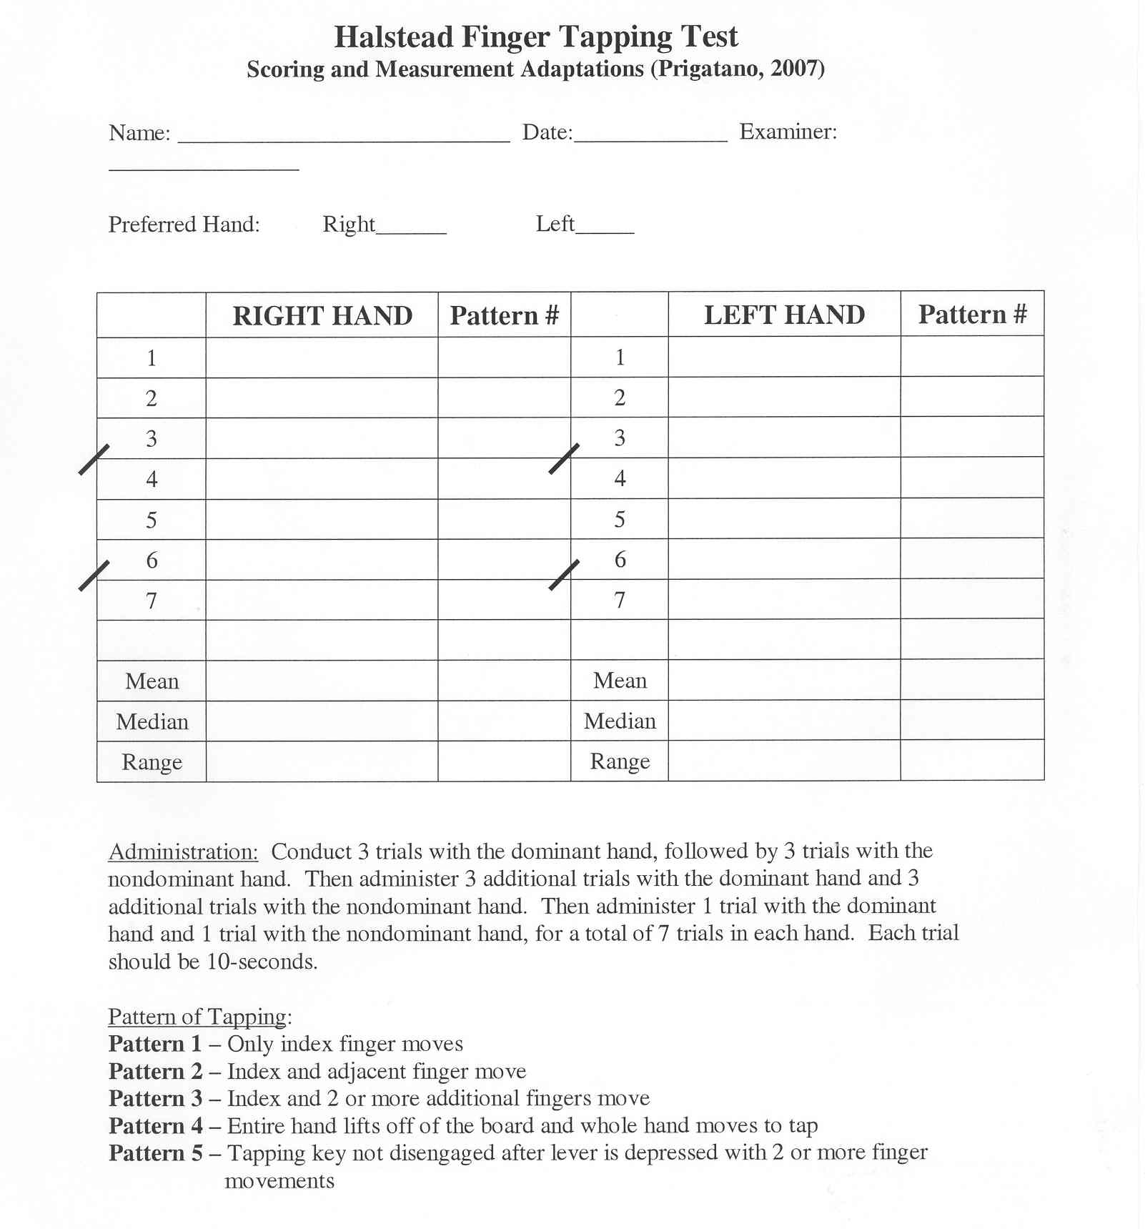
Pattern 1: Only the index finger moves while performing the task and counter advances (valid tap).
Learning Effect: Compare Trial 4 vs 1 score.
Fatigue Effect: Compare Trial 6 vs 4.
Patterns 2 and 3: Selective Motor Inhibition failures, but counter advances.
Pattern 4: Entire hand lifts off the board while attempting to tap.
Pattern 5 is an invalid tapping response. Counter does not advance

Slide 16
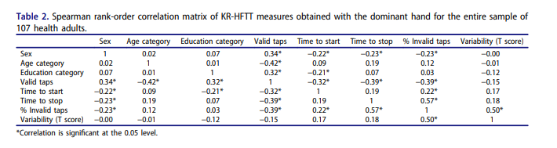

Slide 17
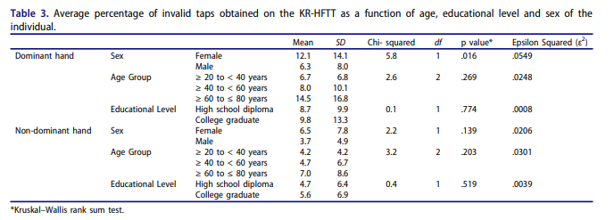

Slide 18
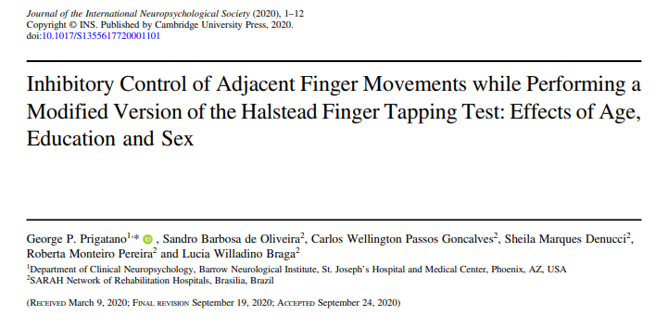

Slide 19
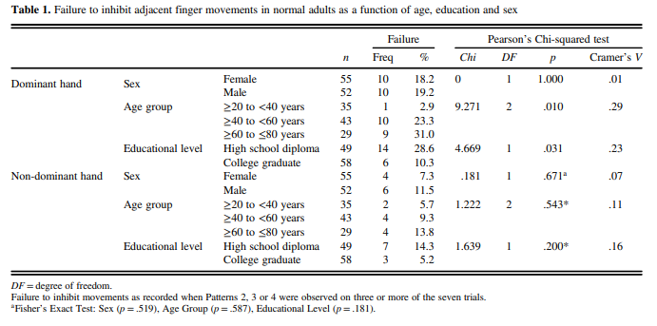

Slide 20
Prigatano, Braga, McElvogue, Coddaire, Steffes, Burke & Stokes (In Press) Motor Correlates of Finger Tapping Variability in Subjective Memory Complaints, Mild Cognitive Impairment and Probable Alzheimer’s Disease. Journal of Alzheimer’s Disease
Using a modified HFTT, we hypothesized:
Finger Tapping Variability would significantly differ across groups with the memory impaired patients showing greater variability, particularly in the nondominant hand. Variability was measured by the range of scores over 7 trials for each hand.
The number of “invalid” tapping responses would positively correlate with finger tapping variability.
The number of “invalid” tapping responses would be greater in the MCI and AD Groups versus the HC and SMC groups.
Explored whether other motor correlates (i.e., selective motor inhibition failures, learning and fatigue effects) helped account for finger tapping variability findings.

Slide 21
Group | HC | SMC | MCI-A | AD | Group Comparisons
Demographics
Age in Years (SD)* | 72.2 (6.3) | 70.3 (5.6) | 74.6 (5.5) | 75.3 (6.1) | ANOVA: F=2.81 (p=0.05)
Education Years (SD) | 16.0 (3.0) | 15.6 (2.3) | 15.6 (2.9) | 14.8 (2.4) | ANOVA: F=0.40 (p=0.76)
N Females (SD) | 12 (7) | 23 (13) | 19 (7) | 11 (5) | Pearson Chi-Square: x²=2.12 (p=0.55)
Handedness [R/L] | 11/1 | 22/1 | 18/1 | 8/3 | Pearson Chi-Square: x²=5.30 (p=0.15)
Psychometric Test Findings
BNIS Total Raw Score (SD)*** | 44.8 (2.9) | 43.3 (3.6) | 36.6 (4.6) | 33.8 (3.3) | F=27.09 (p<0.001)
WAIS-IV FSIQ*** | --- | 109.3 (12.5) | 100.7 (9.3) | 84.9 (12.8) | F=15.59 (p<0.001)
RAVLT TR (T Score)*** | --- | 58.3 (11.6) | 39.1 (12.6) | 25.5 (13.8) | F=27.58 (p<0.001)
RAVLT DR (T Score)*** | --- | 58.9 (11.7) | 30.7 (11.6) | 21.9 (10.6) | F=48.33 (p<0.001)
BMVT-R DR (T Score)*** | --- | 47.3 (13.7) | 27.6 (7.5) | 23.3 (6.5) | F=25.92 (p<0.001)
Trails A (Raw Score)* | --- | 40.3 (15.8) | 41.0 (15.8) | 60.7 (29.6) | F=4.44 (p=0.020)
Trails A (T Score) | --- | 45.4 (10.3) | 46.0 (10.5) | 36.8 (9.9) | F=3.01 (p=0.060)
Trails B (Raw Score)*** | --- | 91.8 (40.9) | 118.6 (62.1) | 202.0 (79.0) | F=10.41 (p<0.001)
Trails B (T Score)*** | --- | 49.5 (9.5) | 46.3 (10.3) | 31.5 (9.8) | F=8.91 (p=0.001)
*p<0.05. **p<0.01. ***p<0.001. HC, health controls; SMC, subjective memory complaints; MCI-A, mild cognitive impairment of the amnestic type; AD, Alzheimer’s dementia; ANOVA, Analysis of Variance; SD, standard deviation; R/L, right/left; BNIS, Barrow Neurological Institute Screen for Higher Cerebral Functions; WAIS-IV, Wechsler Adult Intelligence Scale-IV; FSIQ, Full Scale Intelligence Quotient; RAVLT, Rey Auditory Verbal Learning Test; TR, Total Recall; DR, Delayed Recall; BVMT-R, Brief Visuospatial Memory Test-Revised.

Slide 22
Variability of Finger Tapping Scores Across Groups Using New Test Administration Instructions
Dominant Hand Finger Tapping Variability did not significantly differ across groups using ANCOVA controlling for age (F=2.26, p=.09).
Nondominant Hand Finger Tapping Variability did significantly differ across groups using ANCOVA controlling for age (F=3.72, p=.02 Partial Eta Squared =0.19).
Specific Group Comparisons with the NDH:
HC vs. SMC-no difference
SMC vs. MCI-no difference
MCI vs. AD- difference (p=0.04)

Slide 23
Number of Invalid Taps Across Groups
The number of invalid taps in the dominant and nondominant hand significantly differed across groups using ANCOVA controlling for age ( F=9.62, p <0.001, size effect=.38 and (F=8.99, p<0.001, size effect=.37 respectively).
The total number of invalid taps (DH+NDH) significantly differed across groups (F=11.37, p<0.001, size effect=0.42).
Specific Group Differences: HC vs. SMC—no difference
SMC vs. MCI- difference (p=0.001;size effect=0.9)
MCI vs. probable early AD-difference (p=0.03. size effect=0.76)

Slide 24
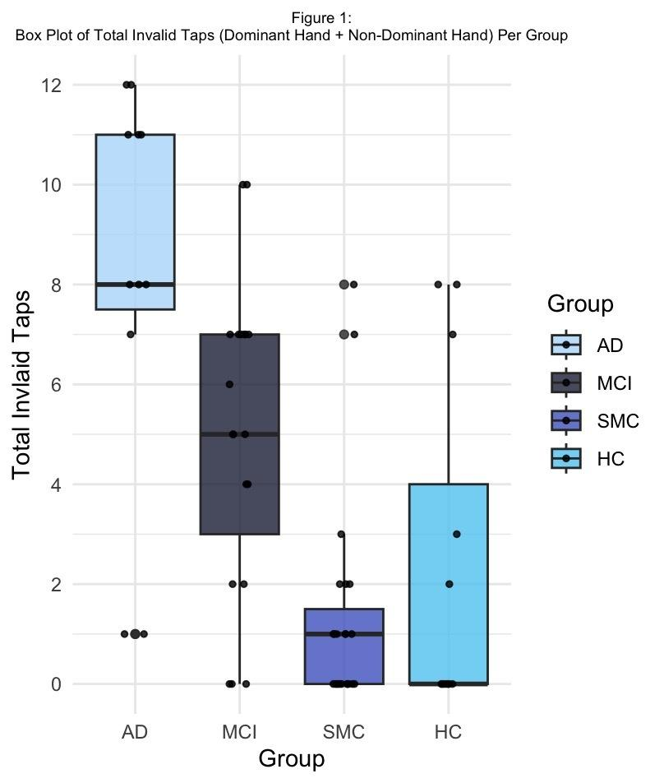

Slide 25
Correlation of Finger Tapping Variability and the Number of Invalid Tapping Responses
The correlation (Spearman’s rho) between DH finger tapping variability (e.g., the range scores) and invalid tapping responses was +0.56 (p<0.001).
For the NDH, the correlation was +0.54 (p<0.001).
The correlation between the combined range scores for both hands and the total number of invalid tapping responses for both hands was +0.65 (p<0.001).

Slide 26
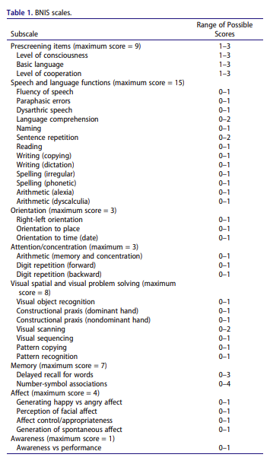
BNI Screen for Higher Cerebral Functions

Slide 27
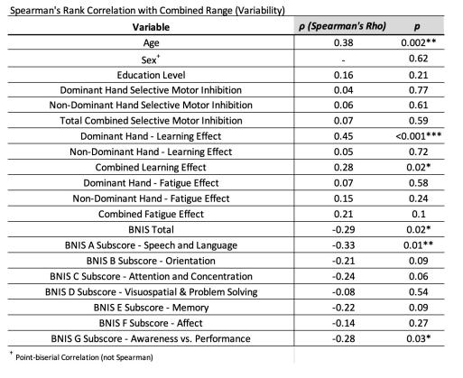
Spearman’s Rank Correlation with Combined Range (Variability) Scores

Slide 28
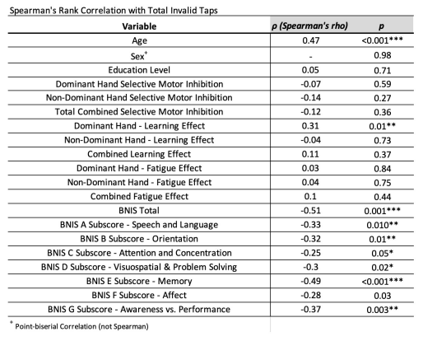
Spearman’s Rank Correlation with Total Invalid Taps

Slide 29
Implications of the Correlational Findings
The number of invalid tapping responses accounts for a large portion of the variance observed in finger tapping variability.
Dominant Hand Learning effects positively correlated with both the number of invalid tapping responses (mildly) and variability of finger tapping scores (moderate relationship). That is the greater the dominant hand learning effect the more variable were the tapping speeds across 7 trials.
Performance on the Speech and Language subtest of the BNIS also negatively correlated with both the number of invalid tapping responses and variability of finger tapping responses. That is the lower Speech and Language scores, the greater the variability and the more invalid tapping responses.
What role does disturbances of the dominant cerebral hemisphere or the corpus callosum play in finger tapping variability and the presence of invalid tapping response? This will be the focus of our next research efforts.

Slide 30
Implications of the Correlational Findings
BNIS Subscale score-Awareness vs. Performance also consistently showed a negative correlation with both the total invalid taps (rho=-0.37) and the variability of finger tapping responses (rho=-0.28). The more accurate self prediction of performance (awareness of one’s abilities), the less variability tapping scores and fewer invalid tapping responses.
Disturbances of impaired self-awareness are common in dementia and many patients who made invalid tapping responses thought there was something wrong with the finger tapping apparatus than with their ability to perform the task.
This is a classic feature observed in brain dysfunctional patients with impaired awareness of their functional limitations.

Slide 31
Concluding Thoughts
Finger tapping variability and invalid tapping responses may reflect a breakdown in what Luria (1974) referred to as the “kinetic melodies” of the brain.
These “kinetic melodies” were thought to represent a complex interaction between frontal and parietal regions of the brain that allowed for smooth, repetitive and accurate motor control according to Luria (1974).
Finger tapping variability and invalid tapping responses may reflect an early motor manifestation of a break down in “executive control” of fine/learned motor movements. The language dominant hemisphere may play a special role in this “executive function.”

Slide 32
Concluding Thoughts
This may help explain why these finger tapping variability and invalid tapping movements are observed in patients with neurodegenerative brain disorders.
The number of invalid taps does not correlate with the educational level in normal functioning and cognitively impaired individuals.
Invalid taps are not commonly observed in the nondominant hand in normal functioning individuals.
Invalid tapping responses (especially in the nondominant hand) and large finger tapping variability scores may be useful biobehavioral markers of neuropsychological decline when evaluating older individuals with limited formal education who complain of/or are thought to show a decline in their memory.

Slide 33

Questions and Answers

