Slide 1

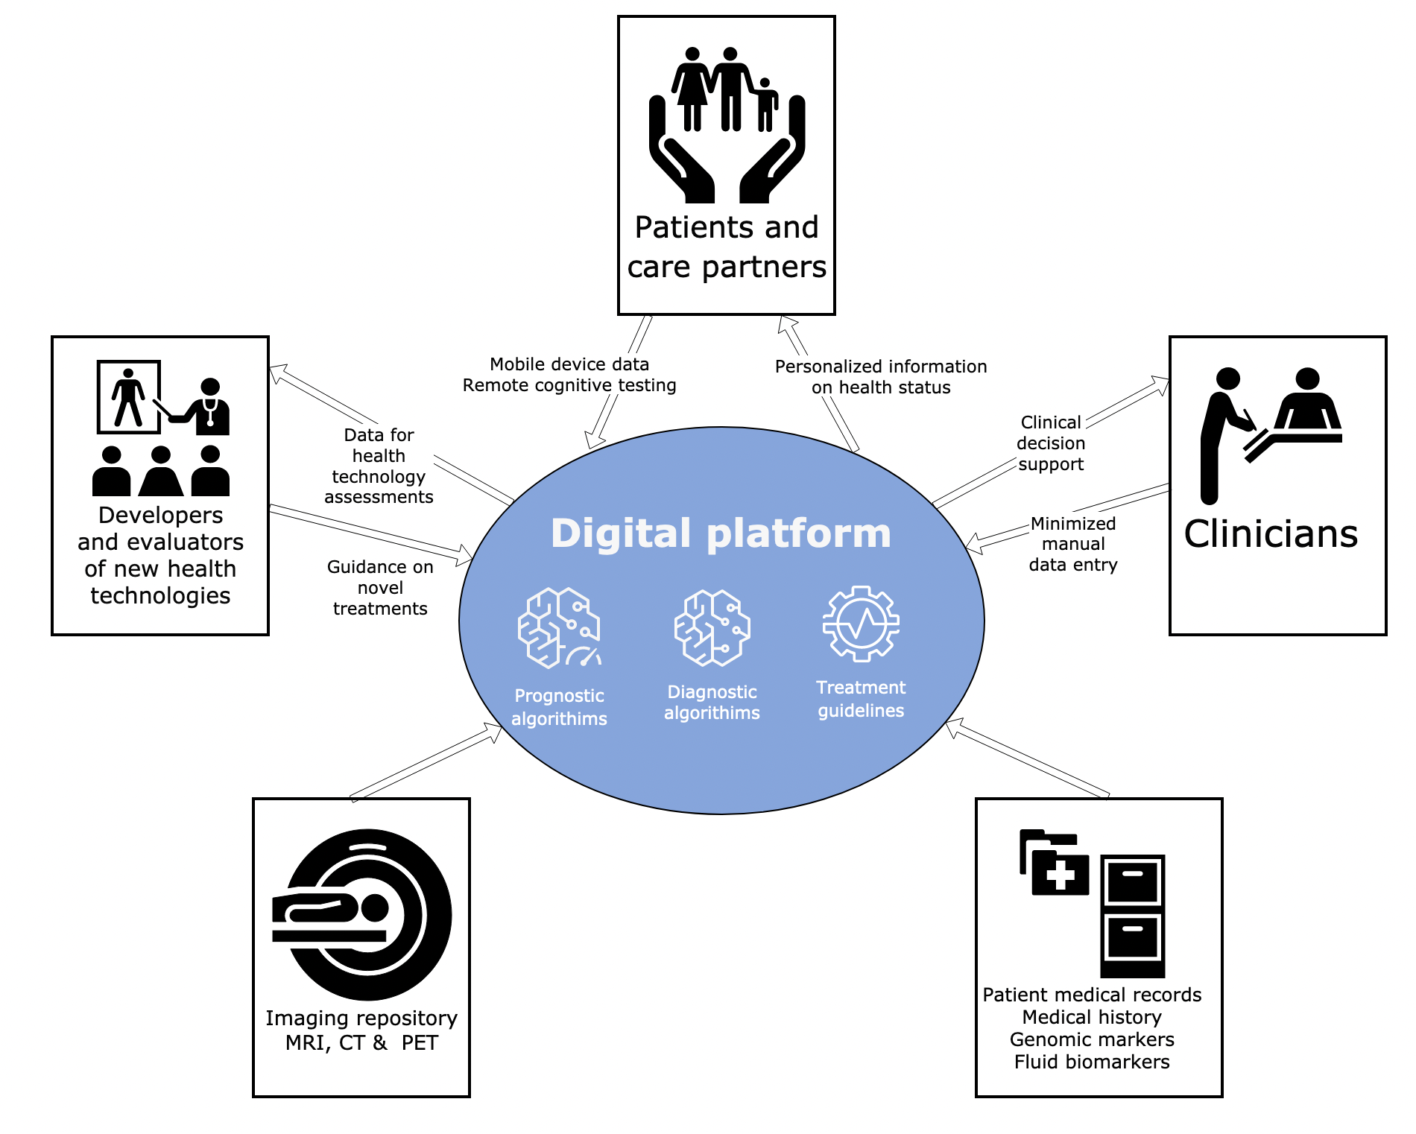

Use of digital tools in dementia diagnostics
Anne-Brita Knapskog
Memory clinic
Oslo Clinical Dementia Research Group
Department of Geriatric Medicine
Oslo University Hospital
Tate, Front Neurol 2023
Notes:
Today, I am going to tell you about an EU finanzed project in which they developed a clinical decision support tool, and about the work we are currently doing to evaluate and validate it.

Slide 2
Disclosures
Funding support from the Norwegian Health Association
Principal investigator in drug trials funded by Roche, Boehringer-Ingelheim, Novo Nordisk and GSK
No financial interest with Combinostics
Notes:
No financial interest with the enterprise Combinostics which I will talk about today.

Slide 3
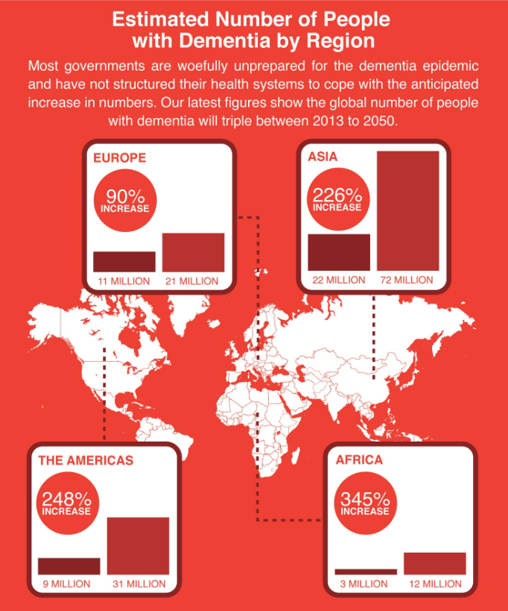
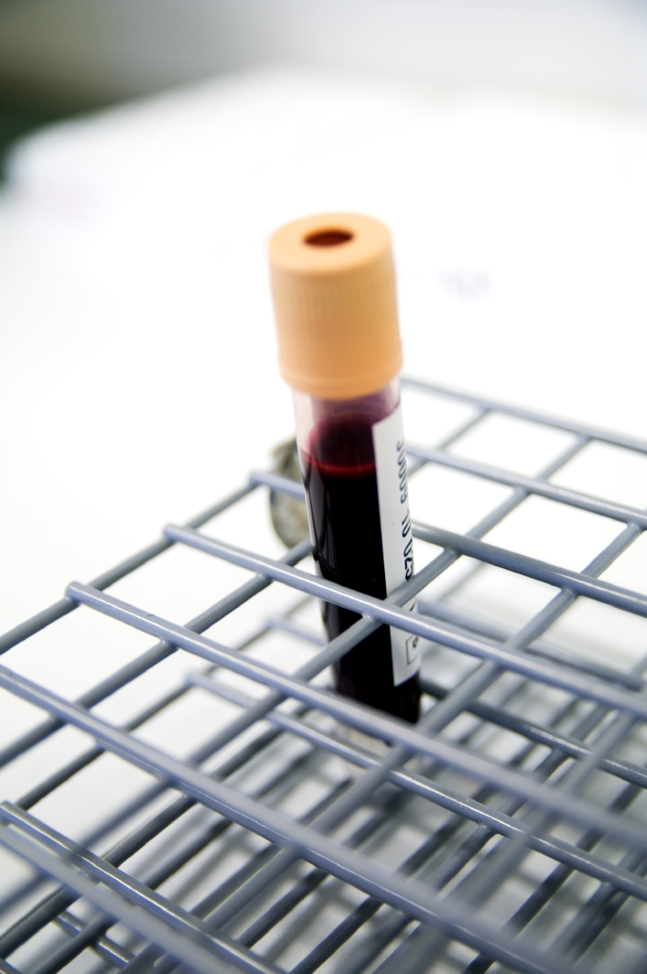
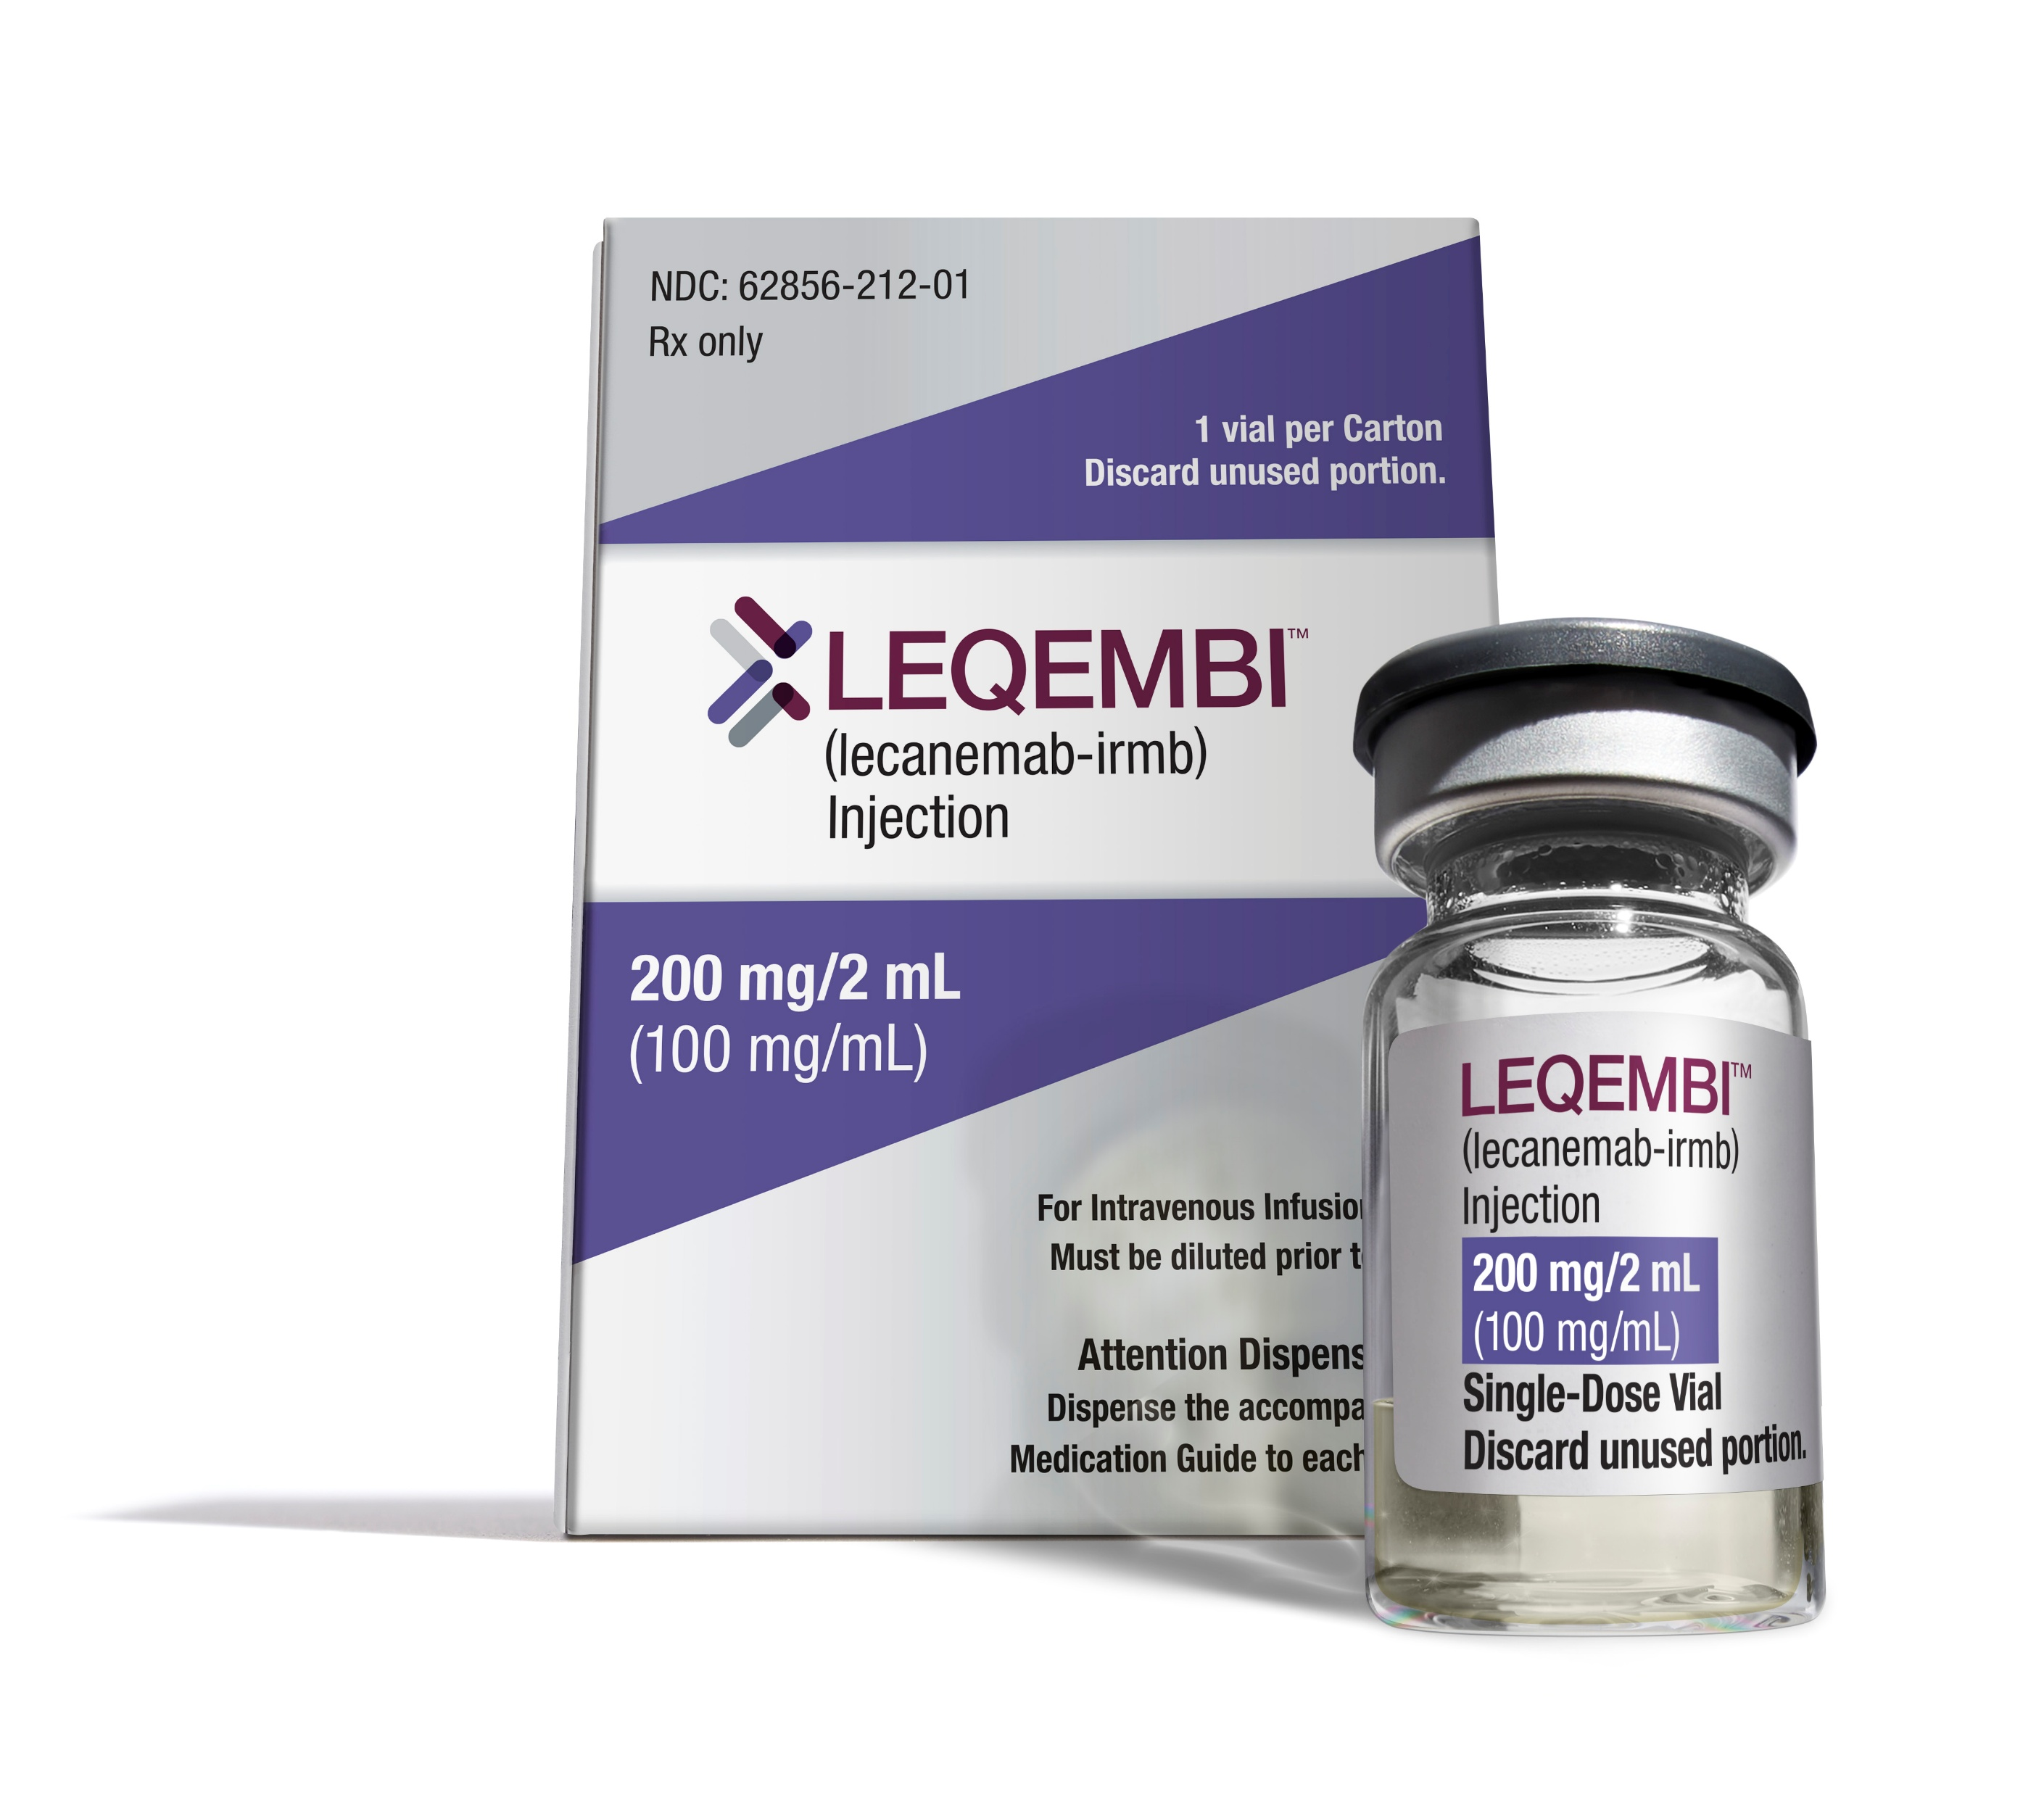
Dementia – a global epidemic
Increasing challenges in the future
Limited resources → need for more efficient diagnostic pathways
Alzheimer’s Disease International
Notes:
As we all know, in the coming years, there will be a significant rise in the number of people with dementia. Moreover, people will seek help earlier in the disease course
Recently, blood-based biomarkers with improved sensitivity to early changes have been developed
And anti-amyloid treatment for early Alzheimer disease now approved in both USA and Europe,
However, this may lead to inequality in access and a lack of capacity within traditional memory clinics. And there is a need for more efficient diagnostic pathways

Slide 4
Is it time for the Digitized Memory Clinic?
Timely and accurate diagnoses:
To make informed choices
Care and treatment
Prevent crisis
Notes:
For all these patients, a timely and accurate diagnosis is essential to make informed choices, arrange care and treatment and prevent crisis later on.
Is it time to rethink the role and functioning of our memory clinics, and implement digital tools in the diagnostic work?

Slide 5
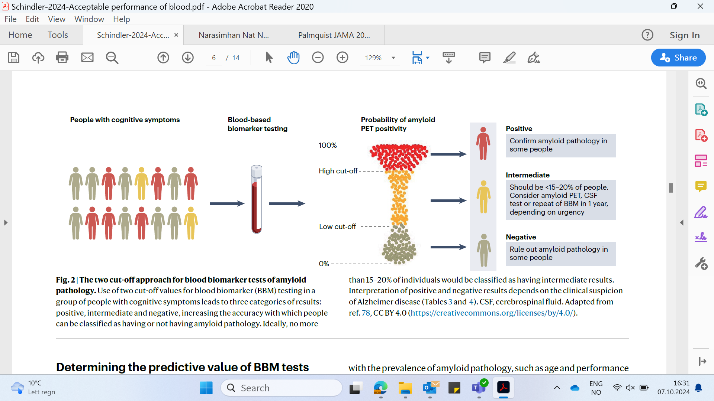
Schindler 2024
Gramkow MH 2024
Notes:
Digital health technologies cover a wide range of possibilities.
It ranges from
- online screening for dementia risk factors
dementia risk-reduction programs
Bedside digital diagnostic test tools
Non-intrusive monitoring techniques
These technologies are at different stages of development and are not all ready for clinical implementation
Today I will focus on an online cognitive test and a clinical decision support tool developed in an EU financed project 10 years ago that are ready to be implemented

Slide 6
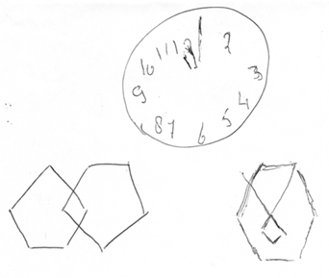



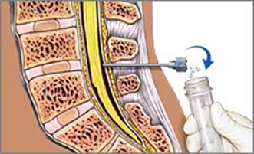
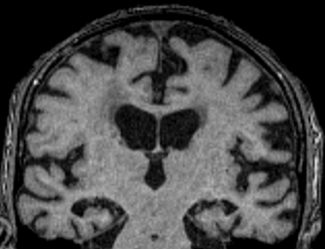


How can digital tools support me as a clinician?
“How to interpret all the test results?”
“and how to explain them to my patient?”
Hanneke Rhodius-Meester, Alzheimer Center Amsterdam and Oslo University Hospital
Notes:
Predict ND was a large European project, back in 2014-2018.
PredictND developed clinical decision support system for dementia including all the cognitive test results, and examinations performed at the memory clinic.
And then developed a summary report to ease the communication with the patient

Slide 7
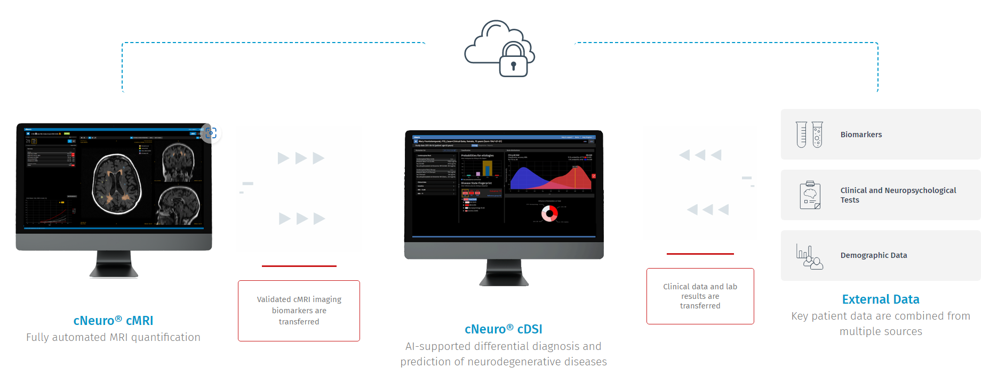

Using my own patient data
CSF
APOE
cCOG
Standard nPSY
Age, sex, education
Rhodius, DADM 2020; Visser, DADM 2021
Notes:
In this AI based tool all clinical data is uploaded including age and sex of my patient, cognitive tests results, and blood and spinal fluid markers if available.

Slide 8
Add automatic quantification of brain MRI (and/or PET)
CSF
APOE
cCOG
Standard nPSY
Age, sex, education
Koikkalainen Eur Radiology 2019, NeuroImage 2019
Notes:
And then the tool combines this with the brain MRI images and possibly other images from my patient and analyses these images automatically. And this is an important step, because a lot of information is hidden in the MRI scan. Information that with radiologists just looking at the scan, remains hidden.
Automatic quantification thus both saves time, and is more accurate than just visual assessment.

Slide 9
And compares to large training dataset
CSF
APOE
cCOG
Standard nPSY
Age, sex, education
Provides overview how my patient data fits the main dementia diagnoses:
→ Cognitive healthy, Alzheimer, vascular dementia, Lewy body, frontotemporal lobe dementia
Not a BLACKBOX
Tolonen Front Aging Neurosci 2018, Bruun Curr Alzheimer Res. 2019
Notes:
And then finally, with all this information, the tool tells me how much the data of my patient fits the most important dementia diseases. And it displays the results in an easy-to-understand manner that I, as clinician can comprehend.

Slide 10
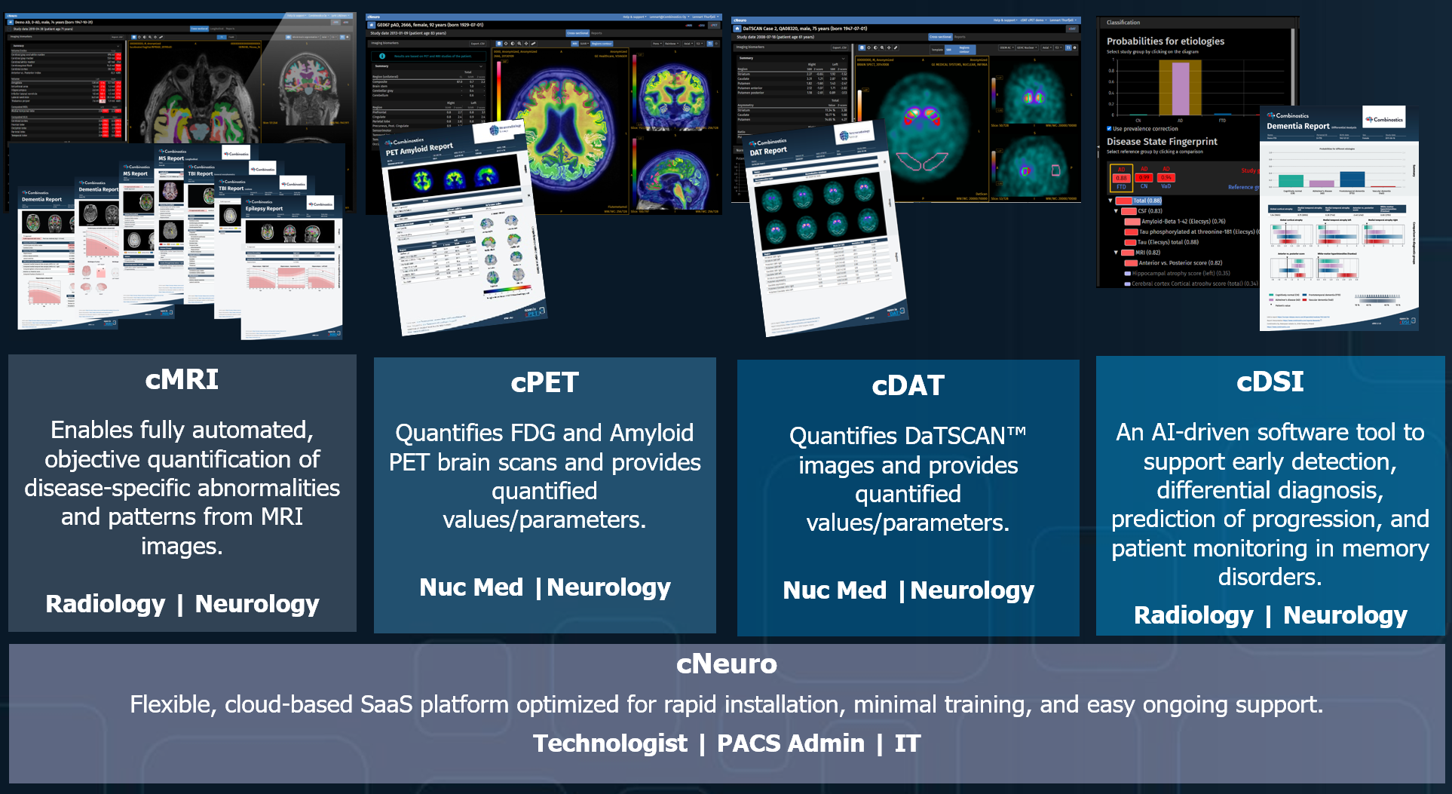
Notes:
The tool provides us with a summary report that includes all the information together, or separately for the different imaging examinations.

Slide 11

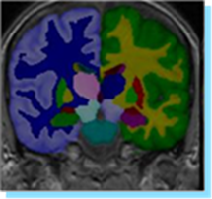
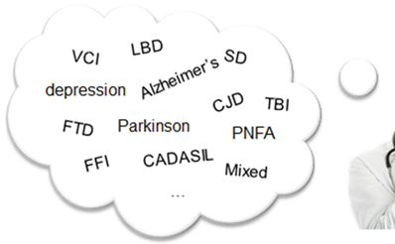


Online cognitive test
Worried at home
Online cognitive test
Now cognitive testing starts at GP
High threshold
Just MMSE/MOCA, pen & paper
Easier and standardized testing?
Online cognitive testing possible?
Notes:
The next step in the project an online cognitive test was developed during the Covid pandemic.

Slide 12
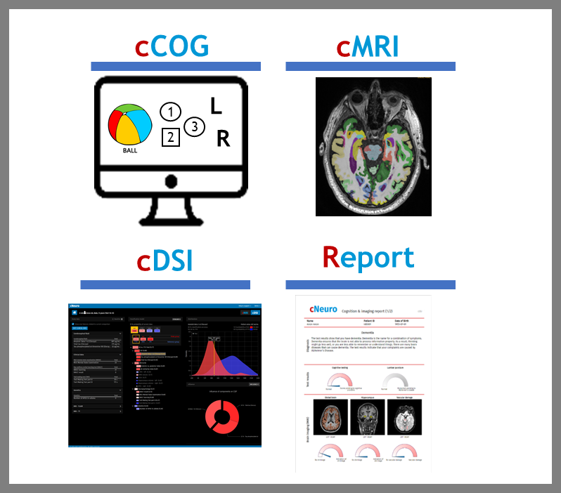
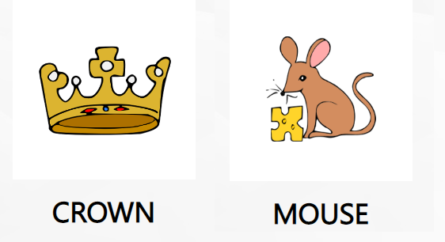

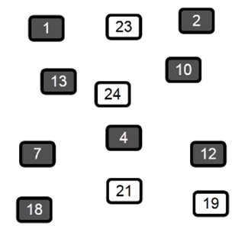
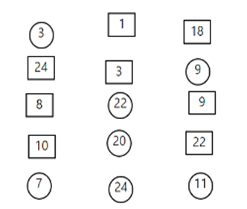
Online cognitive test
High accuracy + correlation paper&pencil
Easy repeated asssement
Use in different contexts
Opportunity for harmonization
cCOG: 7 components immediate and delayed recall simple and complex reaction time Trail making test A + B recognition
Rhodius, DADM 2020; Visser, DADM 2021
Notes:
cCOG resembles traditional tests a lot. So, there are no fancy VR or gaming tests, or passive monitoring, but rather tests that we as doctors are familiar with and have a relationship with, making them easier for us to interpret.
cCOG consists of 7 tests, where we assess memory through 10 pictures with words, learning and recall, reaction, attention, and executive function with TMT tests.
And it takes about 25 minutes to complete."

Slide 13

Notes:
As a next step we are going to test the tools in real clinical practice and explore if the tools can support clinicians in the different questions they experience in daily practice.

Slide 14
Evaluation and validation of a precision medicine platform in neurodegenerative disease
To evaluate a stepwise, data-driven approach – using the online cognitive test tool cCOG as a prescreener – to guide diagnostic decision making for three common clinical scenarios:
syndrome diagnosis
2) etiological diagnosis,
3) disease modifying treatment eligibility
Notes:
In this new EU finanzed project we want to evaluate and validate the digital tools in 8 European countries (Sweden, Finland, Germany, Denmark, Sweden, Slovenia, the Netherlands and Norway)
we evaluate a stepwise, data-driven approach – using the online cognitive test tool cCOG as a prescreener – to guide diagnostic decision making for three common clinical scenarios:
1) syndrome diagnosis, 2) etiological diagnosis, 3) Disease modyfing treatment eligibility

Slide 15
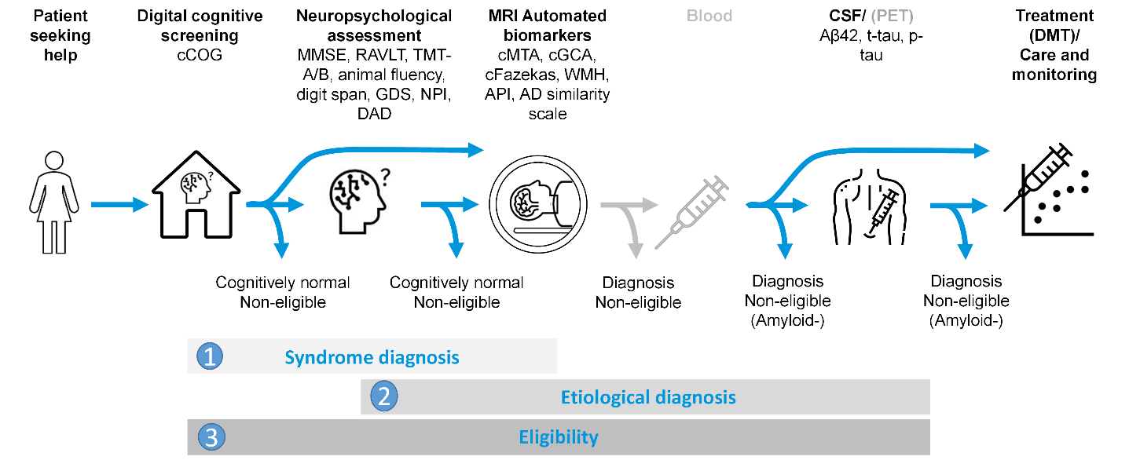
Stepwise approach for a syndrome diagnosis
CN – MCI – dementia?
Notes:
And this is how we shaped our stepwise approach for these 3 different scenarios:
The first scenario involves syndrome diagnosis, where the aim is to find out if a person is cognitively normal, has mild cognitive impairment or dementia
This is often relevant in a primary care or (local) memory clinic setting, where the focus is mostly on arranging care or reassuring people.
To do so, first the (digital) cognitive screening test, cCOG, is done, after which a subject can be reassured if completely normal.

Slide 16
Stepwise approach for a syndrome diagnosis
CN – MCI – dementia?
Notes:
Or can be guided to the next step neuropsychological assessment (NP), and again reassured if normal.

Slide 17
Stepwise approach for a syndrome diagnosis
CN – MCI – dementia?
Notes:
Yet if not normal, the person finally is guided to the last step, MRI of the brain.

Slide 18
Stepwise approach for an etiological diagnosis
CN – AD – FTD – VAD – DLB?
Notes:
And the second scenario works basically similar, where we focus on finding the underlying etiology. And try to differentiate between cognitively healthy, Alzheimer dementia, frontotemporal dementia, vascular dementia and dementia with lewy bodies.
And again we move only to the next step if the diagnosis is not clear yet, moving from cognitive assessment to MRI, and finally CSF analysis.

Slide 19
Methods
Stepwise approach for DMT
According to Cummings criteria?
Notes:
Finally in the third scenario, we assess potential eligibility for disease modifying treatment (DMT) according to the appropriate use criteria by Cummings. By sequential diagnostic tests, including cCOG, NP, and MRI, we detect which patients should undergo CSF or PET confirmation. In each step we make sure only include those that are eligible, so those with MCI or dementia, but not too low a MMSE, those without vascular damage on MRI and finally off course those who are amyloid positive.

Slide 20
Evaluation and validation of a precision medicine platform in neurodegenerative disease
Can we use a digital test as a screening test?
Can a digital tool help us make more accurate diagnoses faster?
Allow doctors at memory clinics and general practitioners and memory teams to try the tool
Further develop summary reports for healthcare personnel and patients
Get feedback from healthcare personnel, patients, and relatives
Notes:
The questions we want to answer are:

