Slide 1
Molecular Targets of Potential Therapeutics for Frontotemporal Degeneration
DeJarra Johnson, MD

Slide 2
No Relevant Disclosures

Slide 3
Objectives
Highlight the key pathophysiology of Frontotemporal Degeneration
Identify the most common genetic mutations in Frontotemporal Degeneration
MAPT, C9orf72, GRN
Discuss current molecular targets for developing therapeutics for Frontotemporal Degeneration

Slide 4
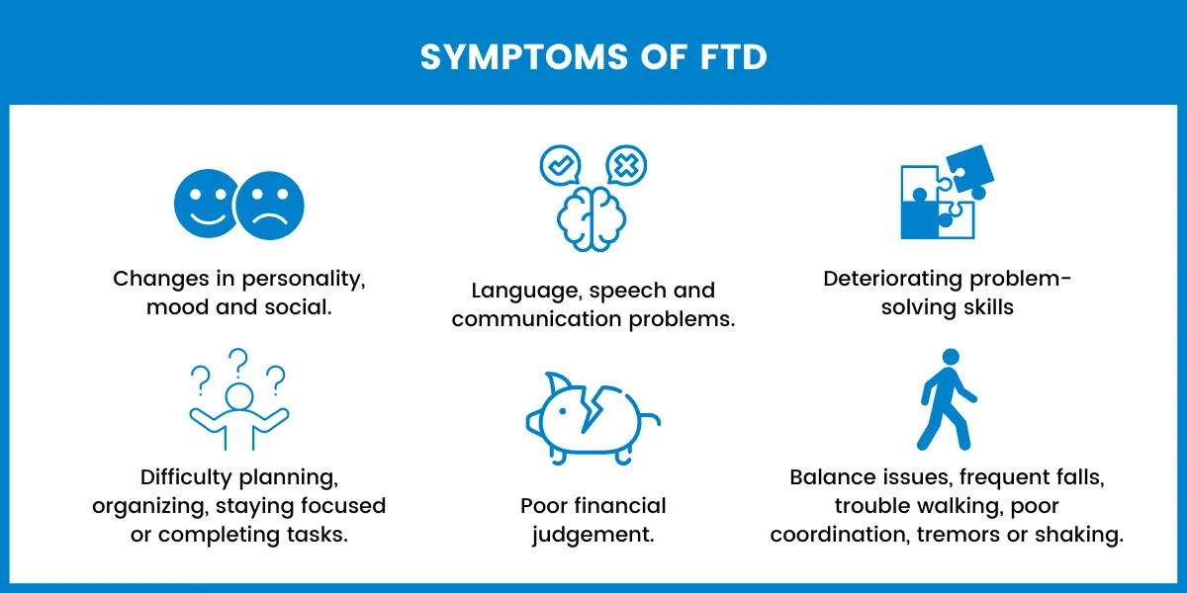
What is Frontotemporal Degeneration?
A rare, progressive neurological disease that damages neurons in the frontal and temporal lobes of the brain.
https://dementiaconnections.org/shining-a-light-on-frontotemporal-dementia/
Notes:
Symptoms of FTD are heterogeneous leading to different clinical phenotypic presentations:
Unusual behaviors
Emotional problems, such as loss of empathy
Difficulty communicating, such as using words incorrectly or repeating phrases
Difficulty with work or walking
Reduced interest in activities previously enjoyed
Overeating or increased hunger for sweets and other carbohydrates

Slide 5
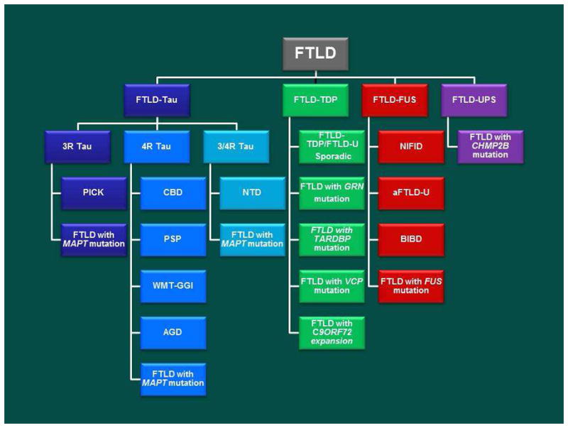
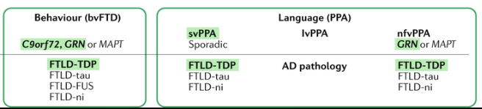
Neuropathological classification of FTLD subtypes.
Boxer AL, Gold M, Huey E, Gao FB, Burton EA, Chow T, Kao A, Leavitt BR, Lamb B, Grether M, Knopman D, Cairns NJ, Mackenzie IR, Mitic L, Roberson ED, Van Kammen D, Cantillon M, Zahs K, Salloway S, Morris J, Tong G, Feldman H, Fillit H, Dickinson S, Khachaturian Z, Sutherland M, Farese R, Miller BL, Cummings J. Frontotemporal degeneration, the next therapeutic frontier: molecules and animal models for frontotemporal degeneration drug development. Alzheimers Dement. 2013 Mar;9(2):176-88. doi: 10.1016/j.jalz.2012.03.002. Epub 2012 Oct 5. PMID: 23043900; PMCID: PMC3542408.
Notes:
Image: https://pmc.ncbi.nlm.nih.gov/articles/PMC3542408/
There are multiple subtypes of FTD with 3 major subtypes of FTLD classified by the protein inclusions, morphology, and anatomic distribution (i.e FTD-tau, TDP-43,and FUS). Though there is heterogeneity among the different subtypes their pathological course shares commonalities. (Next Slide)
(https://www.perplexity.ai/search/pathophysiology-of-frontotempo-UNY9qvo5TEmLcNh2EZOK5Q)
FTLD-tau:
Tau protein is encoded by the MAPT gene on chromosome 17 to stabilize microtubules, promote microtubule assembly, and regulates axonal transport. Tau can accumulate in not only neurons but glial cells.
FTLD-TDP:
TDP-43 protein is an RNA binding protein present in the nucleus of normal cells and involved in transcription regulation.
FTLD-FET:
Mutations in the gene coding for FUS protein were originally identified as a cause of familial AԼЅ
FTLD-UPS:
FTԼD cases that only label for markers of UPS are rare. Most FTԼD-UPS cases are associated with FТD linked to chromosome 3 caused by mutations in СΗМP2B. The neuropathology includes ubiquitin- and p62-positive granular neurocytoplasmic inclusions (that are negative for tau, TDP-43, and FUS proteins)
The clinical phenotype of frontotemporal dementia starts with the accumulation of proteins Tau protein, TDP-43, and FUS-protein

Slide 6
Pathophysiology
Protein Aggregation
Neuroinflammatory Process
Neuroinflammatory Process
Protein Aggregation
Genetic Mutations
Genetic Mutations
Notes:
These pathophysiological commonalities include protein aggregation, neuroinflammatory process, and genetic mutations.

Slide 7
Pathophysiology
Protein Aggregation
Neuroinflammatory Process
Neuroinflammatory Process
Protein Aggregation
Genetic Mutations
Genetic Mutations
Notes:
Let us take a look at protein aggregation

Slide 8
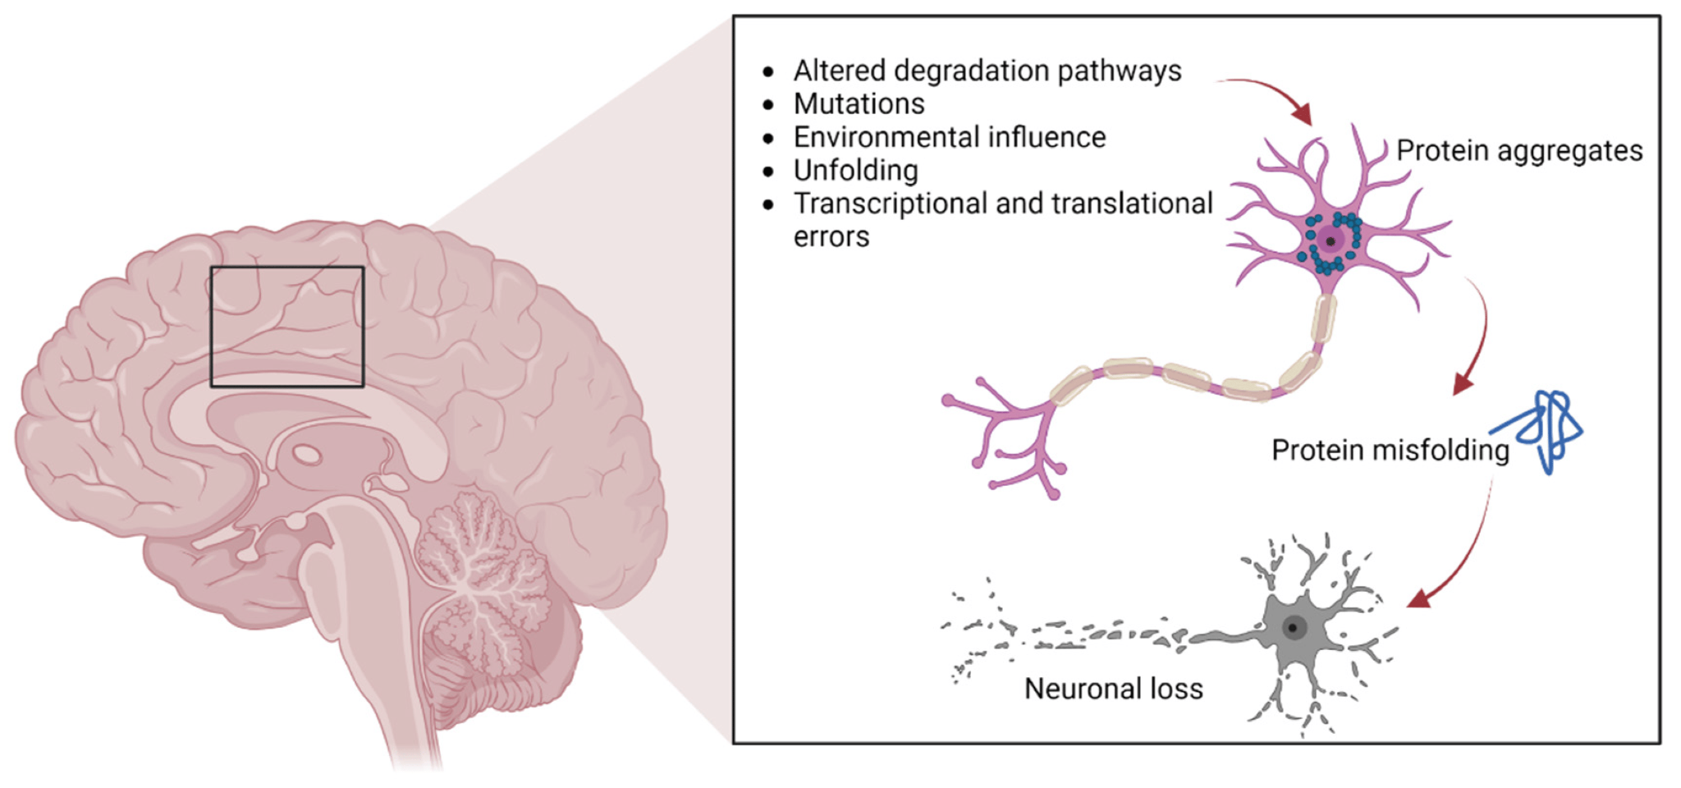
Protein Aggregation
Cardinal features of FTLD is protein misfolding and aggregation
Protein aggregates
Tau
TDP-43 (Transactive response DNA-binding protein 43)
FUS (Fused in Sarcoma)
Duranti, E., & Villa, C. (2023). Molecular Investigations of Protein Aggregation in the Pathogenesis of Amyotrophic Lateral Sclerosis. International Journal of Molecular Sciences, 24(1), 704. https://doi.org/10.3390/ijms24010704
Notes:
Image: (https://www.mdpi.com/1422-0067/24/1/704)
Protein aggregation occurs when there is altered degradation pathways, mutations, transcriptional or translational errors or environmental stressors. These aggregrates can cause protein misfolding and disruption of cellular communication.
The cardinal pathophysiological feature of patients with FTLD is protein misfolding and aggregation. (NEXT SLIDE)

Slide 9
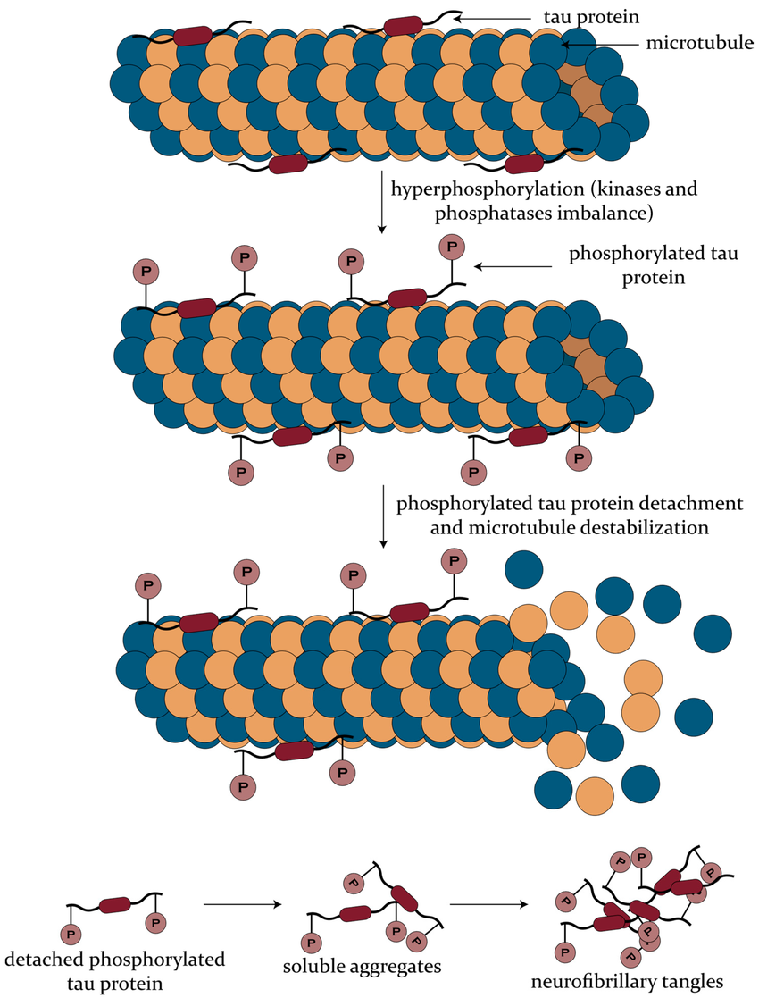
Steps of Tau Aggregation
Imbalance of phosphatases and kinases leading to hyperphosphorylation
Tau phosphorylation leads to detachment from microtubules
Phosphorylation causes tau conformational changes
Concomitant impaired proteolysis and lysosomal breakdown
Leads to soluble aggregation and tangles
DOI:10.3390/biomedicines8100421
Šimić, G., Babić Leko, M., Wray, S., Harrington, C., Delalle, I., Jovanov-Milošević, N., Bažadona, D., Buée, L., De Silva, R., Di Giovanni, G., Wischik, C., & Hof, P. R. (2016). Tau Protein Hyperphosphorylation and Aggregation in Alzheimer’s Disease and Other Tauopathies, and Possible Neuroprotective Strategies. Biomolecules, 6(1), 6. https://doi.org/10.3390/biom6010006
Notes:
Image: (https://www.mdpi.com/2218-273X/6/1/6)
Let us take a closer look at TAU protein aggregation. The tau protein plays an important role in microtubule stabilization. When Tau undergoes phosphorylation microtubule integrity decreases due to the the tau’s reduced ability to connect to the framework. Once tau protein becomes phosphorylated it can become more apt to develop oligomers that lead to aggregation to neurofibrillary tangles.
The breakdown of microtubular structure disrupts various cellular processes (i.e. cellular signaling pathways, organelle transports ultimately lead to cell death.
There are multiple targets of interests for potential therapeutic intervention in this process including looking at inhibition of tau phosphorylation, as well as looking at inhibition of tau aggregation (NEXT SLIDE)

Slide 10
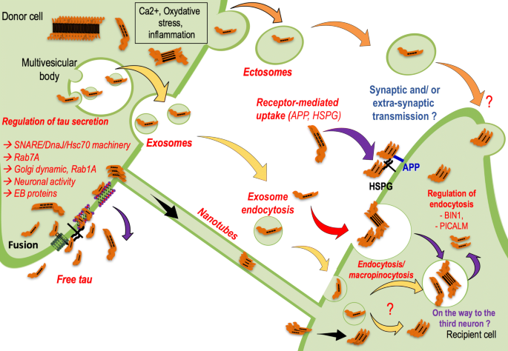
Fate of Cytoplasmic Tau Aggregates
Tau can be secreted via:
exosome vesicles
Ectosome vesicles
Endolysosomes
direct binding to the plasma membrane
Tau can directly transfer to neighboring cells through nanotubes
Amro, Z., Yool, A.J., & Collins-Praino, L.E. (2021). The potential role of glial cells in driving the prion-like transcellular propagation of tau in tauopathies. Brain, Behavior, & Immunity - Health, 14.
Colin, M., Dujardin, S., Schraen-Maschke, S. et al. From the prion-like propagation hypothesis to therapeutic strategies of anti-tau immunotherapy. Acta Neuropathol 139, 3–25 (2020). https://doi.org/10.1007/s00401-019-02087-9
Notes:
Cytoplasmic tau- untethered from microtubles can propagate to neighboring cells via secretary pathways such as being packaged into exosome vesicles within MVBs for secretion through the plasma membrane. (2) Tau can be packaged and secreted into the extracellular space via larger vesicles known as ectosomes that form at the plasma membrane and can be taken up by neighbouring cells via endocytosis. (3) Free tau can be released into the extracellular space in a vesicle free form after being packaged into endo-lysosomes and released at the plasma membrane. (5) Tau can be secreted directly through the plasma membrane by binding to PI(4,5)P2 on the cytosolic side of the membrane, altering membrane integrity and being captured by HSPGs on the extracellular side before secretion. (6) A direct transfer of tau from the secreting cell to the neighbouring cell can occur via tunnelling nanotubules connecting the cytoplasm of the two cells, bypassing the extracellular space. Tau released within the extracellular space can be taken up by recipient neighbouring cells.
Cite: Amro, Z., Yool, A.J., & Collins-Praino, L.E. (2021). The potential role of glial cells in driving the prion-like transcellular propagation of tau in tauopathies. Brain, Behavior, & Immunity - Health, 14.
Colin, M., Dujardin, S., Schraen-Maschke, S. et al. From the prion-like propagation hypothesis to therapeutic strategies of anti-tau immunotherapy. Acta Neuropathol 139, 3–25 (2020). https://doi.org/10.1007/s00401-019-02087-9

Slide 11
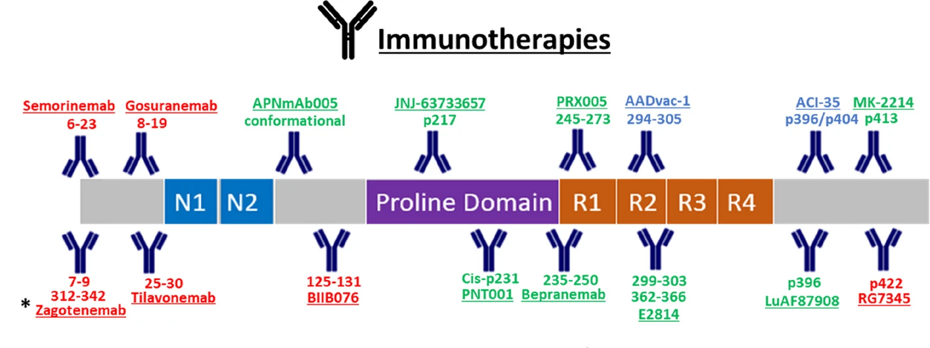
Active and Passive Immunotherapies
Penny, L.K., Lofthouse, R., Arastoo, M. et al. Considerations for biomarker strategies in clinical trials investigating tau-targeting therapeutics for Alzheimer’s disease. Transl Neurodegener 13, 25 (2024). https://doi.org/10.1186/s40035-024-00417-w
Notes:
Promotion of Tau Clearance has been investigated through the trials of multiple immunotherapie.
Some immunotherapies trials have been discontinued with the wording in red, while passive and active immunotherapies that are in development are shown in green and blue, respectively

Slide 12
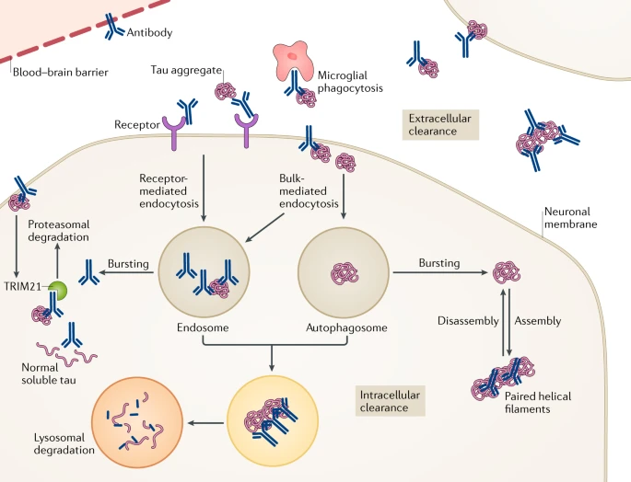
Mechanics of Immunotherapy
-Antibodies can target tau both intracellularly and extracellularly
Congdon, E.E., Sigurdsson, E.M. Tau-targeting therapies for Alzheimer disease. Nat Rev Neurol 14, 399–415 (2018). https://doi.org/10.1038/s41582-018-0013-z
Notes:
Antibodies can target tau both extracellularly and intracellularly. Pathological tau mostly resides within neurons. A much smaller pool of tau aggregates is found extracellularly in the form of small aggregates that are not easily detected or as remnants of neurofibrillary tangles following the death of the neuron. Some anti-tau antibodies are not readily taken up into neurons, presumably because of their unfavourable charge; therefore, they work principally in the extracellular compartment. Within this compartment, antibodies might sequester tau aggregates, interfere with their assembly and promote microglial phagocytosis, with the overall effect of blocking the spread of tau pathology between neurons. Other antibodies are easily detected within neurons, in association with tau, and have been shown to work both intracellularly and extracellularly. Within the cells, these antibodies could bind to tau aggregates within the endosomal–lysosomal system and promote their disassembly, leading to enhanced access of lysosomal enzymes to degrade the aggregates, to sequester tau assemblies in the cytosol and to prevent their release from the neuron, or to promote proteasomal degradation via E3 ubiquitin–protein ligase TRIM21 binding. The most efficacious antibodies are likely to target more than one pathway and/or pool of tau.

Slide 13
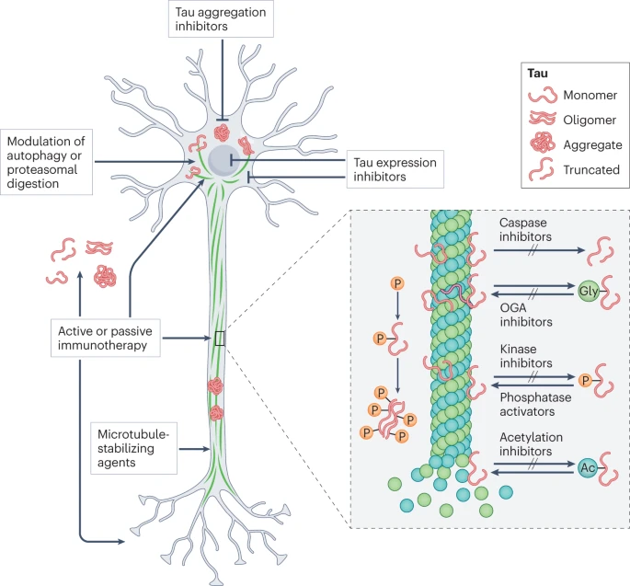
Tau Molecular Targets
Kinases:
GSK-3𝛃 PKA MAPK PKC Cdc2 Cdk5
Proteases:
Caspase
Calpain
Cathepsin
Thrombin-like protease
Phosphatase:
PP2A
Notes:
The therapeutic benefit of developing kinase inhibitors is that

Slide 14
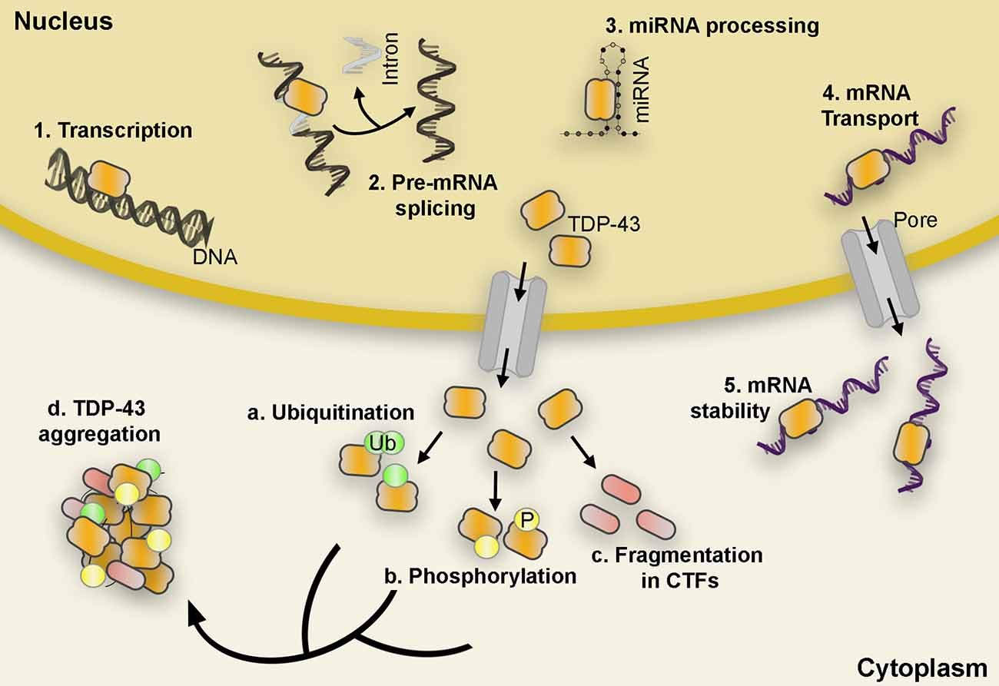
Steps of TDP-43 Aggregation
Chronic stress, neuroinflammation, and degenerative diseases leads to increased cytoplasmic mislocalization of TDP-43
Cytoplasmic TDP-43 undergoes fragmentation, phosphorylation , ubiquitination
Post-translational changes causes protein aggregation
Mena, L., Scarim-Lopez, J. et al. TDP-43 and ER Stress in neurodegeneration:friends or foe. Another protein aggregate that can be seen in FTD is TDP-43. Front. Mol. Neurosci., 24 October 2021 Sec. Molecular Signalling and Pathways Volume 14 - 2021 https://doi.org/10.3389/fnmol.2021.772226
Notes:
Citation: Mena, L., Scarim-Lopez, J. et al. TDP-43 and ER Stress in neurodegeneration:frineds or foe.
Another protein aggregate that can be seen in FTD is TDP-43. Front. Mol. Neurosci., 24 October 2021
Sec. Molecular Signalling and Pathways Volume 14 - 2021 | https://doi.org/10.3389/fnmol.2021.772226
TDP-43 carries out a variety of functions such as initiation of transcription, pre-mRNA splicing, miRNA processing, mRNA transport, and mRNA stability (1–5). However, in pathological conditions, TDP-43 is depleted from the nucleus and accumulates in the cytoplasm in hyperphosphorylated, ubiquitinated, and cleaved (CTFs) forms found in the abnormal protein aggregates characteristic of ALS and FTLD
Cite: (https://www.nature.com/articles/s12276-020-00513-7#:~:text=However%2C%20under%20stress%20conditions%20such,%2C47%2C48%2C49.)
tegies that prevent TDP-43 misfolding and/or enhance clearance of pathological TDP-43 have the potential to prevent RNA processing deficits and pathogenesis in the majority of ALS cases. P = phosphorylation; Ub₄ = tetra-ubiquitin chain

Slide 15
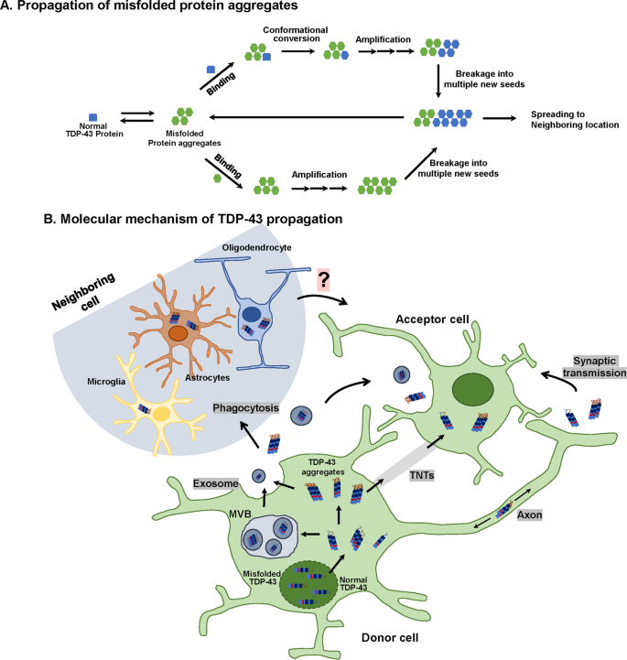
Fate of Cytoplasmic TDP-43 Aggregates
TDP-43 can be secreted via:
exosome vesicles
Ectosome vesicles
Endolysosomes
direct binding to the plasma membrane
TDP-43 can directly transfer to neighboring cells through nanotubes
Jo, M., Lee, S., Jeon, YM. et al. The role of TDP-43 propagation in neurodegenerative diseases: integrating insights from clinical and experimental studies. Exp Mol Med 52, 1652–1662 (2
020). https://doi.org/10.1038/s12276-020-00513-7
Notes:
Similar to the propagation of Tau
Putative mechanism of cell-to-cell spreading of TDP-43 aggregates. TDP-43 aggregates may propagate via exosomes (release from multivesicular bodies (MVBs)), tunneling nanotubes (TNTs), or synaptic transmission (transport from presynaptic to postsynaptic terminals) from donor cells to acceptor cells. Moreover, glial cells (oligodendrocytes, astrocytes, and microglia) can take up TDP-43 aggregates through phagocytosis, after which misfolded TDP-43 is released from glial cells and transmitted to neurons and neighboring glial cells. The neuron-to-glia or glia-to-neuron transfer of TDP-43 has been observed, but its propagation mechanism is not clear.

Slide 16
TDP-43 Molecular Targets
Autophagy Induction:
mTOR Inhibitors
Src/c-Abl inhibitors
Stress Granule Modulator:
ATXN2 Antisense oligonucleotides
Kinase Inhibitors:
GSK-3𝜷
PKC
Cdc7
Notes:
Hayes LR, Kalab P. Emerging Therapies and Novel Targets for TDP-43 Proteinopathy in ALS/FTD. Neurotherapeutics. 2022 Jul;19(4):1061-1084. doi: 10.1007/s13311-022-01260-5. Epub 2022 Jul 5. PMID: 35790708; PMCID: PMC9587158.

Slide 17
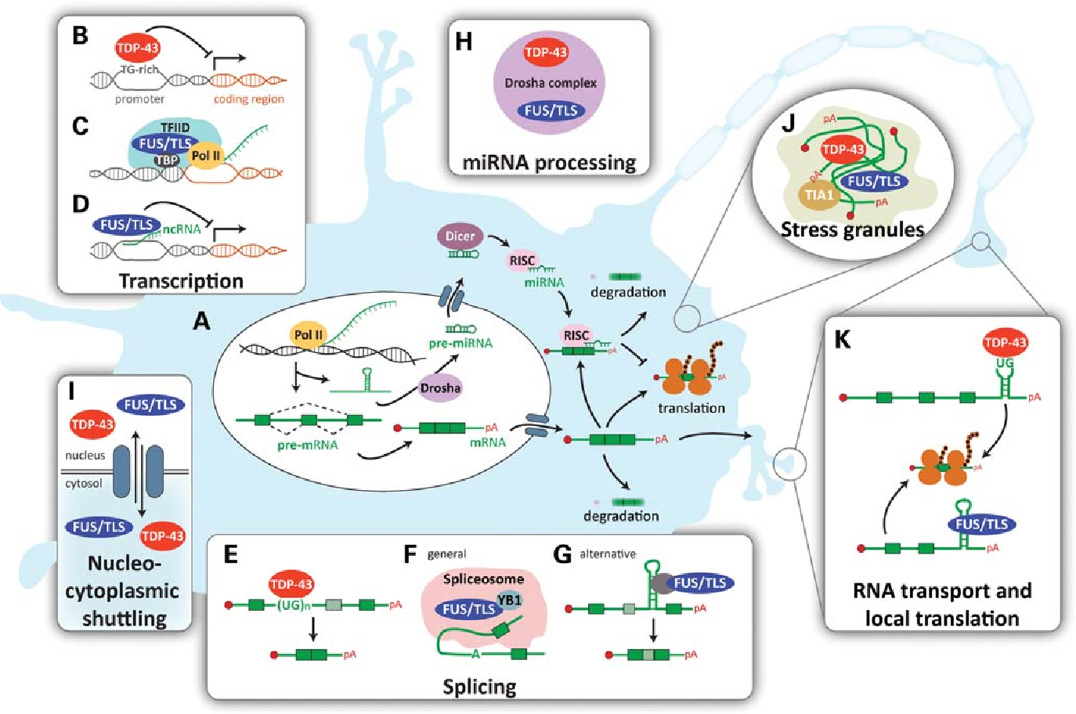
Molecular Targets for FUS Aggregation
FUS
RNA binding protein
Primarily in nucleus
Aggregation occurs similarly to what is seen with TDP-43
Potential Molecular Targets
Histone acetylases
Histone deacetylases
Chen, C., Ding, X., Akram, N., Xue, S., & Luo, S.-Z. (2019). Fused in Sarcoma: Properties, Self-Assembly and Correlation with Neurodegenerative Diseases. Molecules, 24(8), 1622. https://doi.org/10.3390/molecules24081622
Notes:
Image source: https://www.mdpi.com/1420-3049/24/8/1622
FUS in another RNA binding protein that shuttles to and from the cell nucleus however in pathological conditions there becomes an accumulation of irreversible FUS protein aggregates that lead to cellular degeneration via apoptosis.
The molecular targets of interest are the histone acetylases and histone deacetylases: the exact relationship between HDACs and FUS is not yet clear. Historically the main function of HATs and HDACs is to modulate epigenetic on/off chromatin states controlling transcription. However, they can also reversibly acetylate/deacetylate other proteins as a direct post-translational modification. There are both nuclear and cytoplasmic versions of these proteins with inhibition of nuclear HDAC stopping the export of nuclear FUS to the cytoplasm

Slide 18
Pathophysiology
Protein Aggregation
Neuroinflammatory Process
Neuroinflammatory Process
Protein Aggregation
Genetic Mutations
Genetic Mutations
Notes:
Now moving on to neuroinflammatory process.

Slide 19
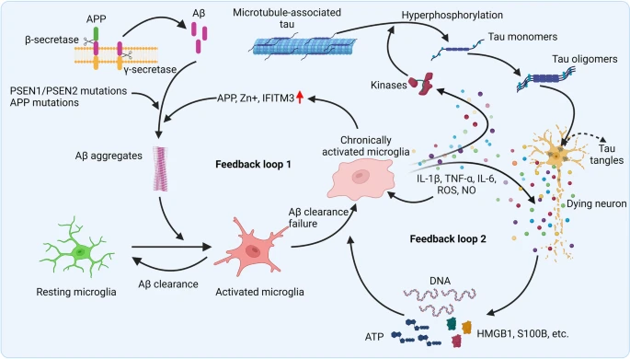
Pathophysiology
Neuroinflammatory Process
Neuroinflammation feedback loop
Not only caused by neurodegeneration but also a crucial player in the process
Zhang, W., Xiao, D., Mao, Q. et al. Role of neuroinflammation in neurodegeneration development. Sig Transduct Target Ther 8, 267 (2023). https://doi.org/10.1038/s41392-023-01486-5
Notes:
Image source: https://www.nature.com/articles/s41392-023-01486-5
-Studies in neurodegenerative diseases, including Alzheimer’s disease, Parkinson’s disease and Amyotrophic lateral sclerosis, Huntington’s disease, and so on, have suggested that inflammation is not only a result of neurodegeneration but also a crucial player in this process.
-In most cases, the immune response is beneficial and self-limited, and it is resolved once the tissue injury has been repaired or the infection has been eliminated. But in some cases, due to the failure to clear an inflammatory stimulus, normal resolution mechanisms become overwhelmed, resulting in chronic inflammation that may lead to the release of neurotoxic factors and exacerbated disease. A persistent stimulus may be caused by endogenous factors (e.g., protein aggregates),^{14,20} environmental factors (e.g., systematic infection, gut commensal dysbiosis, aging, diet),^{21,22,23} and genetic susceptibility (e.g., progranulin (PGRN) mutations, apolipoprotein E4 (APOE4) mutations). These chronic feedback loops can be seen in multiple neurodegegenetive diseases such as Alzheimer’s disease (NEXT SLIDE)
(https://www.nature.com/articles/s41392-023-01486-5)
Molecular Targets
TREM2: an immune regulatory receptor mainly expressed in myeloid cells. TREM2 is exclusively expressed in immune cells (https://www.nature.com/articles/s41392-023-01486-5)
SiGr agonists (https://www.mdpi.com/2218-273X/12/3/363)

Slide 20
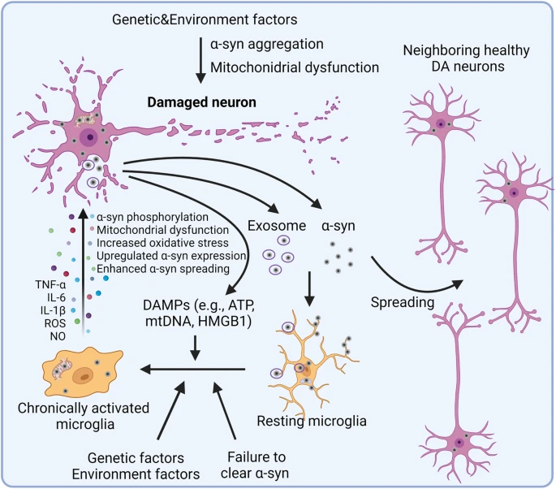
Pathophysiology
Neuroinflammatory Process
Neuroinflammation feedback loop
Not only caused by neurodegeneration but also a crucial player in the process
Zhang, W., Xiao, D., Mao, Q. et al. Role of neuroinflammation in neurodegeneration development. Sig Transduct Target Ther 8, 267 (2023). https://doi.org/10.1038/s41392-023-01486-5
Notes:
Alpha-synucleinopathies such as with Parkinson’s disease (NEXT Slide)
Molecular Targets
TREM2: an immune regulatory receptor mainly expressed in myeloid cells. TREM2 is exclusively expressed in immune cells (https://www.nature.com/articles/s41392-023-01486-5)
SiGr agonists (https://www.mdpi.com/2218-273X/12/3/363)

Slide 21
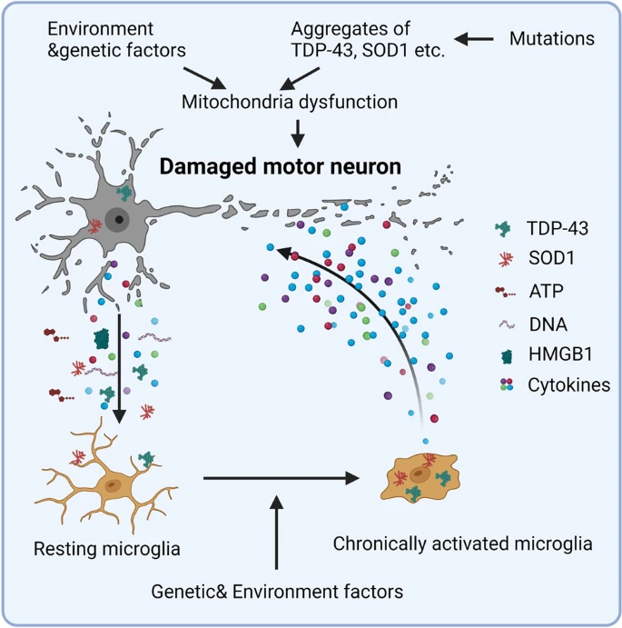
Pathophysiology
Neuroinflammatory Process
Neuroinflammation feedback loop
Not only caused by neurodegeneration but also a crucial player in the process
Zhang, W., Xiao, D., Mao, Q. et al. Role of neuroinflammation in neurodegeneration development. Sig Transduct Target Ther 8, 267 (2023). https://doi.org/10.1038/s41392-023-01486-5
Notes:
And in FTD-ALS spectrum (NEXT SLIDE)
(https://www.nature.com/articles/s41392-023-01486-5)
Molecular Targets
TREM2: an immune regulatory receptor mainly expressed in myeloid cells. TREM2 is exclusively expressed in immune cells (https://www.nature.com/articles/s41392-023-01486-5)
SiGr agonists (https://www.mdpi.com/2218-273X/12/3/363)

Slide 22
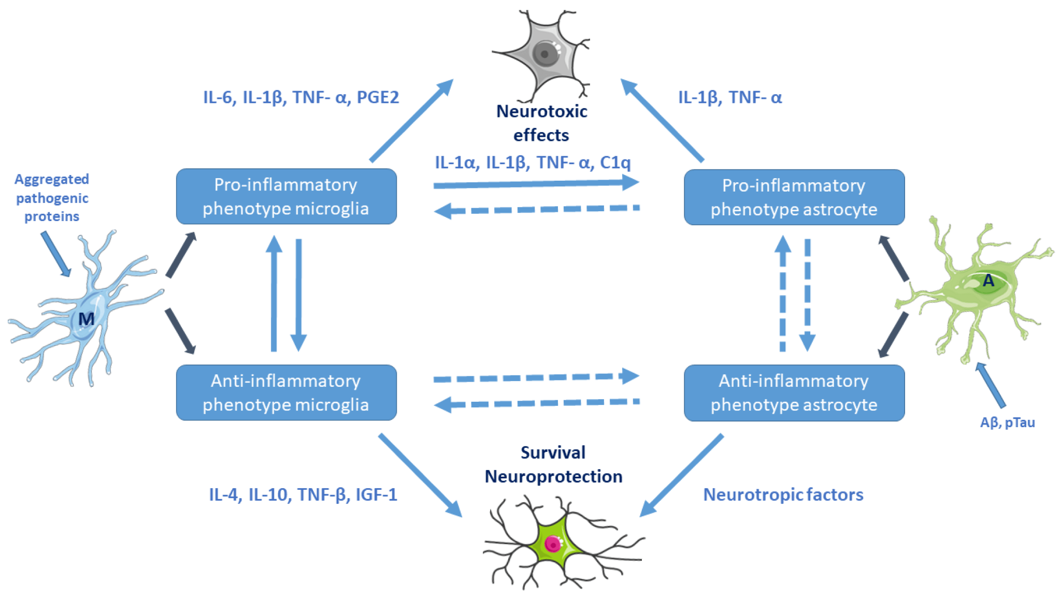
Molecular Targets
Myeloperoxidase
Cell types: neutrophils, monocytes, macrophages, glial cells
P38𝞪 MAPK
Cell Type: Found in nucleus and cytoplasm in most cell types
Progranulin/Prosaposin Stabilizer
Cell Types: multiple cell types in both CNS and peripheral tissue
Notes:
Understanding the detrimental effects of pathologic activation of glial cells have led to therapeutic interests in inhibiting the enzymatic processes that can contribute to the release of reactive oxygen species
Drug Name: Verdiperstat inhibits myeloperoxidase,

Slide 23
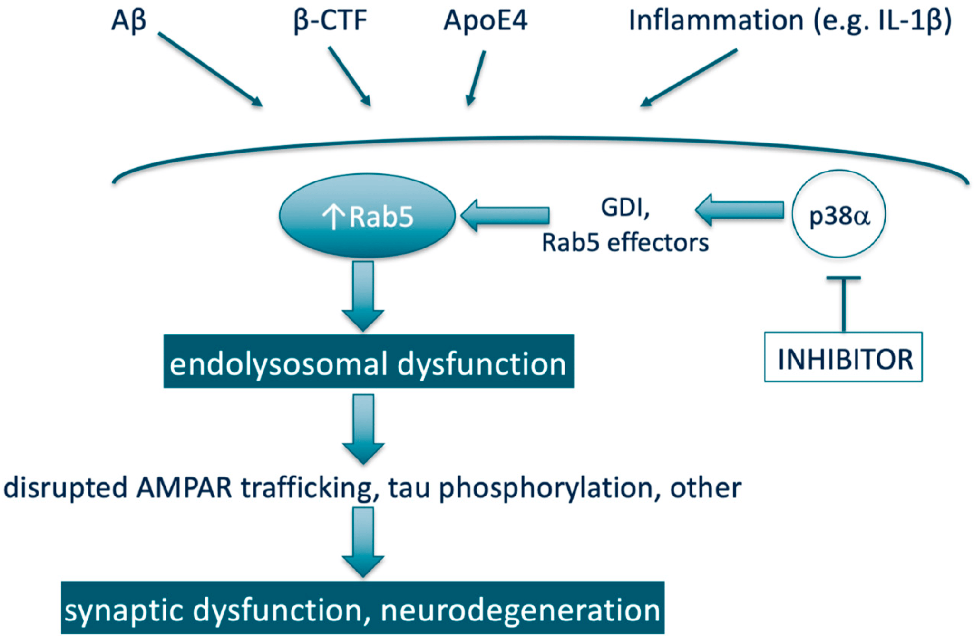
Neuroinflammatory Process
P38𝞪 MAPK
P38(alpha) MAPK signaling that has downstream effects of activating RAB5.
Rab 5, a GTPase, regulates endosomal trafficking
Increased Rab 5 activity leads to increased endosomal enlargement
Slows transportation, inducing cholinergic atrophy and tau hyperphosphorylation
Germann, U. A., & Alam, J. J. (2020). P38α MAPK Signaling—A Robust Therapeutic Target for Rab5-Mediated Neurodegenerative Disease. International Journal of Molecular Sciences, 21(15), 5485. https://doi.org/10.3390/ijms21155485
Notes:
Neflamipod has become of interest because
A part of CNS degeneration is regulated P38(alpha) MAPK signaling that has downstream effects of activating RAB5.
Rab 5, a GTPase, regulates endosomal trafficking
Increased Rab 5 activity leads to increased endosomal enlargement
Slows transportation, inducing cholinergic atrophy and tau hyperphosphorlation
Pathogenic Rab5 activity has been extensively been looked at for synaptic functioning for neurodegenerative diseases such as Alzheimer’s disease but it is also emerging in many other neurodegenerative diseases such as PD, DLB, ALS, FTLD, and HD (https://www.mdpi.com/1422-0067/21/15/5485)
(NEXT SLIDE)

Slide 24
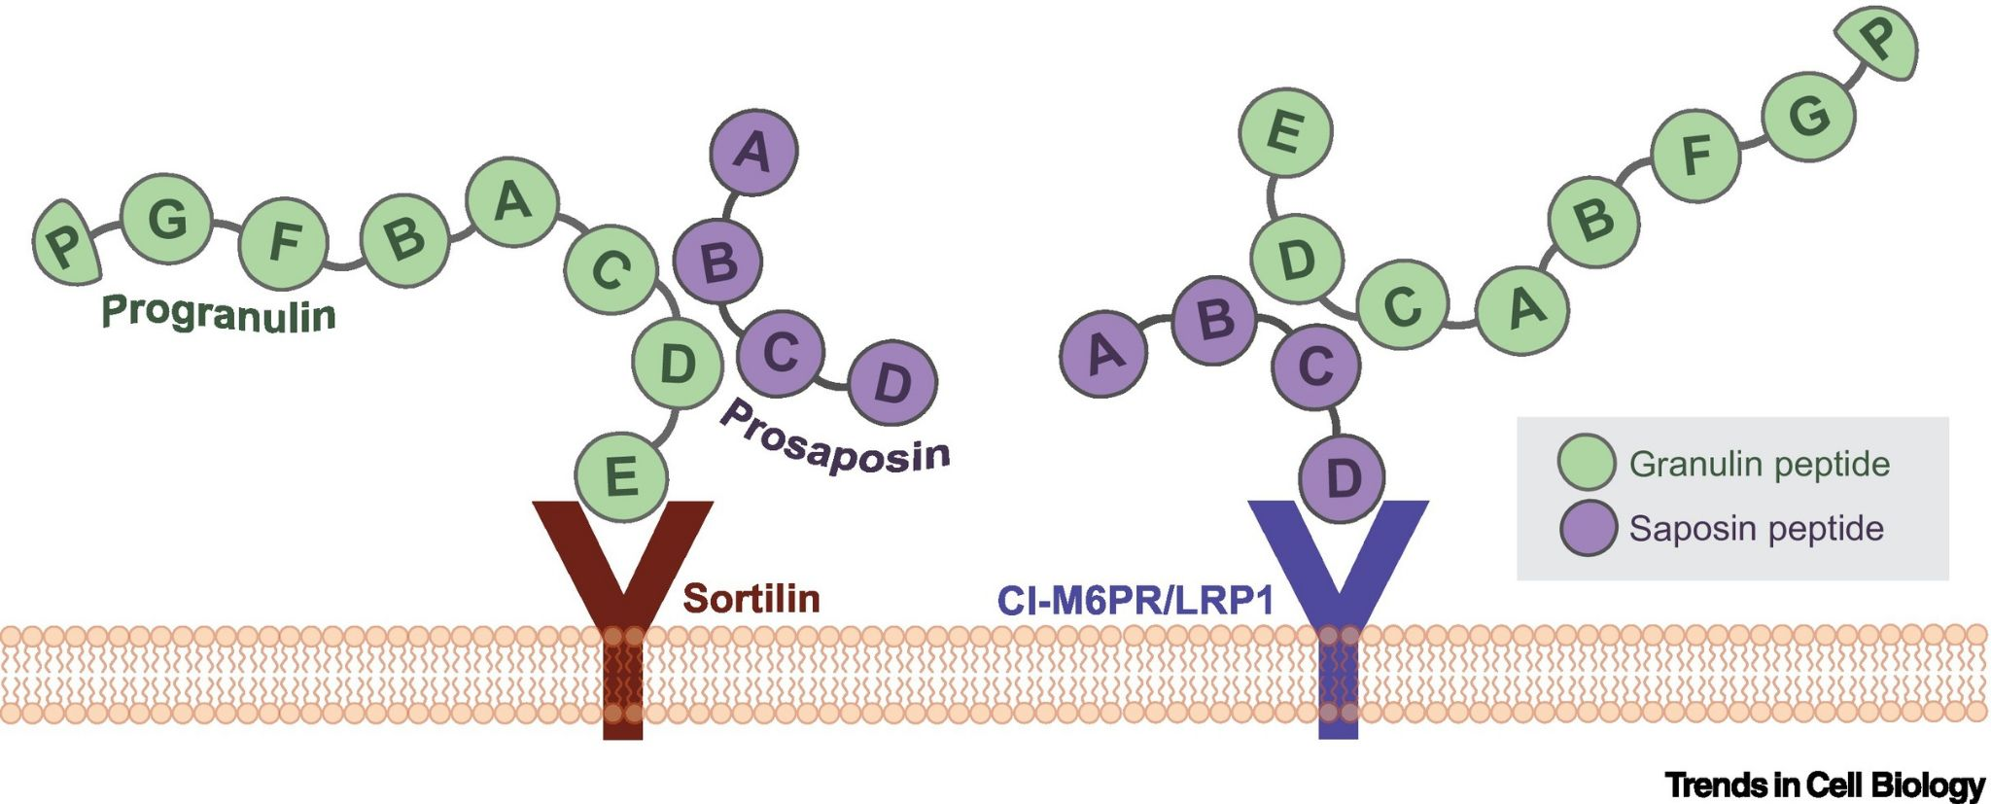
Progranulin
Notes:
Image source: https://www.biomol.com/resources/biomol-blog/progranulin-marker-of-neuroinflammation
In the brain, PGRN is primarily expressed in mature neurons and microglia. Absence of progranulin in microglia causes increased production and release of multiple cytokines, suggesting that PGRN regulates microglia activation. PGRN seems to affect microglial proliferation, recruitment, differentiation, activation and phagocytosis, suggesting that PGRN plays a central role in the regulation of neuroinflammatory responses.
In neurons, PGRN i) co-localizes in late endosomes and early lysosomes with the transmembrane protein TMEM106B, ii) co-localizes with markers such as BDNF along axons, iii) influences synaptic structure and function at synaptic and extra-synaptic sites, where it is secreted in an activity-dependent manner, and iv) extracellular PGRN is endocytosed and delivered to lysosomes. The lysosomal function of PGRN is not well characterized, but probably involves regulation of proteins such as cathepsins, glucocerebrosidase (GBA) or TMEM106B and likely contributes to neurodegeneration.

Slide 25
Pathophysiology
Protein Aggregation
Neuroinflammatory Process
Neuroinflammatory Process
Protein Aggregation
Genetic Mutations
Genetic Mutations
Notes:
Though we discussed about neuroinflammation as a stand alone factors driving neurodegeneration in fronto-temporal lobe dementia there are also genetic mutations that have been identified as inflammation-associated FTD genes. (NEXT SLIDE)
Grn
C9orf72
TBK1
TREM2
Drug therapies
-AVB: gene therapy for those with mutation of GRN so that a functioning copy of GRN is introduced into the system effectively restoring the production of progranulin protein and halting disease progression in affected individuals. (Currently undergoing phase ½ trials in US and Europe to assess for safety)

Slide 26
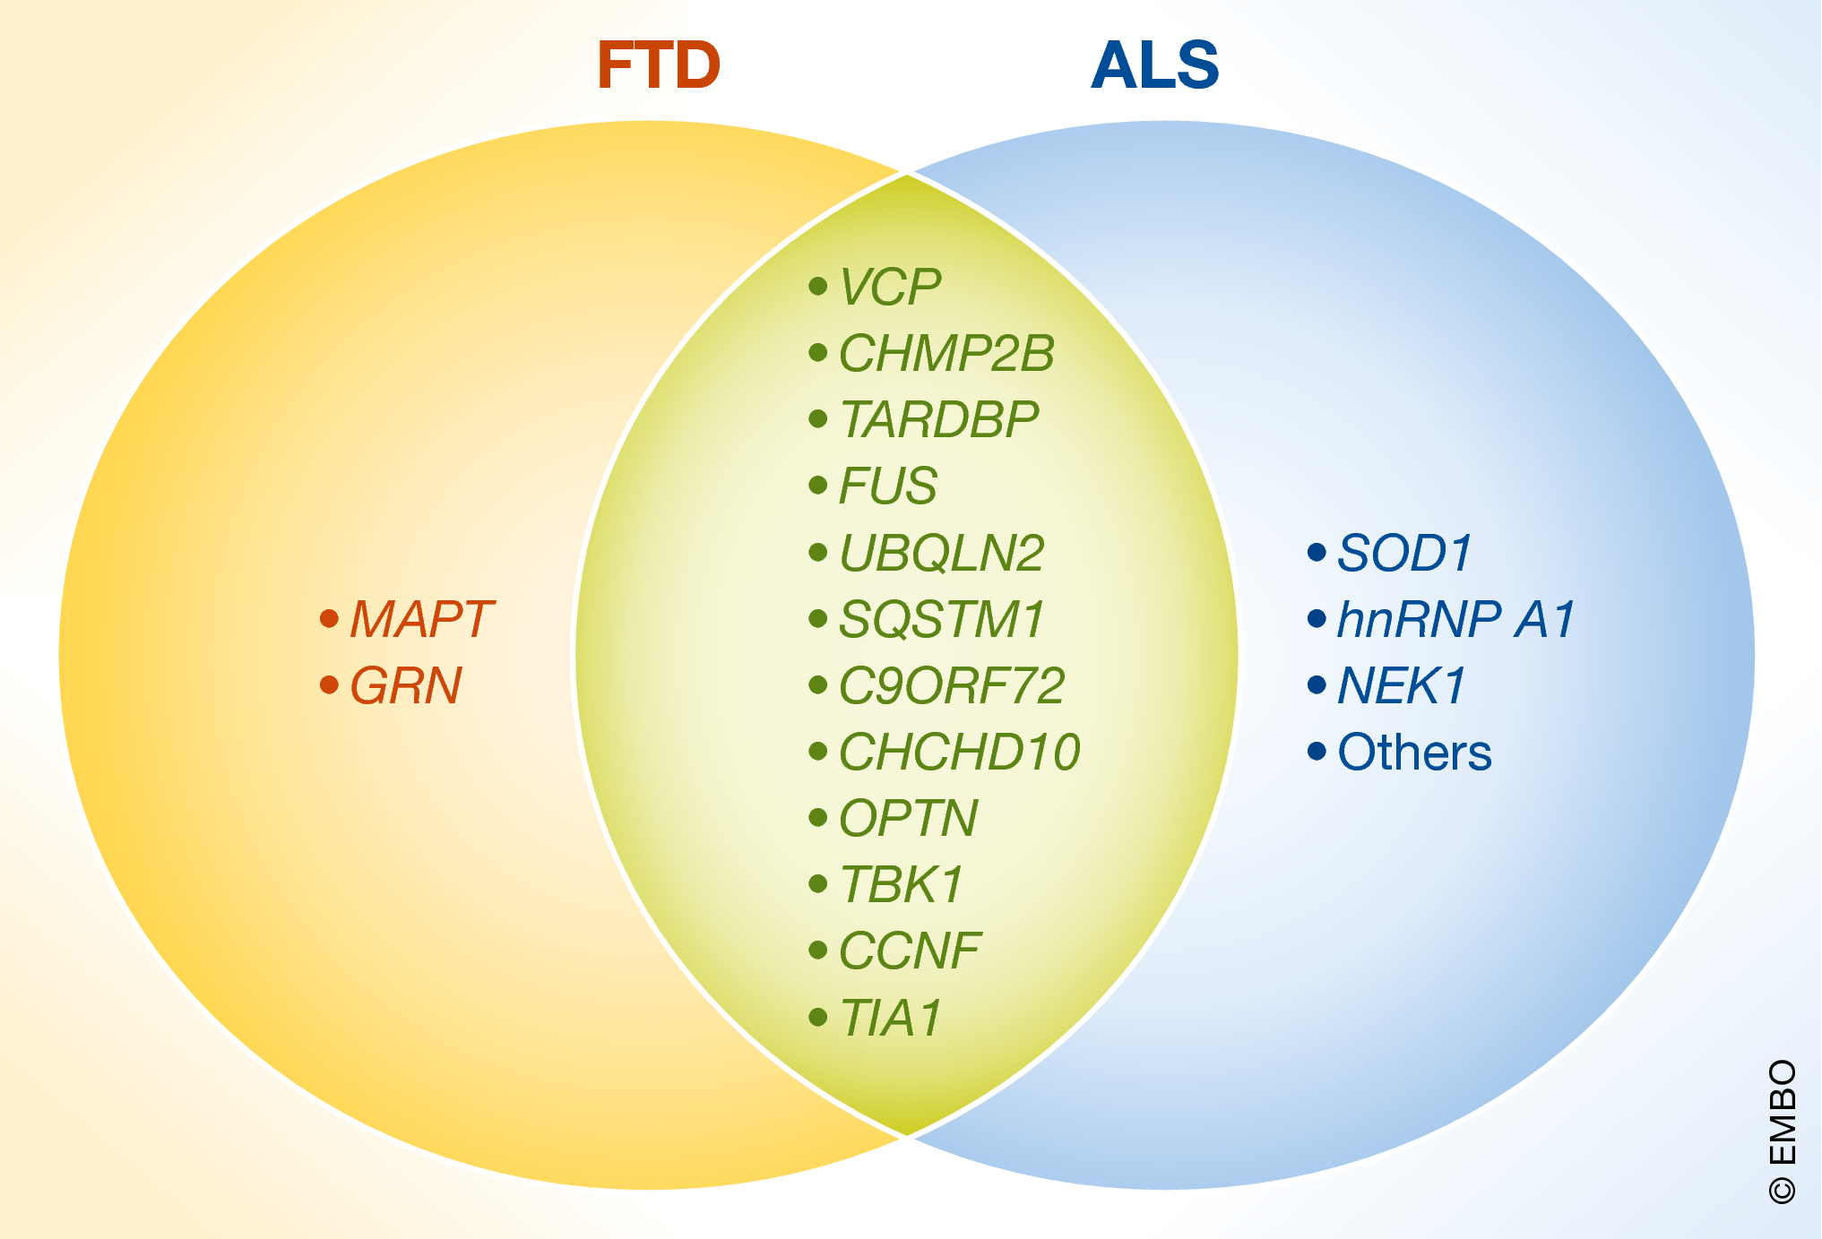
Genetic Mutations
FTD Genes:
GRN
Codes for progranulin
Regulates lysosomal function, neuronal survival, and inflammation
C9orf72
Regulatory gene for RNA processes
MAPT
Codes for tau protein
Helps assemble and stabilize microtubules
Identifying and Diagnosing TDP-43 Neurodegenerative Diseases in Psychiatry Ducharme, Simon et al. The American Journal of Geriatric Psychiatry, Volume 32, Issue 1, 98 - 113
Notes:
There are over a dozen identified gene mutations that have been seen with FTLD However the most common gene mutations are GRN, C9orf72, and MAPT (NEXT Slide)
Information regarding inflammation-associated FTD genes (https://www.nature.com/articles/s41582-019-0231-z)
C9orf72 gene codes for a protein that functions in control of endothelin and glutamate signaling (https://pmc.ncbi.nlm.nih.gov/articles/PMC6206455/#:~:text=MCB.00155%2D18-,The%20C9ORF72%20Gene%2C%20Implicated%20in%20Amyotrophic%20Lateral%20Sclerosis%20and%20Frontotemporal,of%20Endothelin%20and%20Glutamate%20Signaling)
Gene therapies
Current trials
AVB-101 An investigational gene therapy developed by AviadoBio that uses AAV technology to deliver a non-mutated copy of the GRN gene. The FDA has granted Fast Track designation to AVB-101.
PBFT02 An investigational gene therapy developed by Passage Bio that uses AAV1 technology to deliver a non-mutated copy of the GRN gene. The FDA granted orphan drug designation to PBFT02.
PR006 An investigational drug developed by Prevail Therapeutics that is being tested in a clinical trial at UZ Leuven.

Slide 27
Genetic Mutations
FTD Genes:
GRN
Codes for progranulin
Regulates lysosomal function, neuronal survival, and inflammation
C9orf72
Regulatory gene for RNA processes
MAPT
Codes for tau protein
Helps assemble and stabilize microtubules
Identifying and Diagnosing TDP-43 Neurodegenerative Diseases in Psychiatry Ducharme, Simon et al. The American Journal of Geriatric Psychiatry, Volume 32, Issue 1, 98 - 113
Notes:
There are over a dozen identified gene mutations that have been seen with FTLD However the most common gene mutations are GRN, C9orf72, and MAPT (NEXT Slide)
Information regarding inflammation-associated FTD genes (https://www.nature.com/articles/s41582-019-0231-z)
C9orf72 gene codes for a protein that functions in control of endothelin and glutamate signaling (https://pmc.ncbi.nlm.nih.gov/articles/PMC6206455/#:~:text=MCB.00155%2D18-,The%20C9ORF72%20Gene%2C%20Implicated%20in%20Amyotrophic%20Lateral%20Sclerosis%20and%20Frontotemporal,of%20Endothelin%20and%20Glutamate%20Signaling)
Gene therapies
Current trials
AVB-101 An investigational gene therapy developed by AviadoBio that uses AAV technology to deliver a non-mutated copy of the GRN gene. The FDA has granted Fast Track designation to AVB-101.
PBFT02 An investigational gene therapy developed by Passage Bio that uses AAV1 technology to deliver a non-mutated copy of the GRN gene. The FDA granted orphan drug designation to PBFT02.
PR006 An investigational drug developed by Prevail Therapeutics that is being tested in a clinical trial at UZ Leuven.

Slide 28
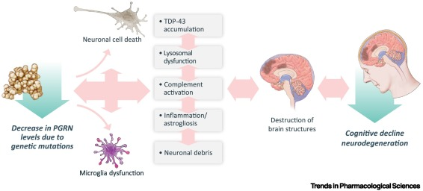
Genetic Mutations
GRN Gene Mutation:
GRN
Potential Therapeutics
Receptor Interactions:
Sortilin
M6P/PSAP
EphA2
LRP1
Notch
EGFR
Herve Rhinn, Nadine Tatton, Stella McCaughey, Michael Kurnellas, Arnon Rosenthal,Progranulin as a therapeutic target in neurodegenerative diseases, Trends in Pharmacological Sciences,Volume 43, Issue 8,2022,Pages 641-652,ISSN 165-6147,https://doi.org/10.1016/j.tips.2021.11.015.
Notes:
Lets look closer at GRN mutation which codes for progranulin.
Progranulin (PGRN) under healthy conditions has roles in homeostasis, lysosomal function, neuroprotection, and microglial regulation. PGRN interacts with multiple receptors to carry out these activities, but its actual mechanism of action and signaling cascades are poorly understood.
Mutations resulting in loss of function or single-nucleotide polymorphisms may cause a reduction in PGRN levels, with implications including (TDP-43) pathology, abnormal microglial activation, neuroinflammation, neuronal loss, synaptic pruning, and lysosomal dysfunction. (NEXT SLIDE)

Slide 29
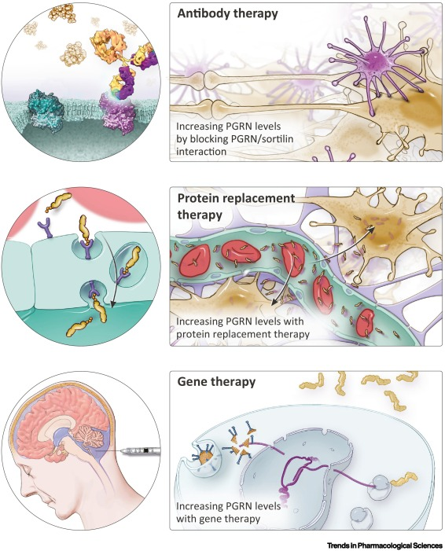
GRN Gene Mutation
Molecular Targets and Potential Therapies
Sortilin
Latozinomab (AL001)
Monoclonal antibody
Blocks sortilin/progranulin interaction
Progranulin
DNL593 (PTV:PGRN)
Protein replacement therapy
Gene Therapy
PR006
Adeno-associated virus
Herve Rhinn, Nadine Tatton, Stella McCaughey, Michael Kurnellas, Arnon Rosenthal,Progranulin as a therapeutic target in neurodegenerative diseases, Trends in Pharmacological Sciences,Volume 43, Issue 8,2022,Pages 641-652,ISSN 165-6147,https://doi.org/10.1016/j.tips.2021.11.015.
Notes:
Multiple therapeutic targets are under investigation to increase progranulin levels.
The sortilin receptor has been identified as the major regulator of PGRN levels in plasma and the brain.
Latizinomab is a monoclonal antibody therapy that blocks the sortilin degradation pathway of progranulin (PGRN) to increase PGRN levels.
Protein replacement therapy uses technology to increase blood–brain barrier transport to get PGRN into the central nervous system (CNS).
Gene therapy utilizes viral vectors injected into the cisterna magna to restore PGRN levels in the CNS.

Slide 30
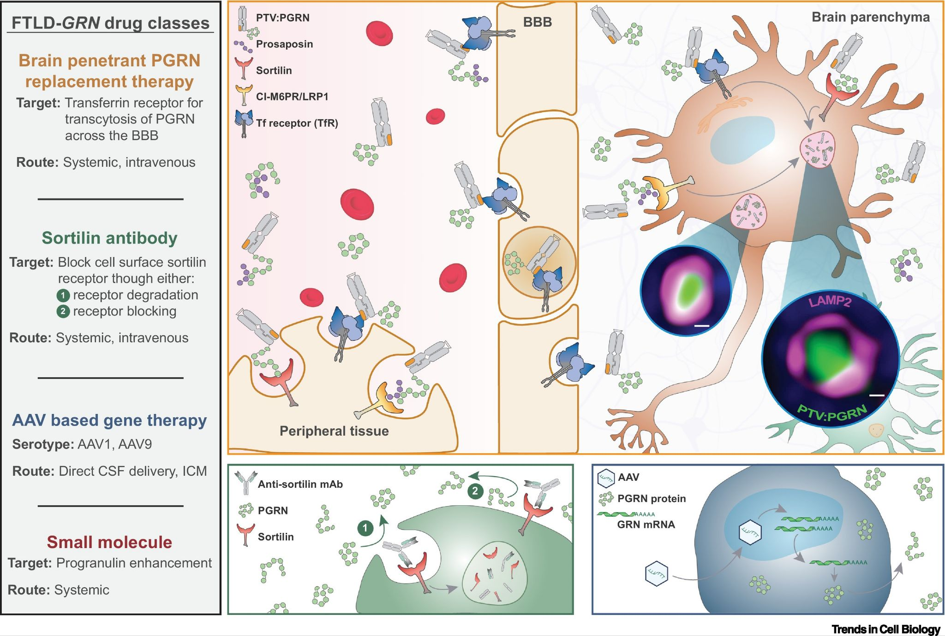
Notes:
Image: https://www.cell.com/trends/cell-biology/fulltext/S0962-8924%2822%2900216-1

Slide 31
Summary
Pathophysiology behind Frontotemporal Degeneration is variable.
Therapeutic Interests
-Protein aggregation: Kinase inhibitors, deacetylases, mTOR inhibitors, protease inhibitors
-Neuroinflammation: P38𝞪 MAPK inhibitor, prosaposin/progranulin stabilizer
-Gene mutations: gene replacement therapy, monoclonal antibodies, protein replacement therapy
Notes:
Frontotemporal degeneration is a rare neurological disease with heterogeneity not only in its clinical presentation but also its pathological processes.
Given this heterogeneity developing therapeutic agents and under going clinical trials is difficult however despite the diversity of the pathological processes there has been some commonality in regards to protein agggregration, neuroinflammatory process, and genetic mutation.
In regards to Protein aggregation : Molecular targets for protein aggregation have been kinase inhibitors and acetylases that can lead to protein hyperphosphorylation and increased protein aggregation.
In regards to neuroinflammatory processes key targets have been lysosomal proteins, myeloperoxidase, and cytokines
In regards to genetic mutations only GRN mutation has gene therapy trials

