Slide 1
From Western to the African Neuropsychology: The ANB
Jean Ikanga, PhD, MPH
Emory University School of Medecine
University of Kinshasa

Slide 2
Funding Disclosure
Research is supported by grants from:
  The Woodruff Health Sciences Center/Woodruff Foundation Synergy Award Program
  The National Academy of Neuropsychology Research Funding Program
  The Alzheimer’s Association Funding Program for Research in Developing Countries
  NIH/NIA supplement

Slide 3
Acknowledgment
Dr. Anthony Stringer: Emory University: Rehab Medicine and Others from the department
Dr. Alvaro Alonso, School of Public Health, Emory
Dr. Blane Roberts, Emory University
Dr. Kevin Yarasheski: C2N Diagnostics
Dr. Samuel Mampunza: University of Kinshasa and others from the University
Dr. Epenge and many residents from University of Kinshasa
Many others from Emory University: Rehab Medicine and university of Kinshasa

Slide 4
Plan
Why an African cognitive assessment?
An overview of African culture
An overview of African Neuropsychology Battery (ANB)
ANB and demographic factors

Slide 5
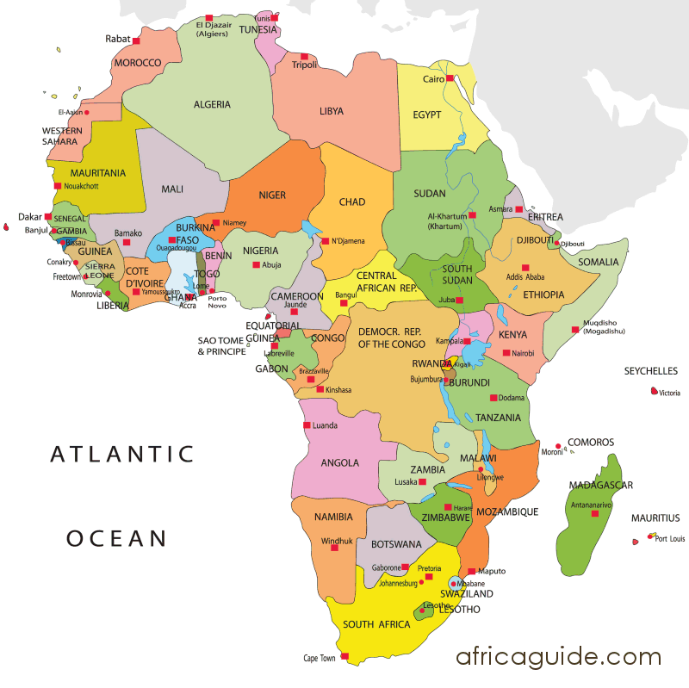
Division of Africa (Geographical and Regional)

Slide 6
Why an African Neuropsychological Battery?
Change in life expectancy (60/61 yrs)
Shift from communicable to non-communicable disease
Neurological disorders account for 7-24% of the admissions in African hospitals.
Age-adjusted prevalence of dementia varies from a low of 2.29% in the Nigerian Yoruba (age 65 and above) to a high of 21.60% in the rural Hai district of Tanzania (age 70 and above).

Slide 7
Importance of Culturally Appropriate Assessment
Clinical presentation of cognitive neurological disease is affected by cultural context.
Cognitive symptom presentation, in particular, differs from what is seen in Western countries, complicating diagnosis.
The patients do not conform to descriptions in Western textbooks.

Slide 8
Barriers to Addressing Needs
Lack of both high and low tech clinical diagnostic tools
Popular beliefs that cognitive changes are due to witchcraft or are a punishment from God
Social stigma suffered by family if the cognitive disorder leads to publically aberrant behavior

Slide 9
Importance of tradition, respect for elders
Oral tradition
1
2
5
Culture and Thinking
3
We rather than I
4
Use metaphor, symbolism to communicate, proverb, story
Gestalt rather than detail

Slide 10
Less emphasis on teaching organization, planning, and categorization.
Concept of time: No hurry
1
2
5
Culture and Thinking
3
Culture of minimum: ”at least…”
4
Do not
show emotion
Difficulty with drawing

Slide 11
WITCHRAFT AND DISEASE IN AFRICA
Beliefs in Supreme being, Spirit, and Witchcraft
Supreme Being: When Africans see the vastness of the universe, human being limitations, and insatiable human needs,
Spirits: The personification of the Supreme Being in “small being”, or “spirits.
Witchcraft: These spirits have most of the time a harmful relationship with human beings (Emeka & Chicke Ekeopara, 2010) “spirit of witches,” which come from witchcraft.
Implications:
Africans would generally find the origin of every biological, mental, and spiritual diseases in bad spirits and witchcraft.
Any misfortunes in life and death are caused by the spirits of witches in the family or clan. For example, epilepsy is considered as a possession by evil spirits.

Slide 12
Polyglot sub-Saharan Africans
Generally, African we learn :
Colonial languages: English, French, and Portuguese
National language: Language imposed by political leaders after independence
Tribal/ethnic languages: 1500 and 2000 African languages (Heine & Nurse, 2000).

Slide 13
Education Challenges (UNESCO, 2000)
1. Languages barriers (colonial language, national, and tribal).
2. Lack of facilities, manuals, libraries, and educators
3. Conflicts/wars
4. Corruption in education and low salary.
5. Low SES (Inability to pay tuition, textbooks, transportation)
6. Women: 94 million are illiterate in sub-Sahara Africa and get married 12-14 yrs.
7. Rural vs urban big town

Slide 14
Initial Target African Country

Slide 15
The African Neuropsychological Battery (ANB)
Measures cognitive dysfunction in a culturally and linguistically appropriate manner
Uses culturally appropriate content
Versions in multiple languages spoken in Congo (and other SSA countries)
  French
  English
  Swahili
  Lingala
  Kikongo
  Tshiluba

Slide 16
Development Procedure of ANB

Slide 17
Criteria for tasks and item selection
The following criteria guided final task and item selection:
Tasks must follow established methods and protocols for measuring the neuropsychological domains of interest, taking into account known brain-behavior relationships and generally accepted assessment procedures.
Items must be commonly found in Congo (and preferably other SSA countries) with identifying names that can be translated across the languages spoken in Congo.
Tasks and items must have high cultural familiarity for individuals in SSA generally, and the DRC in particular.

Slide 18
Criteria for tasks and item selection (ss)
Any verbal content, including names of people, animals, objects, and other stimuli; instructions; and narratives, must be translatable across the major languages spoken in the DRC and other SSA countries.
Preference must be given to content that includes or references games, pastimes, traditions, or other cultural practices likely to be familiar in SSA
Whenever possible, tasks must use inexpensive, easily obtainable materials, not dependent on electricity, computers, or other sophisticated technology.

Slide 19
ANB Overview
Neurological Screening Tests:
  - Visual Fields, Hemineglect, Gross and Fine Motor Coordination, Motor Perseveration
Visuospatial Perception:
  - African Facial Perception Test
Language:
  - African Naming Test
Learning and Memory:
  African List Memory Test
  African Story Memory Test
  African Visuospatial Memory Test
  African Contextual Visuospatial Memory Test
Executive functions:
  African Proverb Interpretation Test
  African Card Game Test

Slide 20
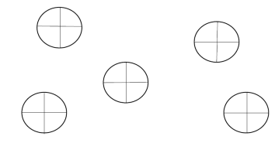
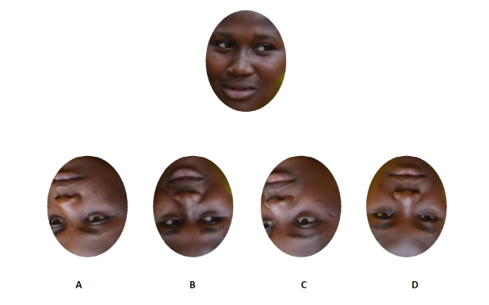
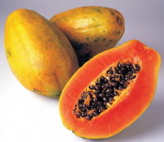
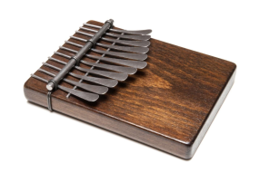
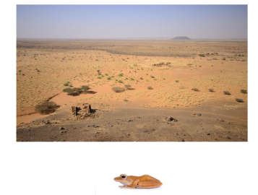
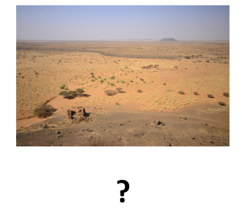
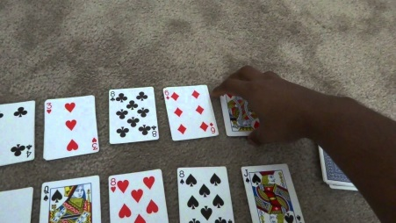

African Neuropsychological Battery
Naming
Hemi-neglect
“A roaring lion kills no game.”
Abstract Reasoning
Perceptual Matching
Visual Associative Memory
Story Memory
Malaika and Oyango wanted to officially marry,
according to their ancestral tradition, after the
birth of their second child. The couple presented
themselves to the village palabra to request
approval of their marriage....
List Items
Head
Lion
Lorry
Banana
Leg
Beans
Visuospatial Memory
Strategy and
Planning
List Memory

Slide 21
Success of Data Collection in Congo
A team of 6 data collectors in DRC were trained over a 4-month period to administer and score the ANB accurately.
This team collected ANB validation data in the DRC, including 392 currently healthy individuals and 52 neurological patients, averaging 20-23 new subjects per week.

Slide 22
Relationship of Age and ANB Performance
- All ANB Tests show significant differences (p<.001) across age decades.
- Younger age is associated with better performance in Bonferroni post-hoc comparisons.

Slide 23
Relationship of Education and ANB Performance
- All ANB Tests show significant differences (p<.001) across education levels.
- More years of education is associated with better performance in Bonferroni post-hoc
comparisons.

Slide 24

Using Hierarchical Multiple Regression to attempt to untangle effects of performance predictors
1. Age
2. Education
4. Locale
3. Gender

Slide 25
ANB Performance of Neurological vs. Matched Controls
Test | Neurological Group Mean (SD) | Healthy Controls Mean (SD) | Significance p <
Naming Fruit Animals Objects | 6.9 (2.7) 5.7 (2.3) 4.9 (1.6) | 8.4 (1.2) 6.8 (2) 5.9 (1.5) | .001 .01 .001
Facial Perception Upright Inverted | 6.6 (2.5) 5.4 (3) | 8.7 (1.5) 6.3 (2) | .001 .001
Proverb | 9.2 (5.4) | 12 (5.4) | .01
Card Game | 25.5 (10) | 30.2 (9.5) | .02

Slide 26
ANB Performance of Neurological vs. Matched Controls
Test | Neurological Group Mean (SD) | Healthy Controls Mean (SD) | Significance p <
Visuospatial Memory Trial 1 Trial 3 Short Delay Long Delay | 2.6 (2) 4.5 (2.5) 3.7 (2.3) 4.6 (2.1) | 4.2 (2.3) 5.8 (2.2) 5.4 (2.1) 5.8 (1.8) | .001 .007 .001 .001
Contextual Visuospatial Memory Trial 1 Trial 3 Short Delay Long Delay | 3.8 (2.9) 6 (4) 3.7 (3.6) 5.6 (4.3) | 5.1 (3.7) 10.3 (4.5) 8.6 (5.3) 9 (4.9) | n.s. .001 .001 .002

Slide 27
ANB Performance of Neurological vs. Matched Controls
Test | Neurological Group Mean (SD) | Healthy Controls Mean (SD) | Significance p <
List Memory Trial 1 Trial 3 Short Delay Long Delay | 3.9 (2.6) 5.4 (3.6) 2.9 (2.9) 4 (3.6) | 6.2 (1.5) 9.1 (1.5) 6.9 (2.1) 7.1 (2.1) | .001 .001 .001 .001
Story Memory* Trial 1 Trial 3 Short Delay Long Delay | 17.4 (8.7) 21.3 (9.8) 20.2 (10.9) 17.5 (9.6) | 11.7 (4.3) 20.5 (7.1) 17.7 (6.4) 18.1 (6.1) | .001 n.s. n.s. n.s.
*Story Memory Test discriminated poorly and performed contrary to expectation.

Slide 28
Reliability and Internal consistency of ANB
Reliability Studies of the African Neuropsychological Battery (ANB):
  Internal Consistency
  Test-Retest Reliability
  Interrater Reliability
Implications for Future Versions of the ANB

Slide 29
Test Scoring Method and Types of Reliability Examined
Test | Scoring Method | Internal Consistency | Test-Retest Reliability | Inter-Rater Reliability
Coin Stacking | Time to completion (1 trial) |  | X
Face Perception | Total correct | X | X
Naming | Total correct without cue | X | X
Visuospatial Memory | Points earned for correct recall and placement of figure details |  | X | X
Contextual Visuospatial Memory | Total correct recognition of stimuli associated with environments |  | X
List Memory | Total correct |  | X
Story Memory | Total recall of details |  | X
Proverb Interpretation | Points earned for abstract vs. concrete interpretation | X | X | X
Card Game | Total games won, organization of cards in hand, number of times incorrect strategy is used | X | X

Slide 30
Internal Consistency
Test | No Items | Crobanch’s alpha | Corrected item total | Mean inter item correlation | Comparison
Naming | 39 | .77 | -.02 to .50 | 0.10 | 0.78 to 0.96 (BNT)
Proverb | 15 | .86 | .23 to .62 | 0.29 | 0.68 to 0.80 (D-KEFS Proverb Test )
African Facial Test | 20 | .82 | .21 to .56 | 0.22 | .53 (Benton Facial Test)
African Card Game | 64 | .93 | -.02 to .72 | 0.17

Slide 31
Implications for Future Versions of the ANB:
Internal Consistency
Naming, Proverb, Face Perception, and Card Game Tests all demonstrated high internal consistency
There was variability in item-total correlations
Deletion of items with lower item-total correlations did not significantly improve the overall internal consistency of any ANB tests

Slide 32
Test-retest Reliability:
Sample Characteristics
Sample included 49 healthy subjects from the Congo
Gender: 24 Male and 25 Female
Age : mean=44, SD=14.86, Range: 20-81
Education: Majority of participants had between 7-12 years of education
One-year test-retest

Slide 33
Test-retest Reliability
Test | No. of Items | Mean (SD) Time 1 | Mean (SD) Time 2 | Correlation coefficient r | Comparison
African Facial Perception Test | 20 | 15.82 (2.82) | 15.57 (2.95) | 0.67 | .61 (Benton Facial Recog.)
African Naming Test | 39 | 28.16 (4.83) | 30.49 (4.74) | 0.91 | 0.59-0.92 (BNT)
AVMT (Long delay) | 4 | 11.33 (4.72) | 11.18 (4.97) | 0.80 | .79 (BVMT)
ALMT (Long delay) | 8 | 6.49 (2.05) | 6.76 (1.82) | 0.62

Slide 34
Test-retest Reliability (con’t)
Test | No. of Items | Mean (SD) Time 1 | Mean (SD) Time 2 | Correlation coefficient r | Comparison
African List Memory Test | 12 | 7.94 (2.14) | 8.39 (2.34) | 0.54 | .88 (CVLT-II)
African Story Memory Test |  | 21.69 (8.32) | 24.53 (9.17) | 0.89 | .74 (WMS-III)
African Proverb Test | 15 | 12.98 (5.94) | 12.84 (5.16) | 0.61 | 0.76 (D-KEFS Prov. Test)
African Card Game Test (wins) | 64 | 33.57 (10.80) | 38.82 (9.46) | .47 | ---------

Slide 35
Test-retest Reliability
Moderate to high reliability for:
  Visuospatial and Story Memory Tests and Naming Test
Moderate for:
  Face Perception, Proverb, Card Game, and List and Contextual Visuospatial Memory Tests
Test-retest reliabilities overall are comparable to other neuropsychological tests that often had shorter retest intervals
Coin Stacking Test may not be useful for serial testing

Slide 36
Inter-rater Reliability:
Sample Characteristics
Sample included 20 subjects
Gender: 10 Male and 10 Female
Age : mean=51, SD=20.23, Range: 20-82
Education: Majority of participants had between 7-18 years of education

Slide 37
Inter-rater Reliability
Test | Interclass correlation | 95% CI
African Visuospatial Memory Test | .81 | .66 to .90
African Proverb Test | .13 | -.29 to .52

Slide 38
Inter-rater Reliability
High for African Contextual Visuospatial Memory Test
Poor for African Proverb Test
  Improved scoring criteria supplemented with examples needed

Slide 39
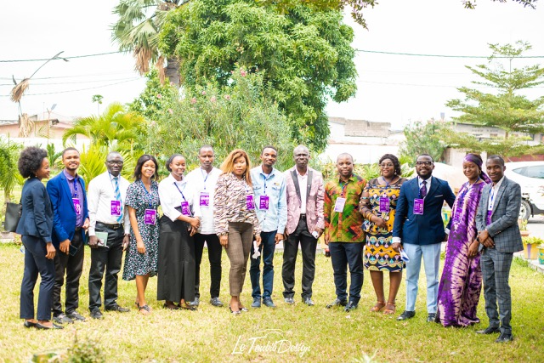
OUR TEAM: Neurologist, psychiatrist and psychologist residents.

