Slide 1
Normal Pressure Hydrocephalus
Update
Justin Hoskin, MD
Barrow Neurological Institute
January 2025

Slide 2
Disclosures
Intramural BNI funding for NPH and MRI study

Slide 3
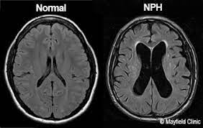
Outline
Definition and Diagnostic Criteria
Pathophysiology
Evaluation
Treatment and Response
Future Directions
https://www.brizbrain.com.au/case-study-normal-pressure-hydrocephalus/

Slide 4
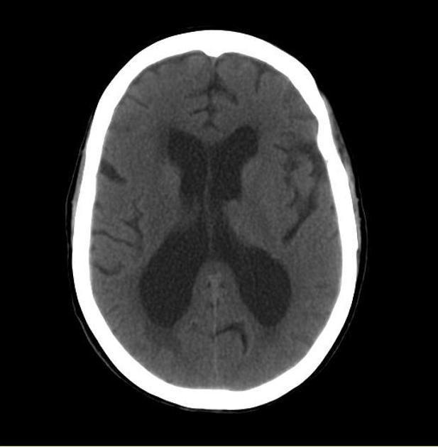
NPH - Definition
Normal Pressure Hydrocephalus
  Symptomatic hydrocephalus; Chronic hydrocephalus in adults; Hakim Syndrome;
  Potentially reversible/improvable syndrome characterized by
    Enlarged cerebral ventricles (ventriculomegaly)
    Gait Apraxia
    Urinary Incontinence
    Cognitive Impairment
https://radiopaedia.org/articles/normal-pressure-hydrocephalus?lang=us

Slide 5
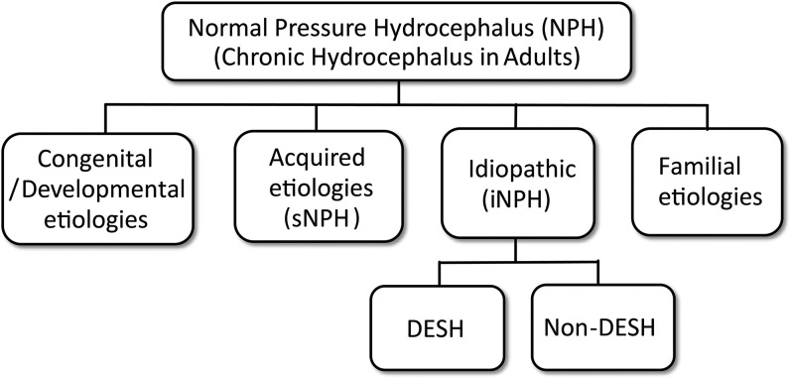
Definition
Nakajima, 2021

Slide 6
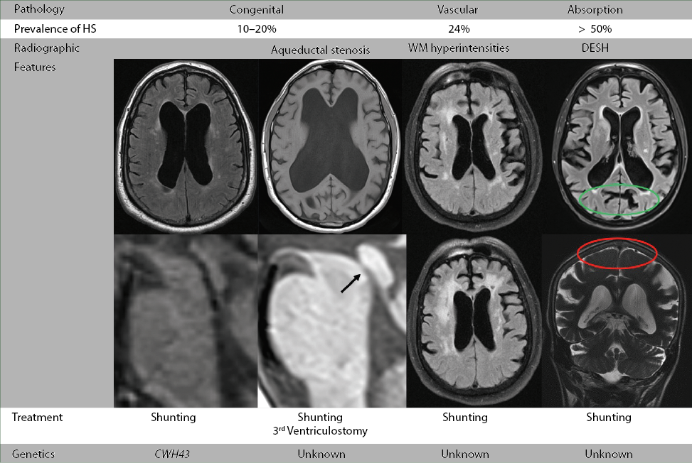
Tipton, et al
Notes:
fNPH may exist in clinically important numbers. In addition, the gene encoding the protein ‘Scm-like with four MBT domains protein1 (SFMBT1)’ has been reported as a risk gene for iNPH, and the cilia-and flagella-associated protein 43 (CFAP43) as a causative gene for fNPH in the field of genetic medicine

Slide 7
iNPH - Pathophysiology
Decrease in cerebral blood flow
  Frontal cortex, periventricular white matter, basal ganglia, thalamus
  Enhancement in cerebral perfusion after CSF removal
Venous Hypertension
  Hinders CSF absorption through the arachnoid villae in the dural sinuses
NPH and the glymphatic system
  Strong correlation between OSA and NPH
    Absence of REM and delta sleep which affects glymphatic flow
    Results in cerebral venous HTN
  Decrease in CSF outflow
Oliveira, 2019

Slide 8
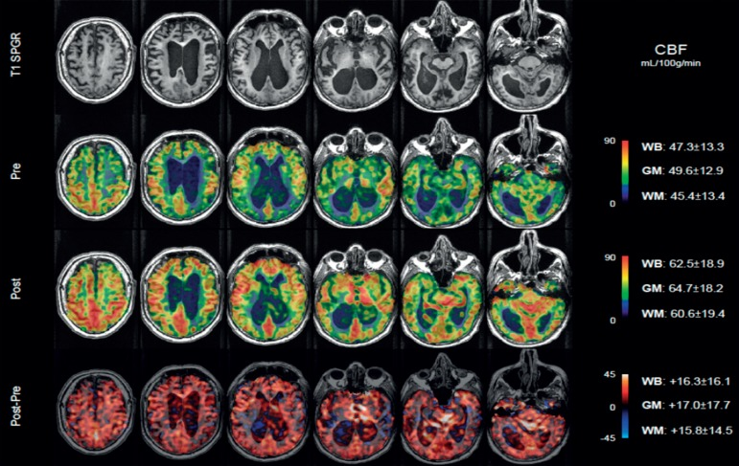
Oliveira, 2019

Slide 9
Japanese Diagnostic Criteria
Diagnostic criteria for possible iNPH
More than one symptom in the clinical triad:
  Gait disturbance
  Cognitive impairment
  Urinary incontinence
No secondary cause of hydrocephalus
Not explained by other disease
Diagnostic criteria for probable iNPH
Meets requirements for possible iNPH
CSF pressure of < 200 mmH₂O
One of the following two investigational features:
  Neuroimaging features with DESH
  Improvement after tap test
Diagnostic criterion for definite iNPH
Objective improvement of symptoms after CSF shunt surgery
“shunt responder”

Slide 10
Epidemiology
Limited data due to difficulty with diagnosis
Recent systematic review
  Mean prevalence of iNPH worldwide is 175 per 100,000
  400 per 100,000 in the population aged 80+
Zaccaria et al. estimated that 128,000 people with iNPH in Europe
  Only 17,000 (13%) patients received a proper diagnosis and appropriate treatment
Prevalence ranges from 300 000 to 700 000 patients in the United States
  2007 study using the Medicare database found that only 25% of patients older than 65 years with the diagnosis of iNPH received shunt surgery.

Slide 11
NPH - Approach
Comprehensive history and neurological examination
Review of neuroimaging studies
As indicated, appropriate evaluation of other etiologies
  Alzheimer’s
  Vascular Dementia
  Dementia with Lewy Bodies
  Atypical parkinsonism
  Progressive supranuclear palsy
Notes:
Variable pathology on brain biopsy -- Often AD - 19-24% of iNPH patients have neuropathologically-confirmed AD

Slide 12
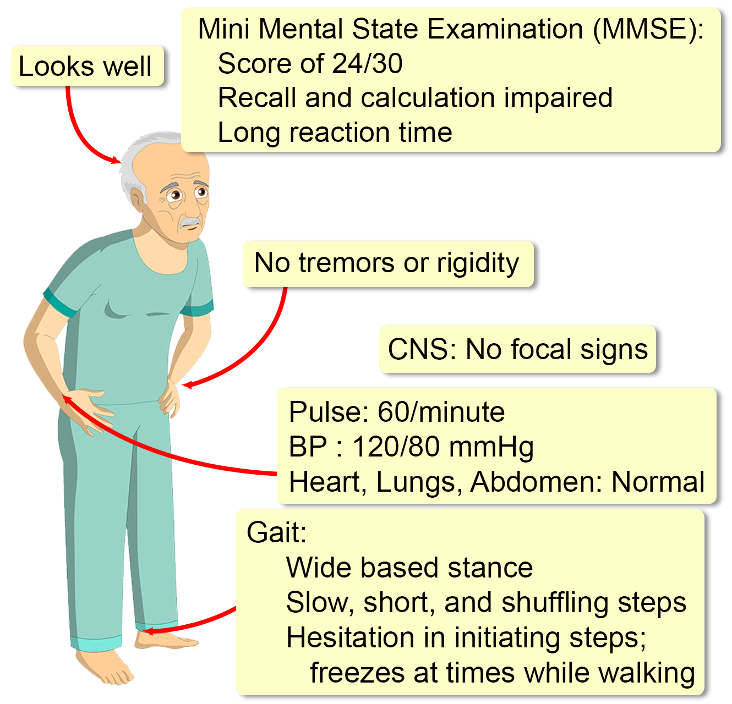
Symptoms
Characterized by a clinical triad
  Progressive gait disturbance
    94-100%
  Cognitive impairment
    78-98%
  Urinary dysfunction
    60-92%
Triad present in 60% of cases
https://clinicalodyssey.com/lm/pd-forgetful-2-normal-pressure-hydrocephalus

Slide 13
Other Symptoms or Findings
Fecal Incontinence
  ~10%
  More likely to occur in advanced stages
Headache
  ~10%
Apathy
  65-86%
Primitive reflexes
  Snout, eyebrow, palmomental
Bradykinesia
  55% of iNPH patients

Slide 14
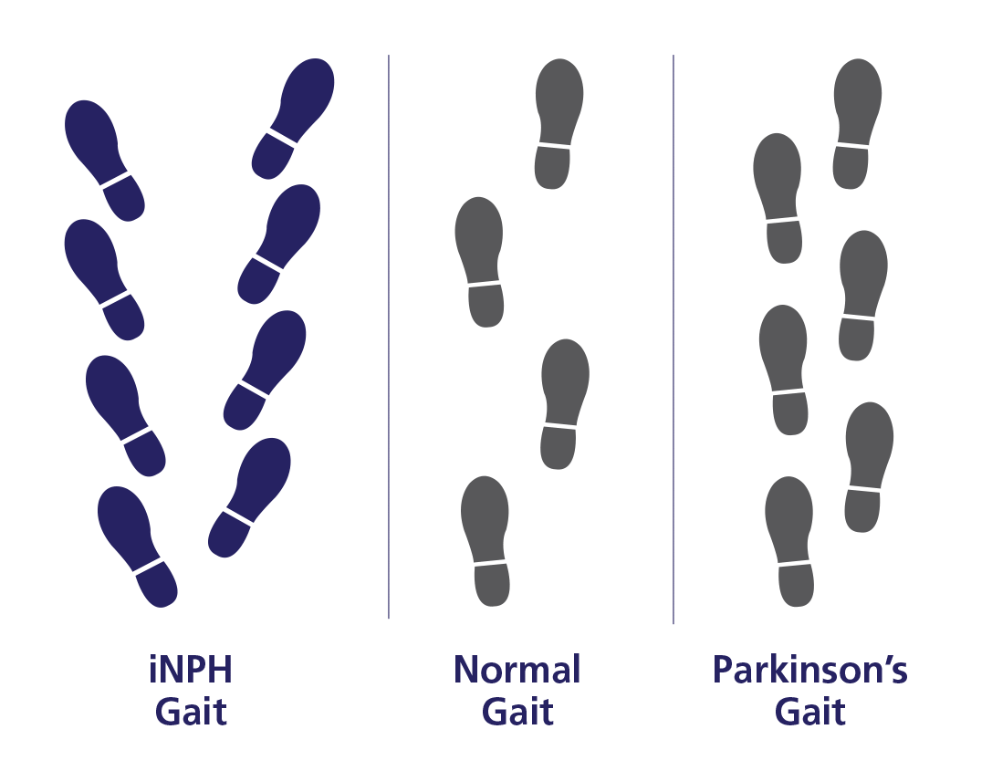
Gait Impairment
Should be the predominant clinical feature
History
  Gradual in onset and worsening
Exam
  Decreased step height
  Decreased step length
  Decreased cadence
  Widened standing base
  External rotation of the feet when walking
  Retropulsion
  En bloc turning (>2 steps for 180º)
  Impaired walking balance (>1 correction on an 8-step tandem walk)
Unlikely to see upper body parkinsonism
  (e.g. soft voice, decreased facial expression)
https://www.lifenph.com/nphsymptoms

Slide 15
Urinary Symptoms
Urinary urgency with incontinence
Gradual in onset
Worsening
Differentiate frequency, leakage, etc

Slide 16
Cognitive Symptoms
NPH is a significant cause of cognitive decline in the elderly
  ~1.0% - 6.0%
80.0% - 98.5% of patients with iNPH have a disturbance of cognition
~75% of severely demented NPH patients experience overlapping AD characteristics
“Frontal” cognitive impairment
  Recent review article did not find a well-defined cognitive profile of NPH prior to shunting
  May manifest with psychomotor slowing, decreased attention and concentration, executive dysfunction, and apathy
Notes:
Execute dysfunction – series of top-down cognitive processes needed for goal-directed behaviors (Inhibition, shifting, updating)

Slide 17
Cognitive Impairment
Executive Dysfunction
  Inhibition
    Color-word stroop testing
      Perform worse than healthy adults and patients with AD
  Shifting
    Trail Making Test B
      1.5 standard deviations longer than healthy adults
  Updating
    Digit span backward test
      Perform worse than healthy adults and patients with AD

Slide 18
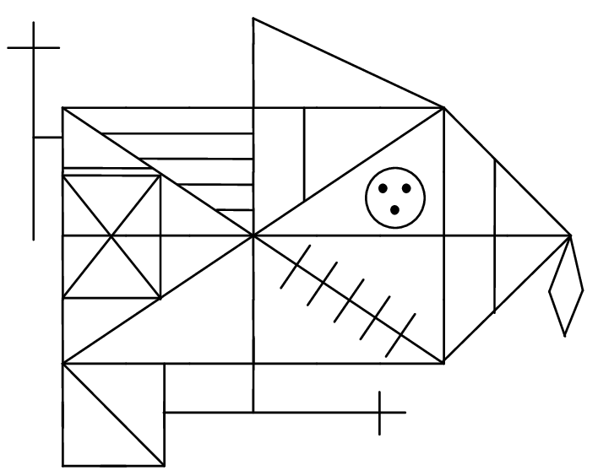
Cognitive Impairment
Language
  Phonemic fluency tests
    iNPH patients generate fewer correct and non-repetitive words
      Worse than healthy controls and AD patients
  Semantic fluency tests
      iNPH worse than healthy adults, but similar to AD or PD
Visuospatial Function
  iNPH patients make more errors than healthy adults and patients with AD when discriminating rotated and flipped graphics or complex figures with different colors and forms
  iNPH patients make more errors when asked to replicate a Rey complex

Slide 19
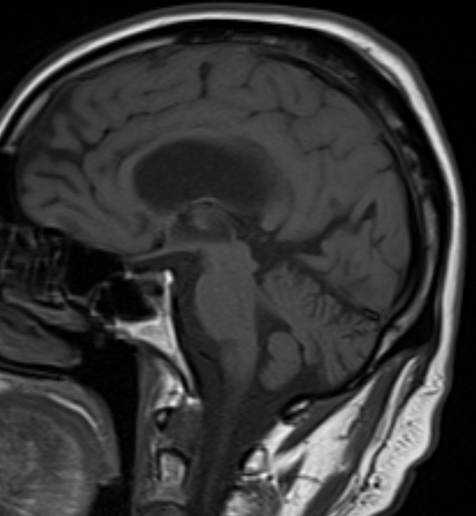
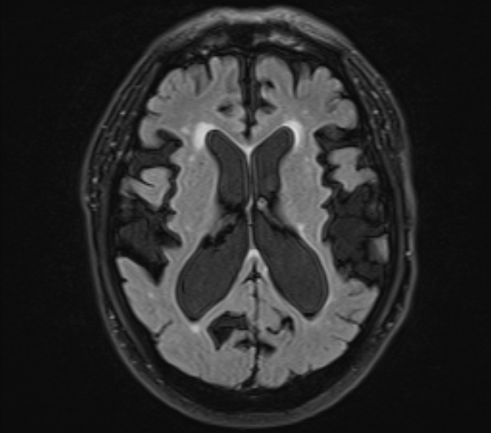
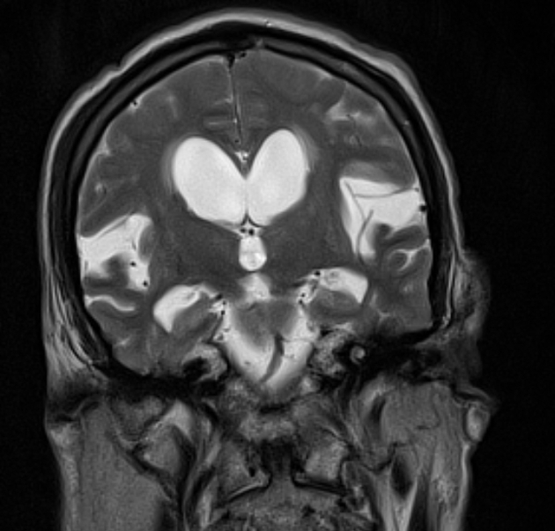
NPH - imaging
Attempts have been made to improve diagnostic accuracy for imaging
  iNPH Radscale
https://radiopaedia.org/articles/normal-pressure-hydrocephalus?lang=us

Slide 20
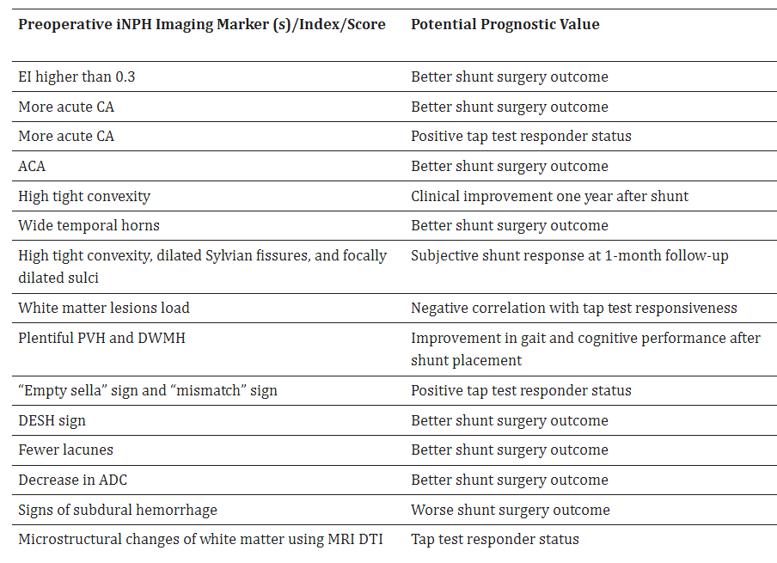
Pyrgelis, 2023

Slide 21
Tap Test
First described with Adams et al in 1965
Lumbar puncture assessment
Temporarily decreasing intraventricular pressure – mimicking the effect of a shunting procedure
Widely disseminated test
  Easily performed and cost-effective

Slide 22
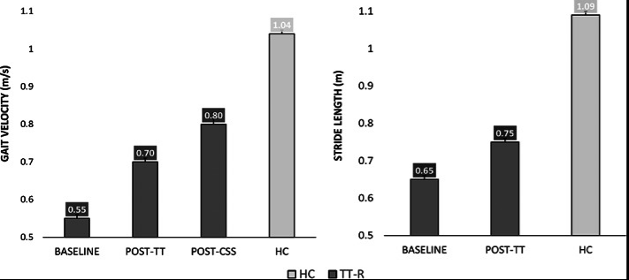
Recent Tap Test Results
In 2018, Souza et al performed tap test
  Gait speed was the most responsive parameter to the test
Passaretti, 2023

Slide 23
Other testing
Lumbar drain
External lumbar drain
Infusion testing
Invasive intracranial pressure
  Waveform alterations and unstable ICP correlate with a 50-90% response to VPS

Slide 24
Shunt Decision
Final diagnosis and decision is the professional responsibility of neurologist and neurosurgeon
Generally should be offered to patients who demonstrate improvement in symptoms
With adequate selection of surgical candidates
  Up to 80-90% response rate
Lack of response does not contraindicate surgery
  Tap test is valid for selecting patients for surgery, but not for excluding them from treatment
  Consider repeat tap test at a later date
Notes:
Endoscopic Third Ventriculostomy -- Effectiveness rate ranging from 21%-72%

Slide 25
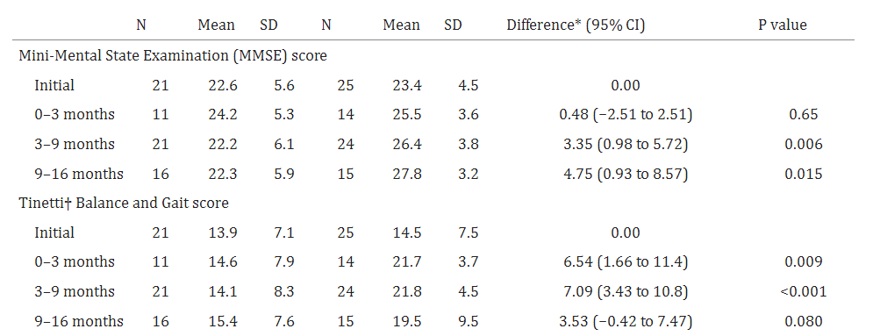
VPS Response
Razay, 2019
Notes:
A prospective observational cross-sectional and cohort study

Slide 26
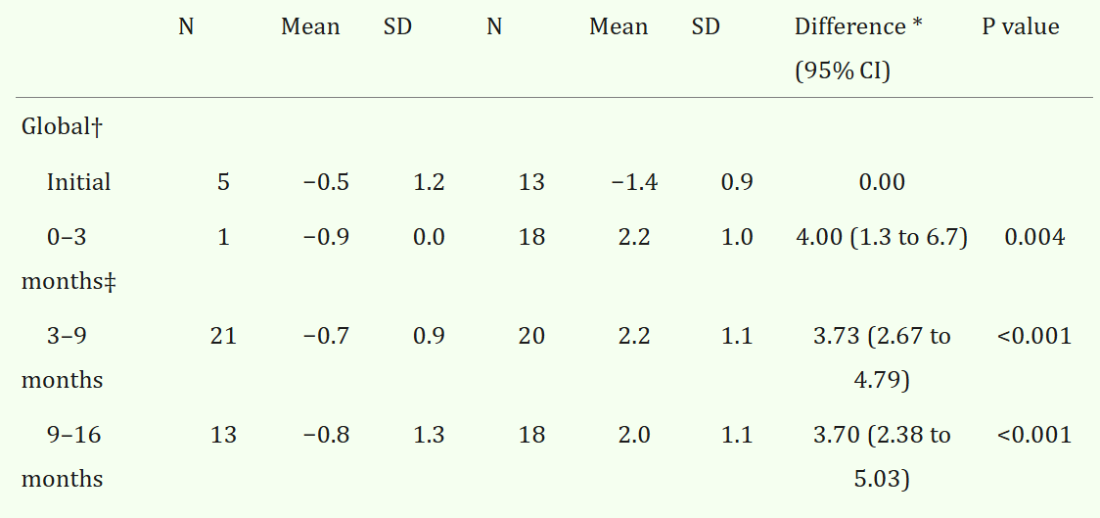
VPS Response - CIBIC plus scores
Razay, 2019
Notes:
The Clinician's Interview-Based Impression of Change (Plus caregiver input)

Slide 27
VPS Cognitive Response
Global Cognitive Decline
  Cohort of nearly 200 patients found:
    48.6% of patients with global cognitive decline
      Average MMSE 16.6/30
  VPS appears to improve MMSE score
Executive Function
  Inhibition – Color-word Stroop
    Hellstrom et al reported that 3 months after surgery
      82.0%-91.0% of patients could complete Stroop in a significantly shorter time
    Duinkerke et al reported that 6 months after surgery
      60.0% of patients had one standard deviation decrease in completion time

Slide 28
Future Directions

Slide 29

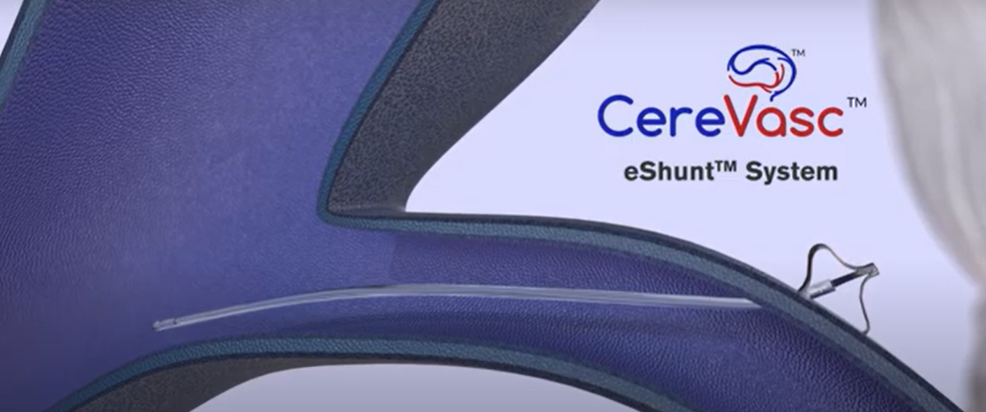

Slide 30
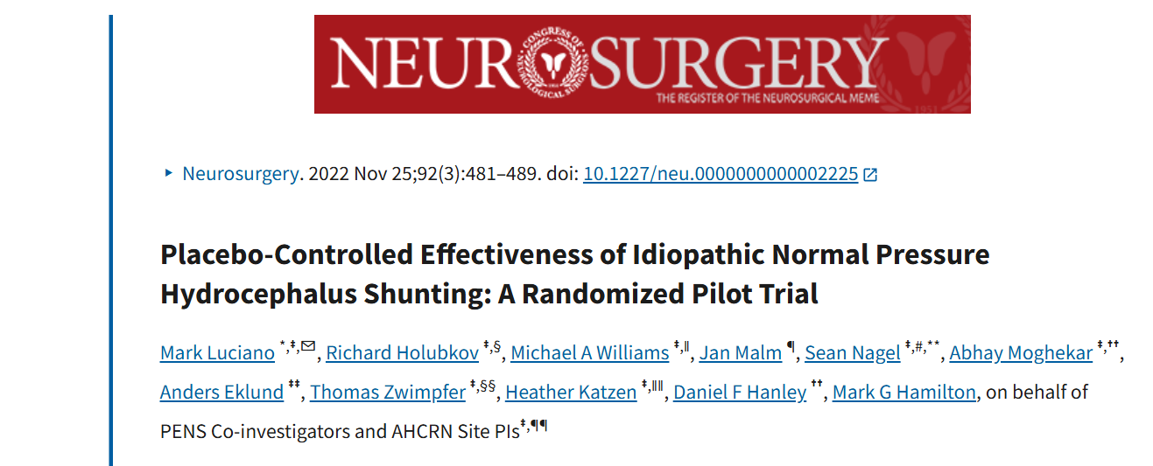

Slide 31
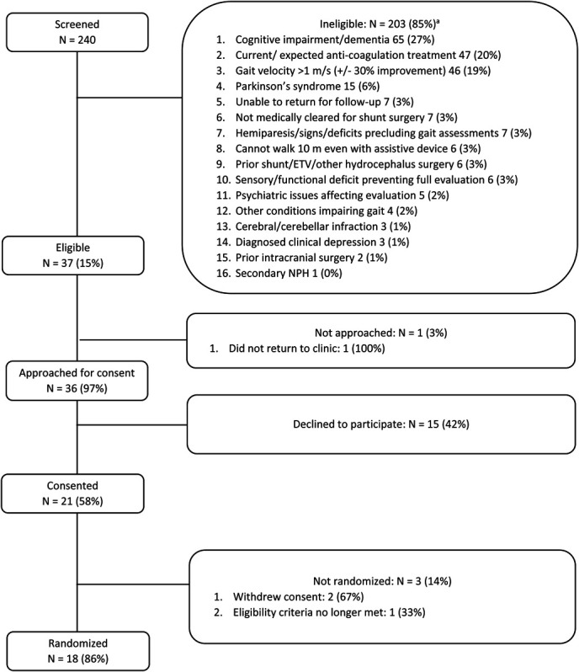
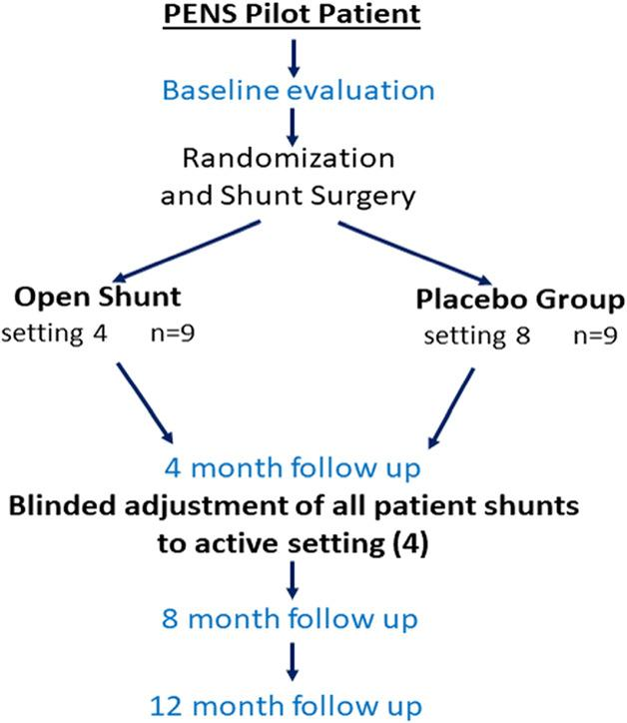

Slide 32
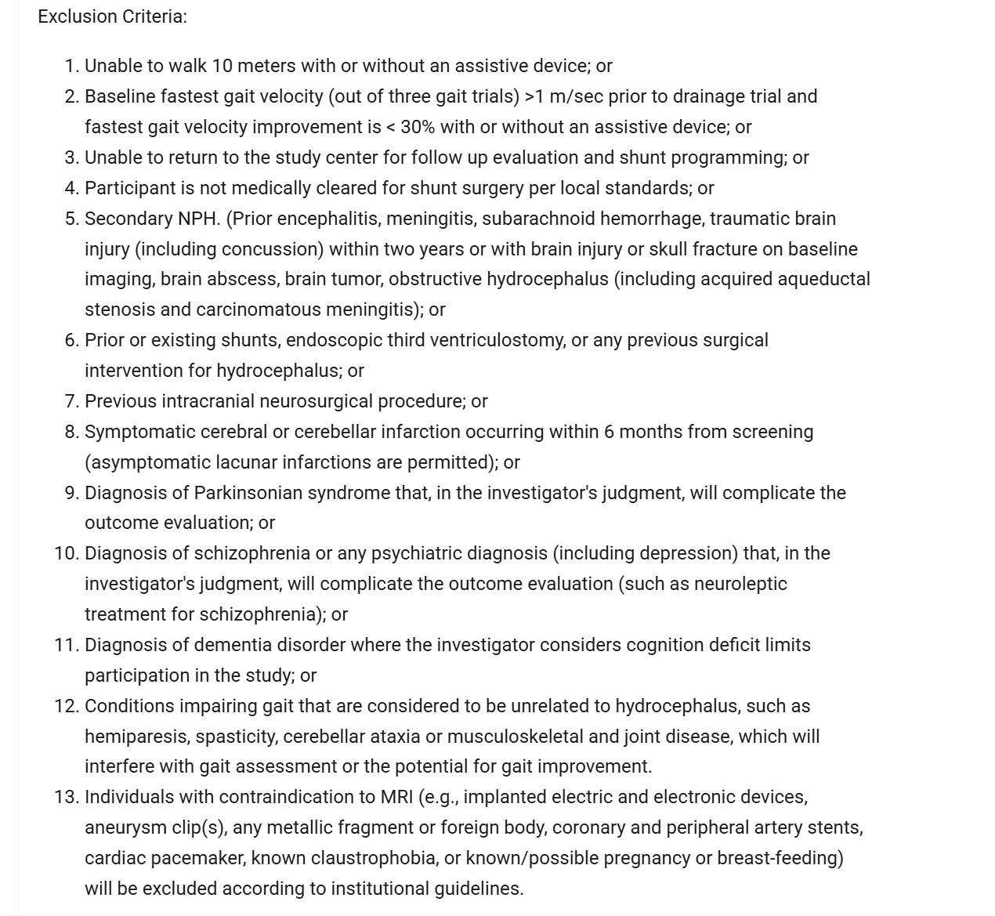

Slide 33
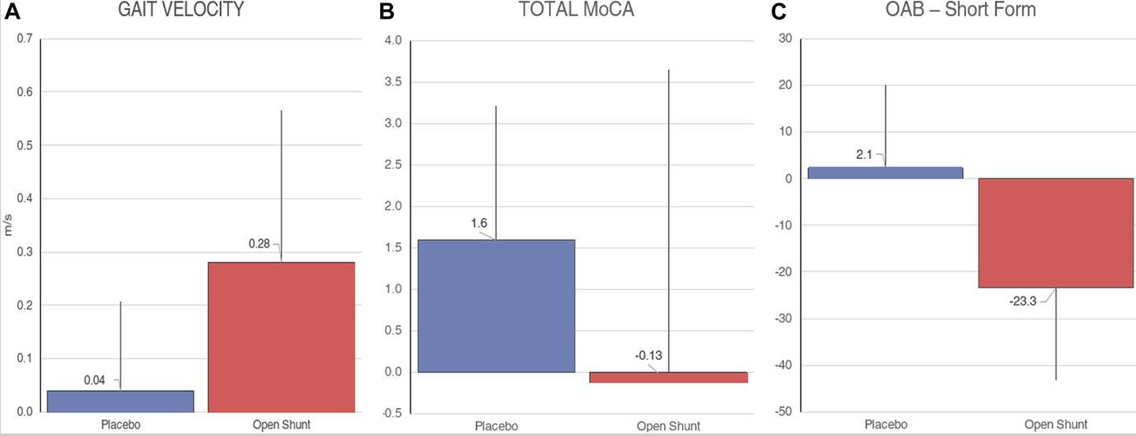

Slide 34
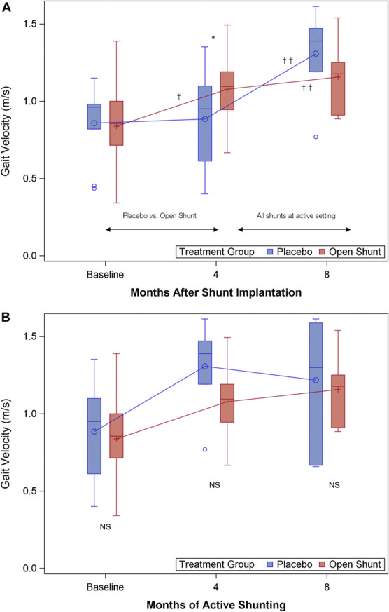

Slide 35
Take Home Points
Not every case of NPH is created equal
  Different types of NPH likely
Diagnostic criteria for NPH should be followed
Gait velocity and stride length should be measured during CSF removal
Several trials are ongoing for the treatment of NPH

Slide 36
Citations
Fasano A, Espay AJ, Tang-Wai DF, Wikkelsö C, Krauss JK. Gaps, Controversies, and Proposed Roadmap for Research in Normal Pressure Hydrocephalus. Mov Disord. 2020 Nov;35(11):1945-1954. doi: 10.1002/mds.28251. Epub 2020 Sep 22. PMID: 32959936.
Manniche C, Hejl AM, Hasselbalch SG, Simonsen AH. Cerebrospinal Fluid Biomarkers in Idiopathic Normal Pressure Hydrocephalus versus Alzheimer's Disease and Subcortical Ischemic Vascular Disease: A Systematic Review. J Alzheimers Dis. 2019;68(1):267-279. doi: 10.3233/JAD-180816. PMID: 30741681.
Micchia K, Formica C, De Salvo S, Muscarà N, Bramanti P, Caminiti F, Marino S, Corallo F. Normal pressure hydrocephalus: Neurophysiological and neuropsychological aspects: a narrative review. Medicine (Baltimore). 2022 Mar 4;101(9):e28922. doi: 10.1097/MD.0000000000028922. PMID: 35244047; PMCID: PMC8896519.
Nakajima M, Yamada S, Miyajima M, Ishii K, Kuriyama N, Kazui H, Kanemoto H, Suehiro T, Yoshiyama K, Kameda M, Kajimoto Y, Mase M, Murai H, Kita D, Kimura T, Samejima N, Tokuda T, Kaijima M, Akiba C, Kawamura K, Atsuchi M, Hirata Y, Matsumae M, Sasaki M, Yamashita F, Aoki S, Irie R, Miyake H, Kato T, Mori E, Ishikawa M, Date I, Arai H; research committee of idiopathic normal pressure hydrocephalus. Guidelines for Management of Idiopathic Normal Pressure Hydrocephalus (Third Edition): Endorsed by the Japanese Society of Normal Pressure Hydrocephalus. Neurol Med Chir (Tokyo). 2021 Feb 15;61(2):63-97. doi: 10.2176/nmc.st.2020-0292. Epub 2021 Jan 15. PMID: 33455998; PMCID: PMC7905302.
Oliveira LM, Nitrini R, Román GC. Normal-pressure hydrocephalus: A critical review. Dement Neuropsychol. 2019 Apr-Jun;13(2):133-143. doi: 10.1590/1980-57642018dn13-020001. Erratum in: Dement Neuropsychol. 2019 Jul-Sep;13(3):361. PMID: 31285787; PMCID: PMC6601311.
Passaretti M, Maranzano A, Bluett B, Rajalingam R, Fasano A. Gait Analysis in Idiopathic Normal Pressure Hydrocephalus: A Meta-Analysis. Mov Disord Clin Pract. 2023 Oct 2;10(11):1574-1584. doi: 10.1002/mdc3.13816. PMID: 38026510; PMCID: PMC10654838.
Patel S, Ditamo M, Mangal R, Gould M, Ganti L. Normal Pressure Hydrocephalus. Cureus. 2023 Feb 18;15(2):e35131. doi: 10.7759/cureus.35131. PMID: 36949988; PMCID: PMC10026533.
Peterson KA, Mole TB, Keong NCH, DeVito EE, Savulich G, Pickard JD, Sahakian BJ. Structural correlates of cognitive impairment in normal pressure hydrocephalus. Acta Neurol Scand. 2019 Mar;139(3):305-312. doi: 10.1111/ane.13052. Epub 2018 Dec 3. PMID: 30428124; PMCID: PMC6492129.
Picascia M, Zangaglia R, Bernini S, Minafra B, Sinforiani E, Pacchetti C. A review of cognitive impairment and differential diagnosis in idiopathic normal pressure hydrocephalus. Funct Neurol. 2015 Oct-Dec;30(4):217-28. doi: 10.11138/fneur/2015.30.4.217. PMID: 26727700; PMCID: PMC4758774.
Pyrgelis ES, Velonakis G, Papageorgiou SG, Stefanis L, Kapaki E, Constantinides VC. Imaging Markers for Normal Pressure Hydrocephalus: An Overview. Biomedicines. 2023 Apr 24;11(5):1265. doi: 10.3390/biomedicines11051265. PMID: 37238936; PMCID: PMC10215615.
Razay G, Wimmer M, Robertson I. Incidence, diagnostic criteria and outcome following ventriculoperitoneal shunting of idiopathic normal pressure hydrocephalus in a memory clinic population: a prospective observational cross-sectional and cohort study. BMJ Open. 2019 Dec 3;9(12):e028103. doi: 10.1136/bmjopen-2018-028103. PMID: 31796471; PMCID: PMC6924805.
Tan C, Wang X, Wang Y, Wang C, Tang Z, Zhang Z, Liu J, Xiao G. The Pathogenesis Based on the Glymphatic System, Diagnosis, and Treatment of Idiopathic Normal Pressure Hydrocephalus. Clin Interv Aging. 2021 Jan 15;16:139-153. doi: 10.2147/CIA.S290709. PMID: 33488070; PMCID: PMC7815082.
Tipton PW, Elder BD, Cogswell PM, Graff-Radford N. Normal pressure hydrocephalus, or Hakim syndrome: review and update. Neurol Neurochir Pol. 2024;58(1):8-20. doi: 10.5603/pjnns.97343. Epub 2023 Dec 6. PMID: 38054275.
Xiao H, Hu F, Ding J, Ye Z. Cognitive Impairment in Idiopathic Normal Pressure Hydrocephalus. Neurosci Bull. 2022 Sep;38(9):1085-1096. doi: 10.1007/s12264-022-00873-2. Epub 2022 May 15. Erratum in: Neurosci Bull. 2022 Jul 25;: PMID: 35569106; PMCID: PMC9468191.

