Slide 1


Cognitive Function and Progression Of Cognitive Decline in a Norwegian MCI Population
Associate professor Susanne Hernes
Gral conference, Phoenix 2025

Slide 2
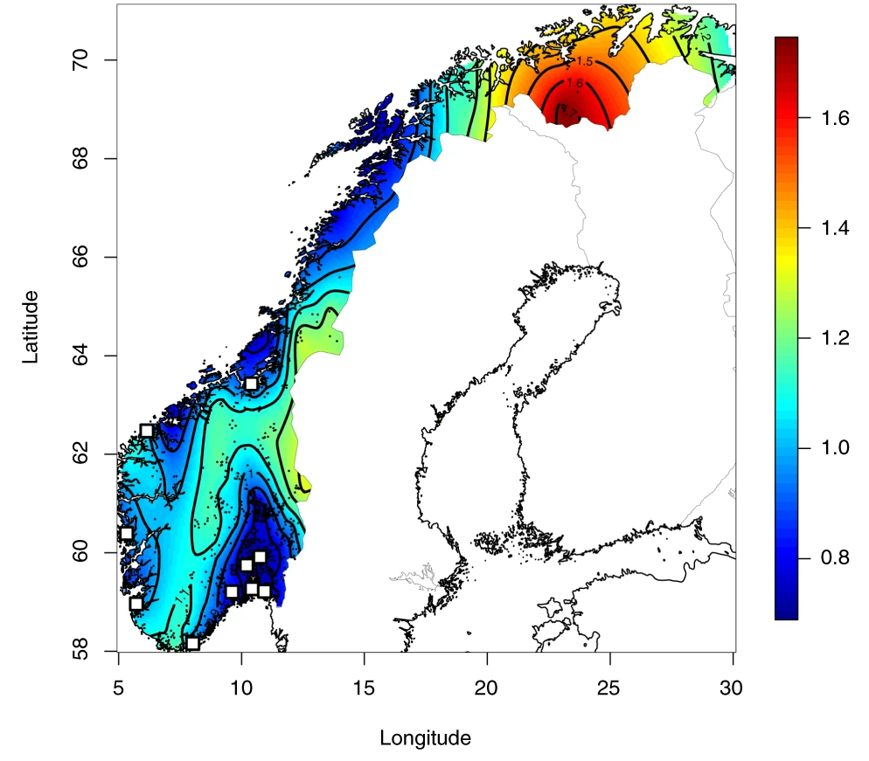
What makes Norway special with regards to cognitive decline
Homogeneous population
  Genetic makeup
  Ethnicity
High educational level
Access to healthcare
Low level of pollution and toxins
Apolipoprotein ε4 carriership 19,8%
Mattingsdal, Morten, et al. "The genetic structure of Norway." European Journal of Human Genetics 29.11 (2021): 1710-1718.
Kumar, Theresa, et al. "Allele frequencies of apolipoprotein E gene polymorphisms in the protein coding region and promoter region (-491A/T) in a healthy Norwegian population." Human biology (2002): 137-142.
Notes:
Contour plot of the cumulative sum of homozygous segments (cM) on the log10 scale detected by Beagle, extrapolated by spatial regression (Krig/fields)

Slide 3
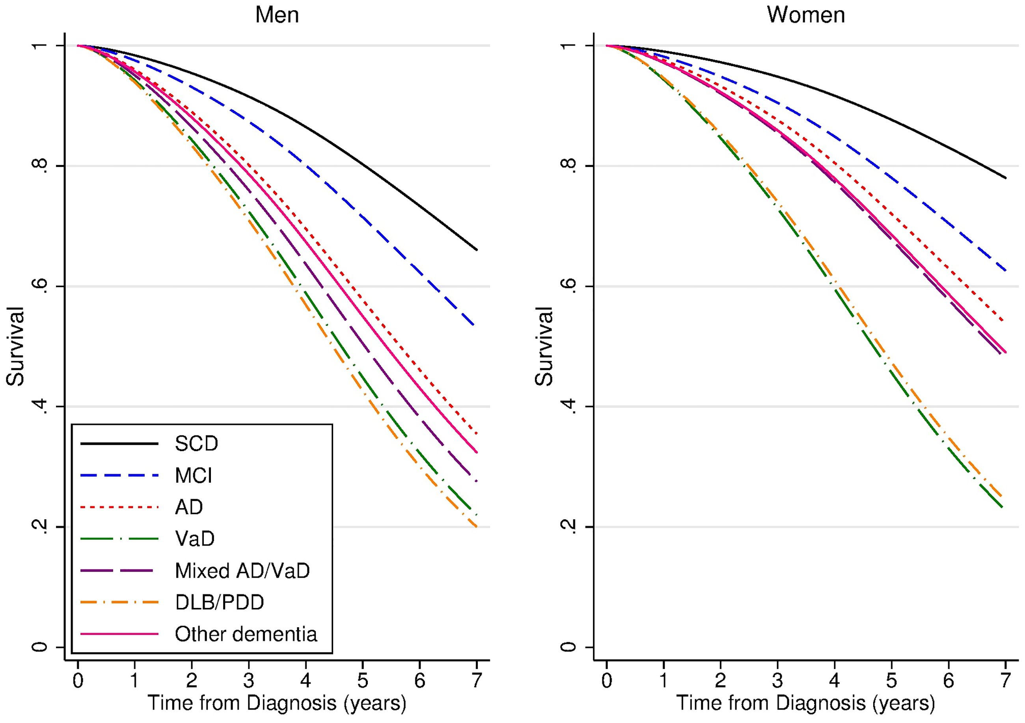
Loss of life years in a Norwegian MCI population
Norwegian individuals with MCI have a reduced life expectancy of 5 to 6 years.
Strand, Bjørn Heine, et al. "The loss in expectation of life due to early-onset mild cognitive impairment and early-onset dementia in Norway." Dementia and geriatric cognitive disorders 47.4-6 (2019): 355-365.

Slide 4
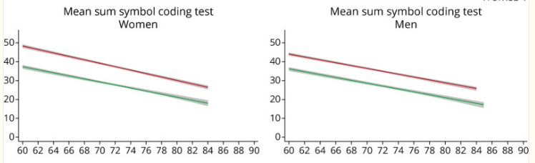
The Tromsø population study 2001 vs 2016
The Tromsø population study 2001 2016
Johnsen, Bente, et al. "Improved cognitive function in the Tromsø study in Norway from 2001 to 2016." Neurology: Clinical Practice 11.6 (2021): e856-e866.

Slide 5
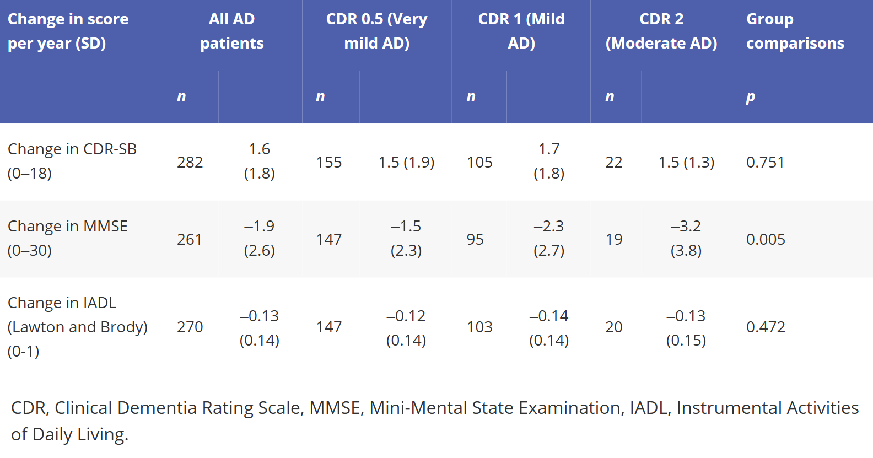
The Progression of AD and Resource use (PADR) study
Eldholm, Rannveig Sakshaug, et al. "Progression of Alzheimer’s disease: a longitudinal study in Norwegian memory clinics." Journal of Alzheimer's disease 61.3 (2018): 1221-1232.

Slide 6
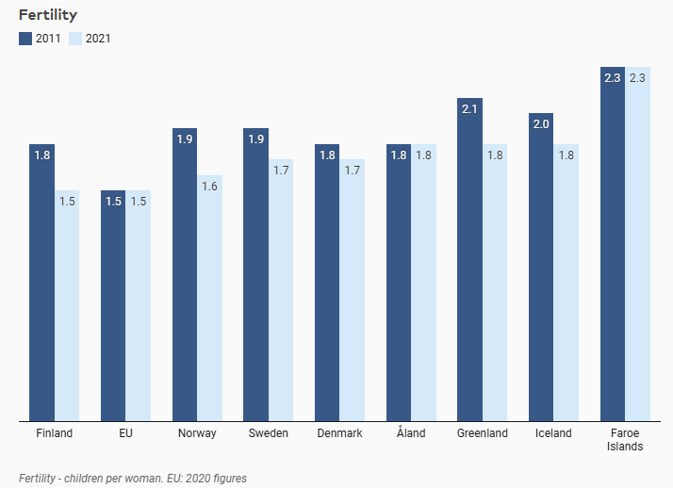
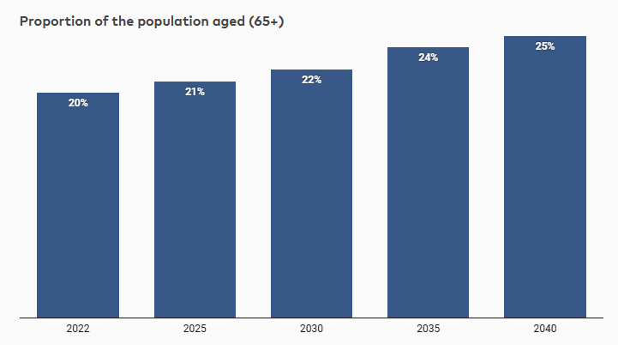
Nordic countries approaching the demographic shift
POPU06: Population projections by reporting country, age, sex and time. PxWeb
CHIL02: Fertility rates by reporting country, age and time. PxWeb

Slide 7

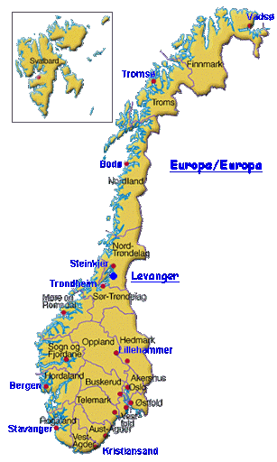





The REACT MCI study
Using computerized working memory training in MCI to investigate the effect on:
Cognition
Quality of life
Health economics
Furhermore:
Investigate super-responders
Investigate training intensity

Slide 8

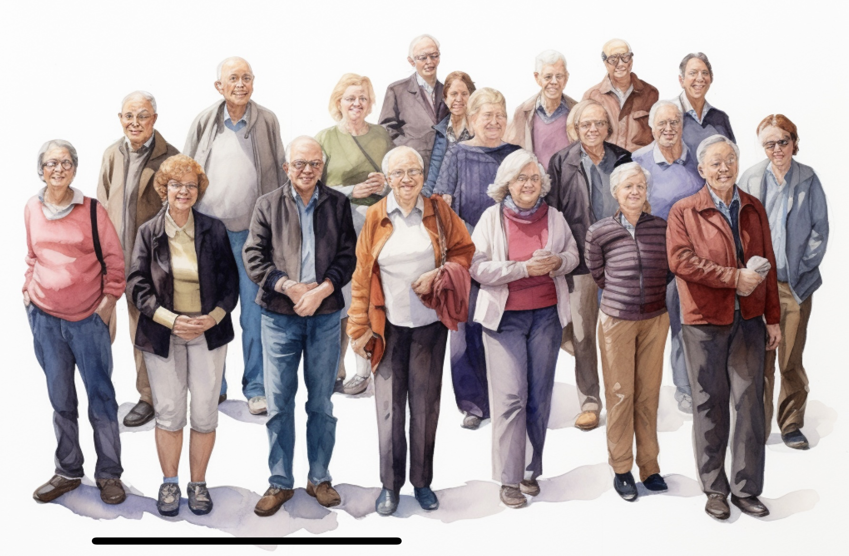
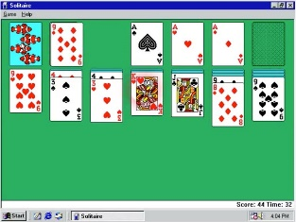
REACT MCI – a double blinded randomized trial
Baseline
3 months
6 months
12 months
24 months
48 months
I: Computerized WMT 5w/25s
I: Computerized WMT 5w/25s
Randomization
II: Computerized WMT 5w/25s
III: Generalized cognitive stimulation 5w/25s
Cognitive testing
QOL
Relatives stress
Health economics
Cognitive testing
MRI
Glymfatics

Slide 9
REACT MCI – preliminary results
 | DOMAIN | Description
 | Intellectual functioning | General Ability Index (GAI)
 | Global screening | MMSE
Conducted by study team | Working memory | Spatial span forward, spatial span backward, digit span forward, and digit span backwards
 | Immediate learning | List learning and story memory
 | Visuospatial | Figure copy and line orientation
 | Language | Picture naming and Semantic fluency
 | Attention | Digit span and coding
 | Delayed memory | List recall, list recognition, story memory and figure recall
 | Executive function | Color Word Interference Task Inhibition and Color Word interference Task Inhibition/switching
Patient self-report | Cognitive function, QOL | Brief A, EQ5D5L
Relative self-report | Cognitive function, QOL, Relatives stress | Brief A, EQ5D5L, Resource utilization in dementia

Slide 10
Overview at baseline for individuals completed 6 months evaluation
 |  | Double | Single | Active control | p
No |  | 32 | 32 | 37 | .45
Sex, no |  | 16M/16F | 21M/11F | 22M/15F | .44
Age, mean (SD) |  | 67.1 (7.4) | 69.0 (7.3) | 67.5 (8.1) | .59
Education | Primary school Secondary school Vocational certificate College/University | 6% 31% 13% 50% | 0 31% 9% 59% | 3% 27% 8% 62% | .78
General ability index WAIS, mean (SD) |  | 97.4 (12.6) | 102.8 (12.1) | 102.7 (11.7) | .12
MMSE, mean (SD) |  | 26.1 (2.9) | 27.5 (1.8) | 27.6 (2.4) | <.05
Clinical dementia rating scale-Sum of boxes, mean (SD) |  | 1.4(1.0) | 1.3(1.1) | 1.4(1.2) | .91

Slide 11
**
*
* p < .05
** p < .001

Slide 12
**
*
* p < .05
** p < .001

Slide 13
*
Model **
* p < .05
** p < .001

Slide 14

How does the participant and the relatives view the effect?

Slide 15
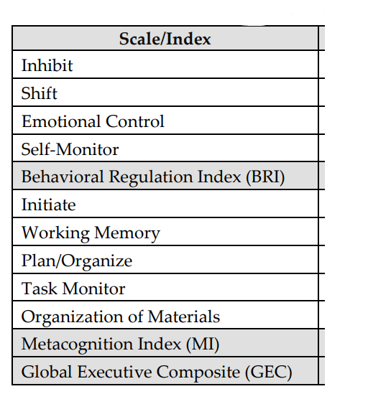
BRIEF-A
Behavior Rating Inventory of Executive Function

Slide 16
Impairment level
In Brief

Slide 17
Model *
*
* p < .05
** p < .001

Slide 19
Model **
*
**
* p < .05
** p < .001

Slide 20

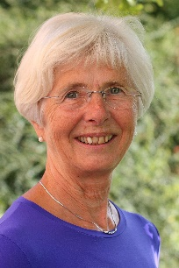






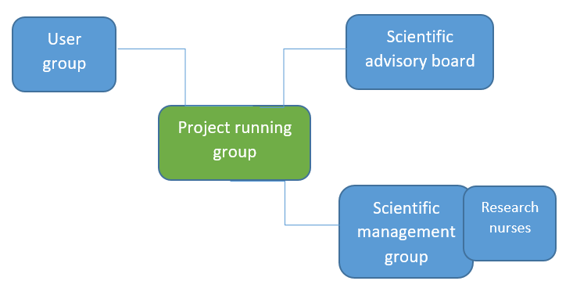
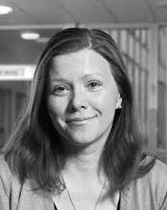

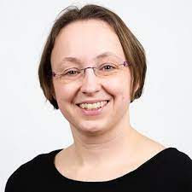
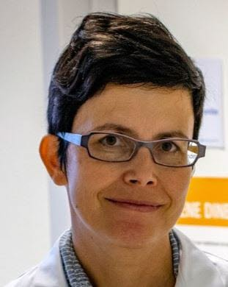


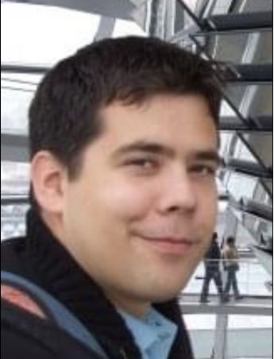


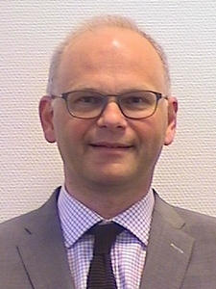
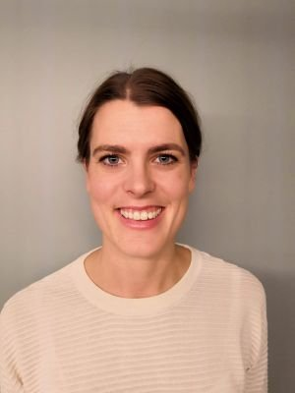


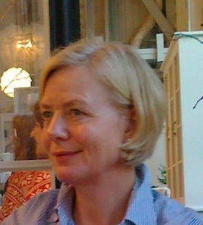
Elin Lien
Tove Nakken
Anne Rita Øksengård
Mirjeta Emini
Linda Chang
Yonas Geda
Anette H. Ranhoff
Per Kristian Eide
Bodil Olsen
Rannveig Eldholm
Kia Minna Hynninen
Susanne Hernes
Anne Brita Knapskog
Per Nordnes
Haakon R Hol
Hans Kr. Bø
Andreas Engvig
Are Pripp
Per Kristian EIde
Trine Holt Edwin
Geir Ringstad
Anne Liv Lyngroth
Mona L Henriksen

