Slide 1


Factors Affecting White Matter Health Over the Lifespan
Christopher M. Filley, MD
Professor Emeritus of Neurology
Founder, Behavioral Neurology Section
University of Colorado School of Medicine

Slide 2
I Have No Disclosures

Slide 3
Objectives
Discuss white matter ontogeny, with maximal mid-life volume
Review the range of neuropathology that affects white matter
Summarize other white matter insults detected by neuroimaging
Propose that white matter involvement may contribute to psychosis in early life and dementia in late life
Consider two common problems – vascular disease and traumatic brain injury (TBI) – that are particularly relevant to dementia via white matter dysfunction
Explore whether white matter inflammation may be a common pathogenesis for both psychosis and dementia

Slide 4
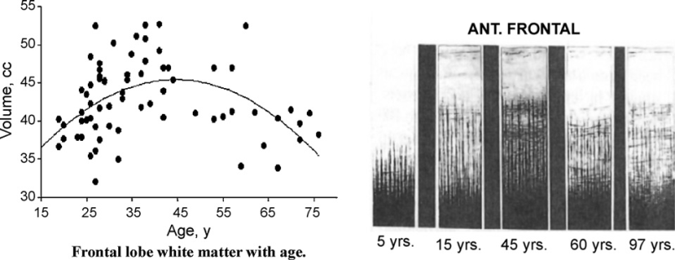
White Matter Ontogeny
White matter volume, including intracortical myelin, is maximal at mid-life and declines in aging (Bartzokis, 2011)
Underdeveloped white matter in adolescence may predispose to early life disorders
White matter retrogenesis could underlie cognitive aging and predispose to late life disorders
Subcortical Intracortical
Bartzokis, 2011

Slide 5
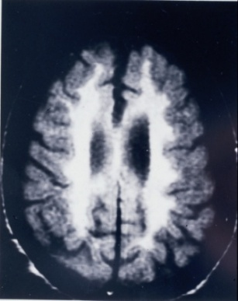
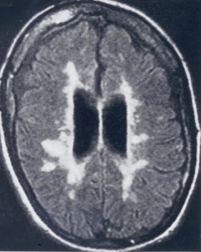
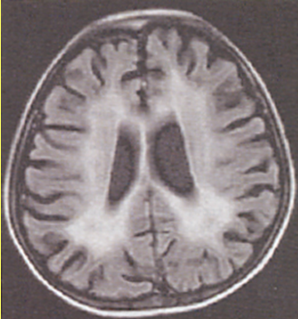
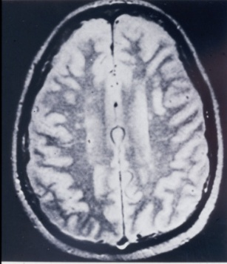
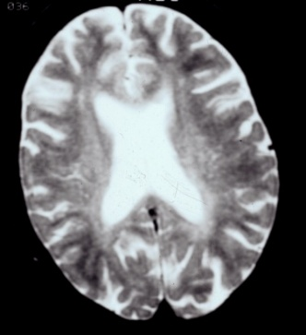
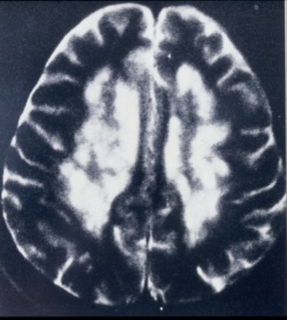
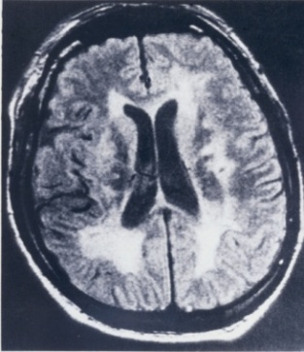
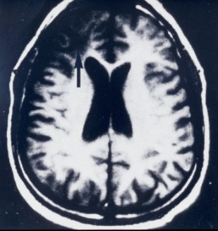
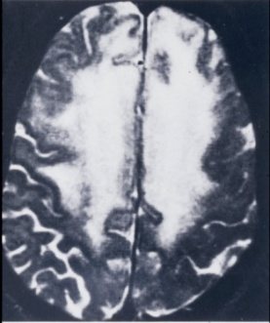
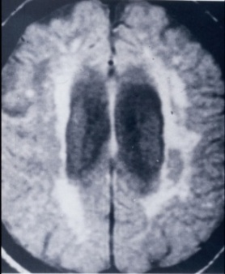
MRI of White Matter Disorders
MLD MS HIV SLE Toluene
B₁₂↓ BD TBI Glioma NPH

Slide 6
White Matter Insults: Macrostructural and Microstructural
Hypertension
Diabetes
Obesity
Smoking
Hyperlipidemia
Metabolic syndrome
Unhealthy diet
Physical inactivity
Sleep disturbance
Ischemia
Cognitive inactivity
Toxins
Air pollution
Infection
Critical illness
Low education
Low SES
Depression
Stress
TBI

Slide 7

White Matter and Major Disorders
Psychosis
Dementia
Injury
Injury
0 45 90
White Matter Volume Over the Lifespan

Slide 8
White Matter and Psychosis
Schizophrenia has been conceptualized as a connectopathy (Friston, 1998), an idea first proposed by Wernicke in 1906 (Collin et al. 2016)
Disrupted synchronization of disparate brain regions may be central to schizophrenia pathogenesis (Collin et al. 2016)
Young adults with MLD and related diseases commonly develop early psychosis in association with frontal dysmyelination (Mighdoll et al. 2015)
White matter insults - stress, TBI, and drug use - could all contribute to psychosis via myelin damage (Bartzokis, 2002; Haroutunian et al. 2014)
DTI studies of white matter microstructure in schizophrenia are widely seen as disclosing lower FA in major tracts (Karlsgodt, 2020)
Post-mortem schizophrenic brains show oligodendrocytes decreased by 28% in frontal cortex, and 27% in subfrontal white matter (Hof et al. 2003)

Slide 9
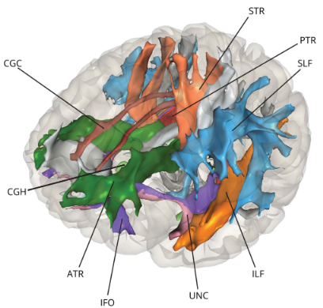
White Matter and Dementia
Much evidence implicates white matter involvement early in pathogenesis
A revealing study from Rotterdam found that in 4,415 non-demented people (mean age 64) followed seven years after DTI, the risk of developing all-cause dementia, including Alzheimer’s Disease, was increased in those with lower FA and higher MD in multiple tracts (Cremers et al. 2020)
Dysconnectivity increases risk
Cremers et al. 2020

Slide 10
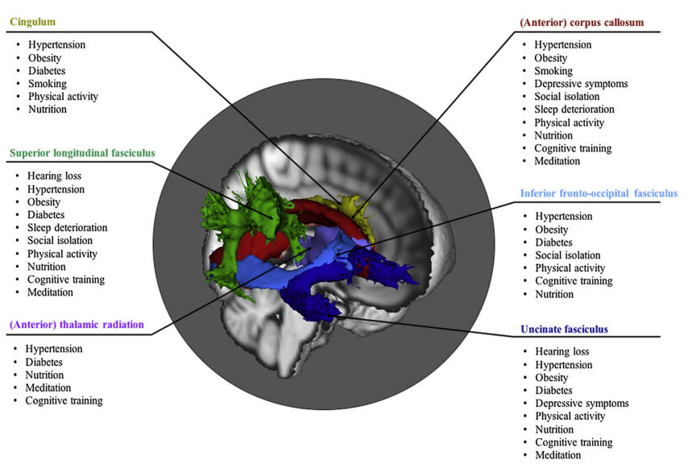
Dementia, White Matter, and Public Health
Livingston et al. (2024) concluded that ~ 50% of dementia worldwide is attributable to 14 risk factors (hypertension, diabetes, obesity, high cholesterol, smoking, TBI, physical inactivity, alcohol excess, hearing loss, vision loss, depression, low education, air pollution, and social isolation)
These factors are “consistently associated with decline and/or protection of [white matter] integrity” (Wassenaar et al. 2019)
Frontal, temporal, and parietal tracts are particularly sensitive
Wassenaar et al. 2019

Slide 11
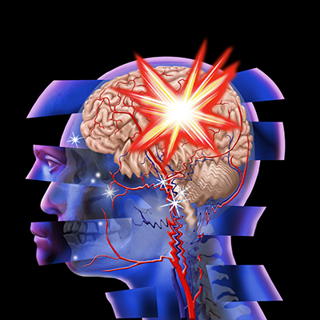
The Two Most Common Risks for Dementia: Vascular Disease and Traumatic Brain Injury

Slide 12
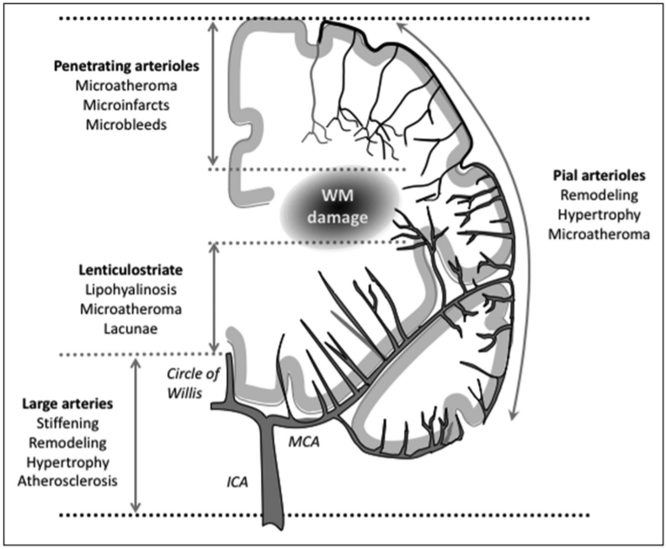
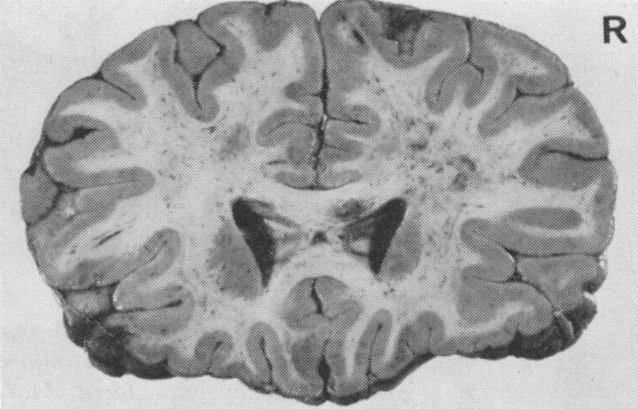
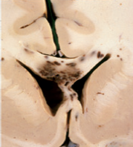

Why Are Vascular Disease and TBI So Damaging?
Strich, 1970
Diffuse Axonal Injury
Iadecola and Gottesman, 2019
Sharp, Scott,
and Leech, 2014
Small Vessel Disease
Caplan, 1995

Slide 13
Vascular Disease and Dementia
Vascular risk factors are all dementia risk factors
“Pure” AD is rare, and all major degenerative dementias – AD, PD, DLB, FTLD – have a vascular component, most notable in AD (Toledo et al. 2013)
“White matter is exquisitely vulnerable to ischemia” (Wang et al. 2016)
“Cerebral SVD causes 45-65% of dementias” (Hachinski et al. 2019)

Slide 14
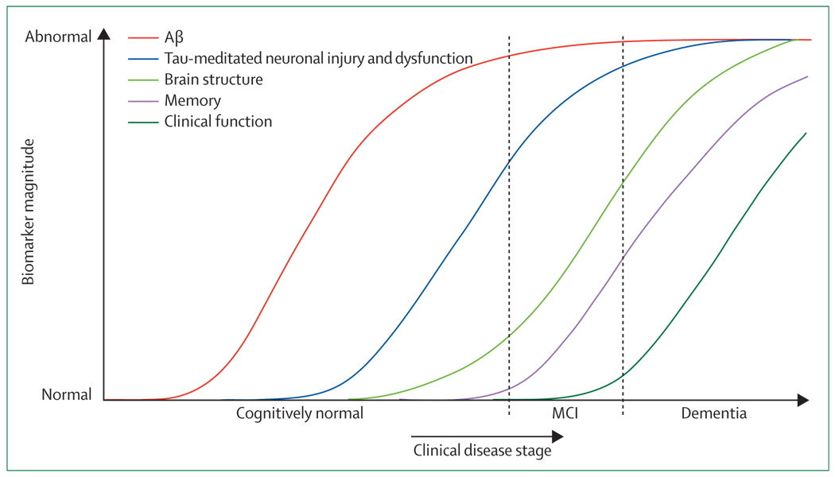
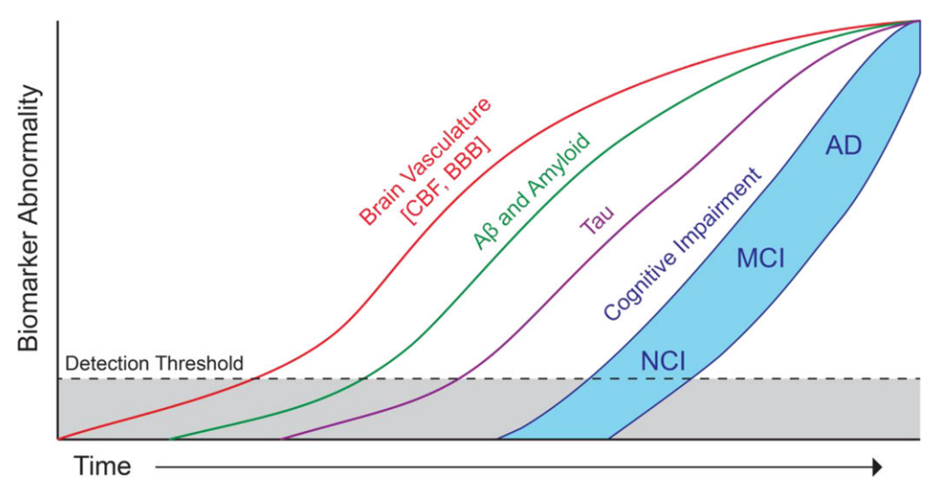
Etiopathogenesis of Alzheimer’s Disease: A Revised Perspective
Jack et al. 2010
Sweeney et al. 2018

Slide 15
Does AD Begin in the White Matter?
Bartzokis (2011) postulated the “myelin model” of AD
The initial damage of AD occurs in white matter, where myelin and oligodendrocytes are uniquely vulnerable to aging, ischemia, and TBI
Amyloid and tau are byproducts of normal homeostatic white matter repair processes
More recently, increased volume of white matter hyperintensities has been documented in people with early-onset AD mutations up to 20 years before the expected onset of symptoms (Nasrabady et al. 2018)

Slide 16
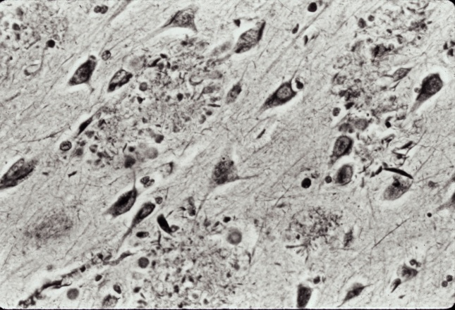
From White Matter Damage to AD
Environmental insults added to
white matter retrogenesis
Plaques and tangles probably matter, but are they primary?
Something happens in the brain before plaques, tangles, and dementia set in, and white matter is a logical place to look
???
AD
Dementia

Slide 17
Traumatic Brain Injury and Dementia
Mild TBI (Concussion) resolves in 90% over days to weeks, but 10% have post-concussion syndrome that may persist for years (Katz et al. 2015)
A recent meta-analysis concluded
that TBI of any severity increases
the risk of all-cause dementia,
including Alzheimer’s Disease
(Gardner et al. 2023)
50,000
Deaths
280,000
Hospitalizations
Return to work is possible
for only 2/3 of those with moderate TBI and 1/3 of those with severe TBI, and work is not at pre-injury levels (Sherer et al. 2000)
2,200,000
Emergency Department Visits
???
Receiving Other Medical Care or No Care
An estimated 2.5 million TBIs occur in the United States annually.
Notes:
http://www.ncbi.nlm.nih.gov/pubmed/23127680

Slide 18
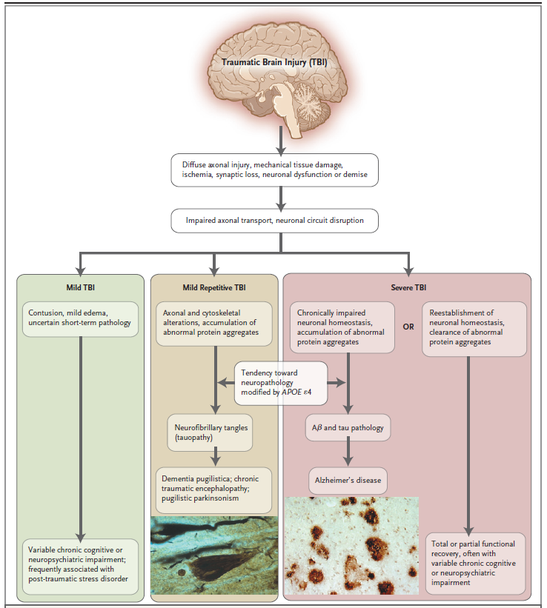
From TBI to Dementia
(DeKosky and Gandy, 2010)
DAI
Diffuse axonal injury may
lead not only to AD, but also to chronic traumatic encephalopathy
(CTE)
CTE
AD

Slide 19

But Just How Do We Get From White Matter Damage to Psychosis and Dementia?

Slide 20
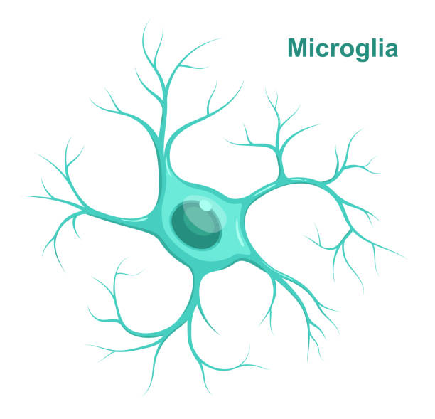
Much Evidence Implicates Neuroinflammation
Inflammation is present in virtually all brain diseases (Ravichandran and Heneka, 2024)
Microglia, the resident immune cells of the brain, are critical, and are in fact more abundant in white than gray matter (Mittelbronn et al. 2001)
Pathology promotes differentiation of microglia into M1 (toxic, pro-inflammatory, “activated”) or M2 (protective, anti-inflammatory) forms
While considering “good” vs. “bad” microglia is likely too simplistic (Paolicelli et al. 2022), reducing inflammation associated with microglia will likely benefit white matter (Groh and Simons, 2025)

Slide 21
Neuroinflammation, White Matter, and Psychosis
An acute inflammatory process related to stressful life events may precipitate the onset of psychosis (Woodberry et al. 2016)
Microglia activation is present in schizophrenic white matter (Najjar and Pearlman, 2015; Laskaris et al. 2016)
Pro-inflammatory cytokines and high CRP have been linked with lower FA in schizophrenic white matter (Prasad et al. 2015)
Interstitial white matter neurons are increased in white matter of schizophrenics, and are associated with an increase of pro-inflammatory cytokines (Najjar and Pearlman, 2015)

Slide 22
Neuroinflammation, White Matter, and Dementia
Microglia activation is robust in white matter of both early-onset and late-onset AD (Raj et al. 2017)
In the early phase of AD, microglial activation is more robust in white matter, and only with disease progression becomes comparable in white and gray matter (Xiang et al. 2006)
Lower CRP (indicating low systemic inflammation) correlates with higher FA in several frontal tracts (Bettcher et al. 2015)
Lifetime number of surgeries (increasing systemic inflammation) predicts lower memory and fornix integrity (Bateman et al. 2019)

Slide 23
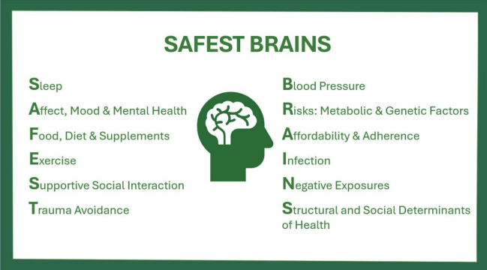
So What Is To Be Done?
As clinicians, we should help optimize the health of white matter
The AAN has endorsed the SAFEST BRAINS mnemonic, which is as reasonable for white matter as it is for the brain as a whole
Selwa et al. 2025

Slide 24
The Big Picture
White Matter Health
Clinical Care
(Vascular disease, TBI, many others)
Public Health
(Public policy, lifestyle modification trials)
Laboratory Investigation
(Neuroinflammation, repair, restoration, other ideas)

Slide 25
Conclusions
White matter undergoes an ontogenetic sequence whereby maximal volume is attained in mid-life
A wide range of insults affects white matter at all ages
As white matter vulnerability is greatest in the young and the old, abnormal myelin and oligodendrocytes may be crucial in the pathogenesis of psychosis in early adulthood and dementia in late life
Early-onset psychiatric diseases, and dementias including AD, all merit focused study in light of white matter neurobiology
Neuroinflammation may be a common pathogenetic mechanism
Prevention of brain insults – notably vascular and traumatic – is crucial
Medical and public health intervention to enhance brain health is essential

Slide 26

Thank You!

