Slide 1
Integrating Dementia Research in a Demographic and Health Surveillance Center in Southern Ethiopia
36th Annual GRAL Conference
Dr. Alemu Tamiso Debiso(PhD, Associate Professor)
Hawassa University, Ethiopia

Slide 2
Background about HDS
Longitudinal data gathered from health surveillance, when combined with detailed demographic information, can provide invaluable insight into disease outcomes(Margaret & Stuart, 2008)
In developing countries, and in particular those that lack effective vital registration systems, small-scale combined Demographic and Health Surveillance (DHS) systems can provide invaluable field data on longitudinal patterns(Sankoh, Chandramohan, Baiden and Ngom)
DHS systems are distinct from demographic and health surveys.
The former represent long-term monitoring of specifically defined populations, typically residing in a small geographic region, while the latter are one-time representative samplings of a country or region(Measure DHS, 2008)

Slide 3
Background…
A health and demographic surveillance system (HDSS) is a population-based health and vital event registration system that regularly monitors demographic and health events in a geographically defined population (Sankoh et all, 2005).
These events include births, deaths, and migration, and are updated periodically, with intervals ranging from quarterly to biannual to yearly (Clark, 2005).
Such a dynamic platform can detect new health events, track long-term population changes through fertility and migration rates, and measure interventions' effectiveness, thereby generating evidence to guide health policy and programmatic decision-making (Ye, 2012).

Slide 4
History of HDS
20th century
HDSS emerged in the mid-20th century as a response to the need for detailed, continuous mortality and morbidity data in low-income countries (Herbst and Network).
1956
The earliest HDSS sites include the Gwembe HDSS (Zambia), established in 1956
1986
The first HDSS in Ethiopia was Butajira HDSS, established in 1986(Berhane Y 2000).
2023
Subsequently, many universities in Ethiopia have established HDSS sites, mainly in rural areas (EPHI

Slide 5
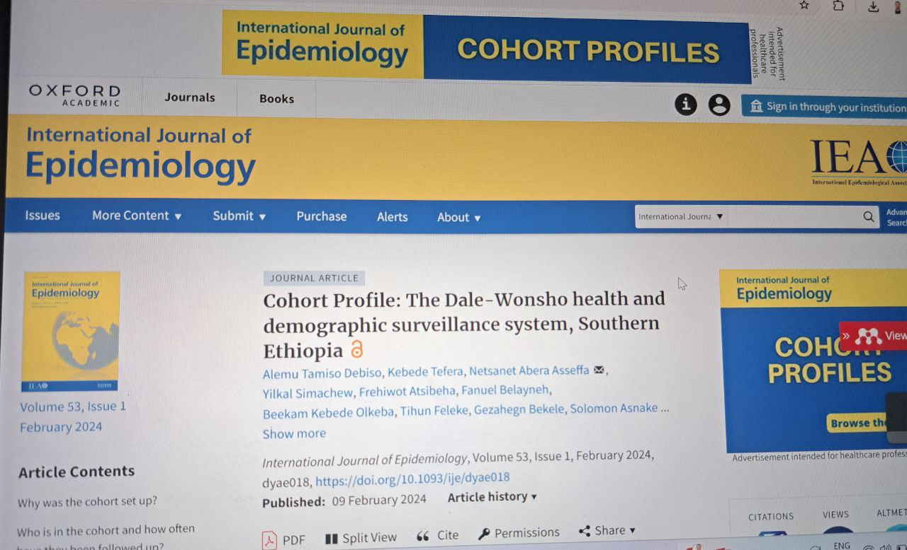
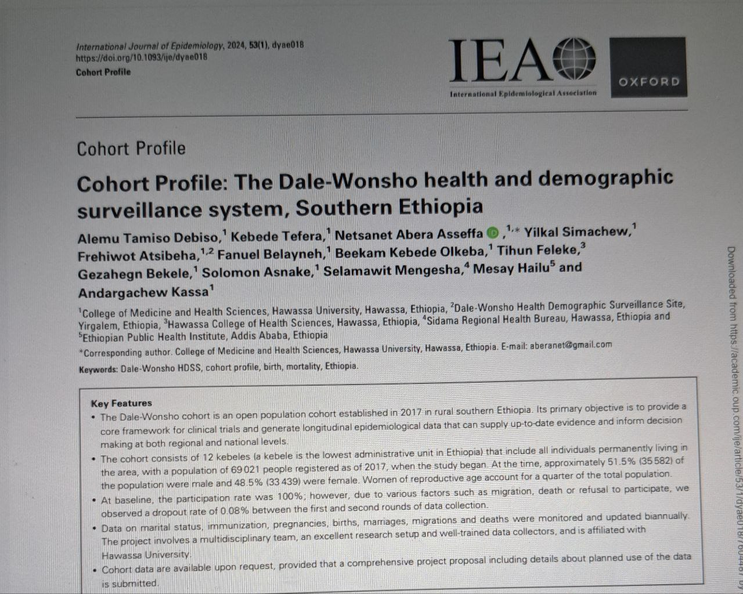
Website
(https://academic.oup.com/ije/article/53/1/dyae018/7604487)

Slide 6
Dale-Wonsho Surveillance site
The Dale-Wonsho cohort is an open population cohort established in 2017 in rural southern Ethiopia.
Its primary objective is to provide a core framework for clinical trials and generate longitudinal epidemiological data that can supply up-to-date evidence and inform decision making at both regional and national levels.
The cohort consists of 12 kebeles (a kebele is the lowest administrative unit in Ethiopia) that include all individuals permanently living in the area, with a population of 69 021 people registered as of 2017, when the study began.

Slide 7
Dale Wonsho…..
At the time, approximately 51.5% (35 582) of the population were male and 48.5% (33 439) were female. Women of reproductive age account for a quarter of the total population.
At baseline, the participation rate was 100%; however, due to various factors such as migration, death or refusal to participate, we observed a dropout rate of 0.08% between the ﬁrst and second rounds of data collection.
Data on marital status, immunization, pregnancies, births, marriages, migrations and deaths were monitored and updated biannually.
The project involves a multidisciplinary team, an excellent research setup and well-trained data collectors, and is afﬁliated with Hawassa University.

Slide 8
Dale Wonsho…..
The Dale-Wonsho cohort is located in southern Ethiopia.
It is one of the most densely populated areas in southern Ethiopia, with a population density of 533 persons/km².
The Dale district covers an area of 30 212 km², situated at latitude 6.6931◦ or 6◦ 41' 35''N and longitude 38.35461◦ or 38◦ 21' 17''E, with a population of 268 839 people and an estimated 53 768 households.
Dale district consists of 36 rural and two urban kebeles, which are the lowest administrative structures.

Slide 9
Dale Wonsho…..
Wonsho district covers an area of 14 528 km², inhabited by 129 730 people living in 17 rural and one urban kebele, with a total of 21 857 households.
Both districts are renowned for their coffee and crop production and sale.
Dale district has 10 health centres and 33 health posts, whereas Wonsho district has five health centres and 17 health posts.

Slide 10
Dale Wonsho…..
Agriculture is the primary source of income for the inhabitants of the site, who primarily produce Enset (false banana) coffee, maize, teff, barley and a variety of fruits, vegetables and livestock.
There is one government general hospital and 15 health centres that provide medical services, as well as 53 health posts and eight private clinics.
The Dale-Wonsho cohort was established in 2017 to ad- dress the lack of comprehensive health and demographic data in rural southern Ethiopia.

Slide 11
Dale Wonsho…..
This issue is particularly pressing in developing countries like Ethiopia, where resource constraints limit the ability to conduct regular registration, census and national population-based surveys and surveillance systems.
As a result, there is often a dearth of health and demographic information at the community or population level, making it difficult to assess health trends accurately and identify areas in need of intervention.
To help address this problem, the site was designed to provide reliable demographic and health indicators for a rural population.
By establishing a continuous systematic registration of vital events, it aims to complement episodic

Slide 12
Dale Wonsho…..
Demographic and health surveys (DHS) by collecting longitudinal data over time, often with multiple household surveys.
This approach allows for a more comprehensive understand- ing of health trends and patterns in the region, enabling researchers and policy makers to make better-informed decisions about public health and development initiatives.
Overall, the cohort serves as a valuable resource for both researchers and policy makers, providing them with accurate and up-to-date data to guide decision making and improve the health and wellbeing of populations in rural Ethiopia.

Slide 13
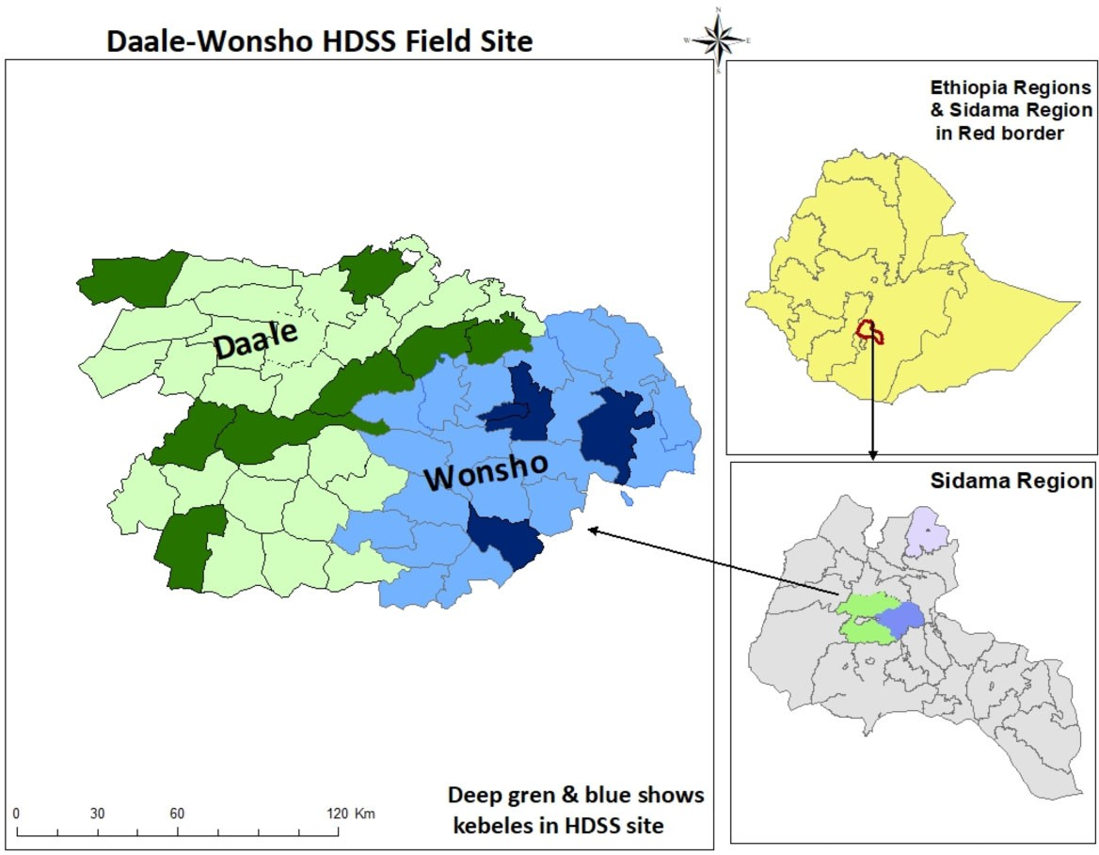
Dale Wonsho…..

Slide 14
Dale Wonsho…..
Who is in the cohort and how often have they been followed up?
The Dale-Wonsho demographic and health survey system [HDSS] is an open cohort. We enrol new participants and up- date our database every 6 months, including 12 kebeles of all individuals who reside permanently in the area.
Individuals who are visiting or have lived in the study site for less than 6 months are not considered residents.
During the initiation of the HDSS in 2017, the study area was mapped, and a census of the population was conducted.

Slide 15
Dale Wonsho…..
Who is in the cohort…
The estimated number of households in the selected kebeles was 13965, with a total population of 69 021 individuals registered.
Following the baseline census, household and individual attributes have been updated biannually.
All residents were assigned a unique 12-digit identification number comprising the 3-digit ‘Got’ code, 3-digit for Open HDS, 3- digit house- hold number and a 3-digit personal number serially assigned to residents of each household.

Slide 16
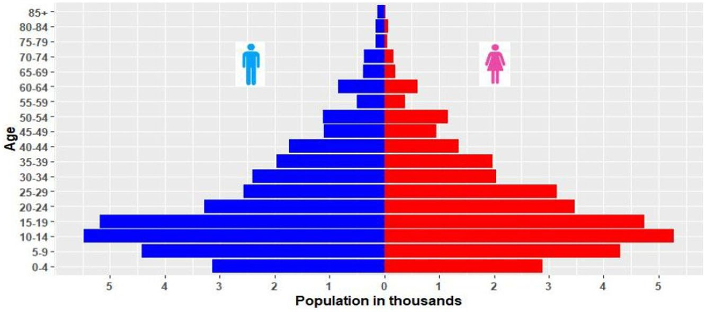
Who is in the cohort…

Slide 17
Dale Wonsho…..
Through initial enumeration, birth or in-migration and data collection is completed within 3 months.
As such, we have a dynamic population under observation, and our sample size changes over time.
We did experience some non-participation from households within the kebeles included in our study area.
Specifically, we had a participation rate of 100% at baseline, all households agreeing to participate in the first round of data collection.
However, due to factors such as migration, death or refusal to participate, we observed a dropout rate of 0.08% between the first and sec- ond rounds of data collection.

Slide 18
Dale Wonsho…..
What has been measured?
The site collects longitudinal, population-based data on demographics (including births, deaths, marriages, pregnancies and migrations), health and socioeconomic information from the surveillance population.
During the baseline survey in 2017, data were collected on different variables such as sociodemographic characteristics, birth, income, family planning and disease conditions.
Now in the second round and third round (not completed yet), it has added variables such as detailed birth information, immunization, antenatal care follow-up, migration and marital status changes (Table 1).

Slide 19
Dale Wonsho…..
In upcoming rounds, the survey will expand to include an
additional district, and there are also plans to implement verbal autopsies using World Health Organization standards, as well as to collect data on other diseases.
Although there is a plan to link data with other datasets, this has not yet begun.

Slide 20
Dale Wonsho…..

Slide 21

Dementia study in demographic and surveillance center
Problem Statement
The World Health Organization projects that by the year 2025, nearly 75% of people aged ≥ 60 years will be living in developing countries.
Unless tangible steps are taken to address aging-related diseases and disability, this could have a devastating consequence to the already weak economies of low-income countries.
It is estimated that the prevalence of AD will quadruple by 2050 (Brookmeyer et al., 2007), and the projected number of people living with dementia in eastern part of sub-Saharan Africa that includes Ethiopia is projected to be one of the highest in the world, with an estimated 357%

Slide 22
Dementia study…
To the best of our knowledge, no population-based study on dementia or AD/ ADRD was done in Ethiopia.
The frequency of dementia from convenience samples in Ethiopia is largely unreliable, ranging from 2-43%, and only some studies used sensitive screening instruments to estimate the frequency and distribution of dementia
Therefore, Integrating Dementia research to a population-based study in Ethiopia, specifically Southern parts of the country, would help bridge this knowledge gap and provide valuable insights into the epidemiology of Dementia in Ethiopia.

Slide 23
Dementia study…
Understanding the population-based prevalence of dementia using validated tools, and identification of risk factors specific to Ethiopia is essential for developing targeted interventions and healthcare strategies.
AD/ ADRD also have significant public health implications, affecting not only individuals but also their families, caregivers, and communities.
Thus, findings also helps to identify vulnerable populations and may guide the development of preventive measures, early detection strategies, and appropriate interventions to mitigate the impact of the disease.

Slide 24
Dementia study…
Conducting research in the demographic and health surveillance center of Southern cohort located in Dale-Wensho, which is the demographic and health surveillance center of the School of Public Health of Hawassa University will allow for a deeper understanding of the cultural and contextual factors that contribute to the prevalence and impact of dementia.
This knowledge can inform culturally sensitive interventions and support systems tailored to the specific needs of the communities
Therefore, the proposed studies will lay down the foundation in order to unravel the complex gene-environment interactions on dementia among Ethiopians.

Slide 25
Dementia study…
In summary, findings from the proposed blood-based biomarkers, genetic/ epigenetic studies will inform the design and conduct of larger studies that address preventative and therapeutic aspects of AD/ ADRD.
Furthermore, conducting research on Dementia in Ethiopia also presents an opportunity for collaboration between local and international researchers, institutions, and organizations.
This provides a logistical convenience to scale up in Africa, if and when solid AD/ ADRD data are acquired in a population-based setting in Ethiopia.

Slide 26
Thanks

