Slide 1
Traumatic Brain Injury
in Aging Populations
Javier Cárdenas, MD
Ludwig Gutmann Endowed Chair
Professor & Chief, Division of Sports Neurology
Director, Concussion & Brain Injury Center
Director, NeuroPerformance Innovation Center

Slide 2
Disclosure
NFL Unaffiliated Neurotrauma Consultant
Vice chair, NFL Head Neck & Spine Committee
NCAA Concussion Advisory Group Member
Senior Medical Advisor, NFL

Slide 3
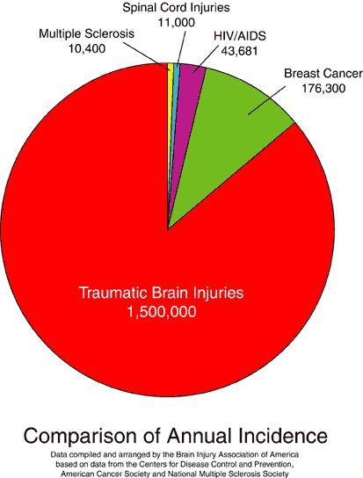
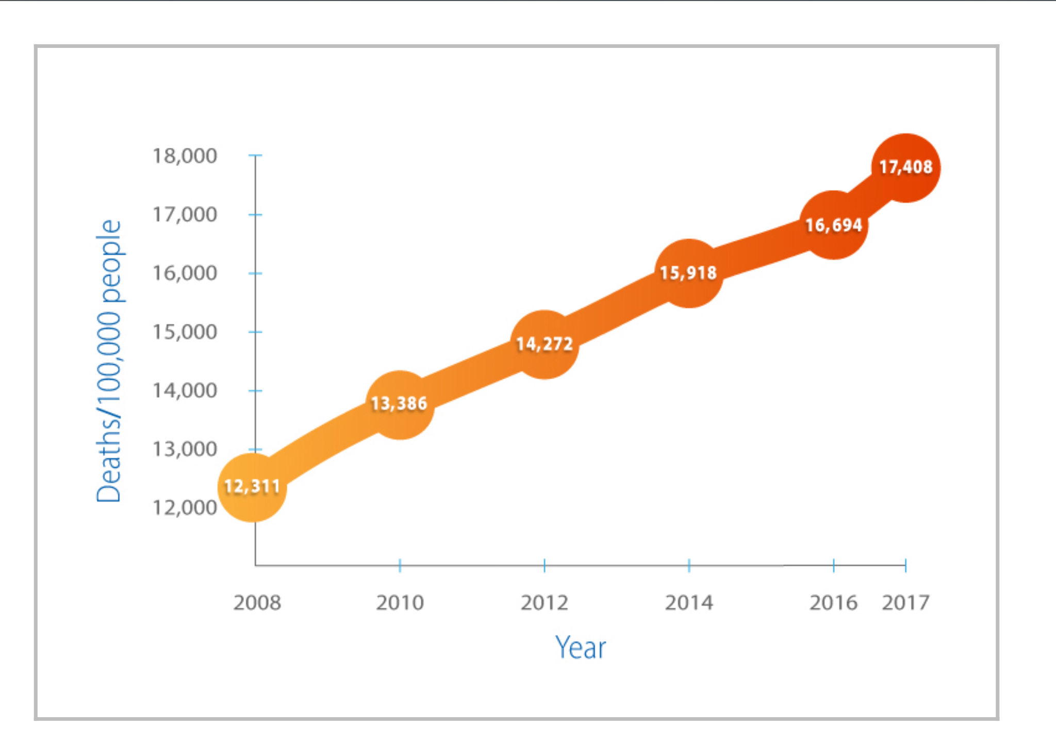
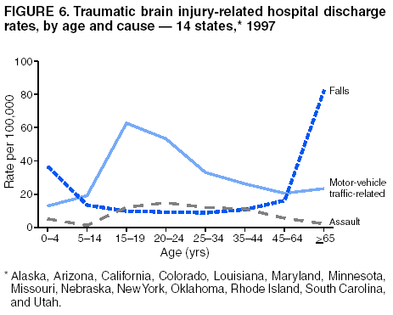
Background
Traumatic brain injury (TBI) is the most common cause of morbidity and mortality in
children and young adults.
Falls are the most common cause of TBI (aging population)
90% of injury related deaths are due to TBI
1.4 million TBIs occur annually in the U.S.
1 million treated in the ED
300, 000 hospitalized and survive
50 – 75,000 die
Direct and indirect costs are $57.8 billion annually in the US.
Average inpatient cost over $150,000

Slide 4
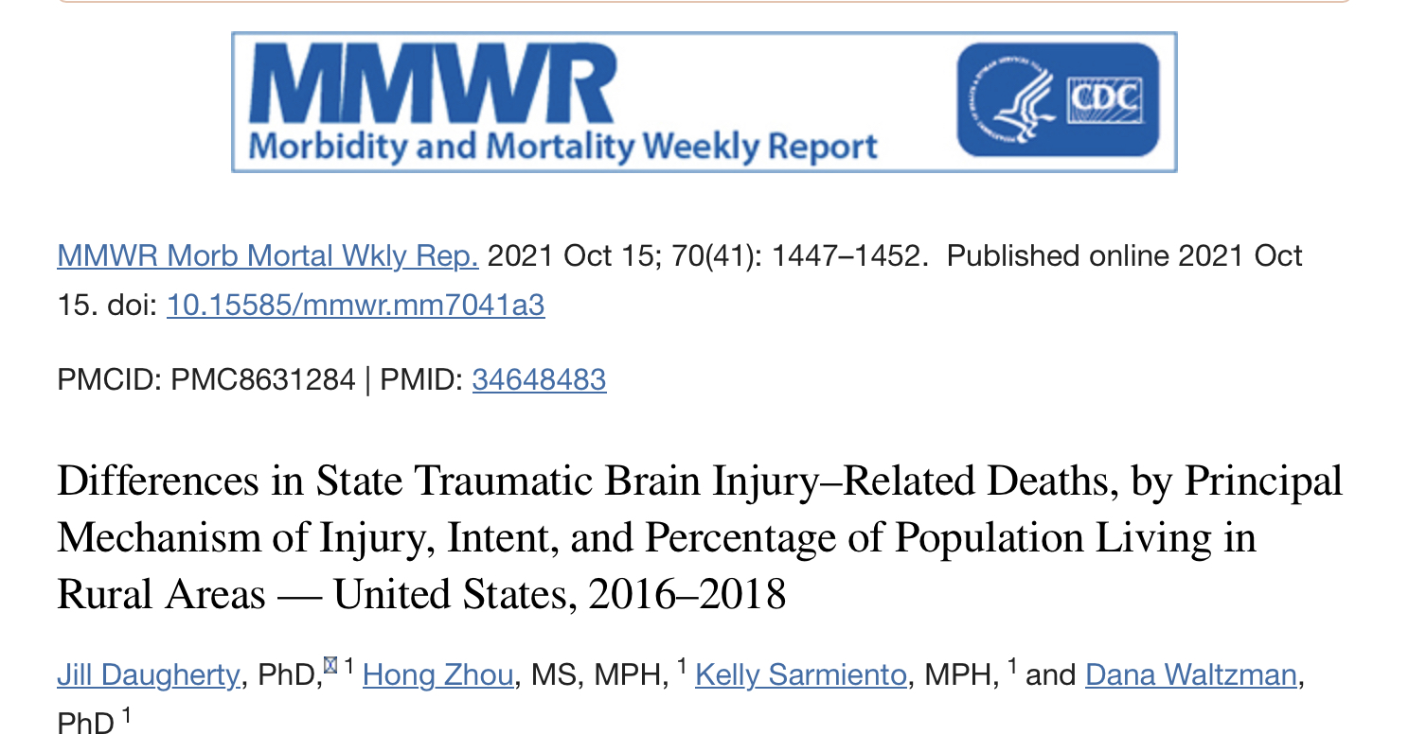
TBI Deaths
MMWR
2016-2018
181,227 TBI related deaths (17.3/100,000)
Lowest state - New Jersey (9.3/100,000)
Highest state - Alaska (343.8/100,000)
Correlated with rurality (lowest in Northeast, highest in South)
44% due to intentional causes (suicide > homicide)
In 43 states, suicide #1 cause of TBI related death.

Slide 5
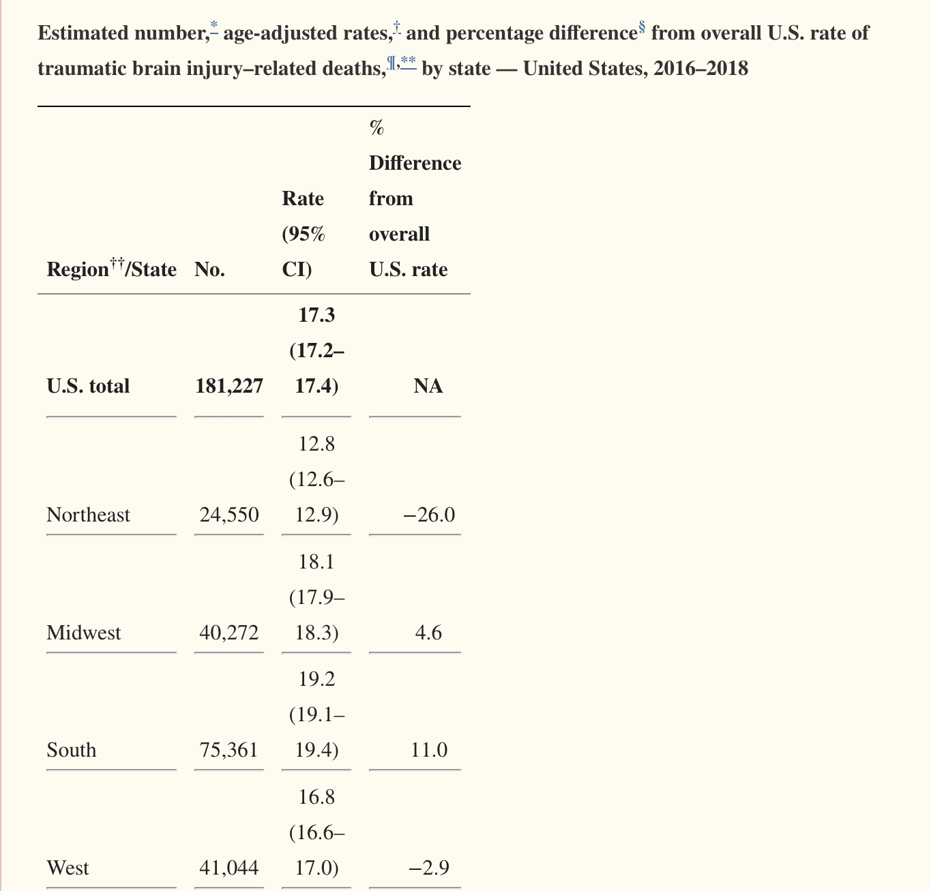

Slide 6
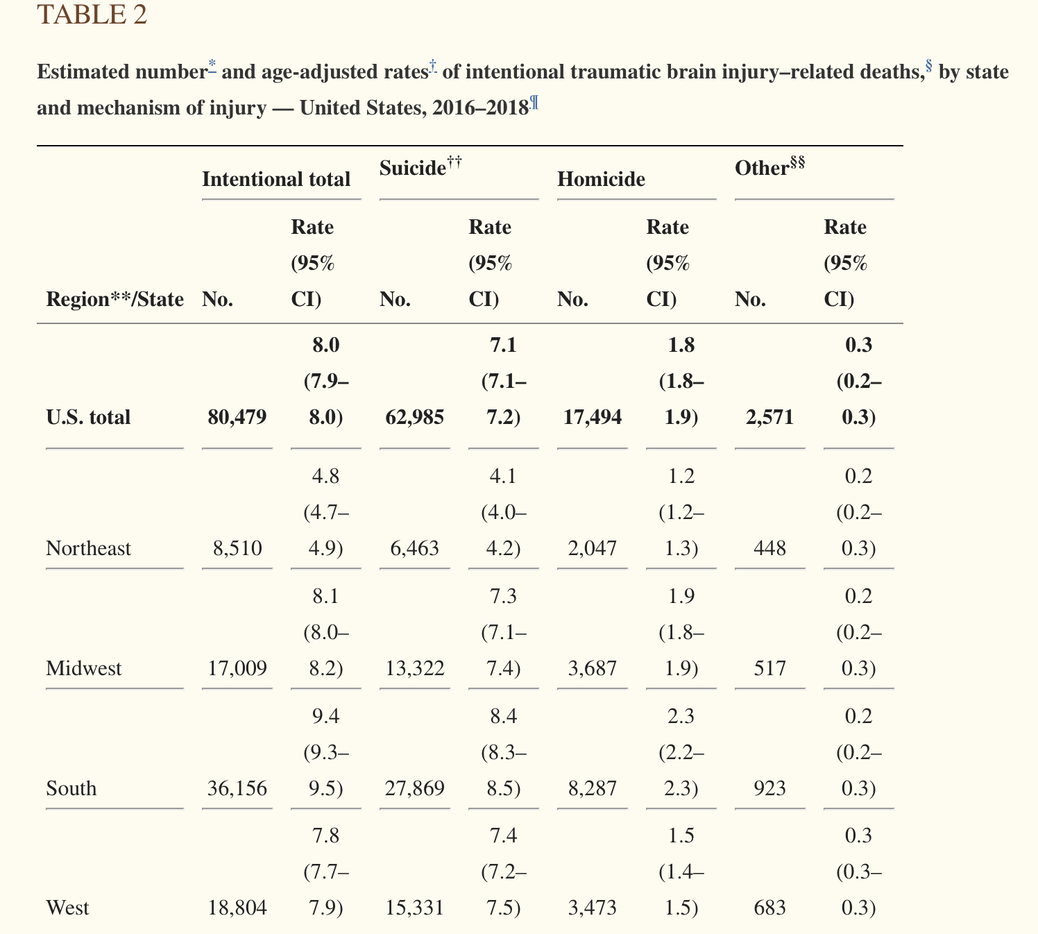
West Virginia

Slide 7
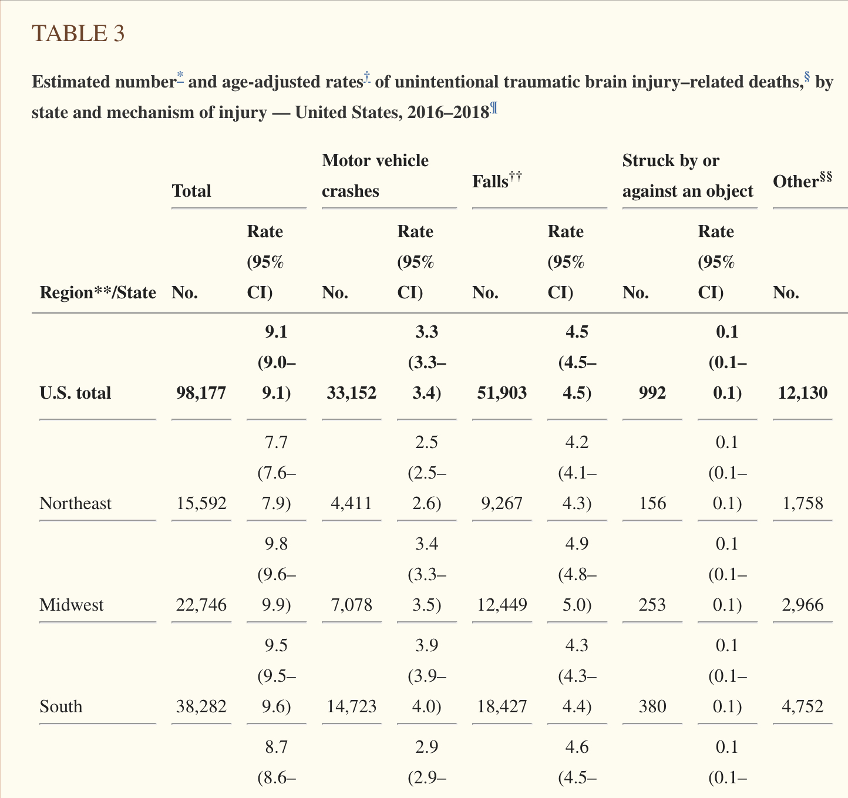
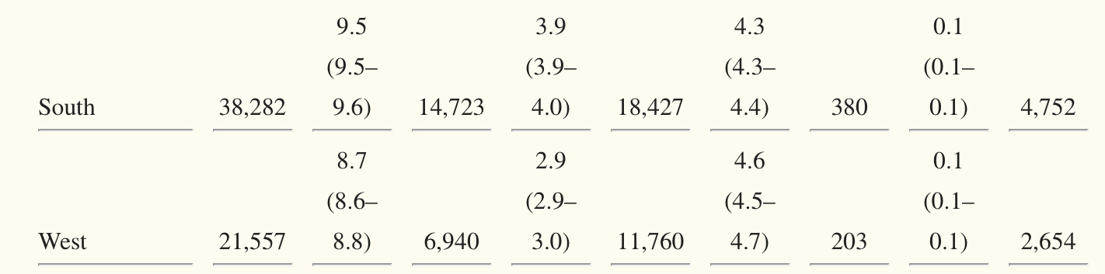
West Virginia

Slide 8
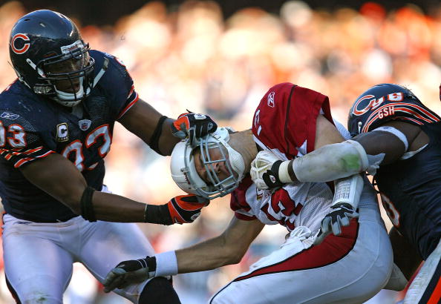
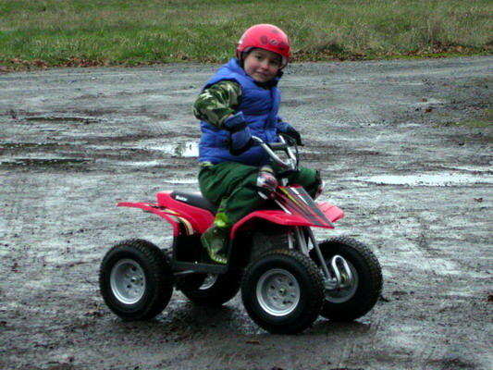
Epidemiology
Males are twice as likely as females to sustain a head injury.
Football is the most common cause of sports-related injury.
ATV accidents result in a disproportionate number of childhood head injury and death.
Children less than 2 years old are at highest risk for non-accidental trauma.
Falls are the most common mechanism of injury

Slide 9
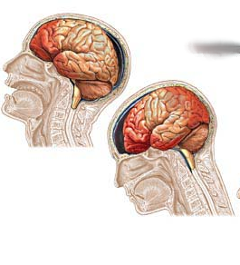
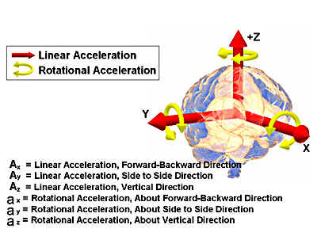
Pathophysiology of TBI
Primary Injury (initial mechanical force)
Acceleration/ deceleration injury
Linear forces
Rotational forces
All result in physical disruption of cell membranes.
All head injury has some degree of axonal damage.
Secondary Injury
Hypoxia, ischemia, reperfusion injury
May start at time of injury
1/3 of those who die after TBI talk/
obey commands immediately after
injury.

Slide 10
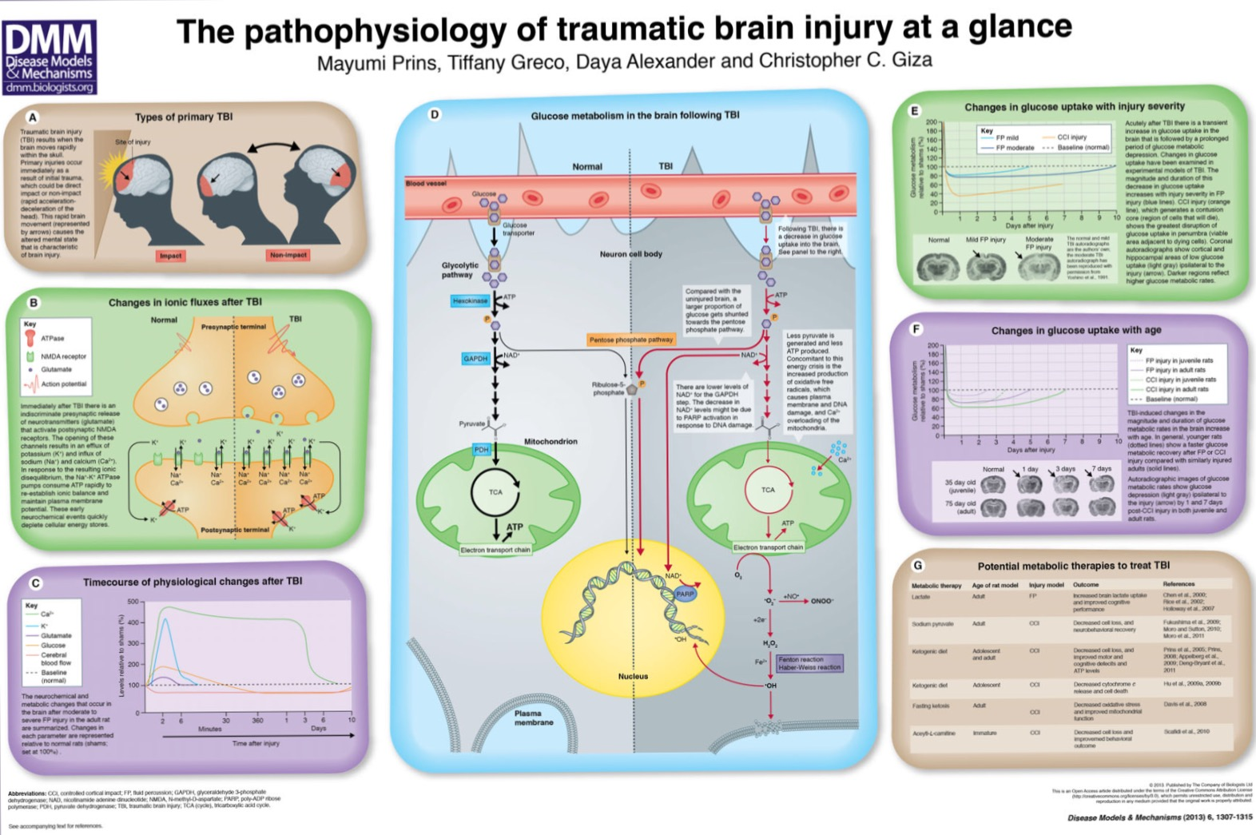
Pathophysiology of TBI

Slide 11
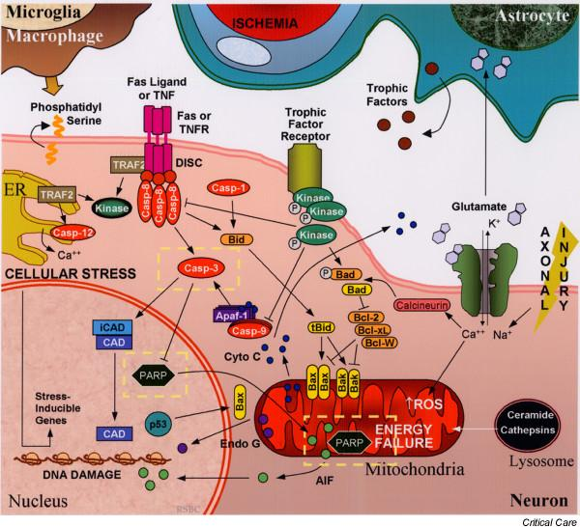
Molecular Pathophysiology of TBI

Slide 12
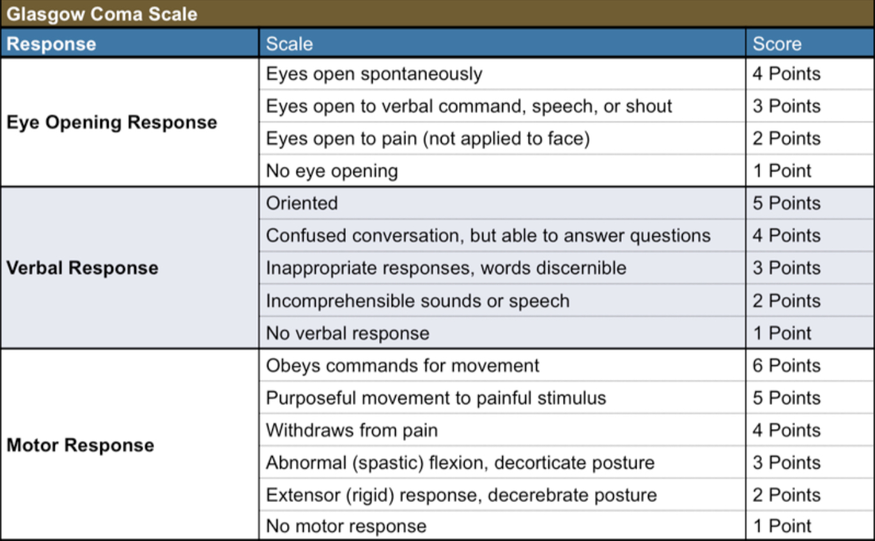
Current Clinical Classification

Slide 13
Current Clinical (GCS) Classification
Mild
(13-15)
Moderate
(9-12)
Severe
(3-8)
GCS Score
TBI Epidemiology

Slide 14
TBI Grading
TBI | GCS | PTA | Witnessed LOC
Mild (Concussion) | 13-15 | <1 day | 0-30 minutes
Moderate | 9-12 | 1 - 7 days | 30min to <24 hours
Severe | 3-8 | > 7 days | >24 hours

Slide 15
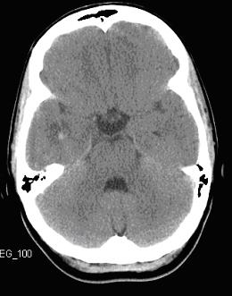
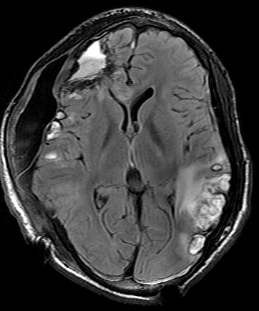
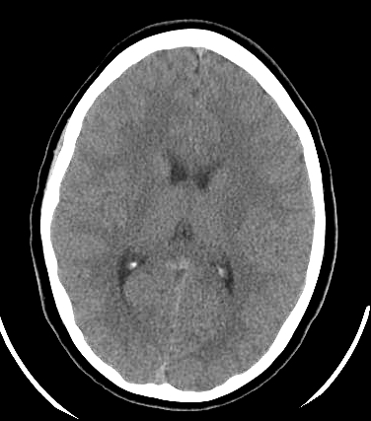
Current TBI Grading and Imaging
TBI | GCS
Mild | 13-15
Moderate | 9-12
Severe | 3-8

Slide 16
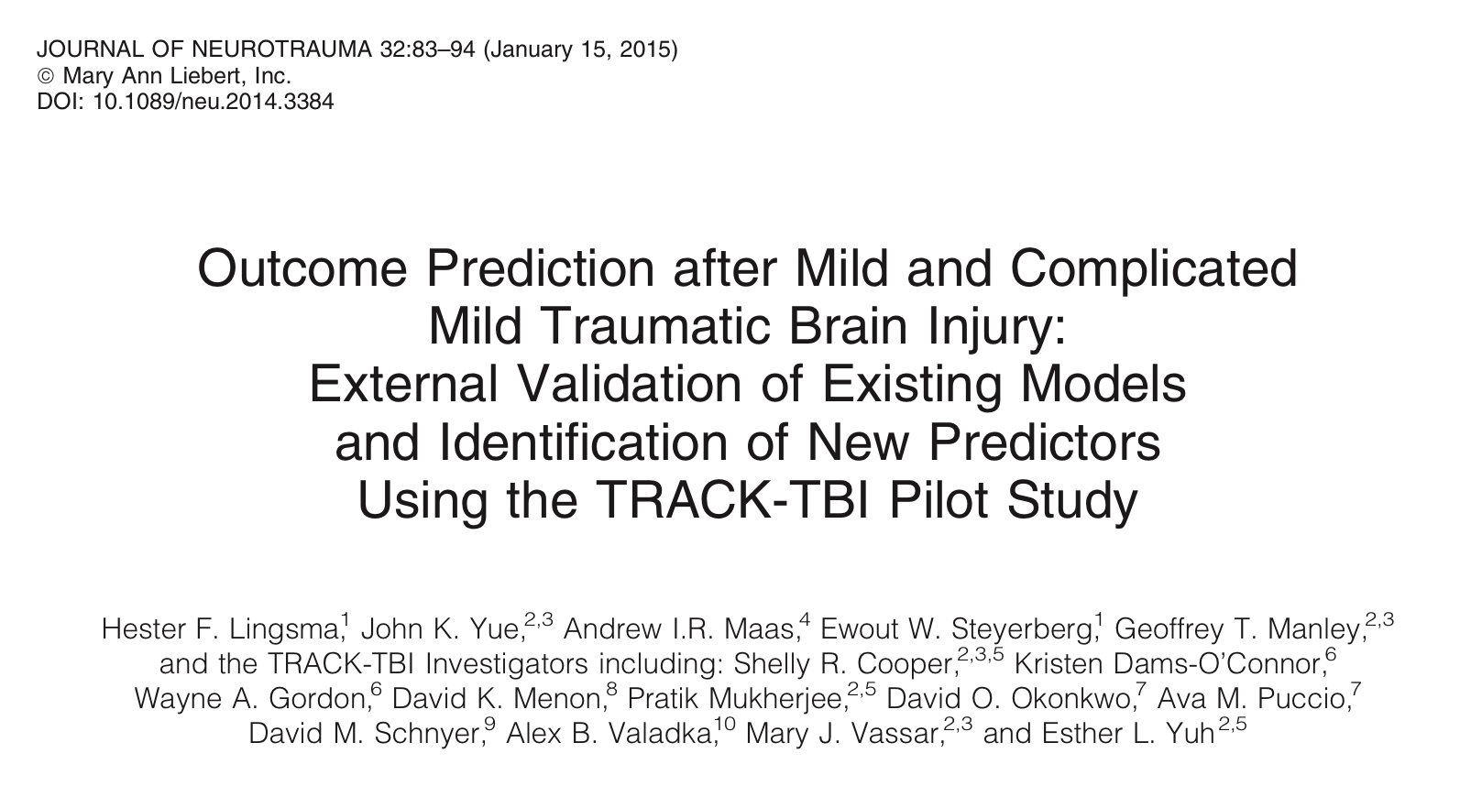
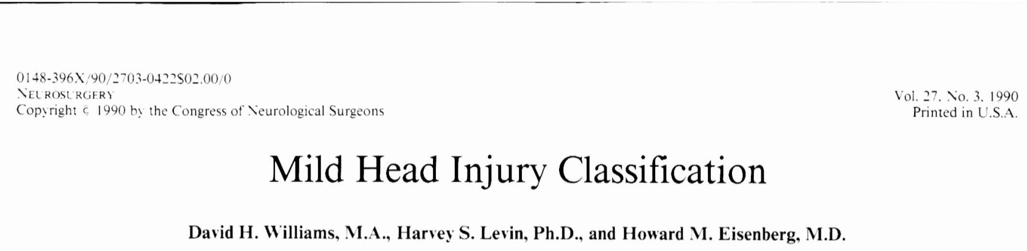
It’s Complicated
Complicated mild traumatic brain injury
Williams, et al Mild head injury classification. Neurosurgery, 1990
addition of “complicated” mTBI for clinical mild TBI, but imaging positive
Outcomes in “complicated” mTBI more like moderate TBI
Transforming Research and Clinical Knowledge in Traumatic Brain Injury
TRACK TBI
International, multi center (18) level 1 trauma center study - Geoff Manley, UCSF
Complicated Mild Traumatic Brain Injury study
Lingsma, et al J. Neurotrauma, 2015
“Complicated” mTBI predictive of worse outcome
Age (older), per morbid psychiatric condition, lower education more predictive
Assault, extracranial injury, lower GCS (still mild) also predictive

Slide 17
Chronic Subdural Hematoma
Increasing problem in aging population
Increasing use of anti-coagulation and anti-platelet medications
Estimated scope of the problem
By 2030
60,000 new cases of SDH annually
17-20 per 100,000 in US annually
Double rate of aneurysmal SAH
Outcome
Death
Disability
Seizures

Slide 18
MMA Embolization
Pathophysiology of cSDH
Cycle of chronic inflammation and angiogenesis
Angiogenesis - in growth of immature capillaries - leak blood chronically
Middle meningeal artery embolization
Goal is top devascularize subdural membranes
Polyvinyl alcohol particles often used
Challenges
Meningeal arteries are small
Small amount of PVA injected
Treatment is pre or post subdural evaluation
Most publications from single center studies
Fiorella D, Arthur AS. Middle meningeal artery embolization for the management of chronic subdural hematoma. J Neurointerv Surg. 2019 Sep;11(9):912-915. doi: 10.1136/neurintsurg-2019-014730. Epub.

Slide 19
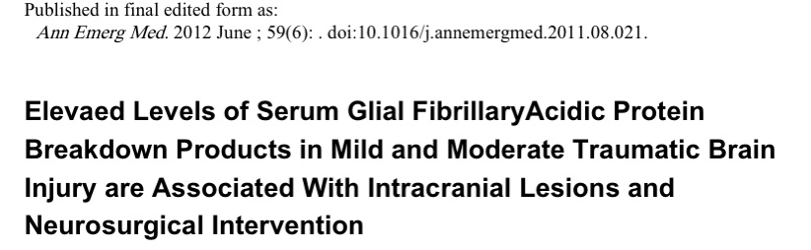
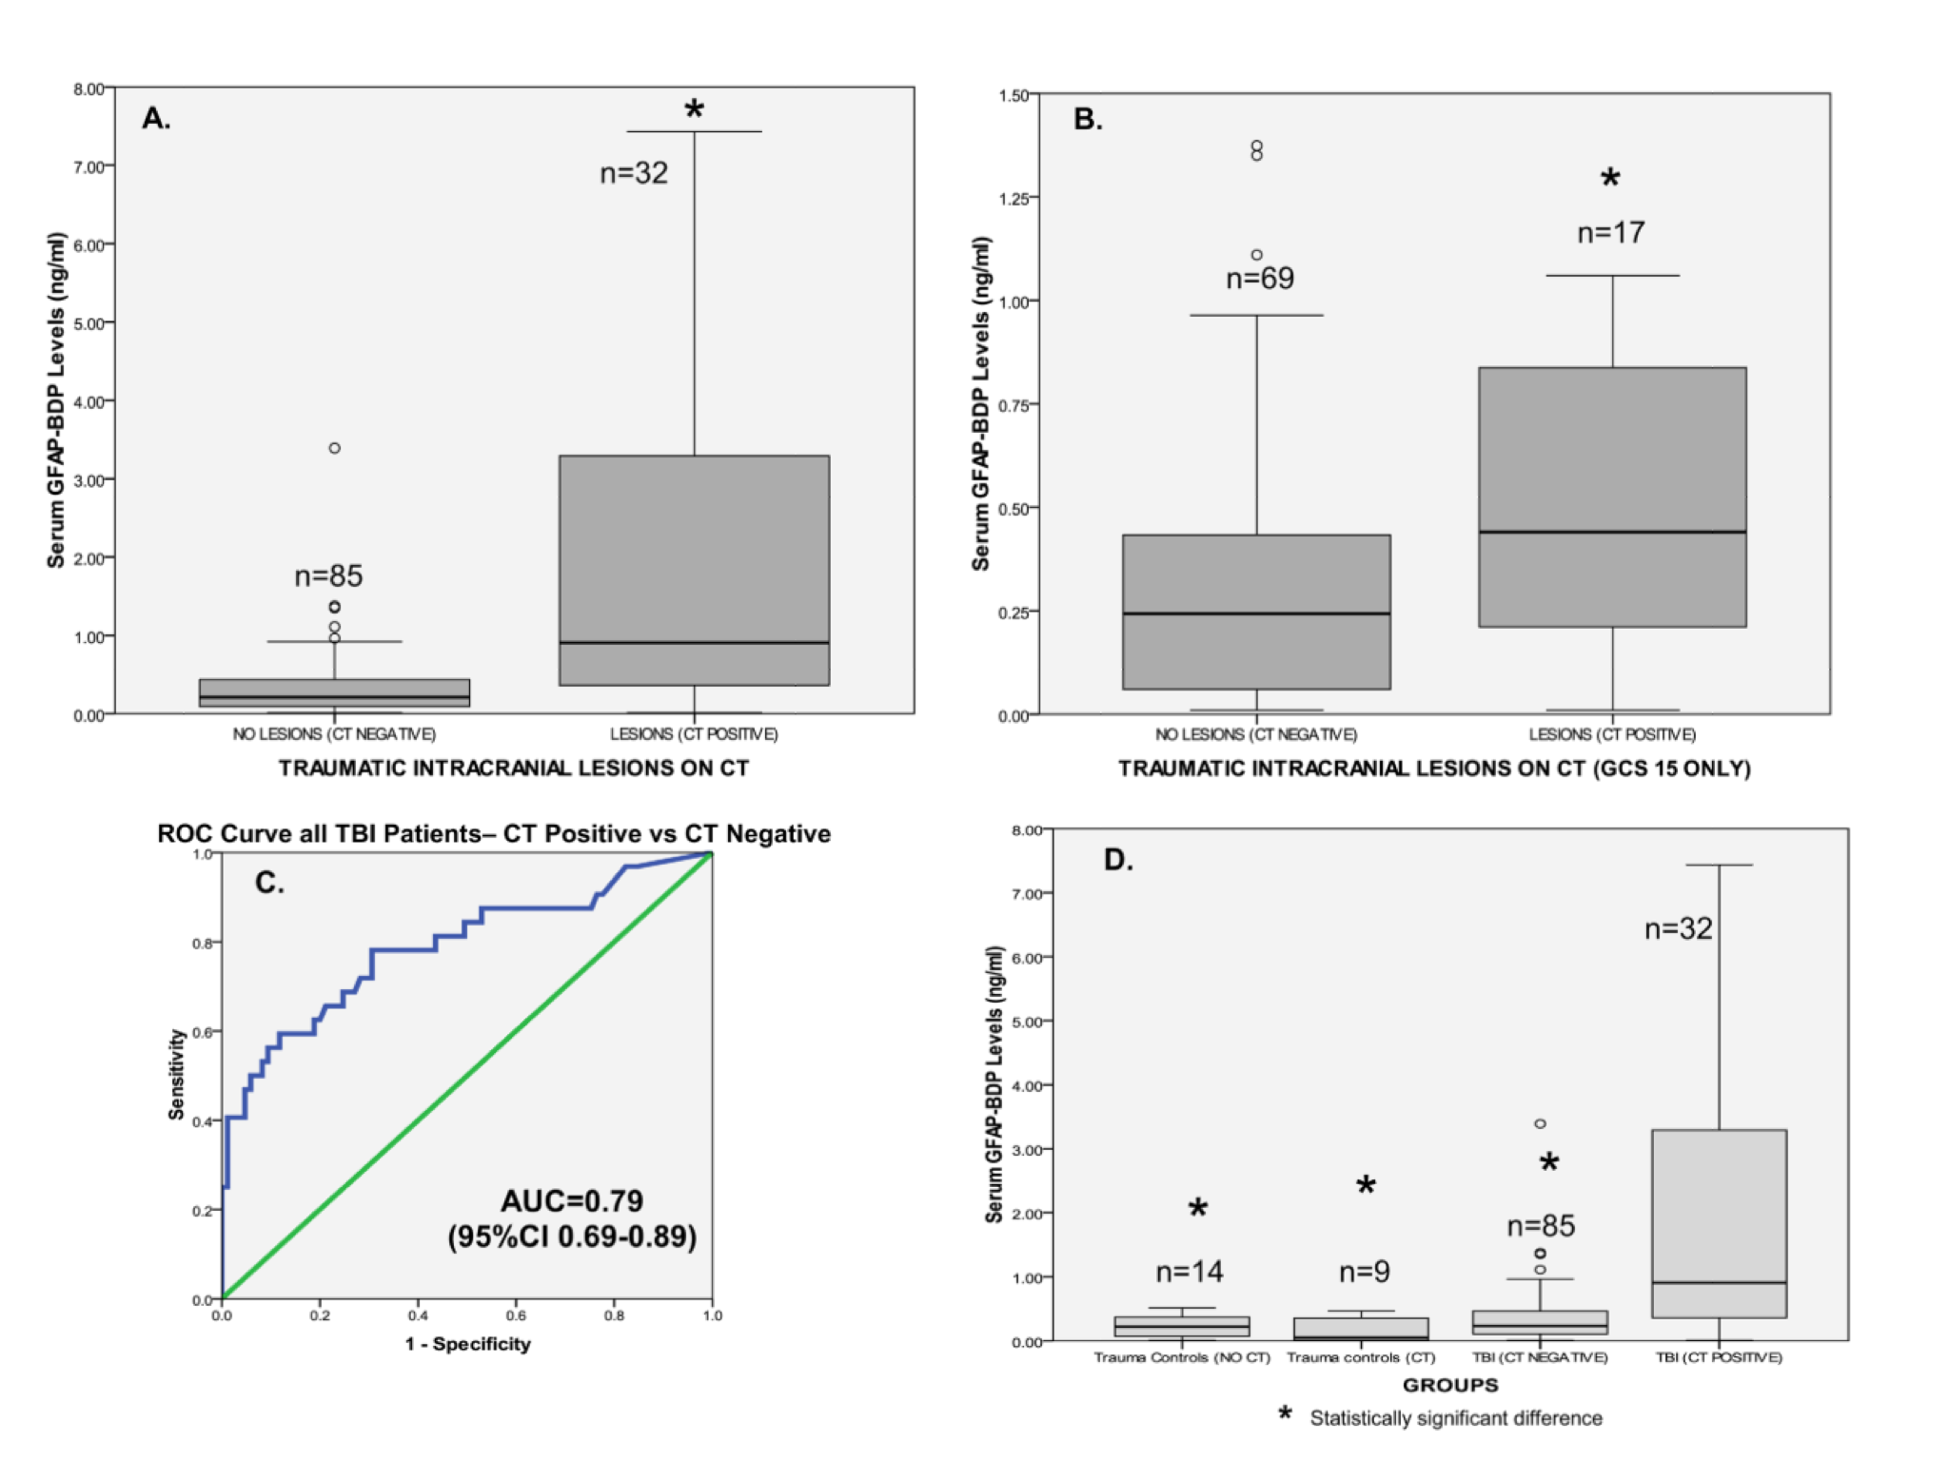
Blood based Biomarkers
Glial Fibrillary Acidic Protein
Marker of astrocyte injury.
Up to a 100-fold increase in GFAP levels in serum of patients after head injury compared to controls
Found to peak in the first few days post-injury with a gradual decline during the first week.
Release and expression is brain-specific
Giza, C et al. N-Methyl-D-Aspartate receptor subunit changes after traumatic injury to the developing brain. J. Neurotrauma 2006; 23:(6) 950-961

Slide 20
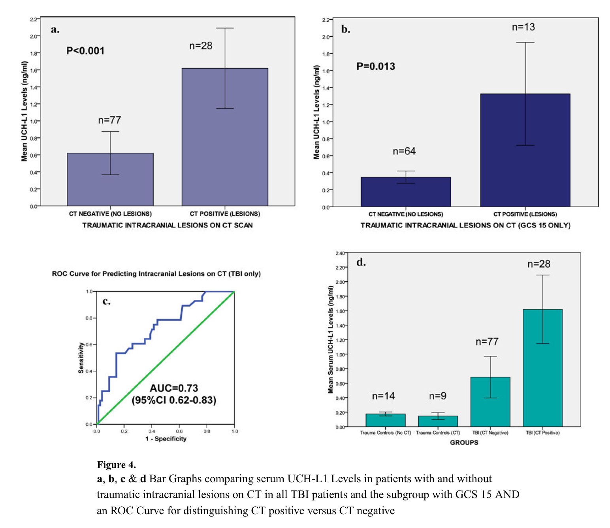
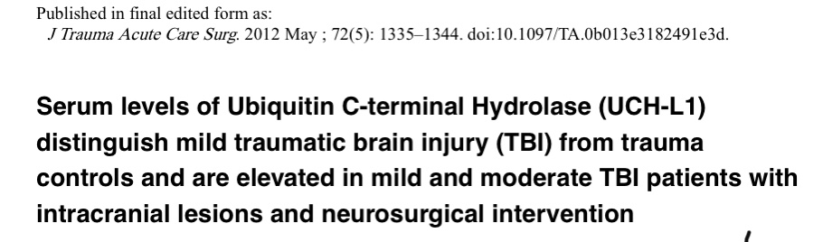
Blood based Biomarkers
Ubiquitin Carboxyl Terminal Hydrolase-L1
Protein of neuronal origin that has been identified as an appealing biomarker candidate.
May distinguish focal from diffuse brain injury
Detectable in serum within 1 hour of head injury
Increased levels are correlated with more severe injuries.
Most work done by a single center.
Giza, C et al. N-Methyl-D-Aspartate receptor subunit changes after traumatic injury to the developing brain. J. Neurotrauma 2006; 23:(6) 950-961

Slide 21
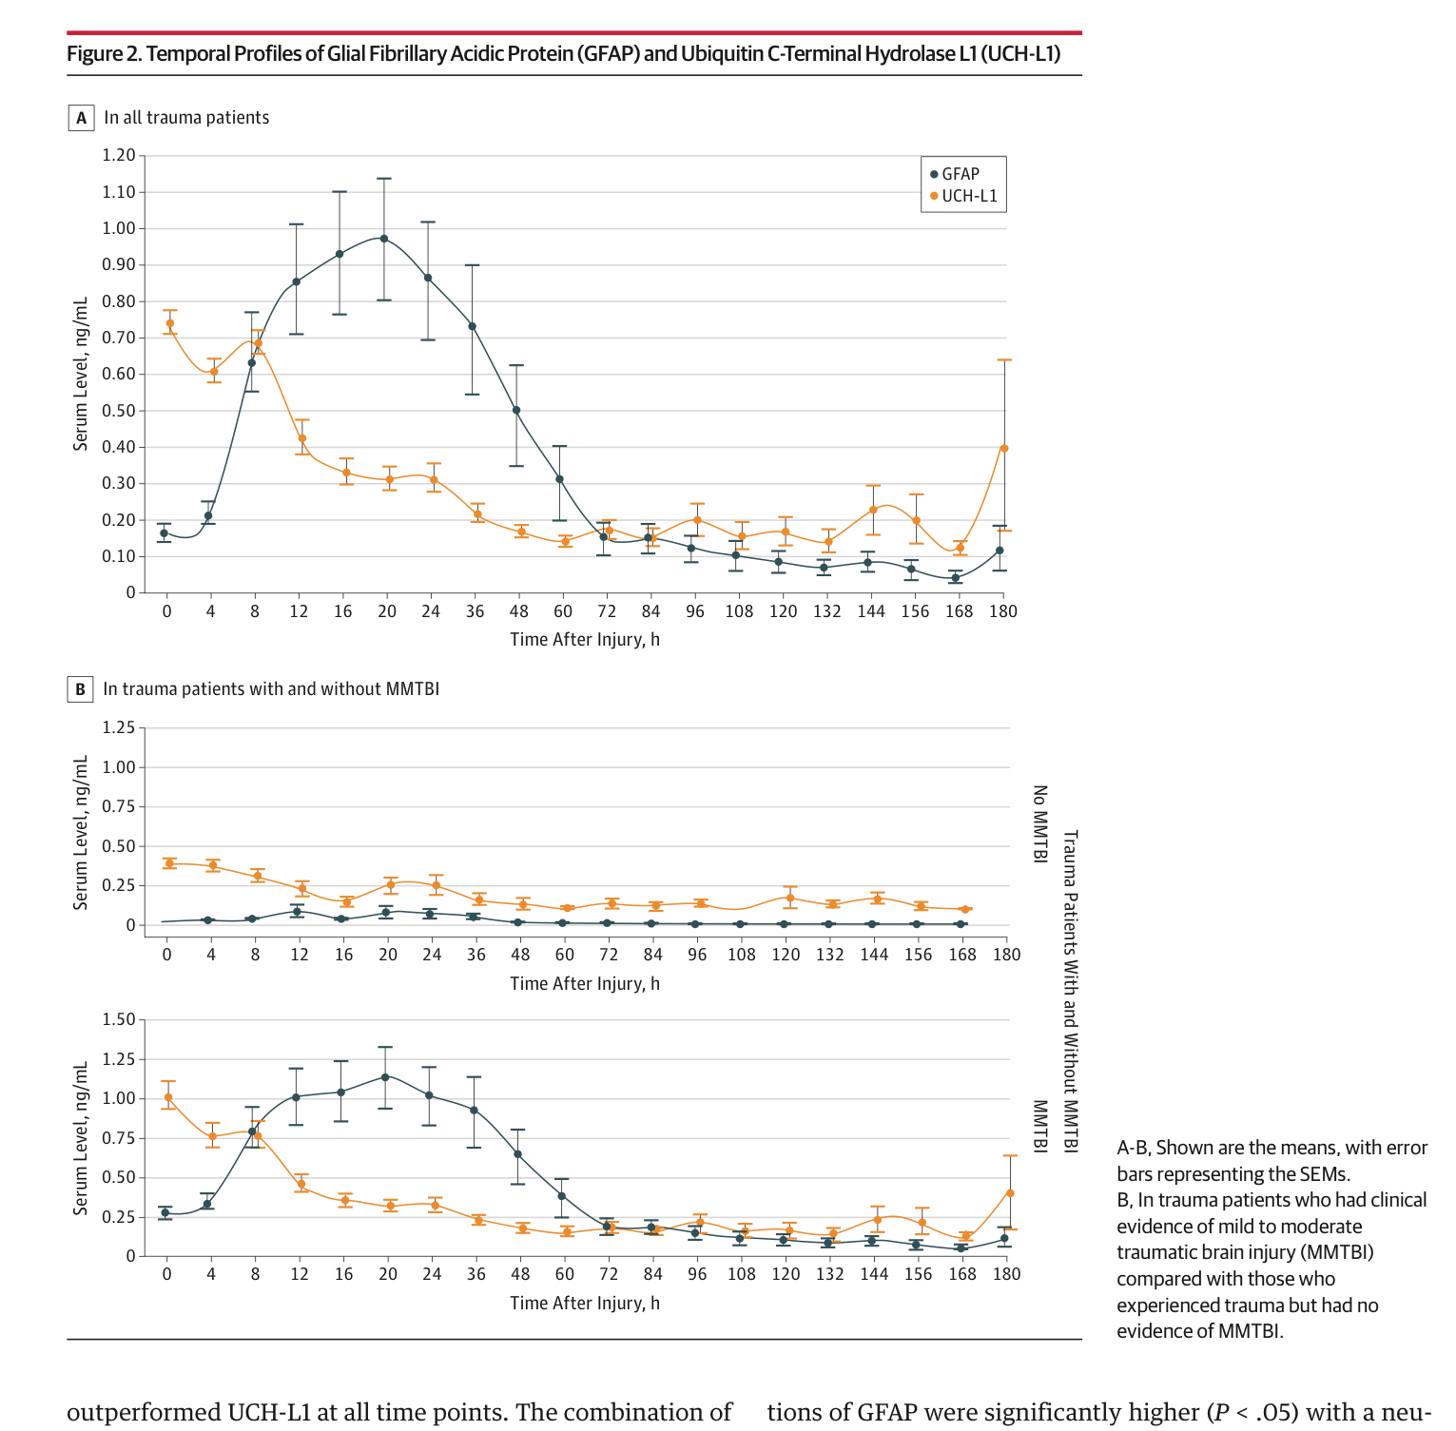
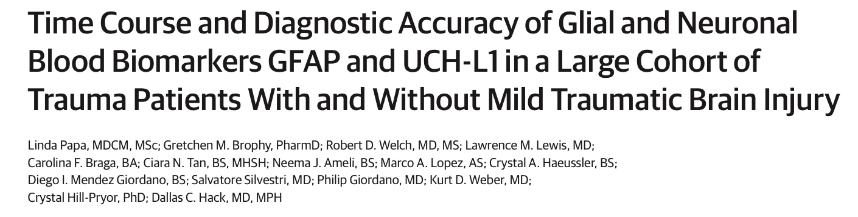
Blood based Biomarkers
GFAP/UCHL-1 combination
Giza, C et al. N-Methyl-D-Aspartate receptor subunit changes after traumatic injury to the developing brain. J. Neurotrauma 2006; 23:(6) 950-961

Slide 22
Blood based Biomarkers
GFAP/UCHL-1 combination
Cleared by the FDA in February 2018 for clinical use.
Determining the need for a head CT in patients presenting to the emergency room within 12 hours of injury.
Confirmed in the ALERT trial.
For detection of intracranial injury
Sensitivity of 97.6%
Negative predictive value of 99.6%
Giza, C et al. N-Methyl-D-Aspartate receptor subunit changes after traumatic injury to the developing brain. J. Neurotrauma 2006; 23:(6) 950-961

Slide 23
Modifiers for TBI Recovery
Pertinent history
Migraine
Anxiety
Depression
Prior injury
Age
Mechanism of injury
Assault
Combat
Giza, C et al. N-Methyl-D-Aspartate receptor subunit changes after traumatic injury to the developing brain. J. Neurotrauma 2006; 23:(6) 950-961

Slide 24
TBI Reclassification
Clinical
GCS score
Biomarker
GFAP/UCH-L1
Imaging
Negative/positive
Type of intracranial lesion
Modifiers
Giza, C et al. N-Methyl-D-Aspartate receptor subunit changes after traumatic injury to the developing brain. J. Neurotrauma 2006; 23:(6) 950-961

Slide 25
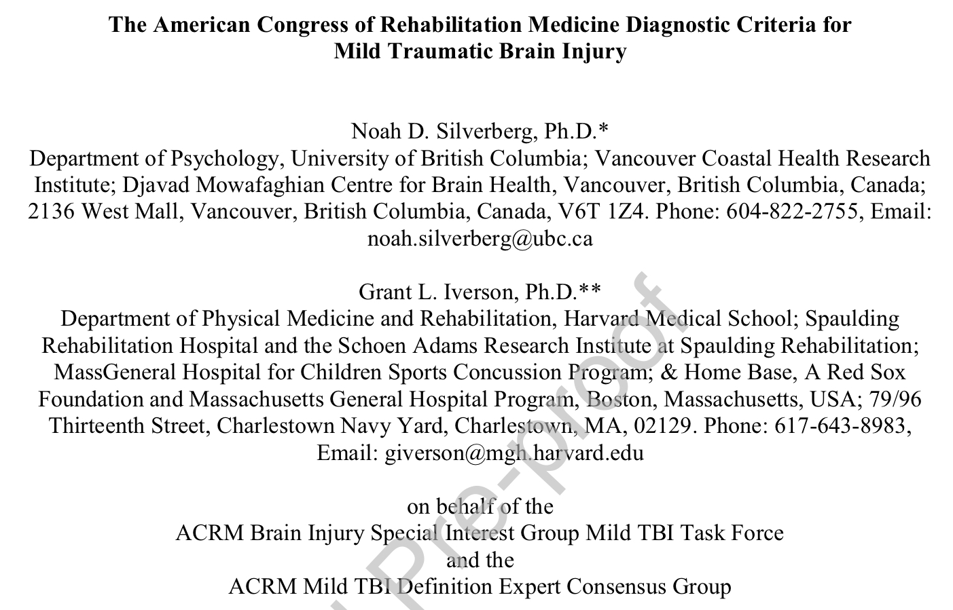
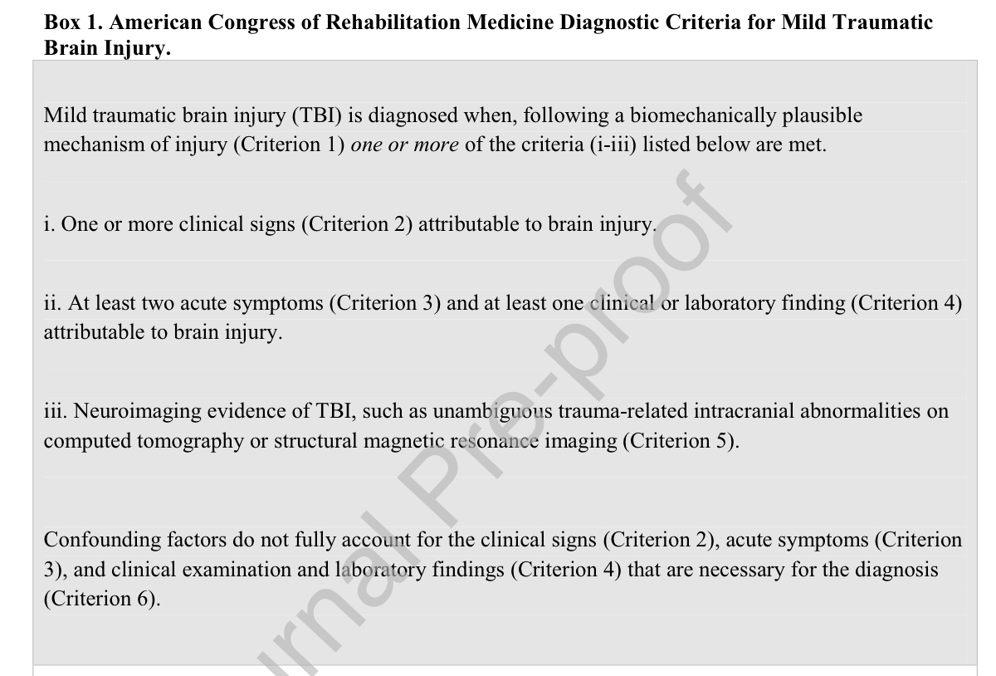
Defining mTBI

Slide 26
Defining mTBI AKA Concussion
1. Biomechanically plausible mechanism of injury
(i) head being struck with an object
(ii) head striking a hard object or surface
(iii) brain undergoing an acceleration/deceleration movement without direct contact between the head and an object or surface, and/or
(iv) forces generated from a blast or explosion

Slide 27
Defining mTBI/ AKA Concussion
2. One or more clinical sign
i. Loss of consciousness
ii. Alteration of mental status
iii. Complete or partial amnesia
iv. Other acute neurological sign(s) (e.g., observed motor incoordination upon standing, seizure, or tonic posturing immediately following injury)

Slide 28
Defining mTBI/ AKA Concussion
3 At least two clinical symptoms AND at least one clinical or laboratory finding
i. Acute subjective alteration in mental status
ii. Physical symptoms
iii. Cognitive symptoms
iv. Emotional symptoms
i. Cognitive impairment on acute clinical examination.
ii. Balance impairment on acute clinical examination.
iii. Oculomotor impairment or symptom provocation in response to vestibular-oculomotor challenge on acute clinical examination.
iv. Elevated blood biomarker(s) indicative of intracranial injury

Slide 29
Defining mTBI/ AKA Concussion
4. Structurally normal neuroimaging
5. Confounding factors do not fully account for presentation

Slide 30
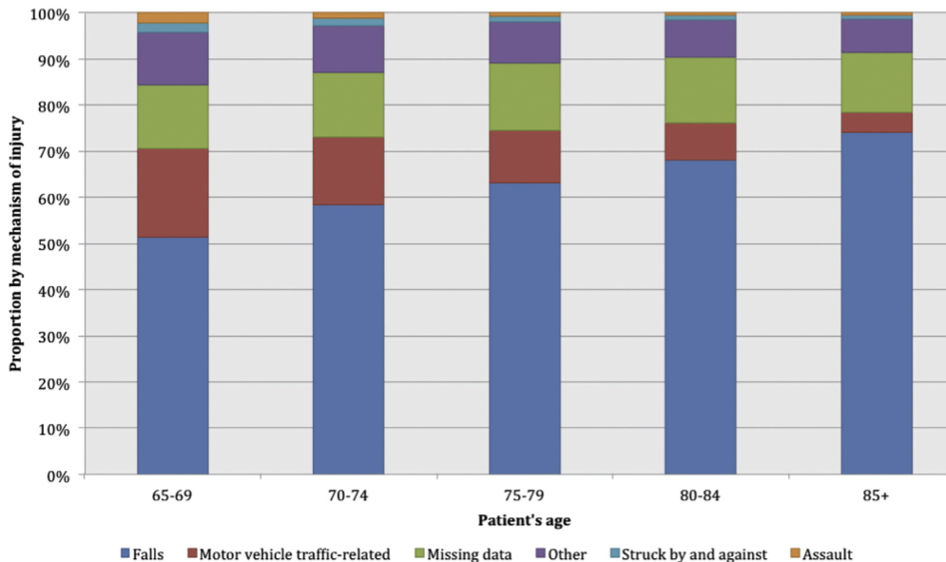
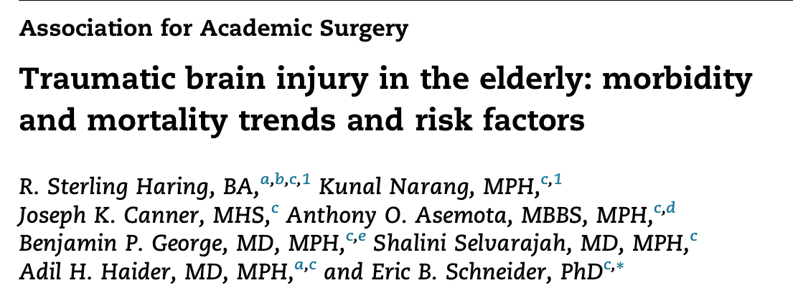
Aging and TBI

Slide 31
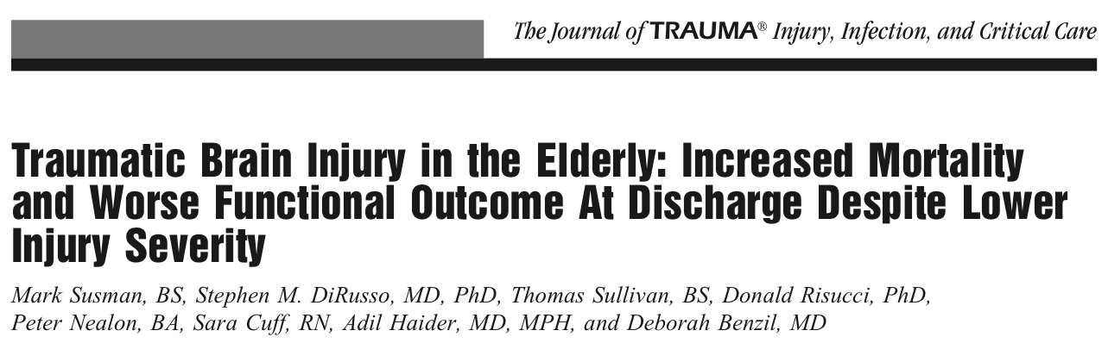
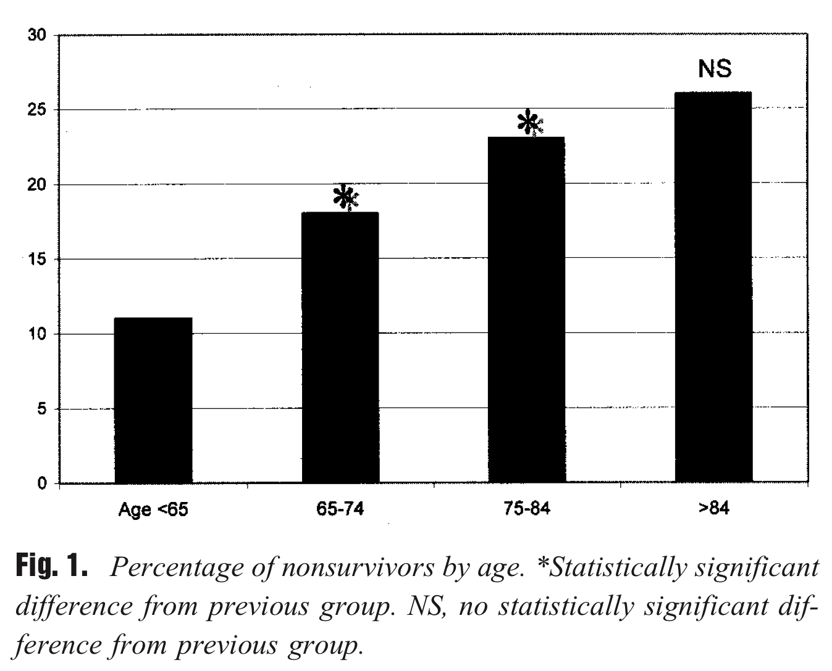
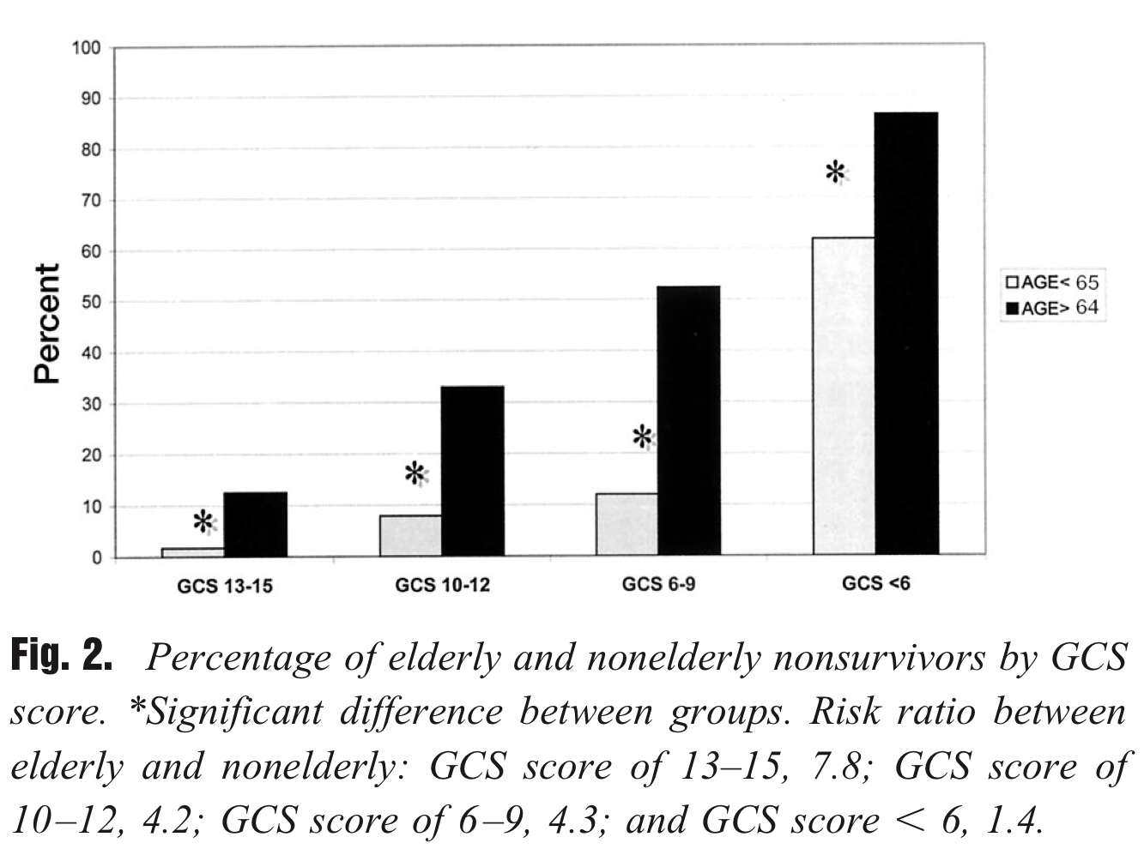
Aging and TBI

Slide 32
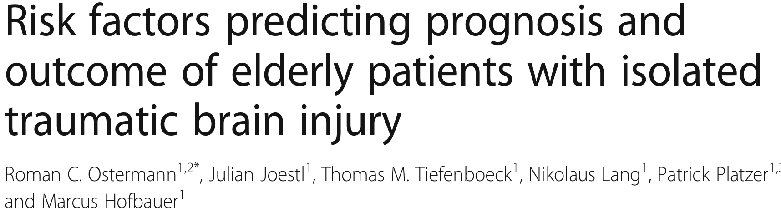
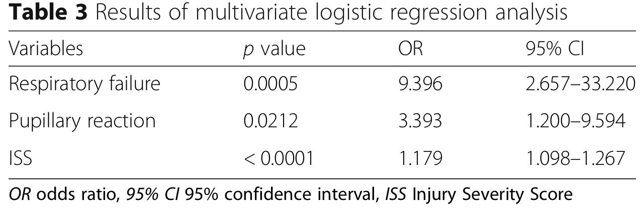

Slide 33
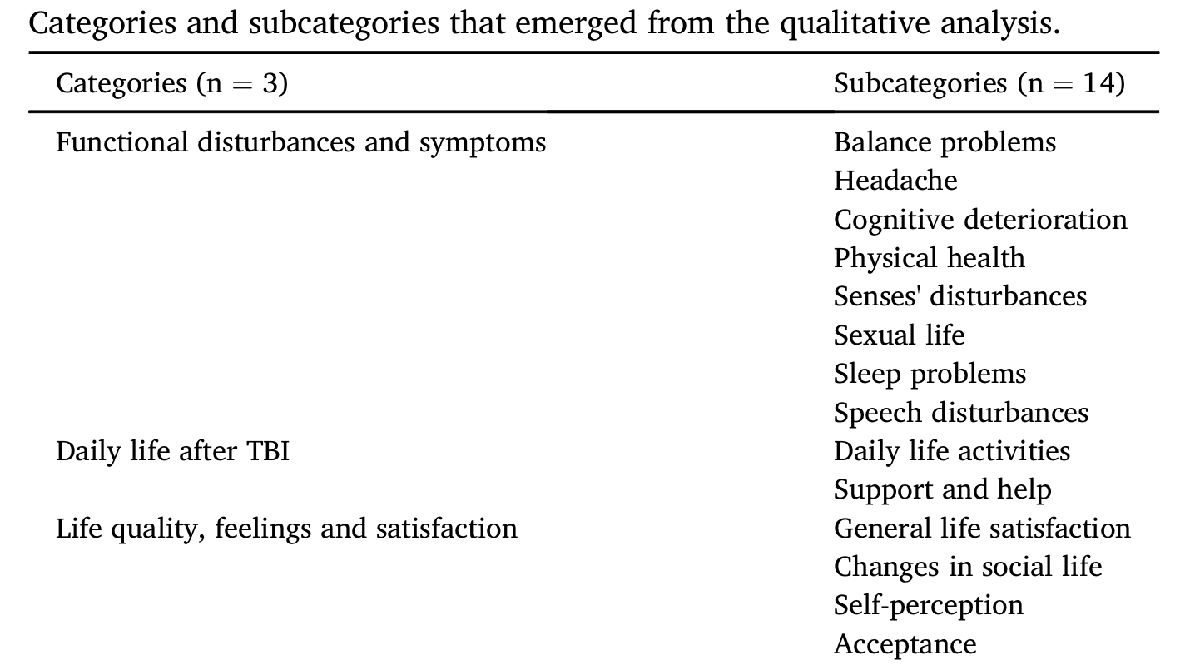
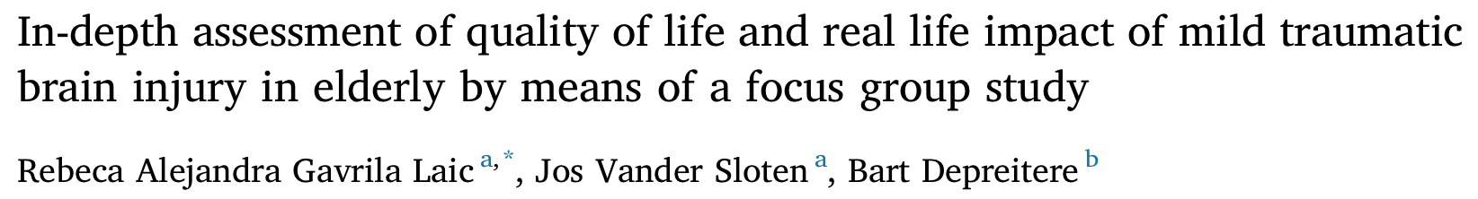

Aging and TBI

Slide 34
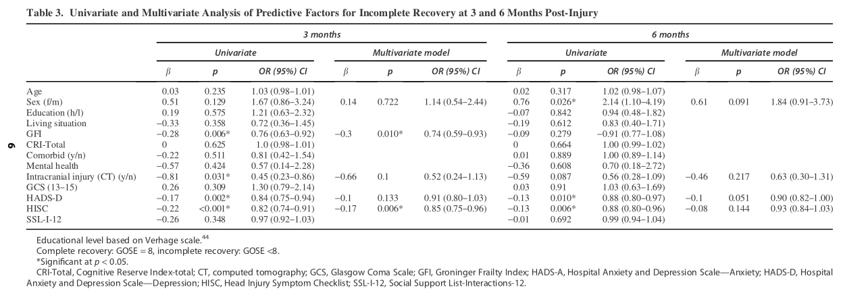
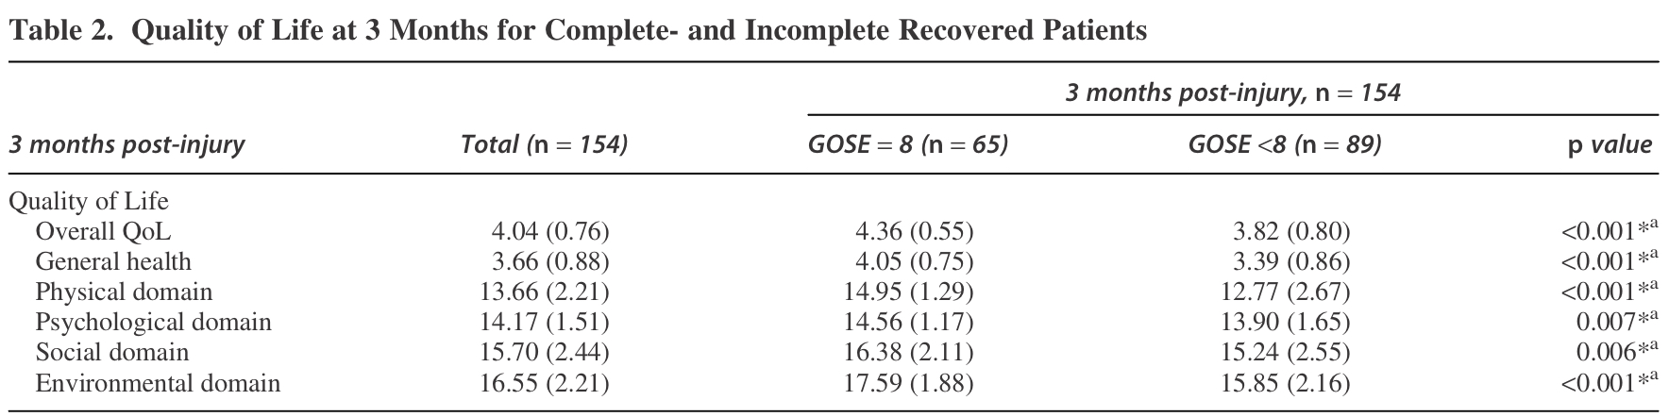
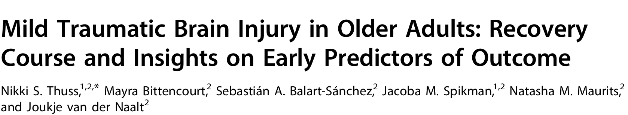
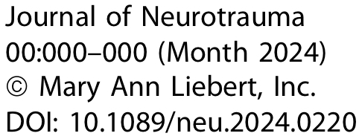
Aging and TBI

Slide 35
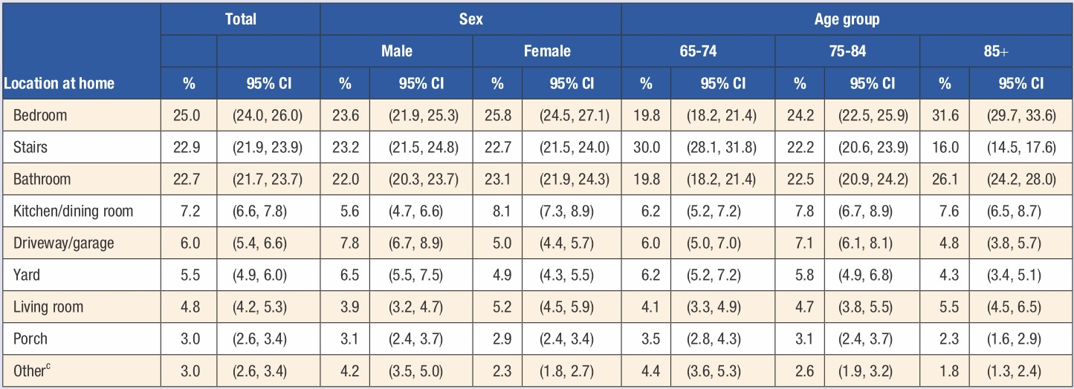


Aging and TBI

Slide 36
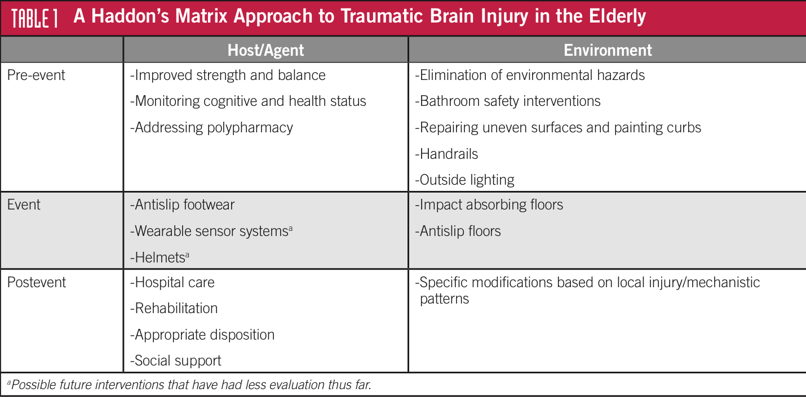
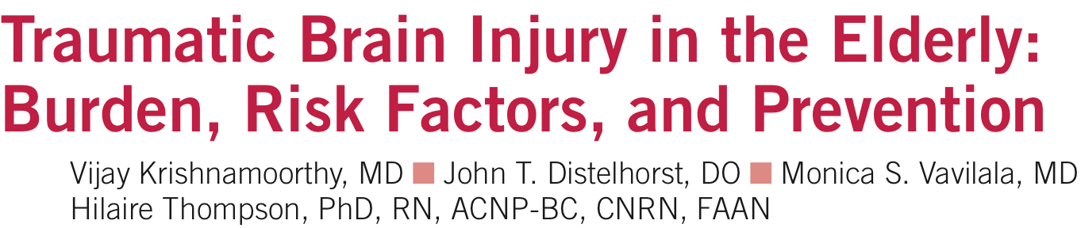

Slide 37
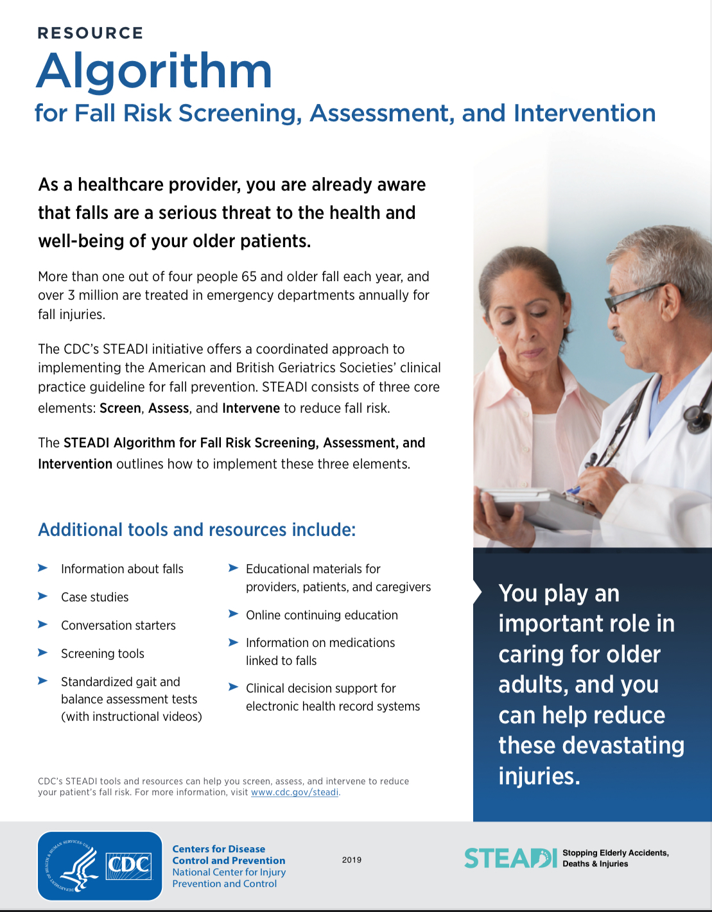

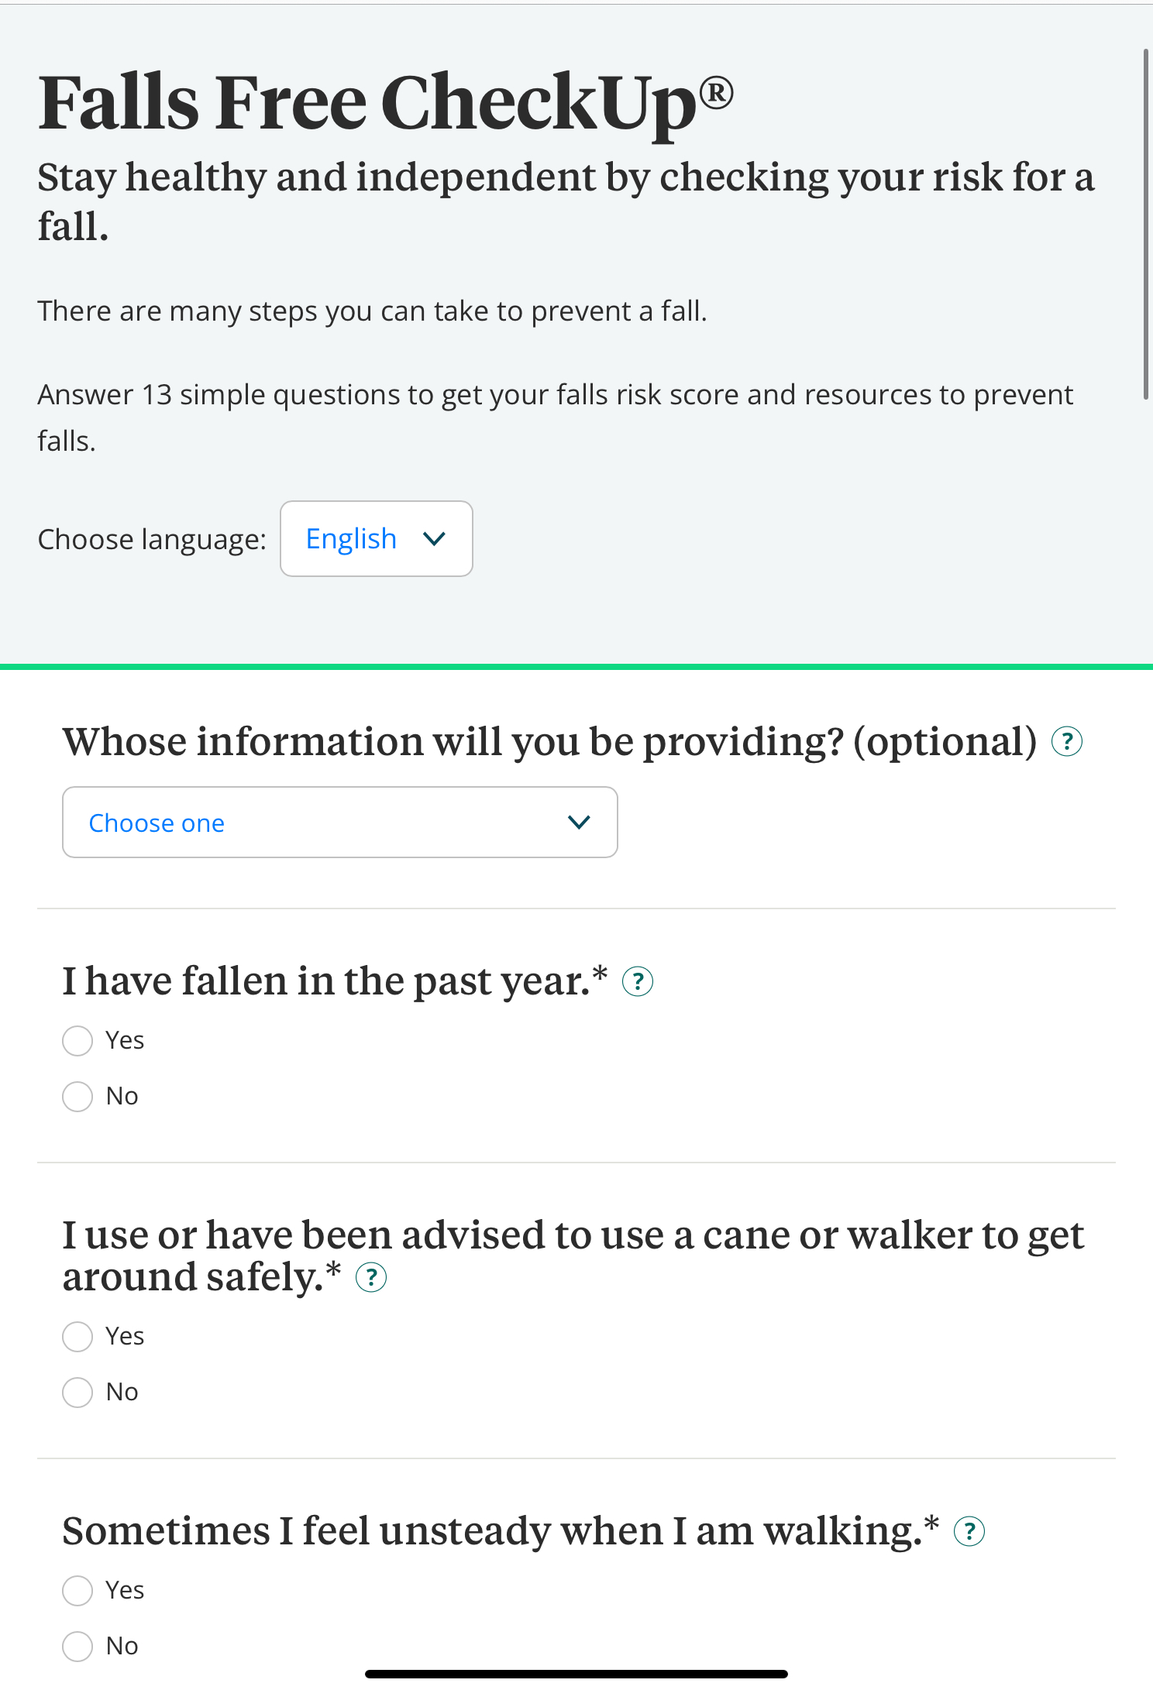
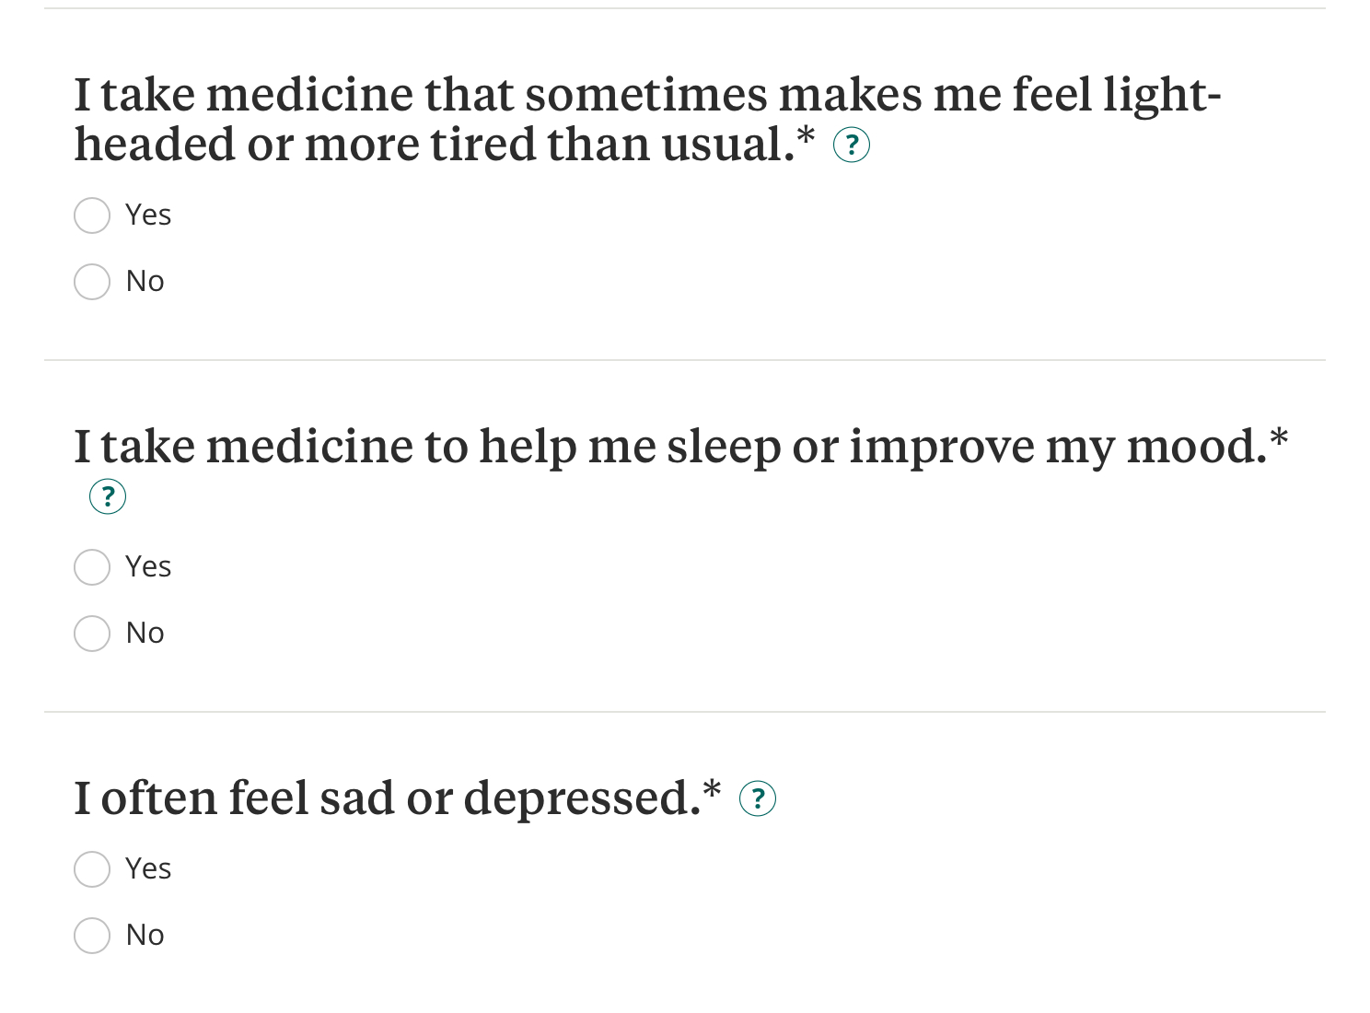

Slide 38
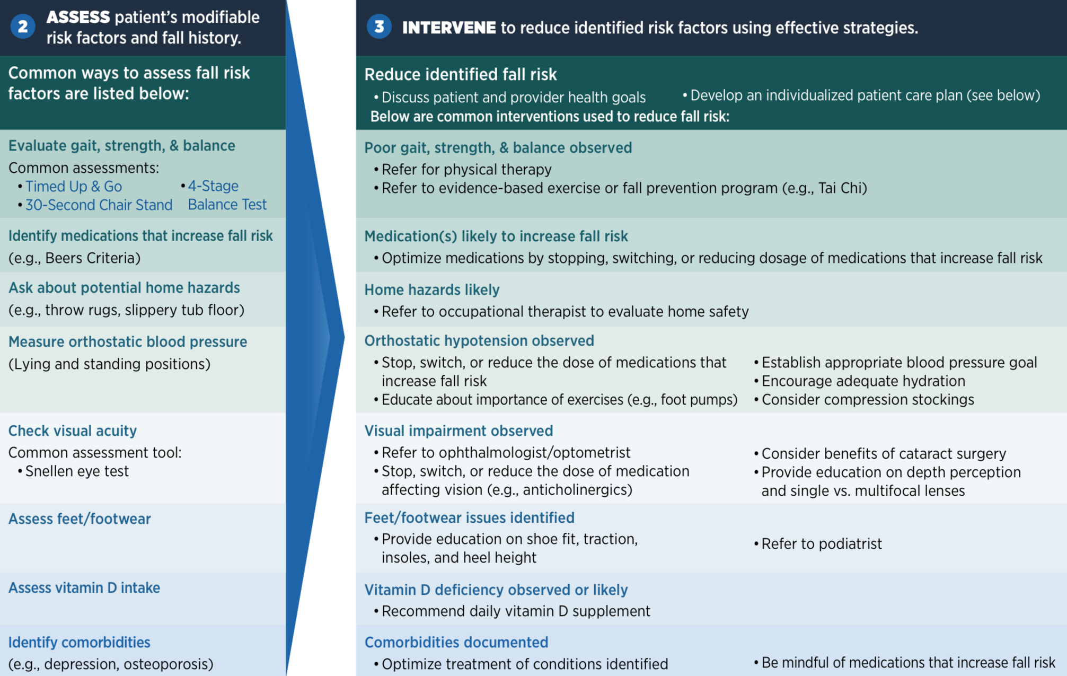

Slide 39
Conclusion
Traumatic brain injury is the leading cause of morbidity and mortality in children and young adults.
Falls are the most common cause of traumatic brain injury
Mild traumatic brain injury represents 70-90% of all TBI
mTBI definition has was recently revised and distinguishes signs from symptoms.
Aging increases the risk for a TBI, specifically from falls
TBI prevention requires a multifactorial analysis

Slide 40

THANK YOU!

