Slide 1

TELEREHABILITATION AMONG OLDER ADULTS
Dr. Nicoletta Caputi, PhD

Slide 2
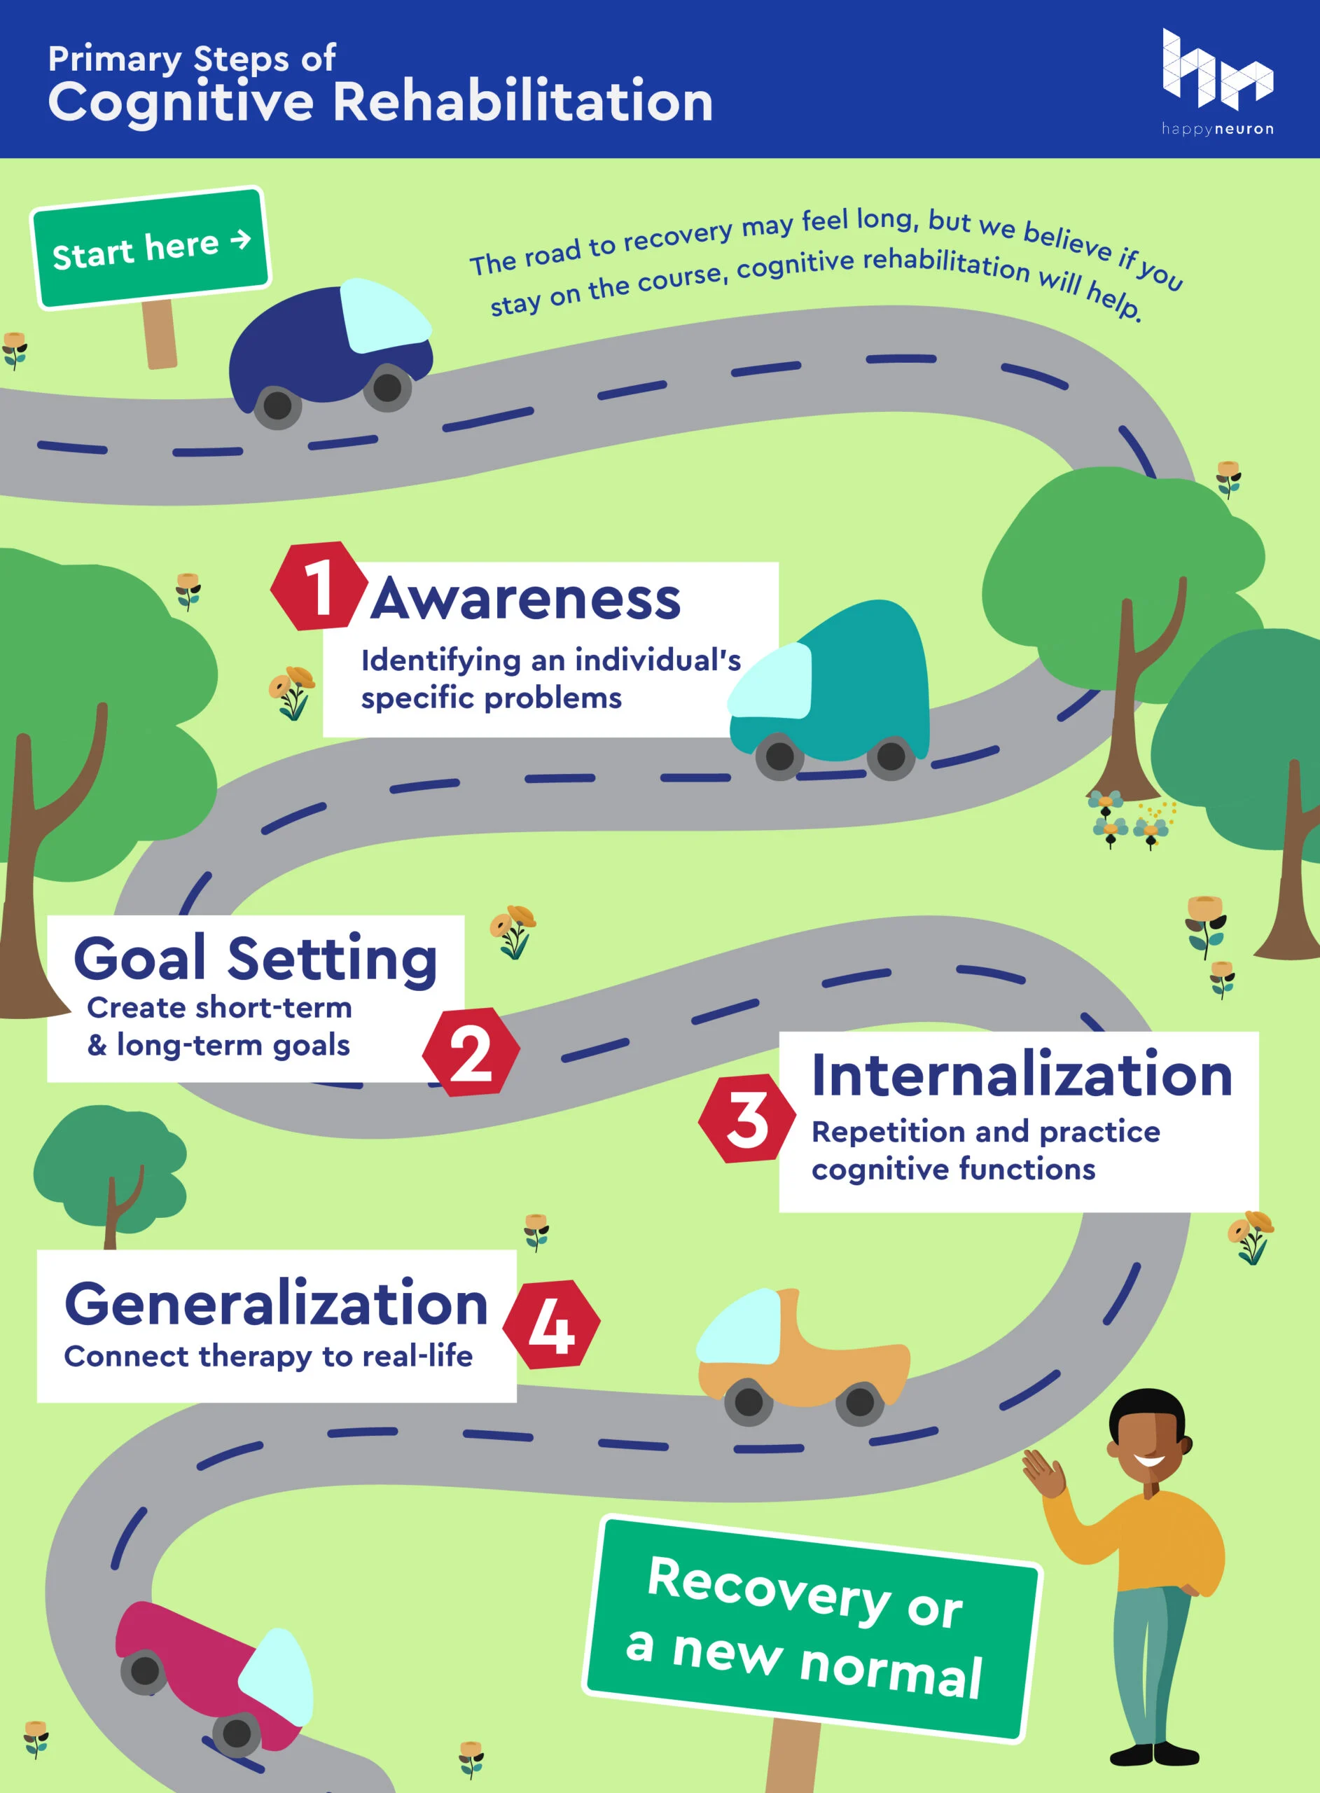
COGNITIVE REHABILITATION (CT)

Slide 3
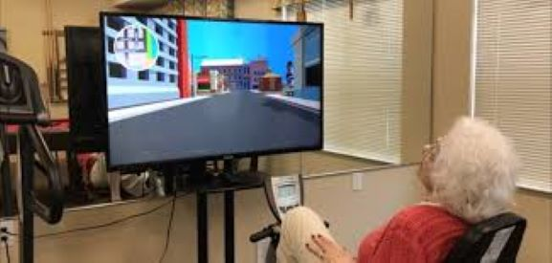
TELEREHABILITATION
selecting the most appropriate approach for each individual patient
monitoring execution and outcomes remotely
modifying the treatment accordingly

Slide 4
ACCESS TO CARE FACILITIES
To be effective, cognitive rehabilitation should be intensive and prolonged over time, but social events that reduce access to care facilities hamper intensive and prolonged cognitive rehabilitation, unless current protocols are modified.
This was the case we had been dealing with during the Covid-19 pandemic.

Slide 5
MAIN METHODS AND TECHNOLOGIES FOR COGNITIVE TR

Slide 6
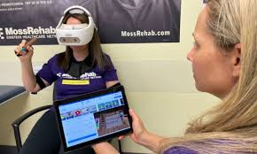
1.Virtual Reality
DEFINITION | ADVANTAGIES | LIMITATIONS
A computer-based, interactive, multisensory environment that occurs in real time, with which the user can directly interact | Provides immediate feedback Allows the adaptation to patient’s performance Highly engaging High level of ecological validity Can be combined with other tools/devices (e.g., electroencephalography, physiological activity registration tools) | Technology requirements are often cumbersome Limited availability (i.e., outpatient clinics) Expensive hardware and software tools
Mantovani et al. (2020). Frontiers in neurology, 11, 926.

Slide 7
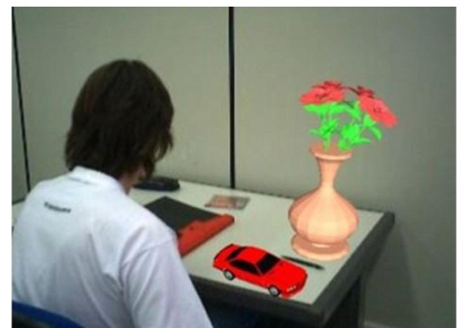
2. Augmented Reality
DEFINITION | ADVANTAGIES | LIMITATIONS
The overlaying of computer-generated imagery atop the real world using a see-through display | Employs wearable devices Allows the adaptation to patient’s performance High patient engagement Available for home-delivered care | Limited user’s immersion Barriers to accessing technology
Mantovani et al. (2020). Frontiers in neurology, 11, 926.

Slide 8
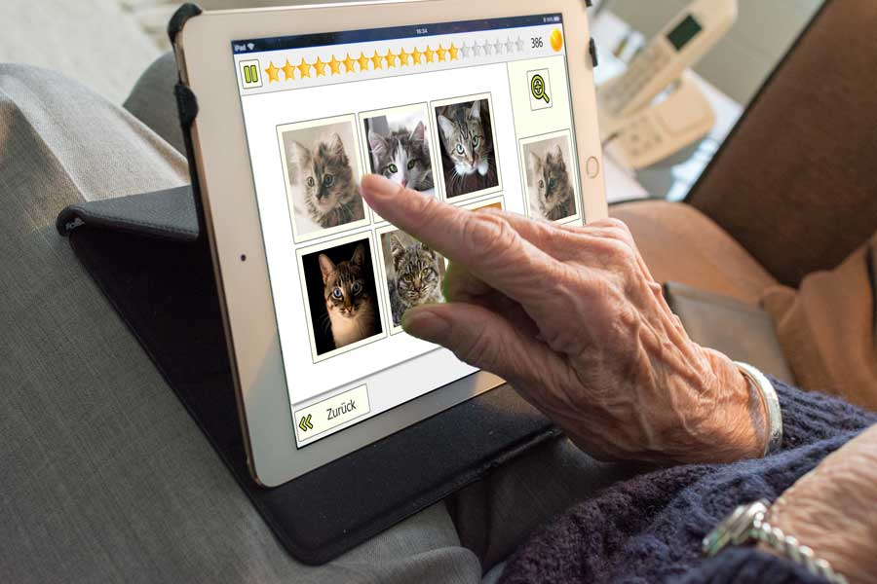
3. Serious Games
DEFINITION | ADVANTAGIES | LIMITATIONS
Digital games whose purpose is to reach a specific goal (e.g., cognitive rehabilitation) other than entertainment | Allows the adaptation to patient’s performance High patient engagement Affordable costs Available for home-delivered care | Lack of immersion Limited flexibility and customizing
Mantovani et al. (2020). Frontiers in neurology, 11, 926.

Slide 9
APPLICATION TO NEUROLOGICAL DISORDERS

Slide 10
Stroke
Cognitive dysfunction
3 months
22 and 56%
Attention
Memory
Praxis
Spatial cognition
Executive functions
1 year
11% and 31%

Slide 11
Stroke
^{Torrisi et al, 2019}
^{Lawson et al., 2020}
^{Faria et al., 2020}
^{Agostini et al., 2014}
Maggio et al. (2024). Frontiers in Neurology, 15, 1338873.

Slide 12
Stroke - summary
Limitations
cost
accessibility
Advantages
Mobile devices
Social reintegration
Continuous assistance

Slide 13
Traumatic brain injury (TBI)
Long term cognitive impairment
Alteration of consciousness
Cognitive
65% of patients with moderate to severe TBI
Sensory
Emotional
Behavioral

Slide 14
Traumatic brain injury (TBI)
^{De Luca et al., 2020}
^{Kornblith et al., 2023}
^{Tsaousides et al, 2014}
^{Raso et al., 2021}
Maggio et al. (2024). Frontiers in Neurology, 15, 1338873.

Slide 15
Traumatic brain injury (TBI) - summary
According to the “INCOG 2.0 Recommendations for Telerehabilitation Treatment in Traumatic Brain Injury”, TR allows timely access to rehabilitation for individuals with TBI.
TR should be implemented via videoconference for direct observation of the patient’s performance, non-verbal behavior, and level of effort.
Despite these indications, studies relating to the TR in cognitive and motor rehabilitation are poor with small samples.
Adequate monitoring of patient motivation or treatment sessions is not adequately implemented.

Slide 16
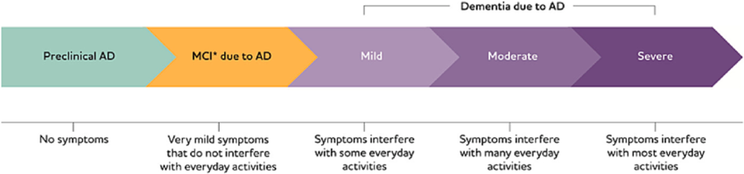
Mild cognitive impairment (MCI) and dementia

Slide 17
MCI and dementia
^{Jelcic et al., 2014}
^{Vermeij et al, 2016}
^{Manenti et al, 2020}
^{Rossetto et al, 2023}
^{Bernini et al., 2023}
Maggio et al. (2024). Frontiers in Neurology, 15, 1338873.

Slide 18
MCI and dementia - summary
feasibility and pilot benefits of cognitive rehabilitation provided by TR.
overcome the current limitations of in-person cognitive rehabilitation
the quality of the clinical studies designs needs to be improved.

Slide 19
Multiple Sclerosis
Cognitive impairment
34 to ≥65%
Information processing speed
Attention
Executive functions
Memory
reduction in participation in family and social activities, in maintaining work, and low compliance to treatments

Slide 20
Multiple Sclerosis
^{Messinis et al., 2020}
^{Chiaravalloti et al., 2020}
^{Naeeni et al., 2022}
^{Arian Darestani et al., 2020}
^{Pagliari et al., 2021}
Maggio et al. (2024). Frontiers in Neurology, 15, 1338873.

Slide 21
Multiple Sclerosis - summary
TR
reconcile long-lasting programs with a social and productive life
promoting continuity of care at home
lack of guidelines in cognitive TR protocol
beneficial, cost-effective, and satisfactory for both patients and healthcare professionals regarding motor symptoms.

Slide 22
Parkinson’s disease
Cognitive impairment
60%
Information processing speed
Attention
Visuospatial skills
Degeneration of the nigrostriatal system

Slide 23
Parkinson’s disease
^{Cornejo Thumm et al., 2021}
^{Bianchini et al., 2022}
^{Isernia et al., 2020}
^{van de Weijer et al., 2020}
^{Santini et al., 2022}
Maggio et al. (2024). Frontiers in Neurology, 15, 1338873.

Slide 24
Parkinson’s disease - summary
TR may be effective in improving cognitive and motor outcomes in PD patients. Studies indicate that the patient demonstrates good acceptability of TR tools and high adherence to therapy. However, few studies have been conducted in this area, so more literature is needed to demonstrate the potential benefit of this type of rehabilitation.

Slide 25
Conclusions
TR as a feasible and effective method
Can improve cognition and quality of life
Continuous monitoring at home
Long-lasting improvements
Customized to the patient’s needs

Slide 26
Issues related to cognitive telerehabilitation and possible solutions
Mantovani et al. (2020). Frontiers in neurology, 11, 926.

Slide 27
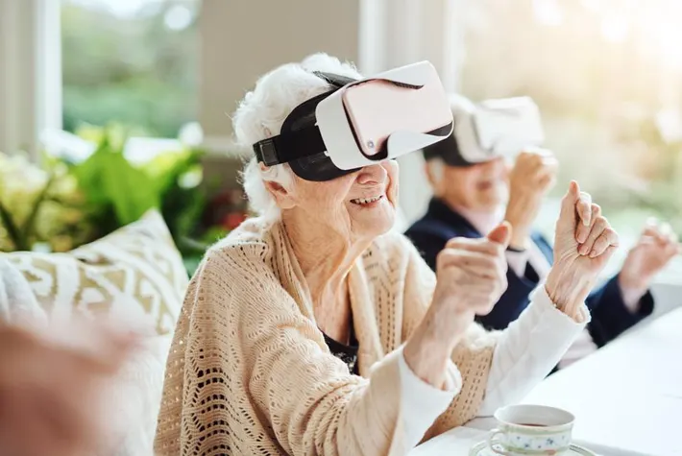
THANK YOU FOR YOUR ATTENTION

