Slide 1

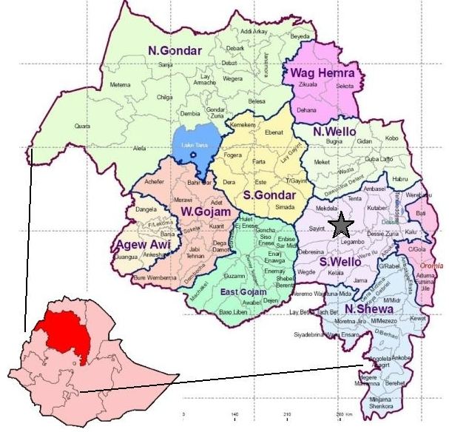
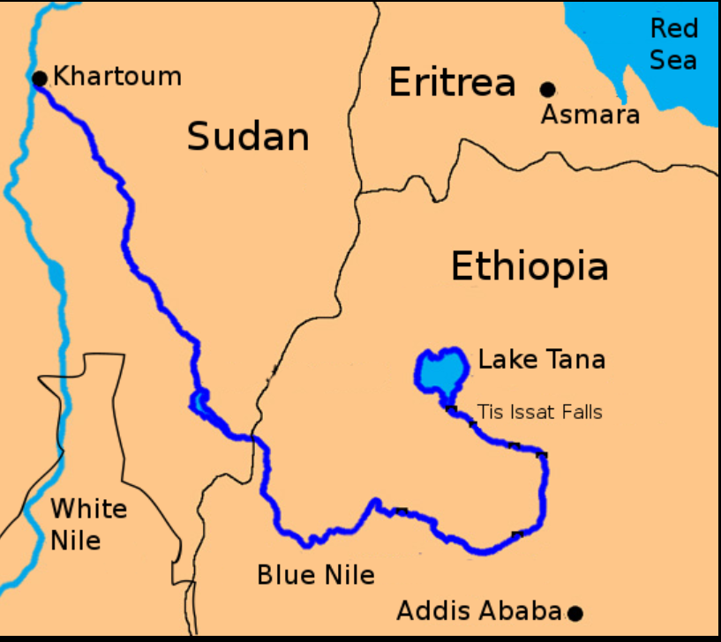
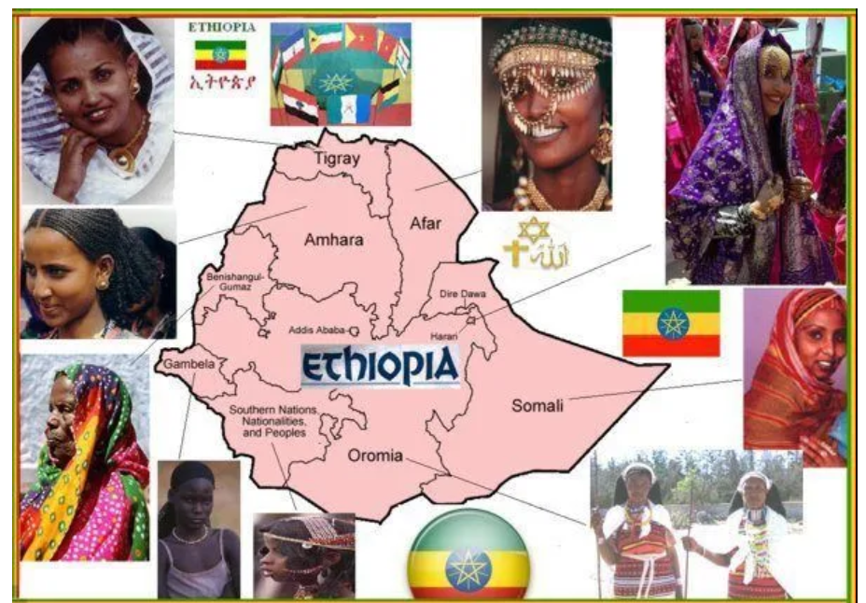


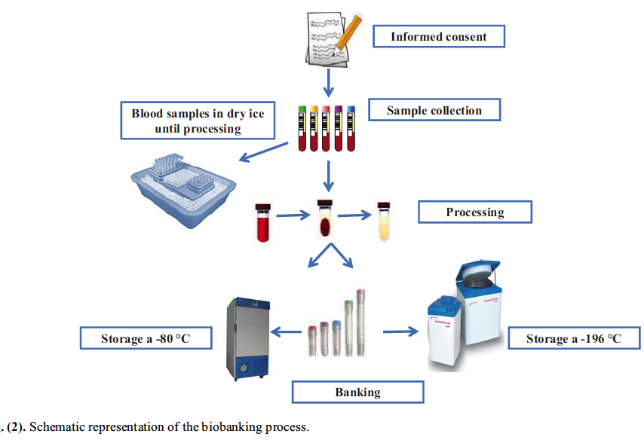
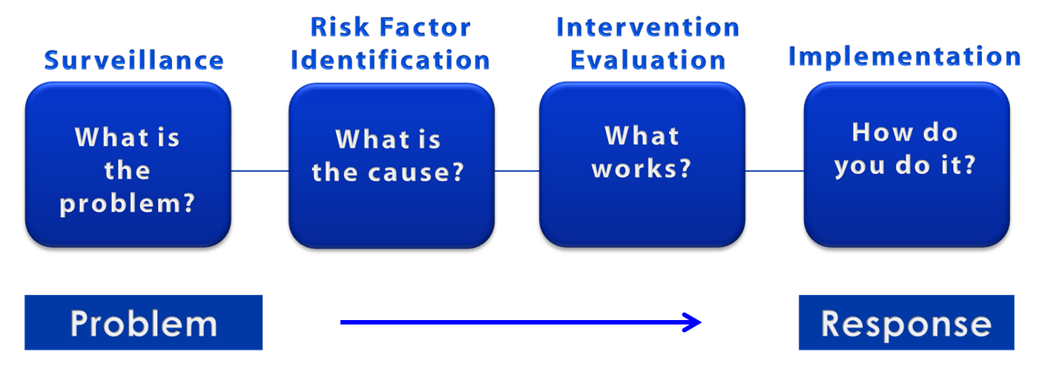

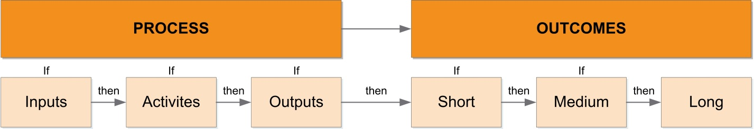
The Design and Conduct of a Pilot Project on Mild Cognitive Impairment in Northern Ethiopia
Gizachew Yismaw⁴, Muluken Azage², Janina Krell-Roesch³,Alemtsehay Mekonnen², Tesfaye Mersha⁵, Daniel Enquobahrie⁶, Susan Racette⁷, Klaus Boes³ , Yonas E. Geda¹
¹Department of Neurology and the Franke Barrow Global Neuroscience Education Center, Barrow Neurological Institute, Phoenix, USA
²School of Public Health, Bahir Dar University, Bahir Dar, Ethiopia
³Institute of Sports and Sports Science, Karlsruhe Institute of Technology, Karlsruhe, Germany
⁴Amhara Public Health Institute, Bahir Dar, Ethiopia
⁵Department of Pediatrics, University of Cincinnati, USA
⁶Department of Epidemiology, University of Washington, USA
⁷ Arizona State University, USA
35th GRAL CONFERENCE
PHOENIX,ARIZONA ,USA
JANUARY 25-27, 2024
Introduction
Methods
The 2015 World Alzheimer Report estimates that in 2050, the number of people living with dementia in low-and middle-income countries is expected to increase.
Study DESIGN and Settings
We will conduct a cross-sectional study in Bahir Dar city and Injibara town, Northern Ethiopia.
Data Collection plan
Preparation phase: the team will prepare study materials
Data collection phase:
A structured questionnaire will be prepared, items:
Socio-demographic
Health status (e.g., body height, weight, medical comorbidities, medication intake, etc.)
Emotional health (e.g., neuropsychiatric symptoms, quality of life)
Lifestyle factors (e.g., nutrition/ diet, alcohol consumption, physical activity, motor fitness)
House-to-house survey to collect the data.
work plan
1 year Schedule of Events
Ethics committee review and approval
Training of data collectors and supervisors
Open data kit (ODK) preparation/ and pre-test
Data collection
Data Analysis and write up
Preparation and submission of manuscript
Tool preparation and pre-test
As low-income country, there is no population based comprehensive baseline study showing the magnitude and distribution of MCI in Northern Ethiopia.
Why conduct this study in Ethiopia
Bahir Dar
Residence : Urban
Elevation: 1,800 m
population : 474,743.
Weather: 25°C
The 12th-most populous country in the world
The 2nd-most populous country in Africa
A landlocked, not colonized country in the Horn of Africa
Multi-ethnic state with over 80 different ethnic groups
Rich and lengthy history in language, literature, religion and culture
Injibara
Residence : Rural
Elevation: 2,560 m
population: 56,723
Weather: 22°C
Screening Tools for Cognitive Impairment;
Mini Mental State Examination (MMSE)
Montreal Cognitive Assessment (MoCA)
Rowlands Universal Dementia Assessment Scale (RUDAS)
Next Steps
A Public Health Approach-Surveillance
Sample size
A single population proportion formula
[ n = Z_{α/2}² *p*(1-p) / D2] = 628
sampling technique
List of Kebeles will be selected by lottery method
House holds will be selected by systematic random sampling
Individuals > 50 years will be selected by lottery method
Blood sample collection for epigenetic study
Surveillance
Risk Factor Identification
Intervention
Evaluation
Source of the Blue Nile
Multi-ethnic state
Step 1
Step 1 -
Amhara region is the site of the largest inland body of water in Ethiopia, Lake Tana (which is the source of the Blue Nile),
Semien Mountains National Park (which includes Ras Dashan, the highest point in Ethiopia)
Data
collection
Surveillance; determine time, place, and person
Inclusion criteria
Age >50 years
Visual and auditory acuity adequate for neuropsychological testing
Good general health
Exclusion criteria
Any significant neurological illness
Screening with evidence of infection,
History of schizophrenia, Bipolar dis.
Any significant systemic illness
Solving brain health and cognitive impairment problems through surveillance
Step 2
Step 2
Assessment
Inference
Step 3
Step 3
Therefore;
There could be unique cultural practices and norms that can give insight about dementia and aging in Ethiopia
Any dementia or other scientific work done in Ethiopia can be scaled up to Africa by coordinating it with the Education Commission of African Union.
Higher intake of calories from carbohydrates(Unique staple food in Ethiopia, and Teff) may be associated with increased risk of MCI and dementia.
Hypothesis
testing
Determine how and why
Step 4
Step 4
City/Town | # of Kebeles | 30% of Kebeles | # of sample households
Bahir Dar | 17 | 6 | 419
Injibara | 5 | 3 | 209
Total | 22 | 9 | 628
Action
Intervention
Evaluation design
The two types of evaluation designs: process evaluation and outcome evaluation.
Data management cycle
Goals and Objectives
Ethical approval
Design
questionnaire
Enumerators collect
data in the field
Immediate goal: To conduct a feasibility study to collect preliminary data on demographical variables, nutrition including indigenous Ethiopian staple food called teff injera, physical activity, quality of life/emotional health variables and cognitive outcomes.
Long-term GOAL: To establish a population-based brain health and cognitive impairment research program in Northern Ethiopia.
Objectives: To provide baseline information about the frequency and distribution of mild cognitive impairment and compare epigenetic and lifestyle factors across the three demographic groups: Ethiopians in urban and rural Ethiopia as well as western lifestyle in Israel and USA.
Criteria for Approval
Risks to subjects are minimized
Equitable subject selection
Adequate protections to protect privacy and confidentiality
Additional safeguards for vulnerable subjects
Risks are reasonable in relation to benefits
Consent will be sought / documented
References
Design
survey
(Conception)
Riley L, Guthold R, Cowan M, Savin S, Bhatti L, Armstrong T, Bonita R. The World Health Organization STEP wise Approach to Noncommunicable Disease Risk-Factor Surveillance: Methods, Challenges, and Opportunities. Am J Public Health. 2016 Jan;106(1):74-8. doi: 10.2105/AJPH.2015.302962. PMID: 26696288; PMCID: PMC4695948.
Daniel B, Agenagnew L, Workicho A, Abera M. Validation of the Rowlands Universal Dementia Assessment Scale (RUDAS) to detect major neurocognitive disorder among elderly people in Ethiopia, 2020. PLoS One. 2022 Jan 20;17(1):e0262483. doi: 10.1371/journal.pone.0262483. PMID: 35051198; PMCID: PMC8775314.
Folstein, M., Folstein, S.E., McHugh, P.R. (1975). “Mini-Mental State” a practical method for grading the cognitive state of patients for the clinician. Journal of Psychiatric Research, 12(3); 189-198.
Francis, Ashley & Dawson, David & Golijani-Moghaddam, Nima. (2016). The Development and Validation of the Comprehensive Assessment of Acceptance and Commitment Therapy Processes (CompACT). Journal of Contextual Behavioral Science. 10.1016/j.jcbs.2016.05.003.
Lins L, Carvalho FM. SF-36 total score as a single measure of health-related quality of life: Scoping review. SAGE Open Med. 2016 Oct 4;4:2050312116671725. doi: 10.1177/2050312116671725. PMID: 27757230; PMCID: PMC5052926.
Nasreddine, Z.S., Phillips, N.A., Bedirian, V., Charbonneau, S., Whitehead, V., Collin, I., Cummings, J.L., & Chertkow, H. (2005). The Montreal Cognitive Assessment, MoCA: A brief screening tool for mild cognitive impairment. Journal of The American Geriatrics Society, 53(4), 695-699.
Manual checking, editing etc.
Reporting of results
Data
Analysis using R
Data entered
Into computer
Computer data management

