Slide 1
Parkinson’s disease: How Genetics is Informing Diagnosis and Treatment
Holly Shill MD
Director, Lonnie and Muhammad Ali Movement Disorder Center

Slide 2
Disclosures
In the last 2 years, Dr. Shill has received research support from Intra-cellular Therapeutics, Transposon, Parkinson Study Group/UCB, Parkinson’s Foundation, NINDS, Supernus/US World Meds, MJFF, Jazz Pharmaceuticals, Barrow Neurological Foundation and Cerevel Therapeutics.
Dr. Shill has served as a consultant for the Parkinson Study Group/Nq, Biogen, Abbvie, Sage/Biogen, Praxis, KeifeRx, Fasikl and Jazz Pharmaceuticals.

Slide 3
OUTLINE
Beyond “TRAP”per
Genetics of PD
Pathology of PD
Prodromal PD
Detecting PD in vivo
New research staging

Slide 4
Diagnosis of PD
Parkinsonism
Bradykinesia plus either:
Rest Tremor
Rigidity
Absence of exclusion
Features of PSP, CBD, MSA, FTD, +DRBD, negative Datscan
2 supportive criteria
LD response, dyskinesia, rest tremor, anosmia
No red flags
Rapid progression, no progression, falls, other neuro findings
(MDS criteria, Postuma et al, 2015)

Slide 5
PDGene
Reported at MDS meeting
Of 1969 individuals with PD, 14.8% had a variant
181 with GBA (9.2%)
56 with LRRK2 (2.9%)
51 with PRKN (2.6%)
8 SNCA (0.41%)
High risk ancestry: 30%
Early onset PD: 26%
1st degree relative with PD: 30%
(Cook, Sept 2022)

Slide 6
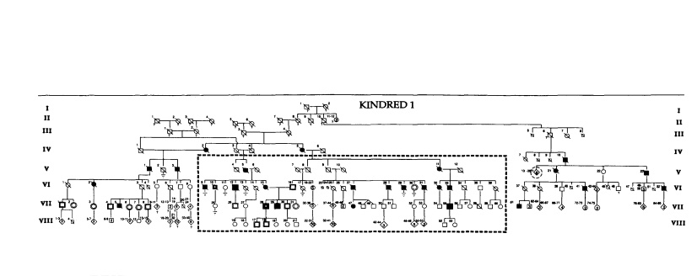
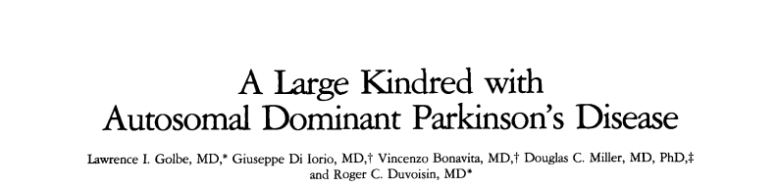
Alpha-synuclein
Golbe LI, Di Iorio G, Bonavita V, Miller DC, Duvoisin RC. A large kindred with autosomal dominant Parkinson’s disease. Ann Neurol 1990;27:276-282

Slide 7

Gene Identified
Mutation in the alpha-synuclein gene identified in families with Parkinson's disease
Science1997 Jun 27;276(5321):2045-7. doi: 10.1126/science.276.5321.2045

Slide 8
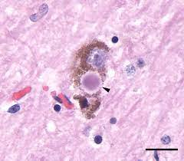
Lewy Body
Spillantini, Nature, 1997

Slide 9
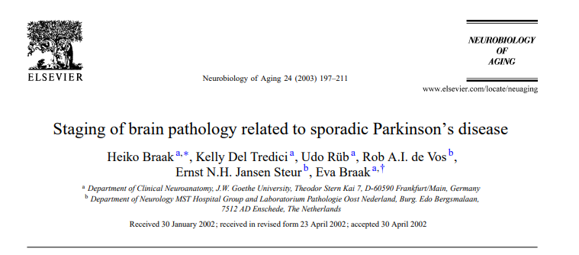
Staging of PD

Slide 10
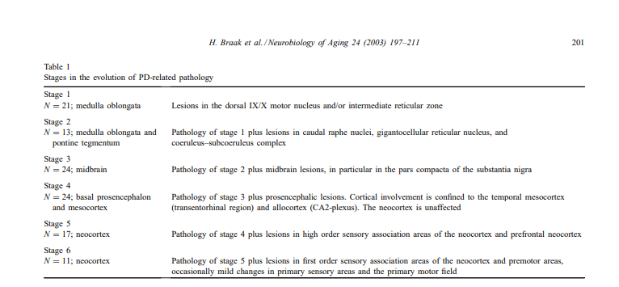
Staging of PD

Slide 11
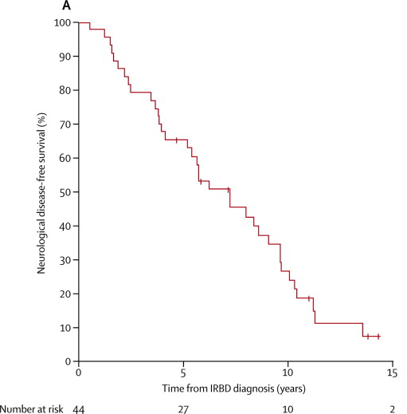
PD symptoms and staging
Reduced sense of smell predates PD (Ponsen, 2004; Haehner, 2007)
Constipation may predate PD (Abbott, 2001)
½ the number BMs as spouse
REM sleep disorder (Iranzo, 2013)
Risk nearly 100% after 15 years follow-up
(Iranzo, 2013)

Slide 12
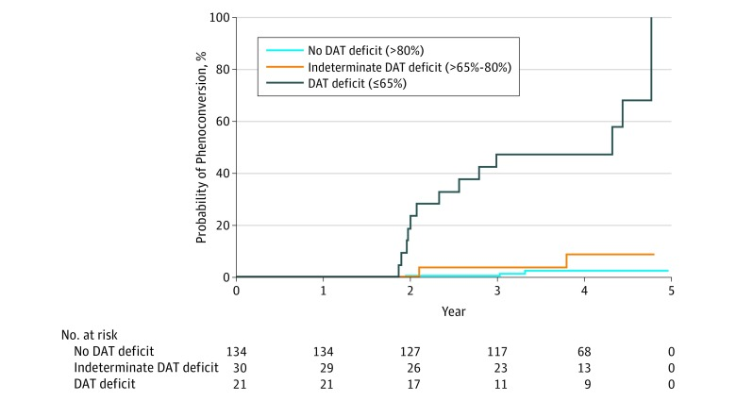
Dopamine Transporter Imaging
280 participants in PARS
All had Hyposmia
With DAT deficit (7.5%)
67% converted at 4 years
Without DAT deficit
2.8% converted
(Jennings, JAMA Neurology, 2017)

Slide 13
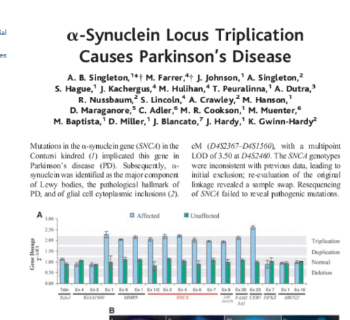
Too much alpha-synuclein is bad
(Science, 2003)

Slide 14
Lewy body-like pathology in long-term embryonic nigral transplants in Parkinson's disease
“Fourteen years after transplantation into the striatum of an individual with Parkinson's disease, grafted nigral neurons were found to have Lewy body-like inclusions that stained positively for alpha-synuclein and ubiquitin and to have reduced immunostaining for dopamine transporter. These pathological changes suggest that Parkinson's disease is an ongoing process that can affect grafted cells in the striatum in a manner similar to host dopamine neurons in the substantia nigra. These findings have implications for cell-based therapies and for understanding the cause of Parkinson's disease.”
Kordower, et al, Nature Medicine, 2008

Slide 15
Therapies
Vaccine
UB-312 (Vaxxinity): Phase 1 active, recruiting, PD and MSA, NYU – 3 priming IM injection and 5 booster
Antibodies
Prasinezumab (Prothena/Roche): U.S. and 7 other countries
MEDI-1341 (Astrazeneca/Takeda): single-dose study reporting results soon; multiple-dose PD study in the U.S.
Lu-AF82422 (Lund): single dose, recruiting in the U.S.
ABBV-0805 (Abbvie): withdrawn
Biogen SPARK study ” Biogen Ditches Parkinson’s Drug After Phase II Study Fails to Show Benefit” 2021

Slide 16
Drugs that break up alpha-synuclein
UCB0599 (Neuropore/UCB)
ENT-01 (Enterin): testing its drug for impact on cognition and constipation; cognition study active but not recruiting
Memantine (Wayne State University)
Inhibits cell to cell transfer alpha-synuclein
Anle-138b (MODAG): UK
NPT088 (Proclara): planning next trial
ATH434 (Alterity Therapeutics): planning next trial
YTX-7739 (Yumanity)- on hold

Slide 17
LRRK2
Protein kinases linked to the pathogenesis of Parkinson's disease
“Two papers in this issue of Neuron identify a causative gene, LRRK2, for familial parkinsonism. Several dominantly inherited missense mutations have been identified in a number of families that exhibit a broad spectrum of neuropathological features, including deposition of alpha-synuclein and tau proteins. The LRRK2 gene is predicted to encode a large protein containing leucine-rich repeats and Ras/GTPase, tyrosine kinase-like, and WD40 domains.”
(Neuron, 2004)

Slide 18
LRRK2 phenotype
Wide penetrance of 17-80%, higher in non-AJ
Mostly typical PD
More gait and LE involvement
Slower progression
Lower rates hyposmia and RBD
Lower rate of alpha-synuclein (Kalia, 2015)
30% of G2019 without LBs
70% of other mutations without LBs.

Slide 19
What does LRRK2 do?
Increase LRRK2 auto-phosphorylation
Increased substrate phosphorylation
“Toxic” kinase activity
Involvement with microtubules/endolysosome
Peripheral functions
Gut and immune system

Slide 20
LRRK2 studies
Nilotinib
BIIB122/DNL151, Biogen, Phase 3 (LRRK +/-)- Oral therapy
BIIB094 (IT injection)
IkT-148009, Inhibikase, Phase 1 / 2
KO706, Phase 2
CML, DLB (GW) and early PD
Radotinib, Phase 2
CML, PD (France)

Slide 21

GBA
Family member of Gaucher’s have increased PD (Goker-Aplan, 2004)
In patients with PD/DLB, risk of GBA mutation 2.3-23%
Among carriers, about 9.1% will develop PD
may be up to 30% by age 80 (Anheim, 2012)
New study in Africa (Rizig, 2023)
Novel variant in Nigerian blacks
39% cases
Does not cause Gaucher
Phenotype
Earlier onset
More non-motor (RBD, PDD)
Review, Riboldi et al, 2019

Slide 22
What does mutated GBA do?
Carriers and non-carriers have reduced GCase activity
Failure of endolysosomal/autophagic pathways
Accumulation of proteins including alpha-synuclein
Misfolded GBA damages endoplasmic reticulum
Increased substrate damages cell

Slide 23
Therapies targeting GBA
Cerezyme (imiglucersase)
Helps Gaucher not PD (Machaczka, 2012)
Ambroxol (GCase chaperon and OTC mucolytic)
Helps in animal studies, patient cells/fluids
Anecdotal responses
Phase 2 starting in DLB
Venglustat (phase 1 /2)
BIA 28-1656 (Phase 2a/b)
PR001 (LY3884961)- Phase 1/2a

Slide 24
Parkinson’s Progression Markers Initiative PPMI
Landmark biomarker study from MJFF
A biomarker tells us about the underlying biology
Why do we need biomarkers?
Animals don’t get PD
PD is slowly progressive
PD may be quite heterogeneous
Our diagnostics abilities are not perfect
Allows greater range of patients to participate
What have we done to date?
951 from PPMI 1.0
1626 in PPMI 2.0

Slide 25
Who is eligible?
Early PD
Diagnosis less than 2 years
No medication
Medication OK if LRRK or GBA
Controls
Over age 30
Prodromal PD
Reduced sense of smell
REM sleep disorder
Genetic variants

Slide 26
What’s involved?
Clinical visits every 6 months
Smell test
Blood
Spinal fluid
Urine
Skin Biopsy
Gait assessment
Brain scans
Datscan and MRI

Slide 27


Slide 28
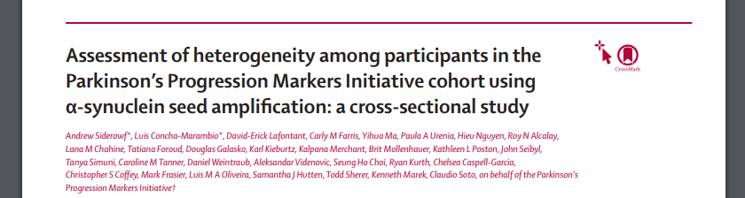
New term: “α-synuclein seed amplification assay” or SAA
CSF on 1123 participants
For PD, 87.7% sensitivity; 96% specificity
For PD with hyposmia, 98.6%
Positive in 28/33 with RBD
Positive in 16/18 with hyposmia
**all enriched for positive Datscan**
(Lancet Neurol 2023; 22: 407–17)

Slide 29
Skin Biopsy
428 patients, 108 with PD, 69 with MSA, 67 with DLB, 33 with PAF and 151 healthy controls
Overall, 95.5% sensitivity and 96.7% specificity
Sensitivity by disease:
92.7% for PD
98.2% with MSA
96.0% with DLB
100% with PAF
1. Gibbons C, Levine T, Bellaire B, et al. The Synuclein-One Study: Skin Biopsy Detection of Phosphorylated alpha-synuclein for Diagnosis of the Synucleinopathies. Presented at: AAN Annual Meeting; April 22-27, 2023; Boston, MA and Virtual. Presentation 6545.

Slide 30
Skin Biopsy- RT-QuIC
Preliminary studies:
64% sensitivity/91% specificity for PD (39 PD and 11 NC)*
NIH RO1: Blinded Comparison of Different Alpha-Synuclein Seeding Assays as Cutaneous Biomarkers of Lewy Body Dementias
30 subjects each with PD, PDD and DLB as well as 30 controls
6 paracervical biopsies
RT-QuIC from 2 independent labs
Other studies of RT-Quic in nasal swabs, GI biopsies
* https://n.neurology.org/content/98/18_Supplement/1907

Slide 31
Caveats
Not all PD has alpha-synuclein
Visual detecting alpha-syn requires expertise
Prodromal state not well studied
RT-QuIC requires special labs
No correlation with progression
Detects pathology not biology

Slide 32
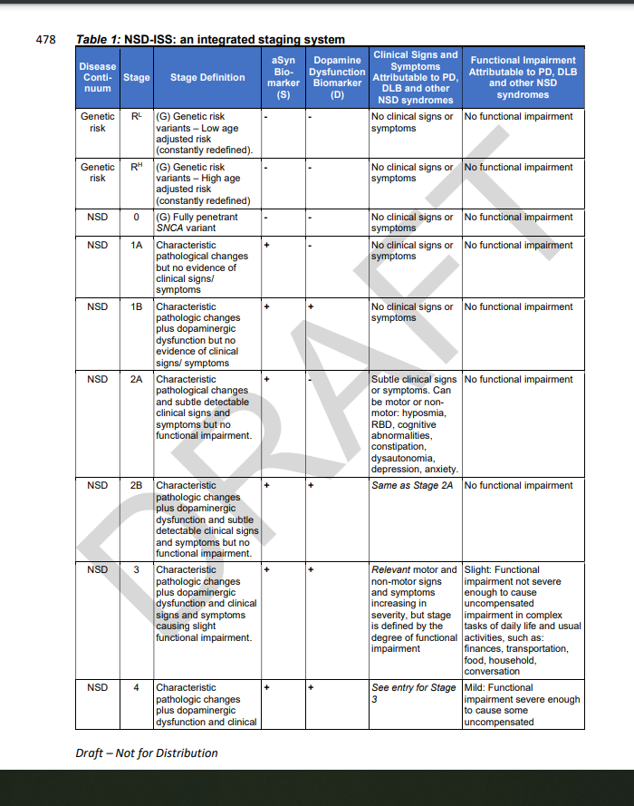
Neuronal Synuclein Disease (NSD)

Slide 33

THE END

