Slide 1
APPLYING TRANSLATIONAL MEDICINE TO REPURPOSE CANCER DRUGS FOR ALZHEIMER’S DISEASE
Marwan Noel Sabbagh MD, FAAN, FANA
Moreno Family Chair of Alzheimer’s Research
Vice Chair for Research and Professor of Neurology
Director of the Applied Alzheimer’s Research Laboratory

Slide 2
CNS Drug Development is expensive and time consuming with a low chance of ROI

Slide 3
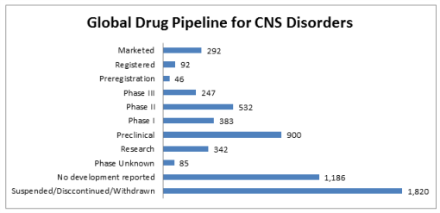

Slide 4
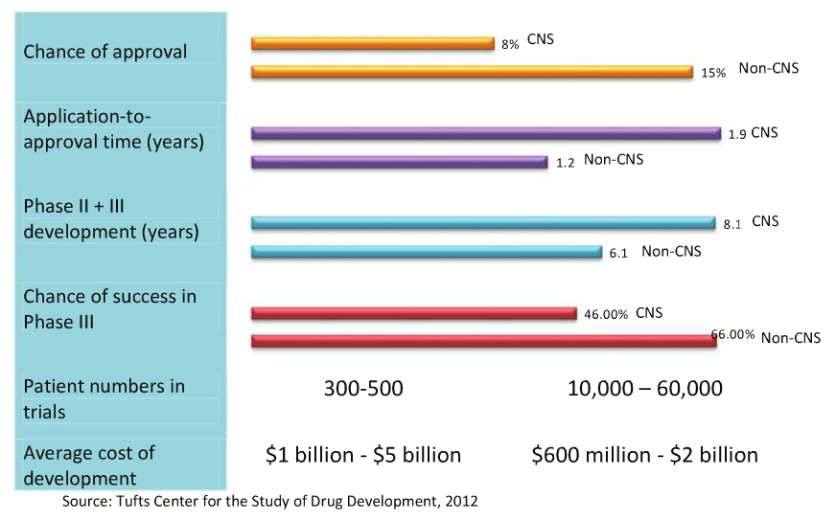

Slide 5
There are multiple approaches to CNS drug development

Slide 6
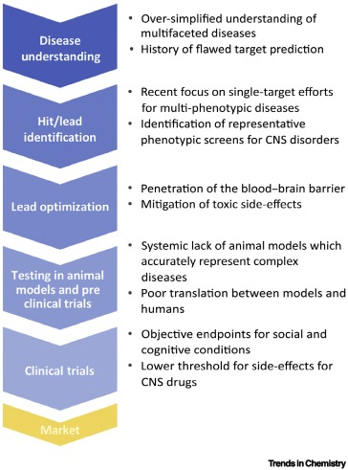

Slide 7
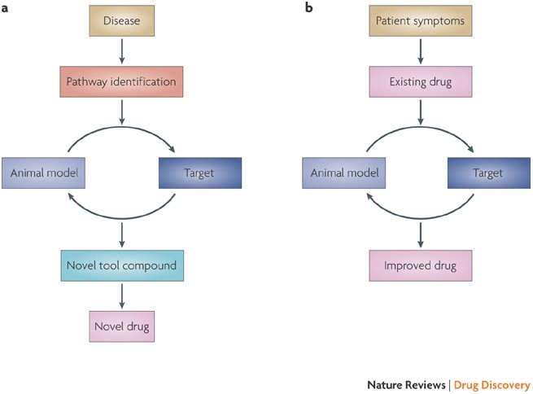

Slide 8
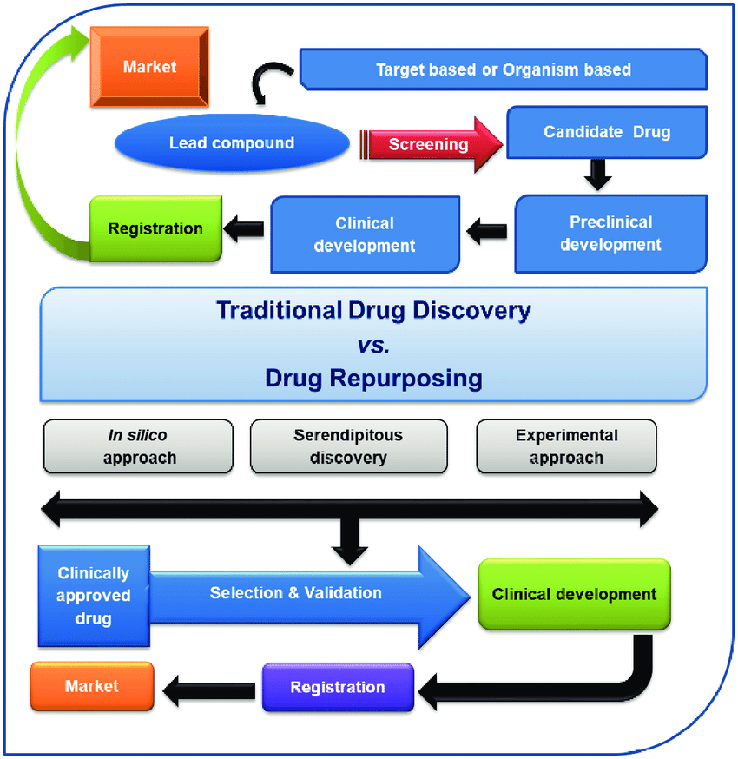

Slide 9
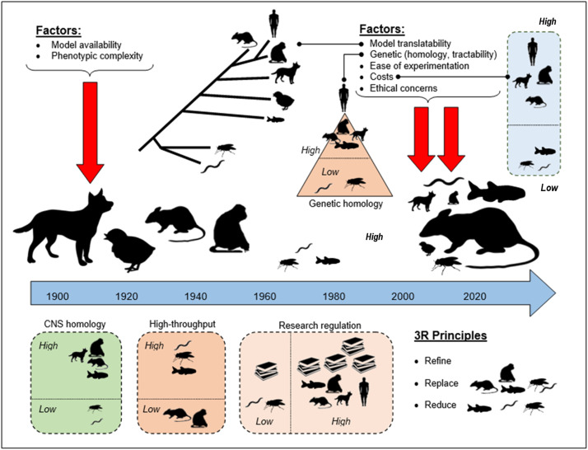
Animal models are a common step in drug development

Slide 10
Transition to clinical research from the lab: IND and phase I,II, III Clinical trials

Slide 11
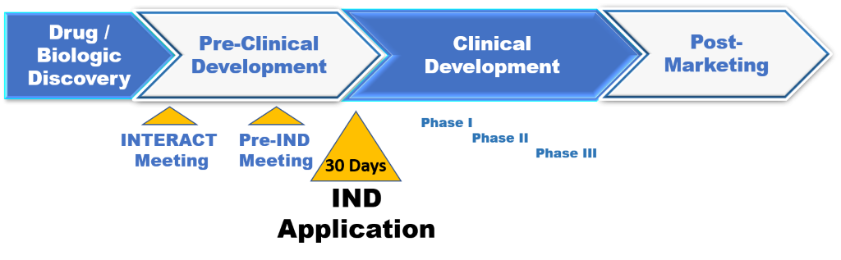

Slide 12
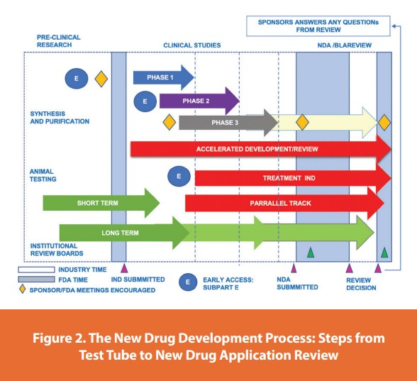

Slide 13
Examples of repurposed drugs in the treatment of Alzheimer’s disease

Slide 14

Thalidomide? Really?
Approved in the 1950s for hyperemesis gravidarium
Removed from the market in 1960s devastating birth defects
Re-introduced in 1997 for the treatment of multiple myeloma
Still used and marketed but with severe restrictions and limitations and patient protections

Slide 15
Why look at Cancer drugs to treat AD
Mechanistic overlap
Tyrosine kinase inhibitors (mastinib, nilotinib) developed for cancer might work in AD
TKI’s also inhibit the Fyn tyrosine protein kinases, which allow for reduced phosphorylation in the body, regulating cell proliferation (cite FYN). Not only do TKI’s inhibit the Fyn signaling pathway, disrupting the Aß signaling cascade, but they also exert a neuroprotective effect via the activity with mast cells and other non-neuronal cells in the body
Inflammation is noted in both

Slide 16
Tyrosine Kinase Inhibitors and AD
regulation of intracellular pathways leading to hyperphosphorylation;
activation of autophagy to regulate protein aggregates (mostly intraneuronal aggregates); and
regulation of astrogliosis (astrocytes express high levels of EGFR).
For example, EGFR signaling can be activated by oligomeric Abeta in vitro, and EGFR inhibitors improved cognitive measures and AD-like pathologies in animal models. But the effects in clinical trials were mixed... likely due to issues with patient selection

Slide 17
Repurposing drug for AD: thalidomide Thalidomide as a BACE 1 inhibitor: rationale and justification for a randomized clinical trial.
NIH R01:5 R01 AG034155-02 Status Application awarded. Project Title: Study on Thalidomide as BACE1 inhibitor in Alzheimer's disease PI Name: SABBAGH, MARWAN N NIH Appl. ID7933771 Application ID5 R01 AG034155-02 9/1/2009-08/31/2013

Slide 18
Abstract
Background: - Aβ has long been considered the pathological hallmark of AD
- Aβ is derived from the amyloid precursor protein (APP)
- beta-secretase (BACE1) is the rate-limiting enzyme in APP processing for Aβ synthesis
- BACE1 activity was significantly increased in post-mortem sporadic AD brain samples
- thus, BACE1 inhibitors tested in pilot clinical trials are of clinical relevance for the treatment of AD
Objective: - We and others have discovered that blocking TNF signaling reduces amyloid plaques and Aβ production through the inhibition of BACE1 in AD transgenic mice
- A clinical study has also demonstrated that the TNF fusion protein antagonist, Enteracept, was beneficial to one AD case. However, Enteracept cannot penetrate the brain blood barrier (BBB), and peri-cervical injections may carry potential risks
- thus, we decided to test the inhibition of BACE1 and specific downstream pathways using the TNF inhibitor Thalidomide
Methods: - NT2 cells transfected with APP containing the Swedish mutation (APPsw)
- several doses of Thalidomide, or vehicle alone, were added for 24h
- we evaluated BACE1, sAPPβ, Aβ40, and Aβ42 expression levels by Western blotting and ELISA
Results: - Thalidomide treatment of APPsw-transfected NT2 cells resulted in a dose-dependent decrease in BACE1, sAPPβ, Aβ40 levels
Conclusions: - Thalidomide reduce BACE1 levels and byproducts
- Thalidomide was later tested on APP23 mice
- leveraging our supporting data, we have obtained approval to pursue Thalidomide treatment in human AD subjects
- Thalidomide was administered to AD patients
- analyses were performed to further test our hypothesis that thalidomide decreases CSF BACE1 and Aβ levels
- we also tested whether Thalidomide improves CSF markers for neuronal loss in AD subjects
- we propose that Thalidomide may represent a novel BACE1 inhibitor.

Slide 19
Background: TNF Signaling Modulates BACE1
Neuroinflammation is a cytokine-mediated inflammatory response that is associated with most chronic neurodegenerative diseases.
Most cytokines, including TNF, are expressed at very low levels in the healthy brain, but they can be detected in individuals with disease-related neuroinflammation years before neuronal death results.
”TNFα is secreted by microglial cells that are activated in diseased brains
TNF receptor (TNFR) signaling is involved in APP processing, which affects Aβ production, in addition to mediating neuron survival and death
A binding site for the transcription factor NF-κB, a component of the TNF type I receptor (TNFRI) signaling pathway, was identified in the BACE1 promoter of the BACE1 gene
We have shown that TNF treatment results in increased BACE1 activity in vitro and that the TNFRI cascade is required for Aβ production in vivo
We have reported that the deletion of the TNFRI gene in APP23 transgenic mice inhibits Aβ generation and diminishes Aβ plaque formation
Genetic deletion of TNFR1 leads to reduced BACE1 expression and activity via the NF-κB pathway, and deletion of TNFRI in APP23 transgenic mice prevents partially rescues learning and memory deficits.
Thus, TNF- and TNFRI-induced BACE1 expression may be viewed as a novel therapeutic target for AD

Slide 20
Hypothesis:
Thalidomide can decrease CSF BACE1 and CSF Aβ1-x and improve CSF neuronal markers for neurodegeneration in AD subjects. We propose that Thalidomide may represent a BACE1 inhibitor.
Research Objectives:
1: To evaluate the effects of 24 weeks of treatment with Thalidomide on surrogate efficacy markers. A lumbar puncture was done before treatment (baseline), and at 24 weeks to collect CSF for the quantification of biomarkers: for BACE1 protein and enzymatic activity, sAPPβ, Aβ40, Aβ42, neuronal markers (total tau and phosphorylated tau) and inflammation markers (C-reactive protein, IL-1, IL-6, TNFα and sTNFR receptors).
2: To evaluate the safety and tolerability of Thalidomide administered daily for 24 weeks to patients with mild to moderate dementia of the Alzheimer’s type. Safety measures included adverse events, laboratory tests, physical exams, vital signs, weight, and 12-lead electrocardiogram.
3: Although 24 weeks of treatment may be an insufficient amount of time to see changes, the effects of Thalidomide treatment on cognitive function in AD patients were also assessed. The Alzheimer’s Disease Assessment Scale – Cognitive Subscale (ADAS-Cog), Clinical Dementia Rating-Sum of Boxes (CDR Sum-of Boxes), Mini Mental State Examination (MMSE) and Alzheimer’s Disease Collaborative Study-Activities of Daily Living (ADCS-ADL) were assessed at baseline, and at the end of treatment.

Slide 21

Preliminary Results: Thalidomide reduces BACE1, Aβ40 and sAPPβ levels in vitro.
Figure 1: BACE1 levels decrease with Thalidomide Treatment.
Figure 2: Aβ40 levels decrease with Thalidomide Treatment.
0
50
150
Thalidomide (μg/mL):
100
BACE1 C-term
0 μg/mL
25 μg/mL
50 μg/mL
100 μg/mL
Procedure:
NT2 cells were transfected with APPsw and then treated with different concentrations of Thalidomide or vehicle for 12h and then again with fresh Thalidomide or vehicle for an additional 12h. Culture media were collected to assess Aβ40 (Figure 2), Aβ42 and sAPPβ (Figure 3) by ELISA. Results are shown as percentage of vehicle only condition. Note that Aβ42 levels were too low to get reliable results. In addition, the cells were lysed and subjected to BACE1 Western blotting using an anti-BACE1 C-terminal antibody (Figure 1).
Figure 3: sAPPβ levels decrease with Thalidomide Treatment.
0 μg/mL
25 μg/mL
50 μg/mL
100 μg/mL

Slide 22
Objectives
Thalidomide may have a mechanism of action beyond inhibition of TNFα, i.e. BACE 1 inhibition
This randomized clinical trial assessed biomarkers as the primary outcome to determine whether thalidomide can inhibit BACE1 in vivo in mild to moderate AD subjects

Slide 23
Inclusion Criteria
Inclusion criteria
Participants in this study must be male or female outpatients who are at least 50 years of age.
Patients must have been diagnosed with probable AD for at least 1 year based on the NINCDS-ADRDA criteria, and the severity of AD must be mild to moderate with a documented Mini Mental State Exam (MMSE) score between 12-26 .
The CT or MRI scan of the brain obtained during the course of the dementia must be consistent with the diagnosis and show no evidence of significant focal lesions or of pathology which could contribute to dementia.
The patient’s vision and hearing must be sufficient to comply with study procedures.
The patient must be able to take oral medications.
The patient’s Hachinski score must be ≤4, and patient must be ≤10 on geriatric depression scale.
The patient must have received a cholinesterase inhibitor and/or memantine for at least 4 months and have been maintained on a stable dose for at least 2 months prior to randomization and must be expected to remain on a stable dose for the remainder of the study period or have demonstrated intolerance to or lack of efficacy from these medications.
The patient must have an adult informant who has significant direct contact with the patient at least 3 days per week and who is willing to accompany the patient to all clinic visits and to be present during all phone visits.
The patient must reside in the community. Supervision must be available for the administration of all study medication.

Slide 24
Exclusion Criteria
Exclusion Criteria
Subjects will be excluded from this study if there is current evidence or history within the last 3 years of a neurological or psychiatric illness that could contribute to dementia, including (but not limited to) epilepsy, focal brain lesion, Parkinson’s disease, seizure disorder, head injury with loss of consciousness, DSM IV criteria for any major psychiatric disorder including psychosis, major depression and bipolar disorder, and alcohol or substance abuse.
The subject cannot have any of the following conditions: poorly controlled hypertension, a history of myocardial infarction or signs or symptoms of unstable coronary artery disease within the last year (including revascularization procedure/angioplasty), severe pulmonary disease (including chronic obstructive pulmonary disease) requiring more than 2 hospitalizations within the past year, a requirement for home oxygen use or sleep apnea, any thyroid disease (unless euthyroid on treatment for at least 6 months), active neoplastic disease (except for skin tumors other than melanoma), a history of multiple myeloma, an absolute neutropenia of 750mm3, a history of neutropenia, a history of or current thromboembolism (including deep venous thrombosis), or any clinically significant hepatic or renal disease (including presence of Hepatitis B or C antigen/antibody or an elevated transaminase levels of greater than two times the upper limit of normal (ULN) or creatinine greater than 1.5 x ULN).
Patients with stable prostate cancer may be included at the discretion of the Medical Monitor.
Subjects cannot have any clinically significant hematologic or coagulation disorder including any unexplained anemia or a platelet counts less than 100,000 μL at screening.
Subjects cannot use of an investigational drug within 30 days or within five half-lives of the investigational agent, whichever is longer. Subjects cannot use an investigational medical device within two weeks before or after the study.
Females who are pregnancy or are of child bearing age are excluded. A patient with any other disease or condition that, in the opinion of the investigator, makes the patient unsuitable to participate in this clinical trial (including inability to undergo a lumbar puncture for any reason) is excluded.

Slide 25
Experimental Design
AD subject meets I/E criteria
LP CSF testing for biomarkers
Randomization to thalidomide or placebo
24 weeks: LP for CSF biomarkers

Slide 26
Schedule of Visits
 | Screening | Baseline WK 0 | WK 2 | WK 4 | WK 6 | WK 8 | WK 12 | WK 16 | Wk 20 | WK 24
 | Visit 1 | Visit 2 | Visit 3 | Visit 4 | Visit 5 | Visit 6 | Visit 7 | Visit 8 | Visit 9 | Visit 10
Consent | X
Vital Signs | X | X | X | X | X | X | X | X | X | X
Inclusion/Exclusion | X
Medical History | X
EKG | X
Con Meds | X | X | X | X | X | X | X | X | X | X
A/E Assessment |  | X | X | X | X | X | X | X | X | X
Constipation Treatment⁴ |  | X | X | X | X | X | X | X | X | X
Laboratory Assessments | X |  | X | X | X | X | X | X | X | X
Shen Labs |  | X | X | X | X | X | X | X | X | X
Physical Exam | X |  | X | X | X | X | X | X | X | X
Neuro Exam | X |  | X | X | X | X | X | X | X | X
Nerve Conduction Test (SNAP) |  | X |  |  |  |  | X |  |  | X
Lumbar Puncture |  | X |  |  |  |  |  |  |  | X
Dispense Study Drug/S.T.E.P.S. |  | X | X | X | X | X | X | X | X
Neuropsychological Assessments | X^{1 &} 3 | X² |  |  |  |  | X¹ |  |  | ^{X1 & 2}
Drug Accountability |  |  | X | X | X | X | X | X | X | X

Slide 27
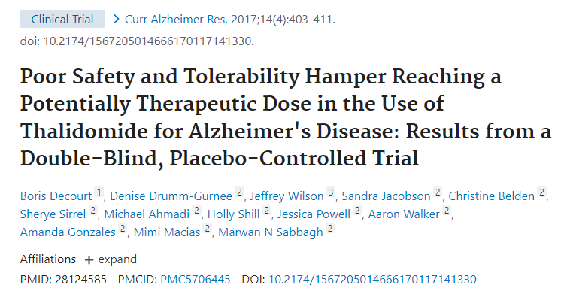

Slide 28
RATIONALE FOR THE PHASE II CLINICAL TRIAL ASSESSING THE SAFETY, TOLERABILITY, AND EFFICACY OF LENALIDOMIDE IN MILD COGNITIVE IMPAIRMENT DUE TO ALZHEIMER’S DISEASE
7 R01 AG059008-04
Status Application awarded.
Project TitleMCLENA-1: A Clinical Trial for the Assessment of Lenalidomide in Amnestic MCI Patients
PI Name: Decourt, Boris; SABBAGH, MARWAN Noel (Contact); Wilson, Jeffrey R
NIH Appl. ID10630526

Slide 29
Rationale for drug targeting of inflammation in AD
All monotherapy clinical trials with a focus on disease modification completed to date have failed to meet the clinical endpoint of significantly slowing cognitive decline in dementia due to Alzheimer’s disease (AD). This includes trials examining BACE1 inhibitors, γ-secretase inhibitors and modulators, and active and passive immunization against monomeric, oligomeric, and protofibril amyloid beta (Aβ)
Surprisingly, the failure of BACE1 inhibitors in recent clinical trials was associated with an exacerbation of cognitive decline, in addition to displaying toxicities due to the inhibition of not only amyloid precursor protein processing, but also the blocking of processing of all BACE1 substrates. These results emphasize the urgent need for novel therapeutic approaches that reduce several AD neuropathologies simultaneously, without worsening cognition
Inflammation is prominent in many neurological disorders, yet no clinical trial has demonstrated the efficacy of anti-inflammatory agents for AD. Interestingly, chronic peripheral low-grade inflammation is associated with aging and increases the risk for disease and mortality, including AD
Accumulating evidence indicates that nuclear factor-κB (NF-κB), tumor necrosis factor alpha (TNF-α), interleukins (e.g., IL-1β, IL-2, and IL-6), and chemokines (e.g., IL-8) are elevated both in the blood and central nervous system (CNS) of AD patients
These data strongly suggest that inflammation plays a critical role in the cause and effect of AD neuropathology. Interestingly, the anti-cancer drug lenalidomide is one of the very few pleiotropic agents that not only lowers the expression of TNF-α, IL-6, and IL-8, but also increases the expression of anti-inflammatory cytokines (e.g., IL-10). Thus, lenalidomide modulates both innate and adaptive immune responses.

Slide 30
Rationale for Lenalidomide
For the first time the potent immunomodulator lenalidomide is used to treat AD at an early stage of the disease (aMCI);
Because lenalidomide has pleiotropic effects, it has the potential to not only modulate chronic inflammation, but also to lower amyloidogenesis by, in part, normalizing BACE1 expression. Thus, the drug is targeting several neuropathologies associated with AD at once, which, to our knowledge, has never been described;
The immunomodulator, anti-cancer agent lenalidomide is one of the very few pleiotropic agents that both lowers the expression of pro-inflammatory cytokines (e.g., TNFα, IL-6, IL-8), and increases the expression of anti-inflammatory cytokines (e.g., IL-10), to modulate both innate and adaptive immune responses
It repurposes a long-used anti-cancer drug that could tackle several pathologies at once. Repurposing an approved drug is very appealing because the safety and toxicity are inherently known.

Slide 31
APP23 mice treated with lenalidomide for 12 weeks showed improved learning in a Barnes maze set up. APP23 and non-transgenic littermate (WT) mice received daily IP injections of lenalidomide (0, 1, 10, and 100 mg/kg) for 12 weeks. In the final two weeks of treatment, the animals underwent cognitive assessment on a Barnes maze set up. Lenalidomide did not affect cognitive performance in WT mice, but improved the learning of APP23 mice at moderate and high dose (10 and 100 mg/kg).

Slide 32
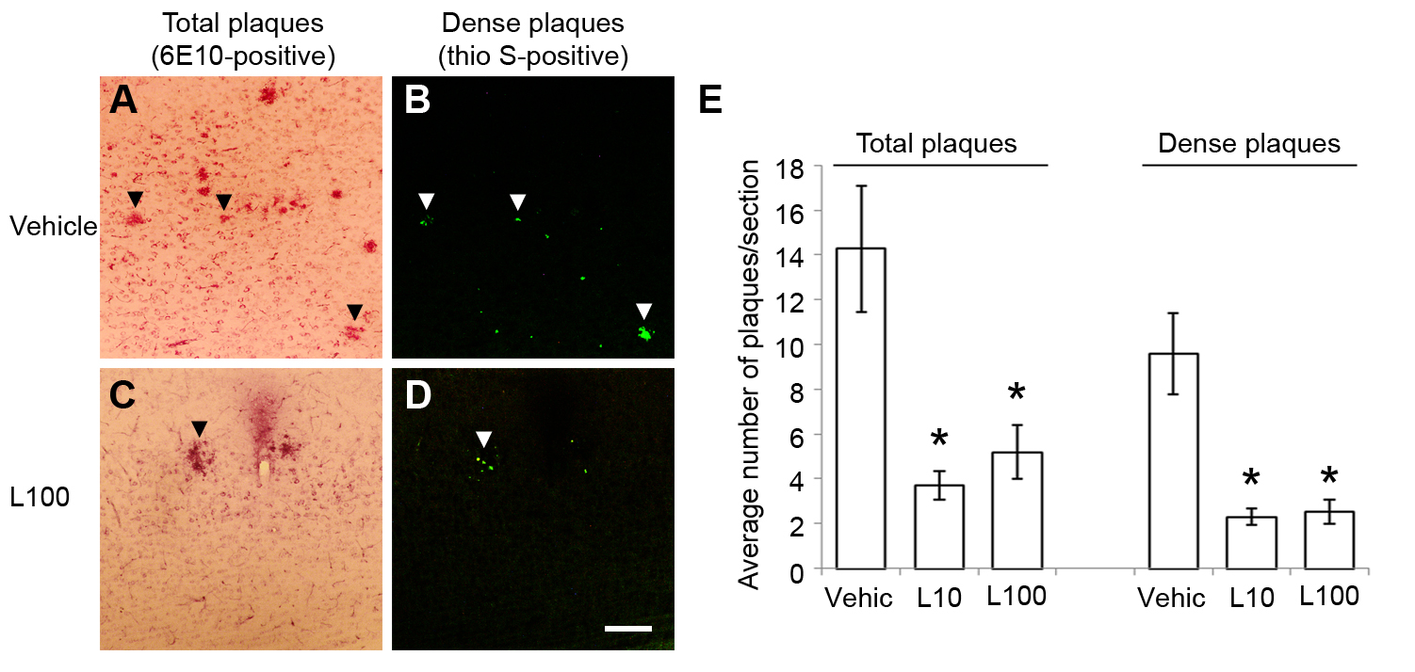
Aβ in situ pathology is decreased in the brain of APP23 mice administered lenalidomide. (A-D) Fixed brains from lenalidomide (10 and 100 mg/kg/day)- and vehicle-treated APP23 mice (n=4 and 3, respectively; 4 week-treatment) were immunostained with 6E10 antibody and counterstained with thioflavin S. Fewer plaques were observed after drug treatment. Quantification in the cortex revealed a significant decrease in plaque number after lenalidomide injection (E). * p<0.05.

Slide 33
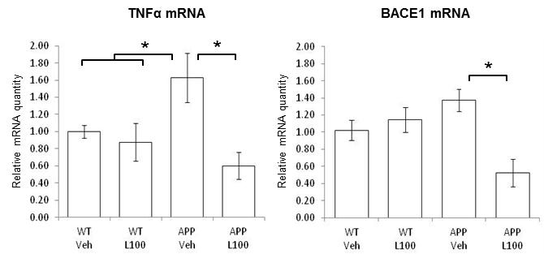
Lenalidomide decreased TNFα and BACE1 expression in APP23 mice. The hippocampus was dissected from WT (n=5/group) and APP23 (n=4-9/group) mice and used for qPCR analyses. (A) TNFα mRNA levels were significantly increased in vehicle-treated APP 23 compared to WT mice (A). Lenalidomide 100 mg/kg reduced TNFα expression to WT levels in APP23 mice. (B) Similarly, BACE1 mRNA levels were dramatically lower after drug treatment compared to vehicle-treated APP23 mice (B). * p<0.05.

Slide 34
Study Design MCLENA 1
We designed a Phase II, proof-of-mechanism, placebo-controlled clinical study on single and multiple domain amnestic MCI subjects administered 10 mg/day lenalidomide for 12 months (15 placebo + 15 drug-treated subjects total). The primary objective of the study is to assess the effect of lenalidomide on cognition after 12 months of treatment
The secondary objective of our study is to assess the safety and tolerability of lenalidomide in aMCI patients. Tertiary and Exploratory Objectives: We will investigate the potential of blood inflammatory markers as surrogate markers of the therapeutic efficacy of the study drug
The Primary Endpoint: cognition (cognitive tests), brain Amyloid loads (Florbetapir PET imaging), neurodegeneration (volumetric MCI). The secondary Endpoints: Safety is evaluated through reported adverse events (AEs), clinical laboratory tests (hematology, serum chemistry, urinalysis), vital signs, physical and neurological examinations, and EKGs. The Tertiary and Exploratory Objectives: We will assess blood inflammatory markers in aMCI after lenalidomide vs. placebo administration. I/E Criteria:

Slide 35
Regulatory
This study was reviewed and endorsed by the Cleveland Clinic Institutional Review Board (IRB; protocol #19-658).
The investigators will report regularly the progress of the study to a medical monitor, a data and safety monitoring board (DSMB), and the IRB for compliance and investigational drug safety purposes.
The Food and Drug Administration authorized the use of lenalidomide for this project under Investigational New Drug Application (IND) #142121.
This trial is registered on ClinicalTrials.gov (NCT #04032626).

Slide 36
Objectives and Endpoints
This is a single site study (initially in Las Vegas, now at BNI)
30 male and female outpatients, 50-90 years of age, in general good health, residing in Las Vegas and Phoenix. Because of the local demographics, the study population will mostly consist of Caucasians, although all efforts will be made to enroll other ethnicities
Lenalidomide 10 mg/day vs. placebo taken daily orally (ratio 1:1) for 52 weeks
The trial will last 18 month in duration. Participants completing the study will be involved for up to 20 months in duration, from screening to end of study
Primary Objective: The primary objective of the study is to assess the effect of lenalidomide on cognition after 12 months of treatment.
Secondary Objectives: The secondary objective of our study is to assess the safety and tolerability of lenalidomide in aMCI patients.
Tertiary and Exploratory Objectives: We will investigate the potential of blood inflammatory markers as surrogate markers of the therapeutic efficacy of the study drug.
Primary Endpoint: cognition (cognitive tests), brain Amyloid loads (Florbetapir PET imaging), neurodegeneration (volumetric MRI).
Secondary Endpoints: Safety is evaluated through reported adverse events (AEs), clinical laboratory tests (hematology, serum chemistry, urinalysis), vital signs, physical and neurological examinations, and EKGs.
Tertiary and Exploratory Objectives: We will assess blood inflammatory markers in aMCI after lenalidomide vs. placebo administration.

Slide 37
Inclusion Criteria
In order to be eligible for this study, subjects must meet the following inclusion criteria:
Male or female outpatients.
At least 50 years of age, but less than 90.
Females must be surgically sterile (bilateral tubal ligation, oophorectomy, or hysterectomy) or postmenopausal for 2 years (no women at risk of pregnancy will be accepted in this study).
Must have been diagnosed with amnestic MCI based on the most recent NIA-AA criteria (Albert et al., 2011), i.e. at both the screening and baseline visits (visits 1 and 2) have a documented Mini Mental State Exam (MMSE) score between 22-28.
CT or MRI scan of the brain obtained during the course of the dementia must be consistent with the diagnosis and show no evidence of significant focal lesions or of pathology which could contribute to dementia. If neither a CT nor an MRI scan is available from the past 12 months, a CT scan fulfilling the requirements must be obtained before randomization.
Vision and hearing must be sufficient to comply with study procedures.
Be able to take oral medications.
Hachinski ischemic score must be ≤ 4.
Geriatric depression scale must be ≤ 10.
Can be on stable doses of a cholinesterase inhibitor and/or memantine as long as it is stable for at least 90 days before screening and is expected to remain on a stable dose for the remainder of the study period; or have demonstrated intolerance to or lack of efficacy from these medications.
Must have a collateral informant/study partner who has significant direct contact with the patient at least 10 hours per week and who is willing to accompany the patient to all clinic visits and to be present during all telephone visits/interviews.
If the patient has a legally authorized representative (LAR), the LAR must review and sign the informed consent form. If the patient does not have an LAR, the patient must appear able to provide informed consent and must review and sign the informed consent form. In addition, the patient’s informant/study partner (as defined above) must sign the informed consent form. If the LAR and the patient’s informant /study partner is the same individual, he/she should sign under both designations.
Must reside in the community.
Supervision must be available for the administration of all study medication.
Patients with stable prostate cancer may be included at the discretion of the Medical Monitor.

Slide 38
Exclusion Criteria
Current evidence or history within the last 3 years of a neurological or psychiatric illness that could contribute to dementia, including (but not limited to) epilepsy, focal brain lesion, Parkinson’s disease, seizure disorder, head injury with loss of consciousness
DSM IV criteria for any major psychiatric disorder including psychosis, major depression and bipolar disorder.
Known history or self-reported alcohol or substance abuse.
Living alone.
Poorly controlled hypertension.
History of myocardial infarction or signs or symptoms of unstable coronary artery disease within the last year (including revascularization procedure/angioplasty).
Severe pulmonary disease (including chronic obstructive pulmonary disease) requiring more than 2 hospitalizations within the past year.
Requirement for home oxygen use or sleep apnea.
Any thyroid disease (unless euthyroid on treatment for at least 6 months prior to screening).
Active neoplastic disease (except for skin tumors other than melanoma) within five years.
History of multiple myeloma.
Absolute neutropenia of <750/mm3, or a history of neutropenia.
History of or current thromboembolism (including deep venous thrombosis).
Any clinically significant hepatic or renal disease (including presence of Hepatitis B or C antigen/antibody or an elevated transaminase levels of greater than two times the upper limit of normal (ULN) or creatinine greater than 1.5 x ULN).
Clinically significant hematologic or coagulation disorder including any unexplained anemia or a platelet count less than 100,000/μL at screening.
Use of any investigational drug within 30 days or within five half-lives of the investigational agent, whichever is longer.
Use any investigational medical device within two weeks before screening or after end of the present study.
Females who are at risk of pregnancy or are of child bearing age.
Any other disease or condition that, in the opinion of the investigator, makes the patient unsuitable to participate in this clinical trial (including inability to undergo a lumbar puncture for any reason).
Unwilling or unable to undergo MRI and PET imaging.
Cardiac pacemaker or defibrillator or other implanted device.

Slide 39
Overall Study Design
Day -85 to Day -1
Screening
Study Drug N=15
Day 1
Randomization
Placebo N=15
Week 2
Blood Toxicity
7 In-Clinic Visits and 6 Telephone Contacts
Weeks 4 - 48
Maintenance
Week 52
End of Dosing
Biomarker & Cognitive Assessments
Week 56
4 Weeks Follow-Up InPerson / Cognitive Assessments
Week 78
6 Month Follow-Up InPerson / End of Study Assessments (EOS)

Slide 40
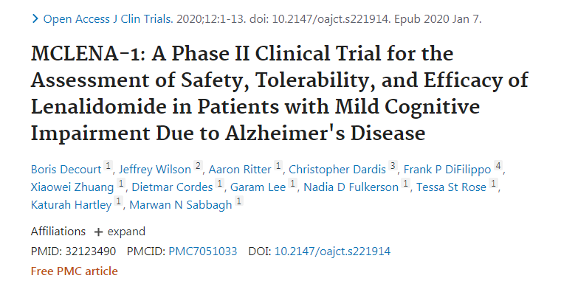

Slide 41
Current Status
15 subjects screened and consented
8 enrolled and 6 completed the study to date
7 screen failed
1 early termination (consented withdrawal) after 1 dose; subject with history of high blood pressure
One withdraw consent before dosing
MCLENA 2 under IRB review.

Slide 42
Study Design MCLENA 2
We designed a Phase II, proof-of-mechanism, placebo-controlled clinical study on single and multiple domain amnestic MCI subjects administered 10 mg/day lenalidomide for 6 months (15 placebo + 30 drug-treated subjects total). The primary objective of the study is to assess the effect of lenalidomide on biomarkers of AD specifically CSF Ab, tau and ptau
The secondary objective of our study is to assess the safety and tolerability of lenalidomide in aMCI patients. Tertiary and Exploratory Objectives: We will investigate the potential of blood inflammatory markers as surrogate markers of the therapeutic efficacy of the study drug

Slide 43
Acknowledgements
Co-PI Boris Decourt PhD
Co-I Aaron Ritter MD, Jiong Shi MD
Research Staff:
BNI: Sandy Quintanilla, Margeaux Snell MD,
Las Vegas: Liliana Dumestriciu, Miranda Staples, Nadia Fulkerson, Elaine Pienschke, Jennifer Hawse

