Slide 1
Love, Anger, and Primary Progressive Aphasia The Psychological Care of a Person with Dementia George P. Prigatano, Ph.D.
The 35th Annual Meeting of the Groupe de Recherche sur la maladie d’Alzheimer (GRAL)
January 25-27, 2024
Barrow Neurological Institute

Slide 2
Disclaimers
No financial or conflicts of interest to disclose regarding this presentation.
However, many important details regarding the psychological care of the person to be described had to be omitted in light of the time allotted for this presentation.
Written and verbal authorization to discuss this case was provided by both the patient and his spouse.

Slide 3
Purpose of this Presentation
To bring attention to the need to provide supportive psychotherapy for some persons with PPA throughout the course of their illness.
To briefly describe two predictable interpersonal problems which can emerge when language functions are significantly impaired.
To illustrate how these problems can be meaningfully managed by providing neuropsychologically informed and psychodynamically sensitive interventions.

Slide 4
Primary Progressive Aphasia
Primary Progressive Aphasia (PPA) is a “focal dementia characterized by an isolated and gradual dissolution of language function.” (Mesulam, 2001,pg.425). As the dementia worsens, multiple neurocognitive impairments are observed, including severe memory impairments.
The natural course of PPA and the underlying neuropathologies associated with the various variants of PPA have been described (Mesulam et al, 2022; Ramanan et al., 2022).

Slide 5
PPA and Psychological Care
Support groups are often offered to persons with PPA and their caregivers (Taylor-Rubin et al., 2019.
Rehabilitation therapies are often attempted with persons with PPA (e.g., traditional speech and language therapy, teaching cognitive compensation skills, outlining behavioral steps to follow when problem solving, and modifying the living environment) (Kortte & Rogalski, 2013; Rogalski & Khayum, 2018).
Individualized supportive psychotherapy is often not mentioned in the literature.

Slide 6
Voice and Language in Interpersonal Relationships
From an evolutionary perspective, vocalizations between animals (humans included) are crucial to avoid a predator, find food, and identify a receptive mate (Darwin, 1889/1998).
Vocalizations are thought to later evolve into speech and language which allowed for more complex communications (Darwin, 1889/1998).
Sapir (1925) noted the importance of sound patterns (not just the words spoken) in conveying “the complete message” of a communication.

Slide 7
Voice and Language in Interpersonal Relationships
Sapir also emphasized the importance of language in defining “person hood” (e.g., our name identifies who we are and what is expected of us) (Sapir & Mandelbaum, 1963).
Sapir argued that language solidified collective perceptions of reality and helped defined our individuality, our autonomy, and our culture.
This insight has considerable psychological importance.

Slide 8
Voice and Language in Psychotherapy
The Client-Centered approach to psychotherapy (Rogers, 1951) focused on the importance of repeating to the patient what they just said in order for them “to hear” (i.e. understand or become aware of) what they are actually experiencing that is not always immediately consciously perceived. Freud and Jung made the same point years earlier.

Slide 9
Four Key Features Involved in the Perception and Expression of Emotion
Darwin (1889/1998) noted four key features in the perception and expression of emotion.
Tone of vocalization
Vocalized sound patterns that convey meaning (including words)
Facial expressions including changes in the look of the eyes
Tactual and tactile movements

Slide 10
Voice, Language and Emotions
Disturbances in understanding what is said and how it is said is, of course, common in persons with aphasia.
Disturbances in the perception of facial emotion have been reported in PPA (Bertoux et al., 2020) as well as disturbances in gesture discrimination (Nelissen et al., 2010).
Errors in the perception and experience of emotion are fertile grounds for disturbances in interpersonal relationships for persons with PPA.

Slide 11
The Case Example: Initial Findings and Diagnosis
76 year old retired right handed male presents unaccompanied for a clinical neuropsychological examination because of increased difficulties with word finding and memory.
He was a high ranking military officer with two bachelor’s degrees.
He appeared to have good insight into his cognitive limitations, but in speaking with his wife over the phone she noted her husband has “a fair amount of difficulty in a number of areas.”

Slide 12
Neuropsychological Findings
Patient’s speech was fluent with no paraphasic errors. Circumlocutions, associated with word finding problems in free speech, were frequent when answering questions.
He did demonstrate difficulties with naming (Boston Naming Test=38/60 points, T=29) and sentence repetition (Multilingual Aphasia Examination subtest score=9/14 points, 7%ile).
Full Scale IQ was within the average range (FSIQ=103). Verbal reasoning skills were normal with evidence of visual spatial impairments (e.g., Similarities =11; Block Design=3).

Slide 13
Neuropsychological Findings
Performance on memory tests were initially within the average range (e.g. on the RAVLT total words recalled was 26, T=42; 20’Delay score was 4 words, T=44).
On tasks involving working memory and language, he demonstrated impairment (e.g., Trail Making Test, Part B, was discontinued due to difficulties remembering the alphabet and keeping the instructions in mind).
Speed of finger tapping and control of adjacent movements was normal in both hands.

Slide 14
Neurological Findings
MRI Brain findings 4 months prior to the neuropsychological examination was interpreted as showing “mild diffuse cerebral atrophy which is more prominent involving the left cerebral hemisphere with associated mild asymmetric left-sided hippocampal atrophy and temporal horn dilation” with extensive small vessel ischemic disease.
PET study revealed bilateral temporal lobe, left parietal and posterior cingulate gyrus decreased FDG uptake.
Patient was diagnosed, by his neurologist, as having Primary Progressive Aphasia, logopenic type.

Slide 15
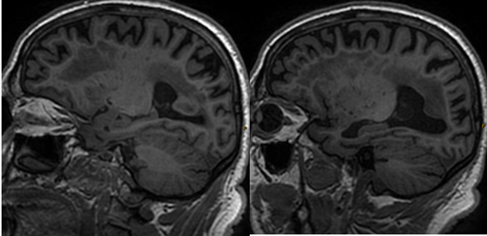
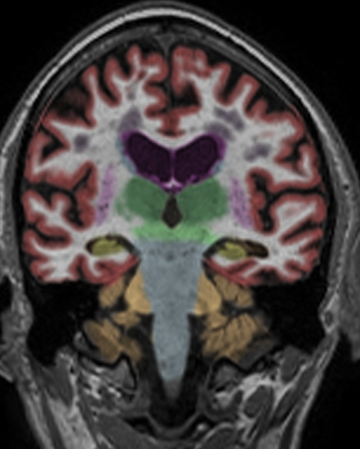
MRI
Right
Left

Slide 16
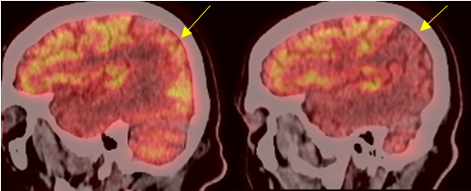
PET
Right
Left

Slide 17
Psychological Care After the Neuropsychological Exanimation
Following the neuropsychological examination, the patient thought it would be helpful to have he and his wife speak with the clinical neuropsychologist on a regular basis so his wife could better understand his clinical condition.
He was not seeking emotional support.
Biweekly supportive psychotherapy sessions were initiated and have continued for three years.

Slide 18
Brief Summary of the Course of Psychological Care
The first few sessions were psychoeducational for the patient and his wife. Various questions were asked about PPA.
The patient was a very organized man and used to having consultants in his prior work.
He wanted the neuropsychologist’s opinion regarding a number of issues including the activities of his speech and language therapies.

Slide 19
The First Major Emotional Conflict
The patient overheard his wife talking with their son about a financial matter and perceived that an important financial decision was being planned without his input. He became very angry.
He wanted to discuss this issue only when the clinical neuropsychologist/psychotherapist was present.
Listening to what the patient and his wife reported, it was suggested to his wife that she put in writing (using brief sentences) what was being proposed. The patient should have ample time to read and re-read these notes.

Slide 20
The First Major Emotional Conflict: Continued
It was also suggested that the background information concerning this financial situation be summarized in a similar manner.
The clinical neuropsychologist/psychotherapist agreed to meet with them conjointly if either one felt it was necessary after doing what was suggested.
This intervention was helpful, and the situation resolved without the therapist’s further input.
A therapeutic alliance was being established.

Slide 21
The Second Major Emotional Conflict
The patient owned several private firearms.
His wife was concerned she did not know the location of one of the guns and wanted her husband to relinquish the firearm.
The patient became very angry, feeling that his wife was needlessly trying to control him.
The therapist encouraged the patient’s wife to clarify her concerns in a supportive and respectful manner.
She did this, and the situation de-escalated. He informed her of the location of the firearm.

Slide 22
The Second Major Emotional Conflict: Continued
The firearm was not relinquished. The patient was not impulsive and had expert knowledge in knowing how to use the firearm safely.
The patient’s wife expressed no concern about her safety.
A calculated risk was taken to support the patient’s decision to keep the firearm.
The patient experienced that his opinion mattered. This was crucial in further building a therapeutic alliance.

Slide 23
Summary of Activities Prior to the Third Major Emotion Conflict
Following the successful management of two episodes of intense anger, therapy sessions varied in content. Sessions were often divided, so that the patient and his wife had private time to discuss their individual issues and questions.
The patient was encouraged to review his personal history, including work history and ongoing friendships. He provided a book on Viet Nam, which had personal relevance to him. It was read and discussed.

Slide 24
Summary of Activities: Continued
Patient’s psychosocial history revealed a relationship with his father that was not supportive. In his adult work life, he often sought out support and guidance from men whom he looked up to and viewed as an authority in different areas.
The patient viewed his older male therapist as authority in neuropsychology, who fostered his autonomy and was interested in what he had to say.

Slide 25
Summary of Activities: Continued
During one psychotherapy session, the patient mentioned that he and his wife slept in separate bedrooms. Reportedly this was done to help his wife have a restful night sleep.
He missed having sexual contact with his wife.
He accepted the situation, however, without protest in order to avoid conflict.
His wife later commented that her husband “would suffer in silence” over an issue and then later explode.

Slide 26
Summary of Activities: Continued
The patient’s language functions deteriorated quite notably over a two year period of time, including a clear breakdown in sematic memory (e.g. What does 4th of July refer to?).
The patient’s wife began looking into adult day care centers and long term residential centers as she observed her husband’s decline.
She found a center that her husband enjoyed attending three days a week.

Slide 27
The Third Major Emotional Conflict
A few months after attending the adult day care center, the patient’s wife reported her husband was becoming increasingly irritable, with episodes of yelling and intense anger at home.
Staff at the adult day care center reported no episodes of agitated or irritable behavior.
The patient’s wife wanted guidance in handling this issue. She was encouraged to first talk to her husband about this privately.

Slide 28
The Third Major Emotional Conflict: Continued
The patient stated to his wife that he did not like the way she speaks to him. She responded that she always communicated in a direct (not necessarily soothing) manner through out their marriage. What had changed?
The patient earlier noted that he enjoying speaking with a fellow female patient at the adult day care center whom he had much in common and felt he was helping her (i.e. a regained sense of being valued, dignity and meaning).

Slide 29
The Third Major Emotional Conflict: Continued
Several weeks later, while on vacation, the patient abruptly announced to his wife he wanted a divorce. He had met another woman whom he loved. He would move out of the house and marry her.
His wife, of course, was shocked and angry with this declaration from her husband.
She contacted the psychotherapist (who was also on vacation) in panic. What should be done?

Slide 30
The Third Major Emotional Conflict: Continued
The therapist asked the wife to tell her husband to please not purse any action until they met. He agreed but stated that the therapist would not change his mind.
Upon returning from vacation, the therapist met with the patient who showed no empathy for his wife’s reaction (a common feature of PPA?)
He was adamant that he loved this other woman and she loved him. However, he had no clear plan of action for moving out or steps to take to initiate a divorce.

Slide 31
The Third Major Emotional Conflict: Continued
The therapist visited the adult care center.
No unusual or inappropriate behaviors were observed. The female friend would, on occasion however, touch his arm when asking to use the scissors next to him.
When leaving the facility, the therapist observed this elderly, reserved soft spoken lady unexpectedly standing behind the patient and massaging his shoulders. She seem to have no awareness or appreciation of how that might be perceived or experienced by the patient.

Slide 32
The Third Major Emotional Conflict: Continued
Darwin (1889/1998) noted that the expression of love is a pleasant experience between humans which often includes soft tender comments, soothing tactile stimulation, brightening of the eyes, and a desire to touch the beloved.
The patient had interpreted these behaviors as a sign of love from this lady, although later she was shocked when asked if she loved the patient.
Her response was: “he is my friend, but I do not love him.”

Slide 33
The Third Emotional Conflict: Continued
In a subsequent session with the patient, he was gently reminded of his dependence on others. When asked if the woman directly expressed love for him, he could not answer the question.
In a private session, his wife was told of her husband’s need to feel of value and be loved. His misperceptions were caused by both his dementia and his existential situation.
It was suggested that she speak with him in a softer (not phony) tone of voice and to gently touch him when communicating support of him.

Slide 34
The Third Emotional Conflict: Continued
After that discussion, the patient’s wife spontaneous spoke of subsequently “pleasuring her husband.”
She was observed to speak with him in a softer tone of voice and would spontaneously touch him in a re-assuring manner.
The situation de-escalated. Patient and his female friend were separated at the adult day center without incident. Patient no longer spoke of her.

Slide 35
The Third Emotional Conflict: Continued
The patient’s wife stopped pursing immediate action to remove him from the home, which appeared to be stimulated by her frustration and anger over the situation that emerged.
A period of calm was reinstated in their relationship.
A period of calm was reinstated in the adult day care center.

Slide 36
Summary Comments
Patients with PPA symbolically “lose their voice” (i.e. their ability to be heard) over important issues in their life. Their sense of dignity and autonomy is threatened.
Patients with PPA can misperceive what other people are saying or doing which can threaten their growing sense of loss of autonomy, and increase confusion in interpersonal interactions.
As language functions decline, the patient is not sure of what they are experiencing and can easily loose their trend of thought.

Slide 37
Summary Comments: Continued
The need to be touched and to hear sounds associated with love and pleasure do not disappear with PPA or other forms of dementia.
Misperceptions of the patient have to be managed in light of their neuropsychological and psychodynamic situation.
In this case, understanding the need for “fatherly advice and guidance” helped the patient experience that his opinion mattered.

Slide 38
Summary Comments: Continued
In this case, the tendency “to suffer in silence” was a premorbid personality feature that was managed by simple behavioral suggestions, which were soothing to the patient and undercut the development of later angry reactions.
The therapeutic alliance with the patient’s wife helped her understand how the patient’s cognitive impairments and basic human needs led to his disturbing behavior.
She was able to obtain her own individual psychotherapy, with medications, at this time.

Slide 39
Summary Comments: Continued
The clinical neuropsychologist/psychotherapist helped the patient clarify his thoughts and experiences as language functions deteriorated.
The clinical neuropsychologist/psychotherapist helped the patient’s spouse understand how the PPA was influencing the patient’s behavior.
Reducing human psychological suffering associated with dementia (including PPA) can be achieved by the clinical neuropsychologist if they also work as a supportive psychotherapist.

Slide 40

Questions and Answers

