Slide 1
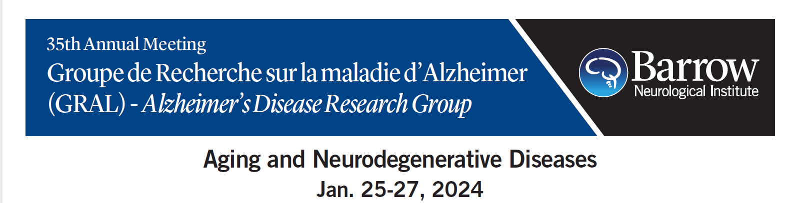
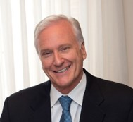
McLean Hospital, Massachusetts General Hospital, Harvard Medical School
Behavioral Neurology and Neuropsychiatry: Where Do We Go From Here?

Slide 2
Why is Science so Important?
Science is agnostic and universal
There are few simple explanations in science
Particularly regarding the brain:
170 billion cells, 3,300 cell types
16,000 genes turned on and off in different combinations
All cell types are similar to gorillas and chimpanzees
So how does the brain communicate?
Research can be misperceived as an endless cauldron of turmoil, doubts, and uncertainties, yet these qualities are essential to the discovery process
No paradox, no progress
Research represents the rare balance between imagination and critical thinking that tells us whether a good story rises to truth
“The slaying of the beautiful hypothesis by ugly facts” is part of the scientific method
The ultimate worth of science is how much it can contribute to the world

Slide 3
What is Neuropsychiatry/Behavioral Neurology?
Definition
1. The multi-dimensional study of brain - cognitive, affective and behavioral relationships including:
* Arousal
* Engagement
* Motivation
* Reward
* Perception
* Memory
* Language
* Emotional Processing
* Social Cognition
2. The exploration of diagnostic and treatment options in neurologic diseases with co-morbid cognitive, behavioral and psychiatric symptoms
3. The investigation of brain circuits involved in mood, anxiety, psychotic, PTSD, stress, sleep, OCD, addiction and somatoform disorders

Slide 4
As Jaspers states, studies of the brain and the mind are like “the exploration of an unknown continent from opposite directions, where the explorers never meet because of the impenetrable country that intervenes.”
Jaspers K. General Psychopathology.7th ed. Vol 1. Hoenig J. Hamilton M. trans. John Hopkins University Press: 1997.
The accelerating growth of research in neuroscience, behavioral sciences, and epigenetics will likely make substantive inroads into this complex territory.
Keshaven MS, Price BH, Martin JB. Cross-Training in Neurology and Psychiatry.
JAMA Psychiatry December 22/29, 2020, Volume 324, Number 24, 2557-25587.

Slide 5
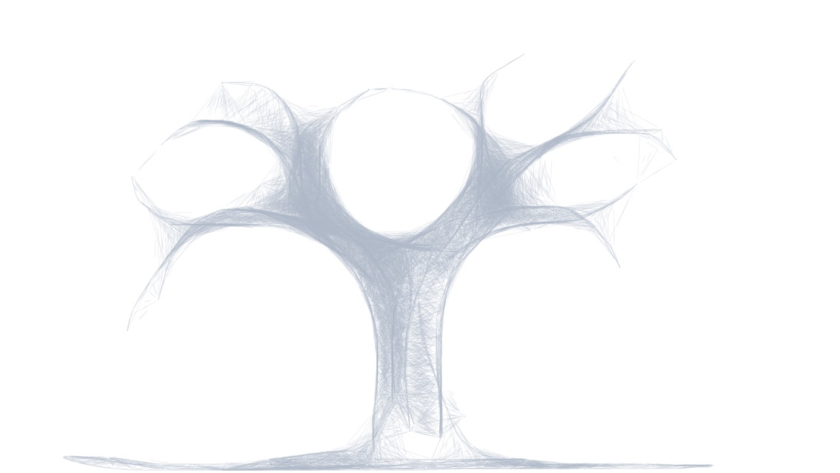
A Collective Model for the Investigation, Formulation and Treatment of All Aspects of Brain Disease
Neurosurgery
Neurology
Psychiatry
Behavioral Neurology & Neuropsychiatry
Neuromodulation
Neuropsychology
Psychology
CLINICAL
NEUROSCIENCE
Neuropathology
Cognitive & Affective Neuroscience
Social Work
Cellular & Molecular Neurobiology, Genetics/Epigenetics
Bruce H. Price MD, McLean & MGH
Matcheri Keshavan MD, BIDMC
Ron Alterman MD, BIDMC
David Perez MD, MMSc, MGH
Drawing Courtesy of
M. Keshavan

Slide 6
Rather than further contracting into separate fields, the convergence of neurology and psychiatry should span the unique intersections of humanity, philosophy, and science.
Keshaven MS, Price BH, Martin JB. The Convergence of Neurology and Psychiatry. JAMA Psychiatry August 11, 2020, Volume 324, Number 6, 554-555.

Slide 7
Reflections
Human cognition and behavior are complex and multi-dimensional
Philosophy matters. Cartesian dualism persists!
Anatomy is foundational
The shifting tectonic plates of basic and clinical neuroscience are inexorable and have created a common foundation
Neuropsychology and Neuropathology should join us at the forefront of scientific advances
Contemporary and future clinicians and basic scientists will view the great divide as quaint, even endearing, but largely irrelevant
Scientific discovery and brain science have never been more promising. The times are ripe for conceptual, cultural, and institutional change
Behavioral Neurology/Neuropsychiatry stands poised to help drive these changes

Slide 8
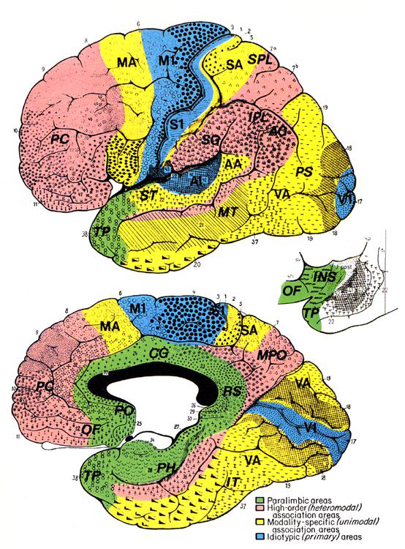
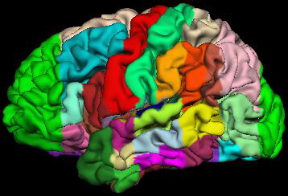
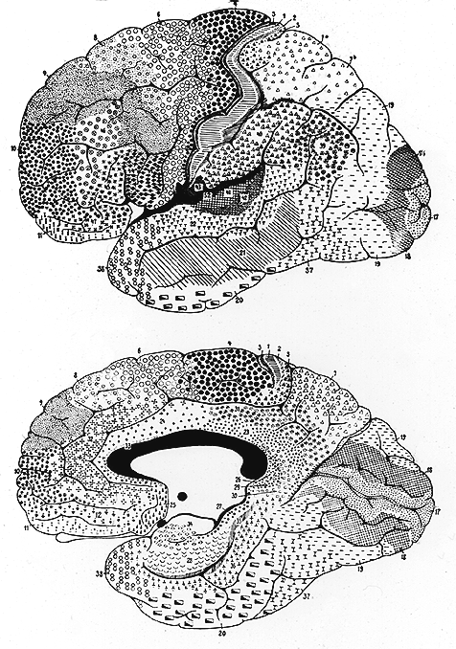
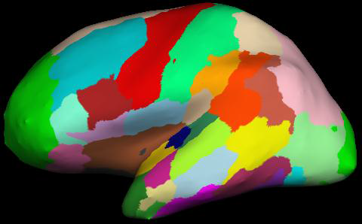
NEUROANATOMY IS FOUNDATIONAL
Courtesy MGH-CMA
Brodmann, 1905
Mesulam, 2000
Distributed neural systems comprise anatomic regions, or nodes
Unique architectural properties
Geographically arranged throughout cortical and subcortical areas
Linked anatomically in a precise and unique manner

Slide 9
Behavioral Neurology/Neuropsychiatry:
Does it improve clinical care?
Does it enhance research?
Does it lower cost?

Slide 10
Can we develop a common vocabulary for
Mind-Body Disorders?
What defines a psychiatric disorder?
What defines a neurologic disorder?
How does a psychiatrist think?
How does a neurologist think?
What research questions can be asked and answered to advance our knowledge?

Slide 11
Science and Medicine do not occur in a vacuum
Science, Public Health, Society, Ethics and Morals are inseparable
“Because of the very way you do science, the vary questions you ask, the methods you use, they’re all embedded in things that are outside of science” - Venkatesh Narayanamurti, Benjamin Peirce Professor of Technology and Public Policy, Engineering and Applied Sciences and Physics Emeritus at Harvard University

Slide 12
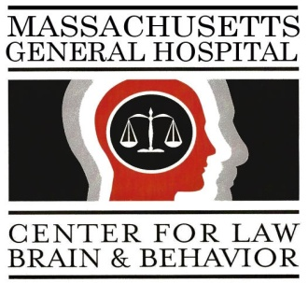
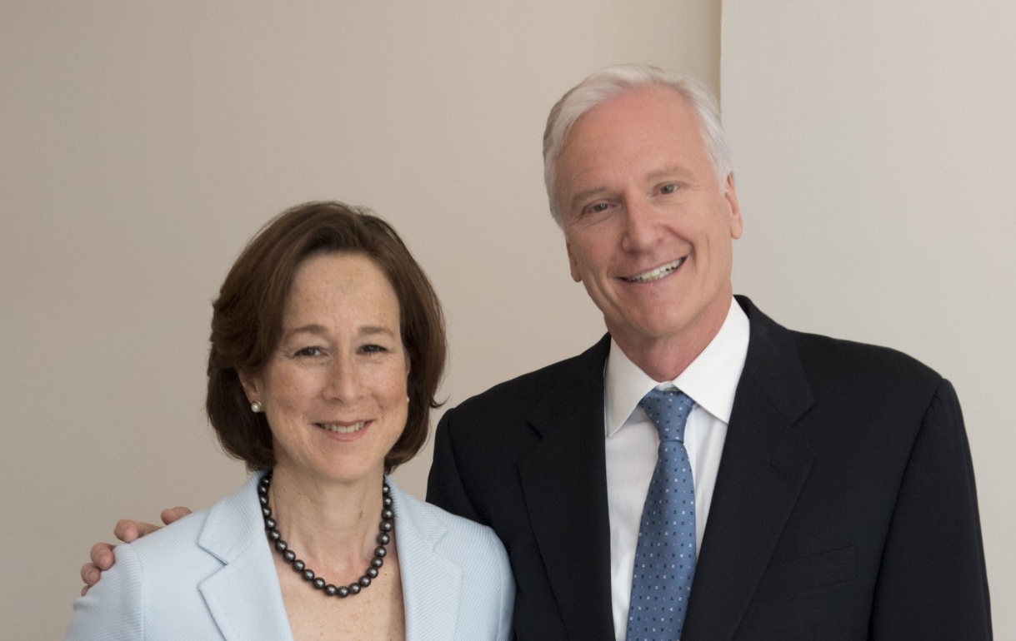



The Center for Law, Brain and Behavior
at Massachusetts General Hospital
Judith Edersheim, JD, MD Bruce H. Price, MD
Visit our website: www.clbb.org
Follow us: twitter.com/mghclbb
View past events: vimeo.com/clbb
The Brain Matters. Science Matters. Justice Matters.

Slide 13
Our Beginning
A young lawyer turned medical student walks into my office on her way to becoming a forensic psychiatrist
Baskin JD, Edersheim JG, Price BH. Neuroimaging in the court room. Is a picture worth a thousand words? American Journal of Law and Medicine 2007;33:239-269.
MGH Center for Law, Brain and Behavior co-founded in 2008

Slide 14
Our Convictions
The time for major criminal and probate justice reform is long overdue
Public health, law and policy are central to health care outcomes
Better decisions aligned with science lead to better outcomes aligned with justice
The ultimate worth of science is measured by how much it can contribute to the world

Slide 15
Center For Law, Brain and Behavior
CLBB’s presentation of accurate and actionable neuroscience to judges, lawyers, policy makers and journalists-those who shape standards and practices-is central to our mission
We accomplish this through expert testimony, friend of the court briefs, innovative reform projects, major publications and education of federal and state judges
Accurate brain science debunks pervasive myths about mental and cognitive states that keep American law anchored in 18th century opinions and injustices
We also work across the media landscape to inform the public about the brain, human behavior and justice, legislative and policy systems
Our efforts have led to more just neuroscience-driven outcomes as well as more enlightened perspectives which advance legislative reforms, trial outcomes at state, national and international levels

Slide 16
Challenges
• A law professor questions “Is neuroscience really useful in law?”
• How do you translate science into the court room?
• How do you debunk junk science and validate good science?

Slide 17
Science and the Law
Differ both in the language used and the objectives to be accomplished
Legal education by history and practice is slow to change
Many judges are eager to learn and apply good science
State courts are where most decisions are rendered
Neither science nor law occur in a social vacuum

Slide 18
Courtroom Issues in the Interpretation of
Scientific Studies
Problems in Experimental Design
Replication
The Number and Diversity of Subjects
Technical Accuracy and the Power of Imaging Results
Statistical Significance
Controversies regarding the Administration and Creation of Neuroscientific Evidence
Applying Group Averages to Individuals
Neuroscience seems unlikely to ever be able to discern a person’s state of mind in the past, in particular at the time of an alleged crime.

Slide 19
Center for Law, Brain and Behavior: 2023 Accomplishments
CLBB operates across the medical and legal arenas and is at the forefront of applying brain science to make the US Federal, State and Local Legal Systems more just, equitable and effective
Elder fraud protection white paper and pilot program in progress
Trained over 100 federal immigration judges regarding the impact of trauma on asylum seekers
4 day in-person “Science in the Courtroom” training seminar with the Federal Judicial Center for Massachusetts judges
Designed and piloting an arraignment and diversion program with the Boston district attorney for young adults based on our 2022 white paper “The Neuroscience of Adolescence and Emerging Adults”
Brain Incite neuro law library accessible to defendants and inmates, prosecutors and defense counsels, judges and legislators, policy makers, advocates, educators and researchers with open source and access to an online live librarian
United Nations Institute of Teaching and Research (UNITAR) in conjunction with CLBB and the University of Maastricht, Netherlands offers an executive diploma in law and neuroscience
Summer research assistant program training and mentoring 8 undergraduate, law, medical and public policy students
Public presentations, amicus (friend of the court) briefs and participation as expert witnesses in key trials

Slide 20
Challenges and Controversies
Cautions
Biological reductionism
Oversimplification
Overpromise
Social determinants remain the primary driver in many illnesses
Strengths
The physician/patient relationship
The emerging neuroscience of integrated transdiagnostic domains and interventions
Requirements
Foster collaborative research, translate to clinical practice
Emphasize prevention, early diagnosis, intervention, and recovery
Train future generations of clinician-scientists and leaders
Change minds, cultures, and curriculum
Convince the public about the positive impact of science, the “How and Why” of what we do
Address stigma, challenge old beliefs, and welcome new science
Translate neuroscience into social impact, address intersecting legal, ethical and philosophical issues

Slide 21
Core Questions
How can we preserve the holistic, humanitarian approach in medicine?
How can we break the chains of tradition and move forward together?
How can we recruit more of the best and brightest to our disciplines?

Slide 22
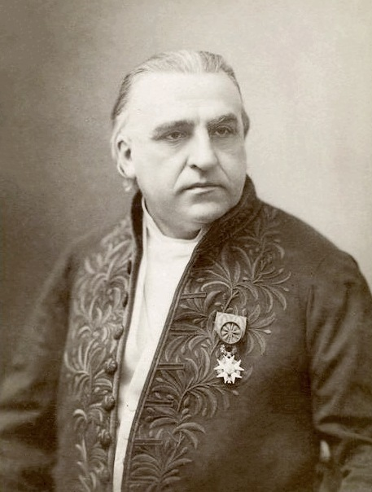
“In the last analysis, we see only what we are ready to see, what we have been taught to see. We eliminate and ignore everything that is not a part of our practices.”
1825 -1893
Jean-Martin Charcot

Slide 23
Neurology and Psychiatry:
Closing the Great Divide
Bruce H. Price, M.D.,
Raymond D. Adams, M.A., M.D.,
Joseph T. Coyle, M.D.
Neurology, 2000; Vol. 54: 8-14

Slide 24
Mentorship

Slide 25
Our Future
Don’t “Stay in Your Lane”. We need to assume a more consequential role in public health related issues
Where are our future Carl Sagans, Stephen Jay Goulds and Oliver Sacks as powerful communicators to the public?
We need an open source, data sharing, and accessible science
Artificial Intelligence can be a huge advance depending on who own’s it and their intended purpose

Slide 26
