Slide 1


Alzheimer’s Disease & Atypical Alzheimer’s Syndromes
Parunyou Julayanont, MD
Assistant professor of neurology
Department of Neurology
Barrow neurological institute

Slide 2
I have no relevant financial relationships to disclose.

Slide 3
Outline
Symptoms and signs of typical/amnestic AD
AD biomarkers (neuroimaging, CSF and plasma biomarkers)
Atypical/non-amnestic AD syndromes
Amnestic AD mimickers (suspected non-Alzheimer disease pathophysiology, SNAP)

Slide 4
Typical/amnestic AD
Symptoms
Lack of insight
Short-term/episodic memory problem
Word finding difficulty
Disorientation

Slide 5
Typical/amnestic AD
Bedside examination
Medial temporal/hippocampal dysfunction
Head turning sign
Encoding memory deficits > retrieval deficits
Parietal lobe dysfunction
Ideomotor apraxia (left parietal)
Impaired visuoconsturction (right parietal)
Temporo-parietal language based dysfunction
Impaired Naming (paraphasic errors with intact object knowledge)
Impaired animal fluency

Slide 6
Outline
Symptoms and signs of typical/amnestic AD
AD biomarkers (neuroimaging, CSF and plasma biomarkers)
Atypical/non-amnestic AD syndromes
Amnestic AD mimickers (suspected non-Alzheimer disease pathophysiology, SNAP)

Slide 7
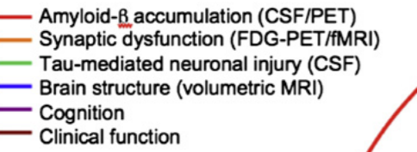
AD biomarkers
Normal
Preclinical
MCI
Dementia
Jack CR Jr, Knopman DS, Jagust WJ, Shaw LM, Aisen PS, Weiner MW, et al. Hypothetical model of dynamic biomarkers of the Alzheimer's pathological cascade. Lancet Neurol. 2010; 9:119–28.

Slide 8
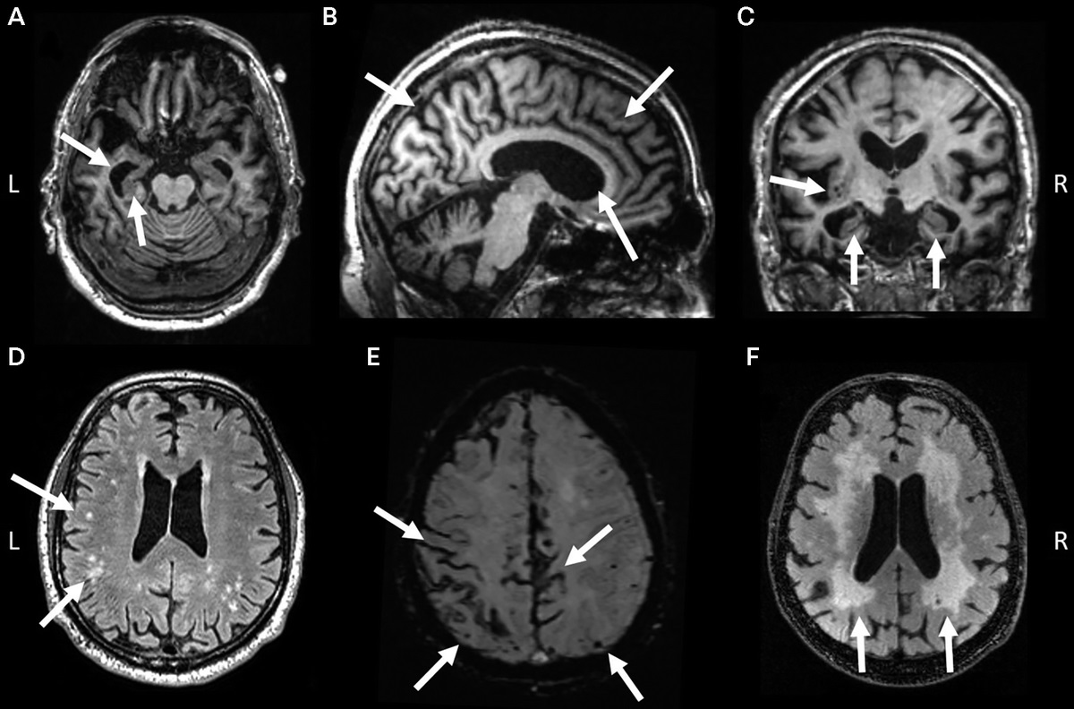
Structural MRI
Gil D. Rabinovici, MD. Late-onset Alzheimer Disease. Continuum (Minneap Minn). February 2019; 25 (1 Dementia):14–33.

Slide 9
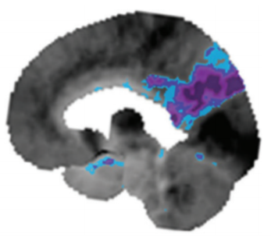
FDG-PET
Brown RK et al. Brain PET in Suspected Dementia: Patterns of Altered FDG Metabolism. RadioGraphics 2014; 34:684–701

Slide 10
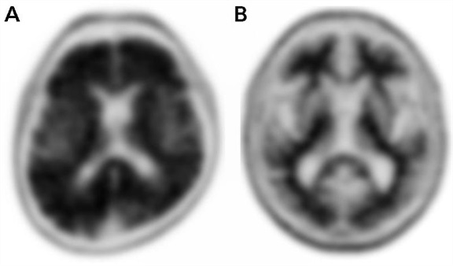
Amyloid PET scan
[18F] florbetapir
Gil D. Rabinovici, MD. Late-onset Alzheimer Disease. Continuum (Minneap Minn). February 2019; 25 (1 Dementia):14–33.

Slide 11
CSF
A: Aggregated Aβ
Decreased CSF Aβ42, or Aβ42/Aβ40 ratio
T: Aggregated tau (neurofibrillary tangles)
Increased CSF phosphorylated tau
N: Neurodegeneration or neuronal injury
Increased CSF total tau
Jack CR Jr, Bennett DA, Blennow K, et al. NIA-AA research framework: toward a biological definition of Alzheimer’s disease. Alzheimers Dement 2018;14(4):535–562.

Slide 12
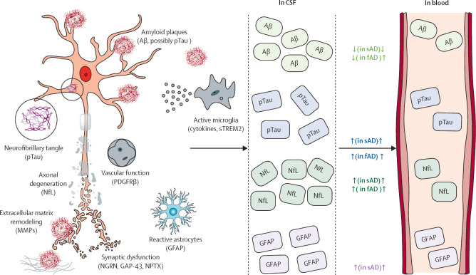
Blood-based biomarkers
Plasma Aβ1–42, Aβ1–40 and ratio
Identified abnormal amyloid CSF or PET
Earlier change than amyloid PET scan
Plasma p-tau (p-tau181, 217 and 231)
p-tau217
correlates with the cortical tau-tangle neuropathological staging
pTau217 was better able to detect Aβ-PET positivity than p-tau 181
Plasma neurofilament light chain (NfL) & glial fibrillary acidic protein (GFAP)
a biomarker of neuronal injury which increases in CSF and in blood
Tuenissen et al. Blood-based biomarkers for Alzheimer’s disease: towards clinical implementation. Lancet Neurol 2022; 21: 66–77
Schindler et al. High-precision plasma β-amyloid 42/40 predicts current and future brain amyloidosis. Neurology. 2019 Oct 22;93(17):e1647-e1659.

Slide 13
Blood-based biomarkers
Blood-based markers as prescreening tools
Increase pretest-probability individuals before undergo CSF or PET testing
Used in clinics → Elecsys Amyloid Plasma Panel (EAPP) measures plasma p-tau181 and APOE4 earned breakthrough label from Food and Drug Administration
Used in trials → recruitment (AUTONOMY, anti-tau in early AD trial; plasma p-tau217) and exclusion (Neflamapimod in DLB; Plasma ptau181)
Blood-based markers as an diagnosis tool without confirmatory CSF or PET testing
The trial including participants at the preclinical stage/cognitively normal AD → less invasive
TRAILBLAZER-ALZ3 → evaluating the efficacy of donanemab in cognitively normal people with elevated plasma p-tau 217
Blood-based markers as pharmacodynamic markers
EMERGE and ENGAGE trials of aducanumab → a reduction of p-tau181 associated with 1) decreased amyloid PET burden and 2) less clinical decline.
TRAILBLAZER-ALZ → donanemab showed a reduction of plasma p-tau217 levels over time → correlated with changes in PET amyloid and tau uptake
Angioni et al. Blood Biomarkers from Research Use to Clinical Practice: What Must Be Done? A Report from the EU/US CTAD Task Force. J Prev Alzheimers Dis. 2022; 9(4): 569–579.

Slide 14
Outline
Symptoms and signs of typical/amnestic AD
AD biomarkers (neuroimaging, CSF and plasma biomarkers)
Atypical/non-amnestic AD syndromes
Amnestic AD mimickers (suspected non-Alzheimer disease pathophysiology, SNAP)

Slide 15
Atypical AD syndromes
Atypical AD
ε4 -
ε4 +
← Younger 65 75 85 Older →
Age (years)
van der Flier WM, Pijnenburg YA, Fox NC, Scheltens P. Early-onset versus late-onset Alzheimer’s disease: the case of the missing APOE ε4 allele. Lancet Neurol 2011;10(3):280–288.

Slide 16

Logopenic variant of Primary Progressive Aphasia
Most common non-amnestic variant of early-onset AD
Present with word-finding difficulty and repetition difficulty
Preserve object knowledge
Focal Alzheimer neuropathology in language dominant temporo-parietal cortices
Amyloid PET scans are positive in about 85% in logopenic variant PPA
Gorno-Tempini ML, Hillis AE, Weintraub S, et al. Classification of primary progressive aphasia and its variants. Neurology 2011;76(11):1006–1014.
Mendez MF. Early-onset Alzheimer Disease and Its Variants. Continuum (Minneap Minn). 2019 February ; 25(1): 34–51.
Oh MJ, Kim S, Park YH, et al. Early Onset Alzheimer's Disease Presenting as Logopenic Primary Progressive Aphasia. Dement Neurocogn Disord. 2018 Jun;17(2):66-70.
Video: https://www.youtube.com/watch?v=XJyRpPjT-jk

Slide 17
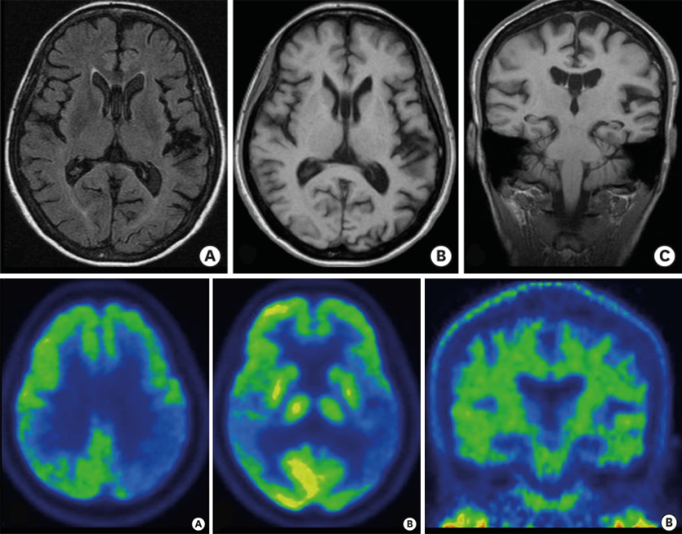
Logopenic variant of Primary Progressive Aphasia
Gorno-Tempini ML, Hillis AE, Weintraub S, et al. Classification of primary progressive aphasia and its variants. Neurology 2011;76(11):1006–1014.
Mendez MF. Early-onset Alzheimer Disease and Its Variants. Continuum (Minneap Minn). 2019 February ; 25(1): 34–51.
Oh MJ, Kim S, Park YH, et al. Early Onset Alzheimer's Disease Presenting as Logopenic Primary Progressive Aphasia. Dement Neurocogn Disord. 2018 Jun;17(2):66-70.

Slide 18
Posterior Cortical Atrophy
Onset between 50 and 65 years of age
History
Repeated visits to optometrists and ophthalmologists without a clear ophthalmological diagnosis
Difficulty reading
Minor damage to their cars because of problems judging distances
Difficulty finding items in front

Slide 19
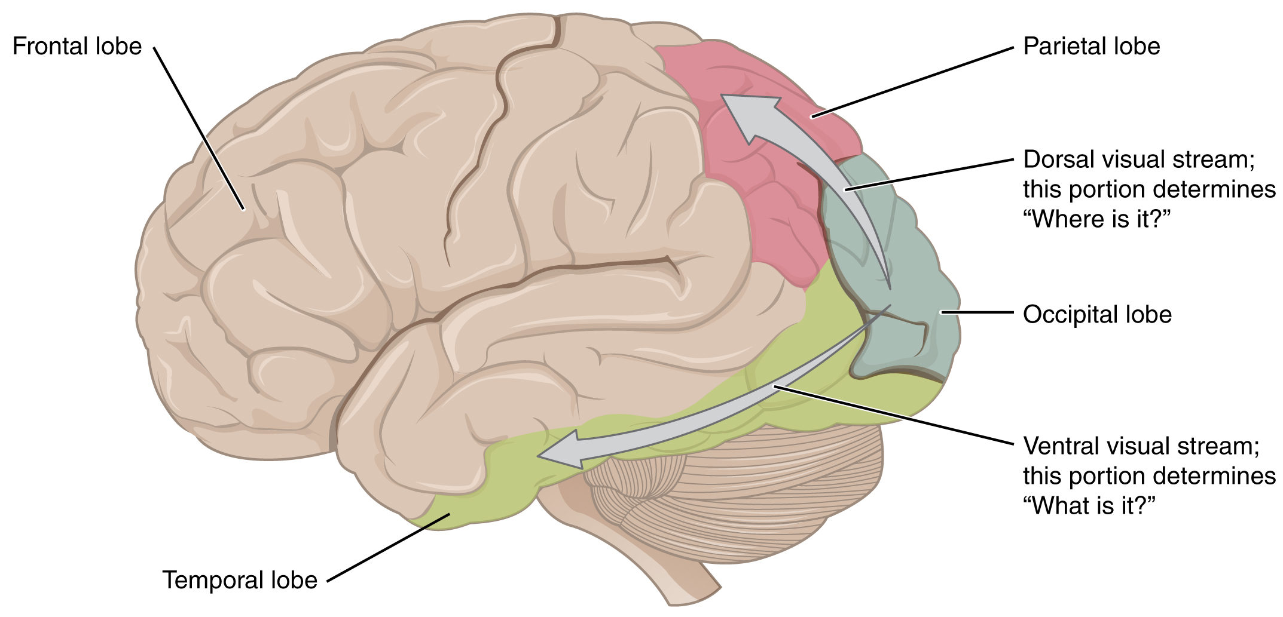
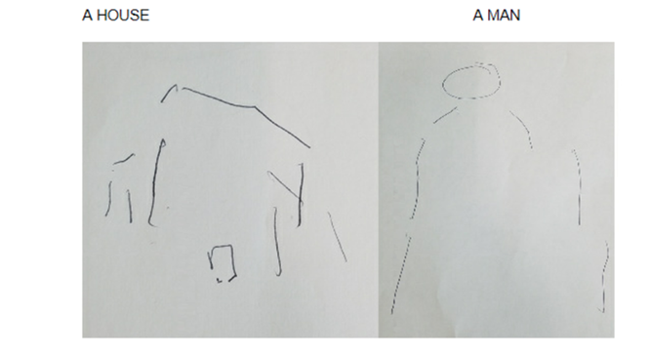
Posterior Cortical Atrophy
Dorsal “where” visual stream
Simultanagnosia
Optic ataxia
Oculomotor apraxia
Difficulty reading a paragraph
Impaired visuoconstruction

Slide 20
Posterior Cortical Atrophy
Ventral “what” visual stream
Prosopagnosia → right fusiform gyrus
Object agnosia → temporo-occipital cortices.

Slide 21
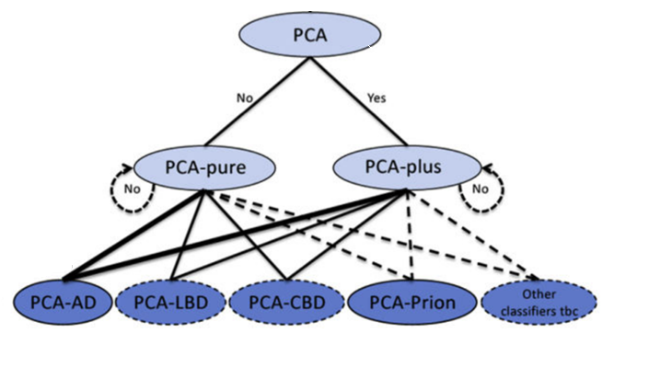
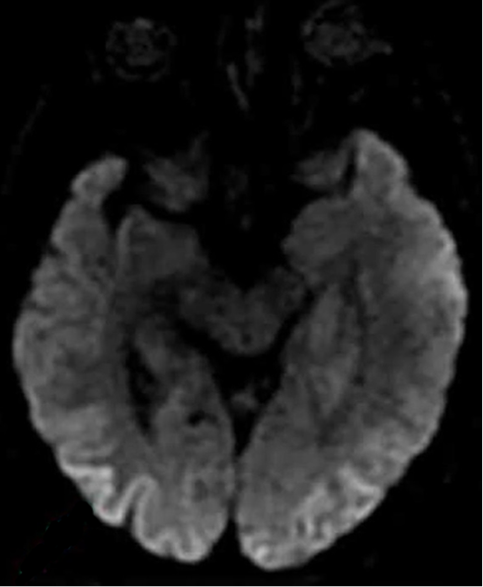
Posterior Cortical Atrophy
Crutch SJ, Schott JM, Rabinovici GD, et al. Consensus classification of posterior cortical atrophy. Alzheimers Dement 2017;13(8):870–884.
Townley RA, Dawson ET, Drubach DA. Heterozygous genotype at codon 129 correlates with prolonged disease course in Heidenhain variant sporadic CJD: case report. Neurocase 2018;24(1):54–58.

Slide 22
behavioral/dysexecutive AD
Demographic profile (compared to typical AD)
younger age (mean age, 62.0 years at diagnosis)
Neuropsychiatric disturbances
greater agitation, delusions, and hallucinations than typical AD
early apathy
Cognition
worse memory scores and executive function than bvFTD
relatively better/similar memory function but worse executive functioning compared with typical AD
Ossenkoppele R. et al. Research Criteria for the Behavioral Variant of Alzheimer Disease A Systematic Review and Meta-analysis. JAMA Neurol. 2022;79(1):48-60.

Slide 23
behavioral/dysexecutive AD
Neuroimaging
behavioral/dysexecutive AD
temporoparietal cortex
greater involvement of the frontal cortex than patients with AD but lesser than bvFTD
typical AD
posterior cingulate, precuneus and the medial temporal lobes
bv FTD
frontal and anterior temporal lobes
Frequency of brain atrophy
Ossenkoppele R. et al. The behavioural/dysexecutive variant of Alzheimer’s disease: clinical, neuroimaging and pathological features. Brain. 2015 Sep; 138(9): 2732–2749.

Slide 24
Corticobasal syndrome due to AD (CBS-AD)
CBD: astrocytic plaques (C), numerous tau-positive threads in the white matter (D) and pretangles (E).
PSP: tufted astrocytes (H), oligodendroglial coiled bodies (I), and globose neurofibrillary tangles (J).
AD: amyloid-β positive amyloid plaques (M), neuritic plaques (N) and neurofibrillary tangles (O)
Koga et al. Neuropathology and emerging biomarkers in corticobasal syndrome. J Neurol Neurosurg Psychiatry. 2022 Jun 13;93(9):919-929.

Slide 25
Corticobasal syndrome due to AD (CBS-AD)
Compared to the CBS-CBD
younger onset than the CDS-CBD
More parietal involvement → early memory/visuospatial impairment, early dressing apraxia/hemi-neglect
Less frontal lobe dysfunction
More prevalence of myoclonus
Less prevalence of tremor
Armstrong et al. Criteria for the diagnosis of corticobasal degeneration. Neurology. 2013 Jan 29; 80(5): 496–503.
Hassan et al. The corticobasal syndrome–Alzheimer’s disease conundrum. Expert Rev Neurother. 2011 Nov; 11(11): 1569–1578.
Koga et al. Neuropathology and emerging biomarkers in corticobasal syndrome. J Neurol Neurosurg Psychiatry. 2022 Jun 13;93(9):919-929.

Slide 26
Outline
Symptoms and signs of typical/amnestic AD
AD biomarkers (neuroimaging, CSF and plasma biomarkers)
Atypical/non-amnestic AD syndromes
Amnestic AD mimickers (suspected non-Alzheimer disease pathophysiology (SNAP)

Slide 27
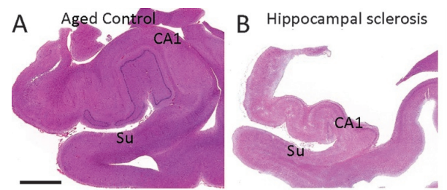
Hippocampal sclerosis
Hippocampal neuron loss in subiculum and CA1 segment of hippocampus
Causes:
anoxic/hypoxic injury or a chronic hypoxia
undiagnosed seizure activity
underlying limbic-predominant age-related TDP-43 encephalopathy (LATE)
Frequently found to be coexisting with AD, PSP, DLB, and ALS
1. Jicha GA, Nelson PT. Hippocampal Sclerosis, Argyrophilic Grain Disease, and Primary Age-Related Tauopathy. Continuum (Minneap Minn). 2019 Feb;25(1):208-233.
2. Neltner JH, Abner EL, Baker S, et al. Arteriolosclerosis that affects multiple brain regions is linked to hippocampal sclerosis of ageing. Brain 2014;137(pt 1):255–267.
3. Boyle PA, Yu L, Wilson RS, et al. Person-specific contribution of neuropathologies to cognitive loss in old age. Ann Neurol 2018;83(1):74–83.

Slide 28
Limbic-predominant age-related TDP-43 encephalopathy (LATE)
TDP-43 proteinopathy
present in 20-50% of individuals > 80 years (oldest-old)
More gradual clinical decline compared to those with ‘pure’ AD pathology
May coexist with AD pathology and hippocampal sclerosis
No in vivo biomarker → only autopsy confirmation
Murray ME, Cannon A, Graff-Radford NR, Liesinger AM, Rutherford NJ, Ross OA, et al. Differential clinicopathologic and genetic features of late-onset amnestic dementias. Acta Neuropathol. 2014; 128: 411–21.
Nelson PT. et al. Limbic-predominant age-related TDP-43 encephalopathy (LATE): consensus working group report. Brain. 2019 Jun 1;142(6):1503-1527.

Slide 29
Argyrophilic grain disease
AGD
Limbic-predominant 4R-tauopathy
Only confirmed by autopsy.
Slower cognitive decline than AD.
Associated with emotional and personality changes reflecting the limbic predominance of this pathology
AD
Ferrer et al. Argyrophilic grain disease. Brain. 2008 Jun;131(Pt 6):1416-32.
Jicha GA, Nelson PT. Hippocampal Sclerosis, Argyrophilic Grain Disease, and Primary Age-Related Tauopathy. Continuum (Minneap Minn). 2019 Feb;25(1):208-233.

Slide 30
Primary age-related tauopathy (PART)
Positive neurofibrillary tangles (NFT) in the absence of Aβ plaques (NFT+/Aβ−)
Identical to AD tangle (3-repeat or 4-repeat isoforms)
Tau neurofibrillary tangles
In PART → restricted medial temporal lobe tangles
In AD → cortically wide spreading tangles
In vivo diagnosis:
Positive tau PET selectively binds on the temporal lobe
Negative AD pathology by the amyloid PET scan/CSF
Jicha GA, Nelson PT. Hippocampal Sclerosis, Argyrophilic Grain Disease, and Primary Age-Related Tauopathy. Continuum (Minneap Minn). 2019 Feb;25(1):208-233.
Smirnov DS et al. TDP-43 Pathology Exacerbates Cognitive Decline in Primary Age-Related Tauopathy. Ann Neurol. 2022 Sep;92(3):425-438.

Slide 31
Summary
Typical, amnestic Alzheimer’s disease
Neuropathology
Clinical symptoms and signs
Biomarkers (in vivo diagnosis)
Medial temporal lobe and biparietal cortical atrophy/hypometabolism
Decreased CSF levels of amyloid-β
Increased CSF phosphorylated and total tau
Amyloid positron emission tomography radiotracers (clinical use)
Plasma biomarkers (promising biomarkers)

Slide 32
Summary
Atypical AD syndromes
Posterior Cortical Atrophy
Logopenic variant of primary progressive aphasia
Less common: Behavioral/dysexecutive AD, Acalculia variant AD, Corticobasal syndrome
Amnestic cognitive impairment with negative AD pathology → slow progression
Hippocampal sclerosis of aging
Limbic-predominant age-related TDP-43 encephalopathy (LATE)
Argyrophilic grain disease
Primary Age-Related Tauopathy (PART)

Slide 33


