Slide 1
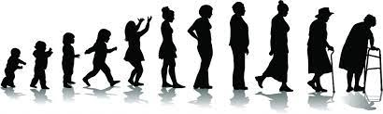
Neurobiology of Aging
Greg Jicha, M.D., Ph.D.
Robert T. & Nyles Y. McCowan Endowed Chair in Alzheimer Research
Professor & Vice Chair for Faculty Affairs in Neurology
Sanders-Brown Center on Aging
University of Kentucky College of Medicine

Slide 2
Disclosures
Grants
NIH P30 AG072946, U24 AG057437, R01 AG053798, R01 AG063689, U19 AG010483, R01 AG054029, R01 AG061848, R01AG061146, UF1 NS125488, R01 AG061111, U19 NS120384, R01 AG065248, R01 AG068324, P01 AG078116, R01 NS116058, U54 TR001998, U13 AG067696, U19 AG024904
Contract Research
AbbVie, Cassava, Eisai, Lilly, Vivoryon, Suven, Cognition therapeutics, Neurovision
Educational Programming
Medscape, CEConcepts, AAFP, Mid-America Institute on Aging and Wellness
Leadership Roles
Alzheimer’s Association ALZ-NET, ACTC, ADCS, AAN Education, ADRC Clinical Task Force & Clinical Core Steering Committees

Slide 3
Key questions in the field…
What is normal brain aging?
How do aging & age-related diseases, including cognitive impairment/dementia, affect one another?
What pathologies are found in the “normal” human brain?
Isn’t there any consequence to such pathologies or are they all modified by cognitive reserve?
What does this mean for diagnosis & treatment?

Slide 4
Outline
Aging changes in multiple organ systems
“Normal” aging in the brain
Interaction of “normal” brain aging with pathological disease
“Normal” brain aging is heterogeneous as a result of interactions with multiple pathologic processes
“Normal” brain aging is a key target for primary and secondary prevention of cognitive impairment & dementia

Slide 5
Outline
Aging changes in multiple organ systems
“Normal” aging in the brain
Interaction of “normal” brain aging with pathological disease
“Normal” brain aging is heterogeneous as a result of interactions with multiple pathologic processes
“Normal” brain aging is a key target for primary and secondary prevention of cognitive impairment & dementia

Slide 6
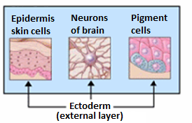
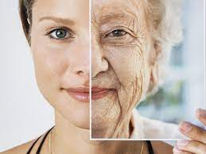
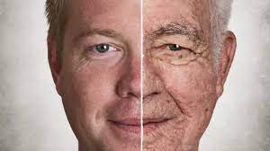
Why talk about skin? Isn’t this supposed to be about the brain?
The skin and the brain are the two major organs derived from ectoderm
Similar embryologic development predisposes to similar age-related changes
https://en.wikipedia.org/wiki/Ectoderm

Slide 7
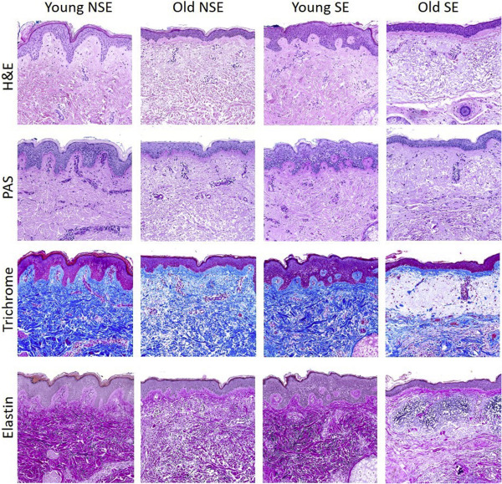
Age-related skin changes…
Old skin is not the same as young skin
Neither has disease
But the changes are molecular, cellular, histological and structural
Environmental exposures (Sun in this instance) can greatly alter such changes
Thus, there are age related changes and changes that are related to advance aging risk in skin tissue
This is similar to aging in the normal brain!
Russell-Goldman & Murphy, Am J Pathology, Volume 190, Issue 7, July 2020, Pages 1356-1369

Slide 8
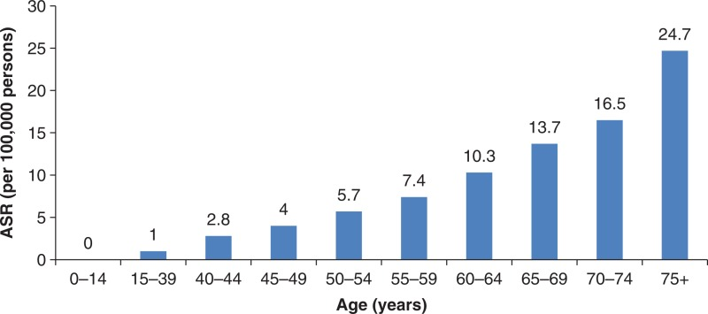
Does aging increase disease susceptibility in skin tissue?
Melanoma incidence across the lifespan
Yes, it does!
Matthews et al. Epidemiology of Melanoma. In: Ward WH, Farma JM, editors. Cutaneous Melanoma: Etiology and Therapy [Internet]. Brisbane (AU): Codon Publications; 2017

Slide 9
Outline
Aging changes in multiple organ systems
“Normal” aging in the brain
Interaction of “normal” brain aging with pathological disease
“Normal” brain aging is heterogeneous as a result of interactions with multiple pathologic processes
“Normal” brain aging is a key target for primary and secondary prevention of cognitive impairment & dementia

Slide 10
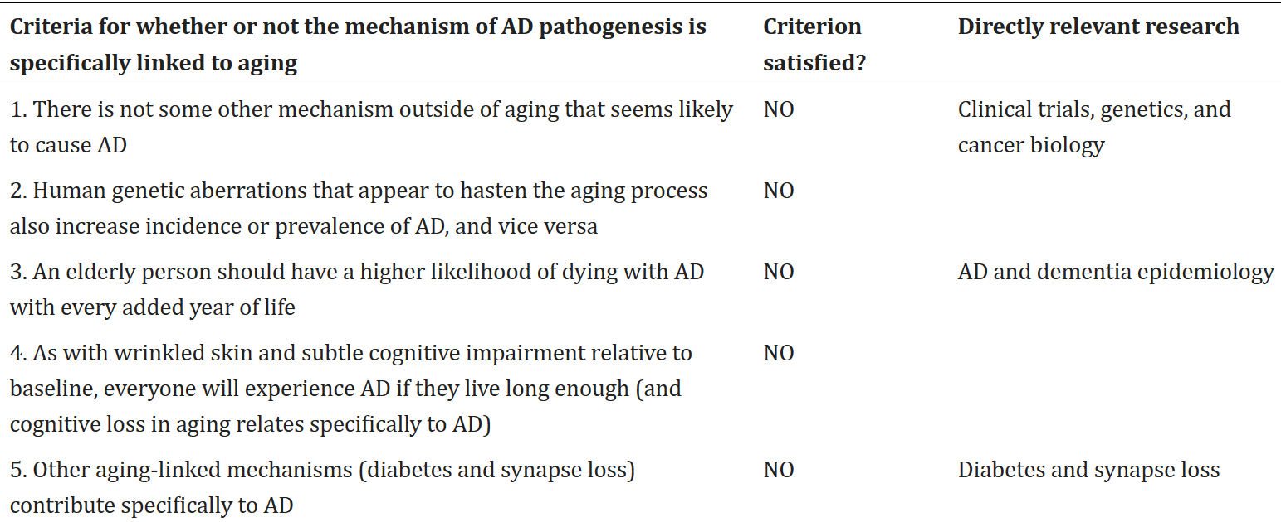
Criteria for whether “aging mechanisms” specifically are linked with AD
Nelson et al., Acta Neuropathol. 2011 May;121(5):571-87

Slide 11
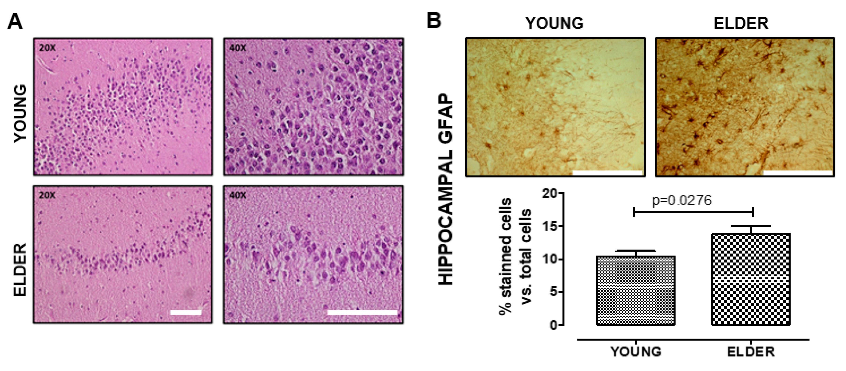
Young vs. Old brain histology
(A) Age related changes in the human hippocampus without protein inclusions, cells with apoptotic characteristics, or other abnormalities
(B) Increased glial fibrillary acidic protein (GFAP) staining is seen in the elderly vs. the young brain. Values are mean ± SEM; Statistics were performed by unpaired t-test. Young (n = 7): 20–30 years old. Elder (n = 6): >60 years old. Scale bar = 100 μm.
Tsoukalas et al., International Journal of Molecular Medicine. 48. 10.3892/ijmm.2021.5032.

Slide 12
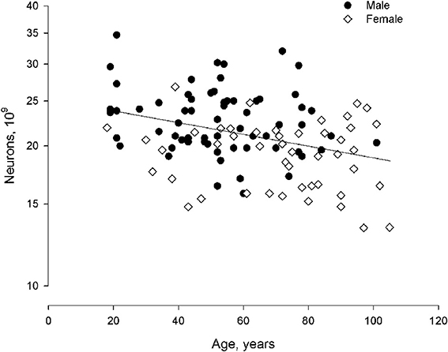
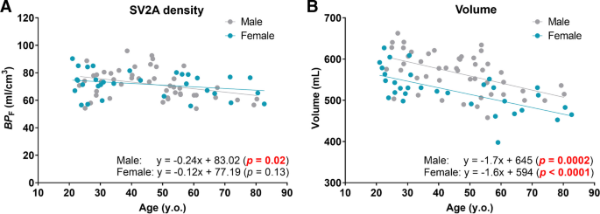
Neuronal & synaptic losses with advanced aging?
Overall neuron number declines to a plateau with age
Minimal changes in synaptic density with age
Walloe et al., Front. Hum. Neurosci., 15 July 2014
Toyonagaet al., Eur J Nucl Med Mol Imaging (2023)

Slide 13

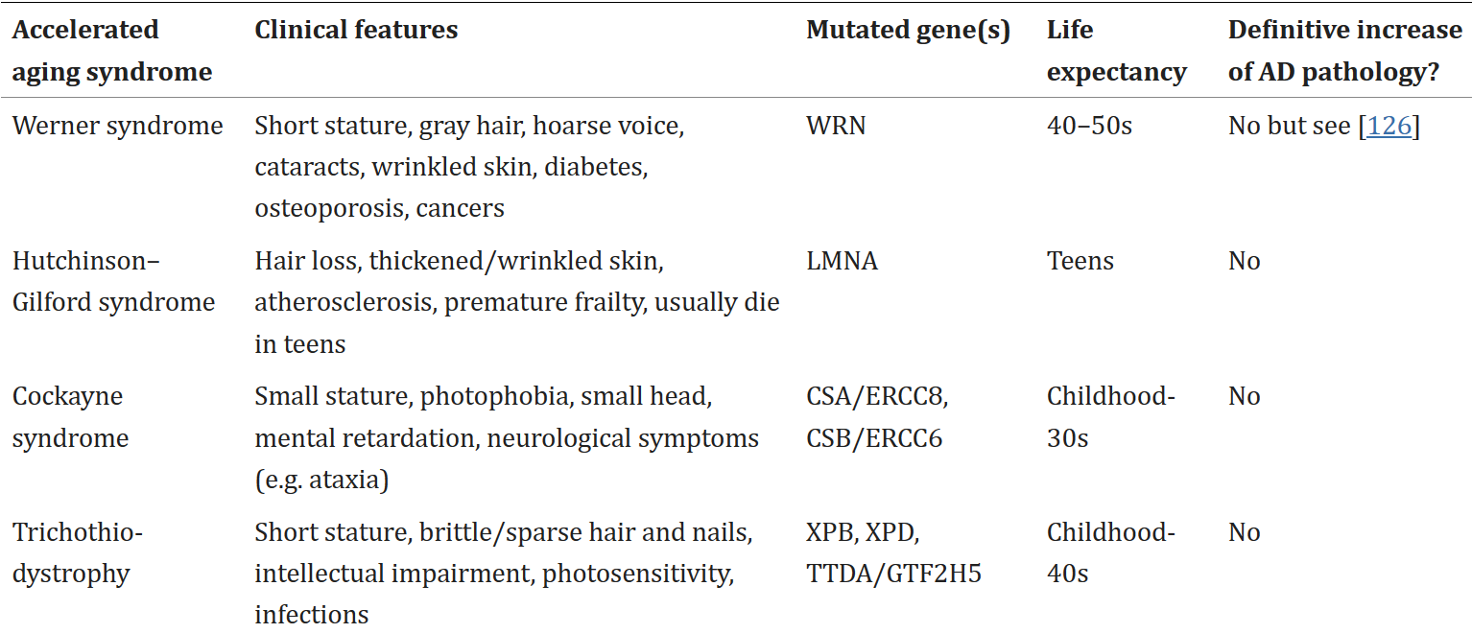
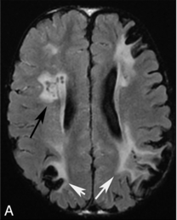
Does aging cause AD: Progeria as an example
Single case of 55 year-old ApoE e4 homozygote with AD pathology
16 year-old with progeria
Tissue aging is not the same as a degenerative disease of aging!
The exception may be vascular disease as a cause of cognitive decline in both genetic and late-life sporadic aging
Silvera et al., Am J Neurorad May 2013, 34 (5) 1091-1097
Nelson et al., Acta Neuropathol. 2011 May;121(5):571-87

Slide 14
Outline
Aging changes in multiple organ systems
“Normal” aging in the brain
Interaction of “normal” brain aging with pathological disease
“Normal” brain aging is heterogeneous as a result of interactions with multiple pathologic processes
“Normal” brain aging is a key target for primary and secondary prevention of cognitive impairment & dementia

Slide 15
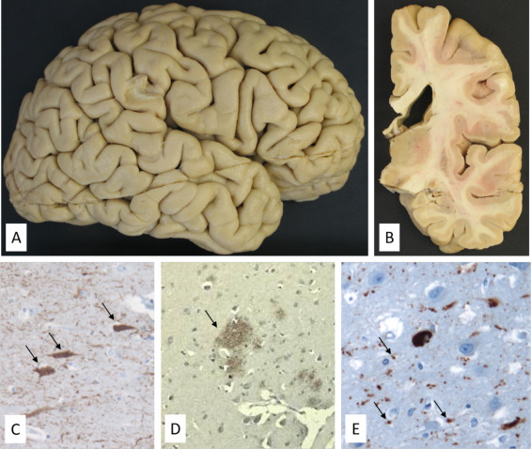
A cognitively normal brain at age 85 years
A: Gross morphology of a formalin-fixed post mortem brain hemisphere from a 85-yo man without any cognitive decline. Note the very subtle and diffuse cortical atrophy and the preservation of most associative cortical areas.
B: Coronal view from the same brain specimen. Note the absence of significant atrophy of the hippocampus.
C: Sparse neurofibrillary tangles (arrows) in the hippocampus of the same patient (Tau protein immunohistochemistry).
D: Diffuse cortical amyloid deposits in the same case (arrow). Note the absence of senile plaque (β-amyloid immunohistochemistry).
D: Isolated argyrophilic grains (arrows) in the hippocampus of a 86-yo cognitively normal woman (Tau protein immunohistochemistry).
Teissier et al., Revue Neurologique, Volume 176, Issue 9, 2020, Pages 649-660

Slide 16
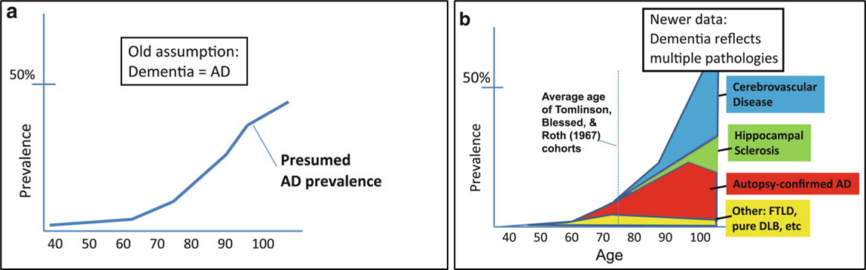
Will everyone eventually get AD if they live long enough?
The answer is no, AD and other degenerative causes decline past certain ages
The exceptions may be LATE/HS and VCID
Nelson et al., Acta Neuropathol. 2011 May;121(5):571-87

Slide 17
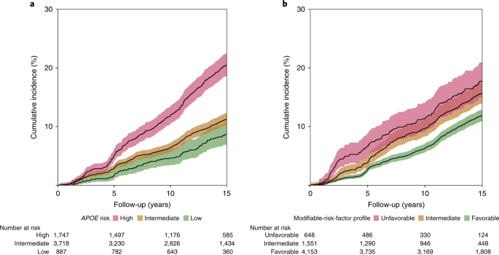
Genetic & environmental risk influences on age related cognitive decline (Rotterdam)
Genetic disposition increases with age
Environmental risks are just as common and also increase with age
Licher et al. Genetic predisposition, modifiable-risk-factor profile and long-term dementia risk in the general population. Nat Med 25, 1364–1369 (2019).

Slide 18
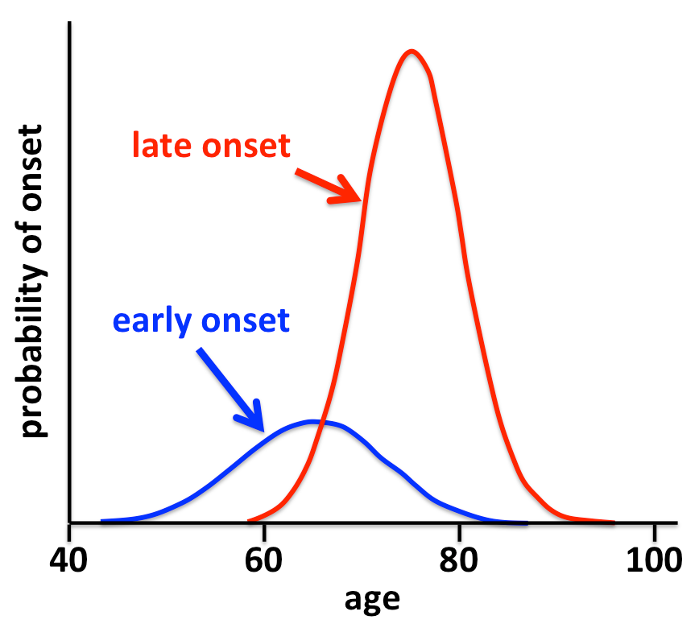
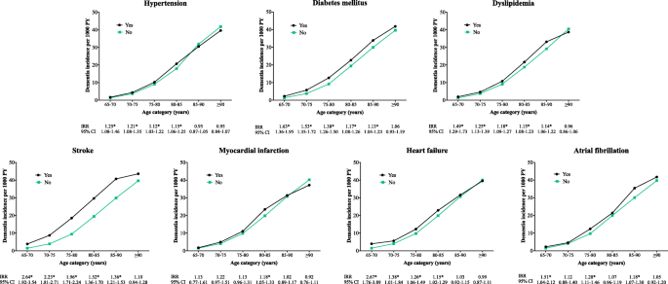
Risk exposure and age of onset for dementia
Spalletta et al., Adv Alz Dis, Vol.2, No.1, 40-47 (2013)
Legdeur et al. Alz Res Therapy 11, 47 (2019)
It is clear that the higher the risk (genetic or acquired) the earlier the disease manifests!

Slide 19
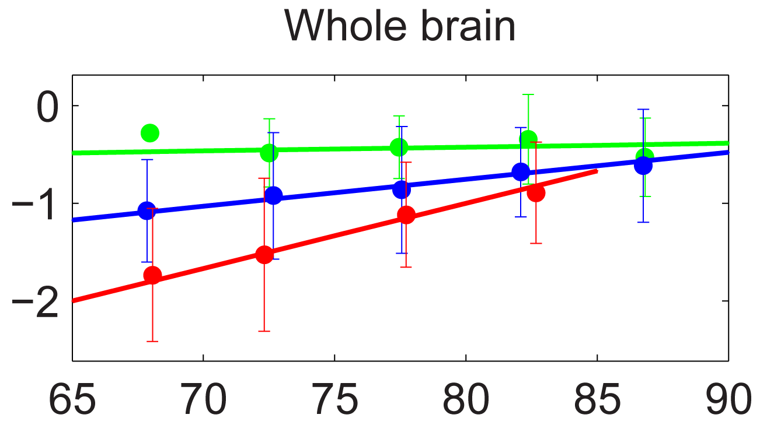
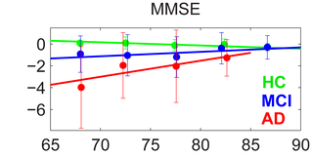
Does age influence the rate of disease progression?
Age (years)
Age (years)
Rates of both atrophy and cognitive decline are faster in those with disease at younger ages compared to older folks
Holland et al., (2012) PLoS ONE 7(8): e42325.

Slide 20
Outline
Aging changes in multiple organ systems
“Normal” aging in the brain
Interaction of “normal” brain aging with pathological disease
“Normal” brain aging is heterogeneous as a result of interactions with multiple pathologic processes
“Normal” brain aging is a key target for primary and secondary prevention of cognitive impairment & dementia

Slide 21
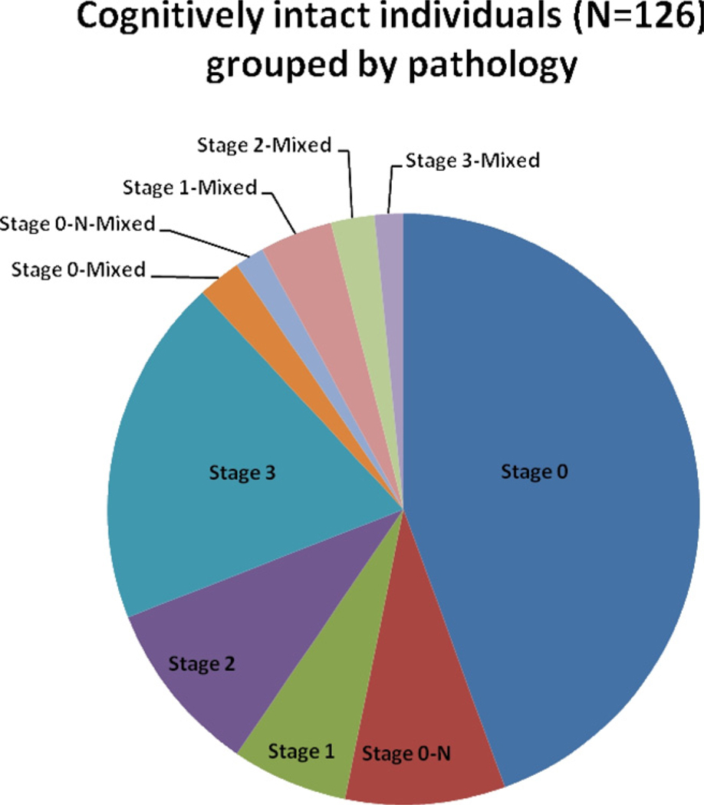
Neuropathology in aged persons with “normal” cognitive performance
Pathology in cognitive normals from NACC & UK Community Sample
Variable | NACC (% cases) | UK (% cases)
No Pathology | 13 | 47
CERAD Aβ (mod/freq) | 59 | 43
Tau (Braak ≥ 4) | 63 | 35
Lewy Bodies | 37 | 21
FTLD | 18 | 0
AGD | 6 | ND
LATE | 17 | 10
Vascular disease | 66 | 72
Jicha et al.,. Neurobiol Aging. 2012 Mar;33(3); .Gauthreaux et al., Alzheimers Dement. 2023 Aug 17

Slide 22
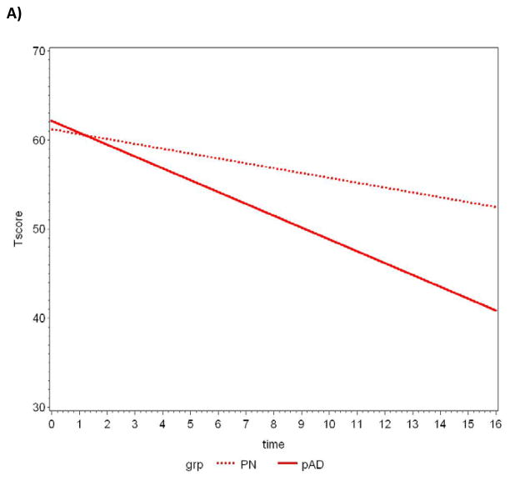
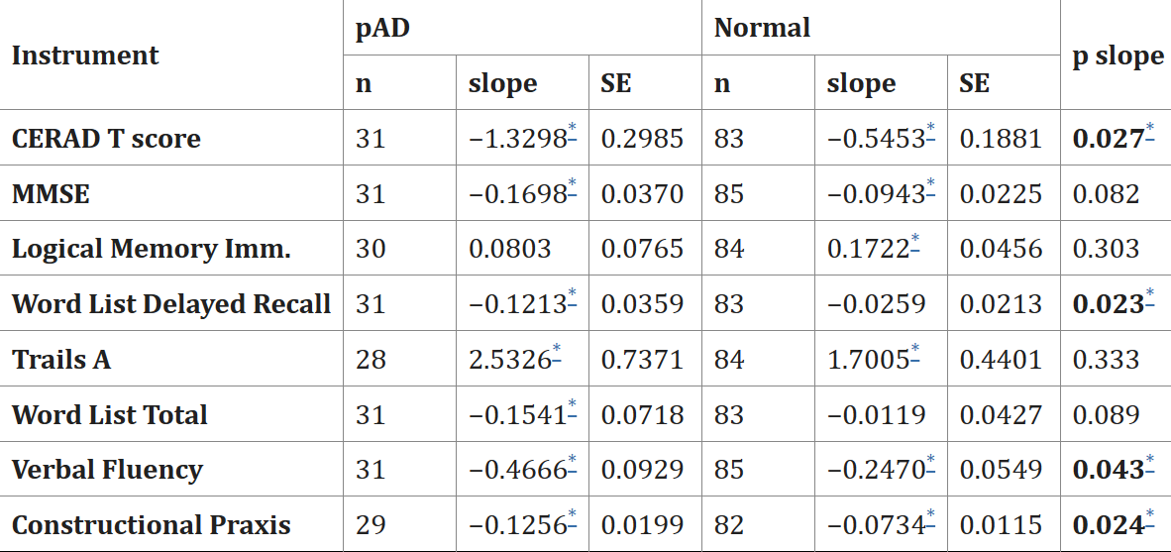
Are they really “normal” or “cognitively intact/unimpaired”?
CERAD T-Score change over time
It is clear that 47% harbored sufficient pathology to be impaired
Yet they all remain cognitively normal within age, sex, education adjusted norms
Riley, Jicha, et al., J Alzheimers Dis. 2011;25(4):707-17.

Slide 23
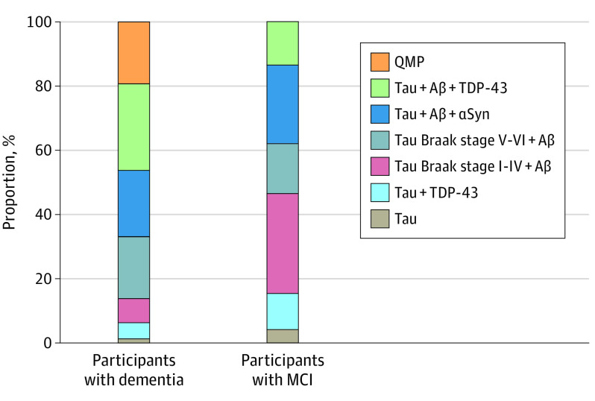
Is it just one pathology?
While those with normal aging commonly have one pathology…
Those with more than one form of pathology are more likely to experience clinically relevant cognitive decline
Karanth et al., JAMA Neurol. 2020 Oct 1;77(10):1299-1307

Slide 24
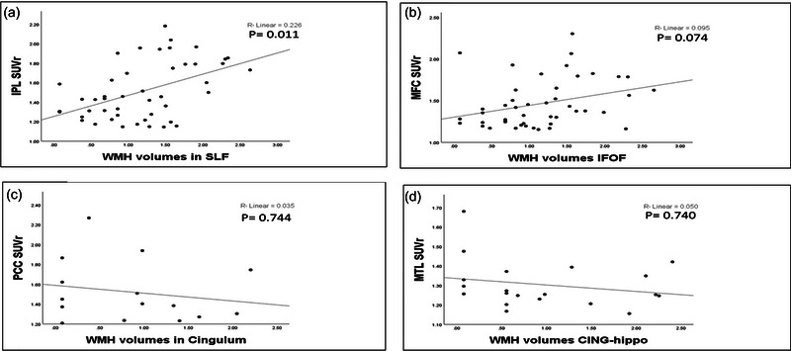
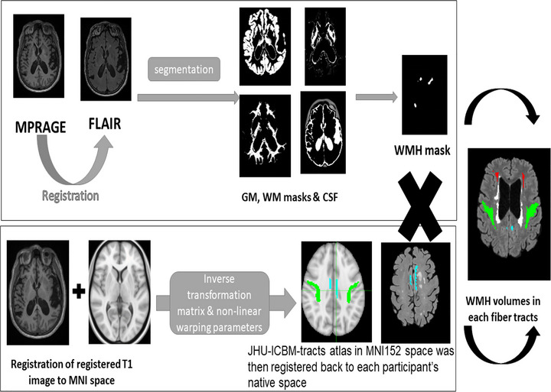
How might these pathologies allow an age x degenerative disease state to emerge?
We are largely inferring interrelationships of pathological disease by frequency associations…
Much work needs to be done, but links between CVD and increased amyloid accumulation have been described…
These data show that axonal injury is associated with upstream increases in Aβ accumulation
Thus, while CVD appears to be age-related and AD has variable associations with age based on genetics and risks, links between CVD & AD may tie in these diseases in an informed manner…
Ali et al., Brain Behav. 2023 Oct;13(10)

Slide 25
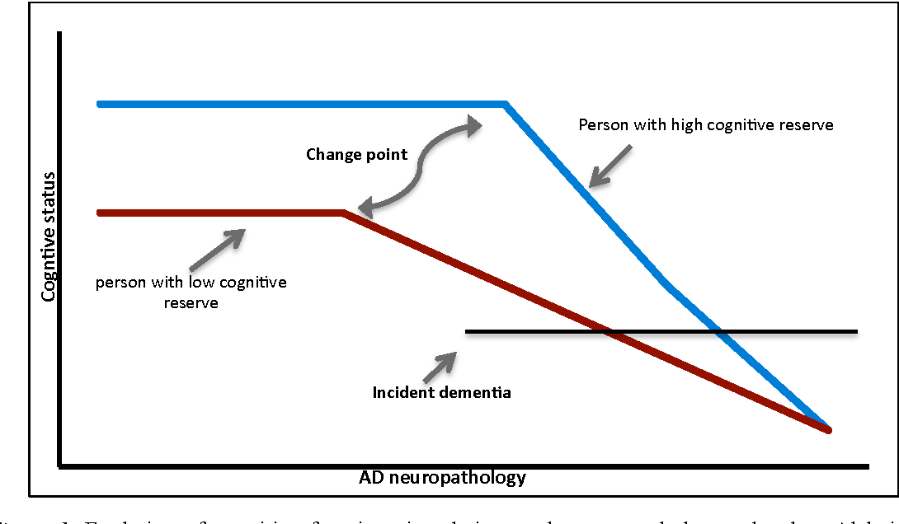
Cognitive reserve?
How can such disease exist I appreciable amounts without clinical consequences?
Measuring cognitive reserve?
Increasing cognitive reserve?
Valenciano-Mendoza, Eduardo and Joan Guàrdia-Olmos. “COGNITIVE RESERVE AS A PREDICTOR OF HEALTHY AGING.” (2014).

Slide 26
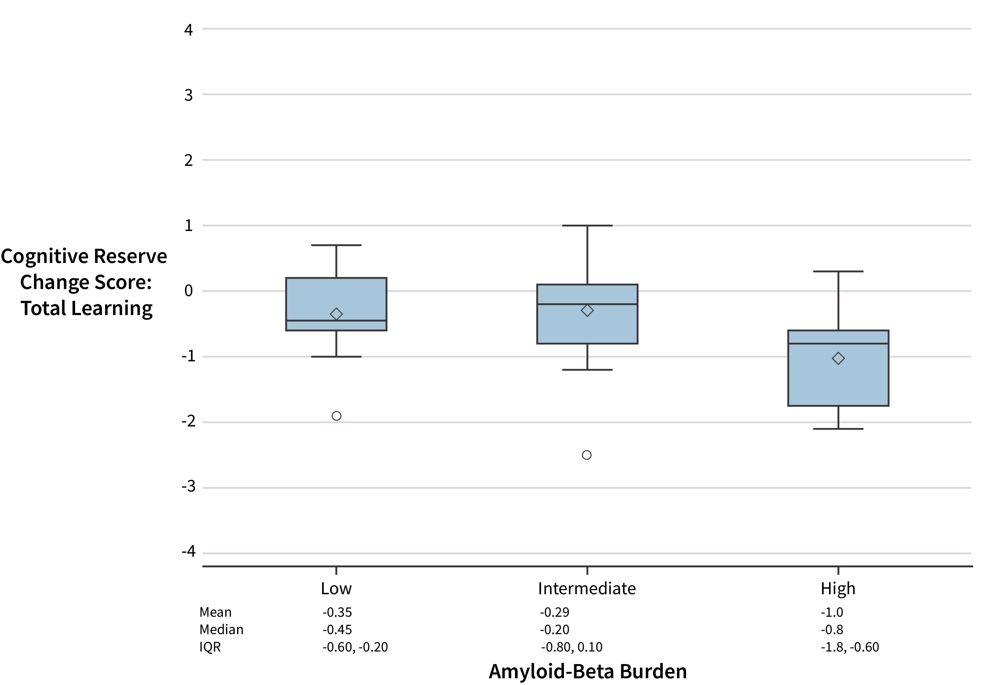
Operationalizing cognitive reserve to detect meaningful outcomes…
Clinical trial (INCREASE study NCT02849639)
Used scopolamine patch to detect cognitive reserve
Showed that pathology impacts resistance to cognitive challenges in a measurable way!
CVLT Total Learning (trials 1-5)
p =0.02
*
Change Z-Score
Moga et al., J Prev Alzheimers Dis. 2022;9(4):646-654.
Low Intermediate High
(SUVr < 1.2) (SUVr 1.2-1.4) (SUVr > 1.4)
Amyloid Burden

Slide 27
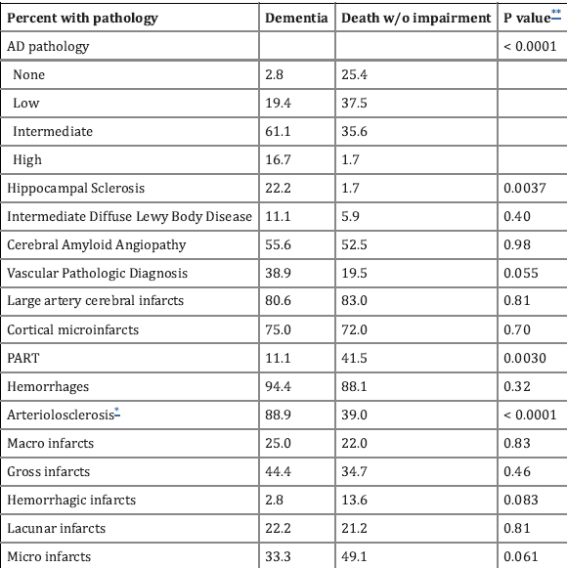
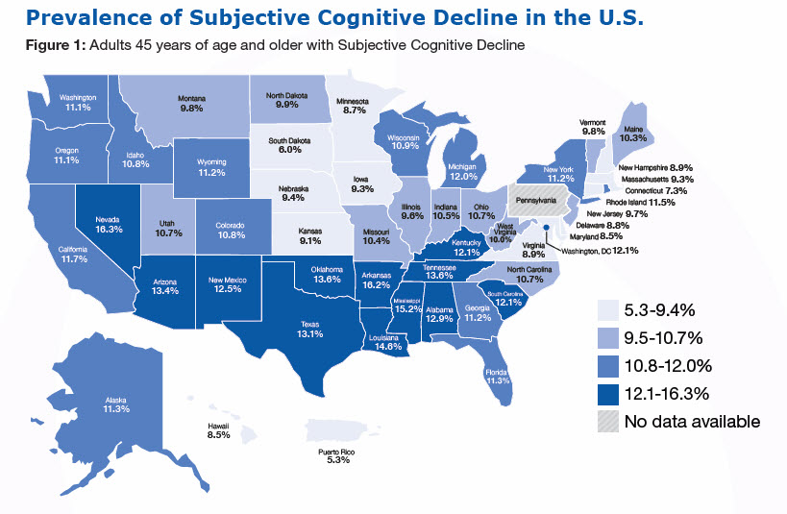
Subjective cognitive decline?
SCD is related to AD, HS-Aging/LATE, PART, & arteriolar sclerosis.
https://www.cdc.gov/aging/data/subjective-cognitive-decline-brief.html
Kryscio et al., J Prev Alzheimers Dis. 2016 Mar;3(1):13-19

Slide 28
Outline
Aging changes in multiple organ systems
“Normal” aging in the brain
Interaction of “normal” brain aging with pathological disease
“Normal” brain aging is heterogeneous as a result of interactions with multiple pathologic processes
“Normal” brain aging is a key target for primary and secondary prevention of cognitive impairment & dementia

Slide 29
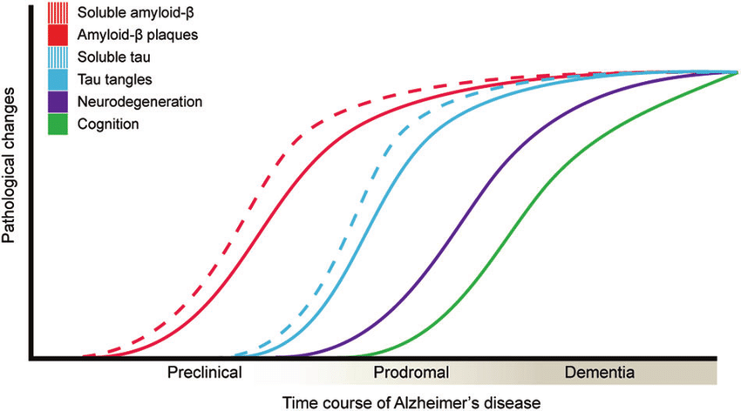
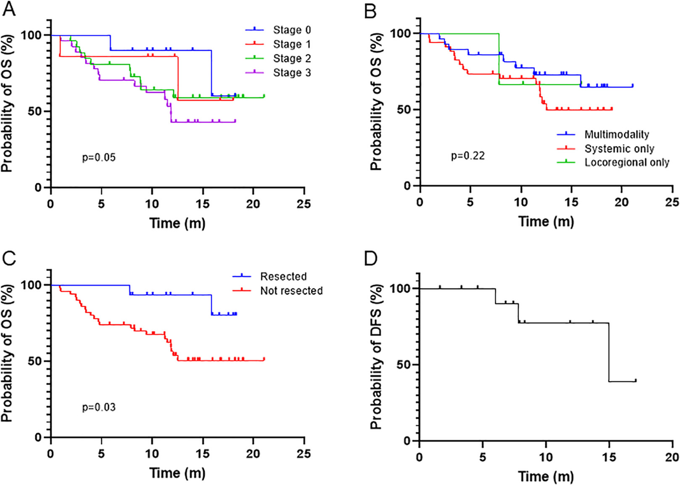
Intervening early gives the highest chance for impact…
Leuzyet al. (2019). Molecular Psychiatry. 24
Jia et al., Cancer Control. 2021;28.
This is true for liver cancer and for all known diseases
Picking the therapies that might work best at the earliest stages of AD include anti-Aβ and anti-tau but also other therapies!

Slide 30
Cognitively intact persons in clinical trials for prevention of dementia
What is normal aging is not always clear…
Biomarkers may help us understand preclinical disease states (Reflect the pathology)
When we look at interventions for maintaining brain health, we must take all pathologies into account in order to understand the data
Manuscript in preparation

Slide 31
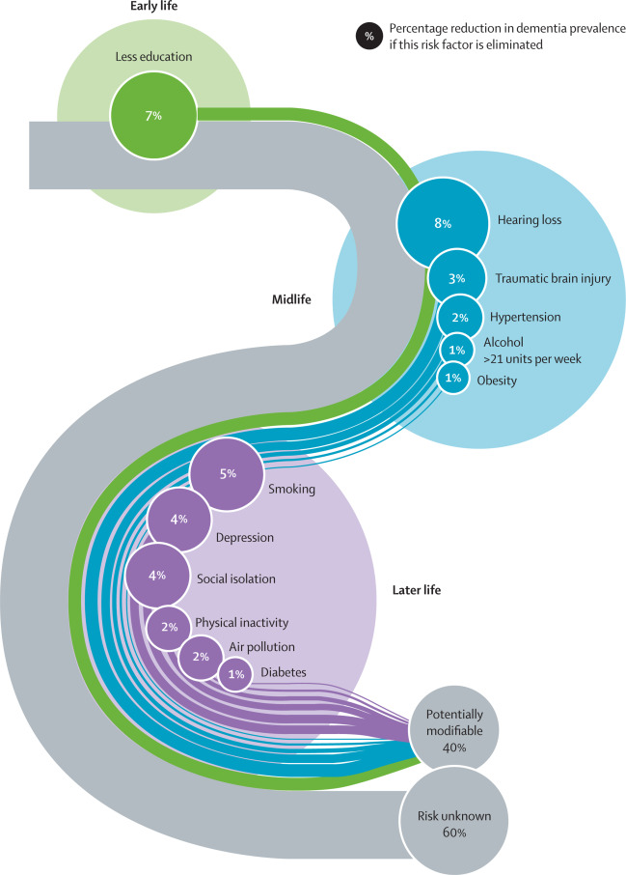
Sometimes the question is not what stage of disease, but rather what life stage?
The time for intervention is when the risk factor impacts it most!
It is never too late to change risk!
Livingston etal., 2020 report of the Lancet Commission. Lancet. 2020 Aug 8;396(10248):413-446.

Slide 32
Conclusions: let’s return to my key questions in the field…
What is normal brain aging?
It depends on how you ask the question, but it is clear that the brain of a 75 year-old is not the same as it was at age 25 years
How do aging & age-related diseases, including cognitive impairment/dementia, affect one another?
Age is a risk for dementia , but it does not cause dementia and vice-versa
What pathologies are found in the “normal” human brain?
Multiple pathologies are found in the “normal” brain, less often mixed than we see in MCI and dementia stages
Isn’t there any consequence to such pathologies?
Subtle cognitive decline can be seen in pre-dementia despite “normal” cognitive performance
What does this mean for diagnosis & treatment?
Targeting disease earlier rather than later is important
Targeting risks at the time when they most impact the disease is optimal

Slide 33
Let’s open discussion!
But age is the greatest risk factor for dementia?
How does cognitive reserve affect our understanding of the aging brain?
Vascular disease appears to link both?
?
How can we possibly modify disease in the later stages of AD?
Do all early pathologies eventually lead to dementia?
When we eventually develop a vaccine, should everyone get it?
How can we better detect preclinical cognitive decline?
How can I possibly do an outcome trial for risks that predate biomarkers?

