Slide 1



Preliminary results from the REACT MCI trial
Associate professor Susanne Hernes, MD,Phd.
University of Bergen, Norway
Chief medical officer, Sorlandet hospital HF, Norway
January 25 2024

Slide 2

Disclosure
I have no conflict of interest to declare
www.reactmci.no

Slide 3
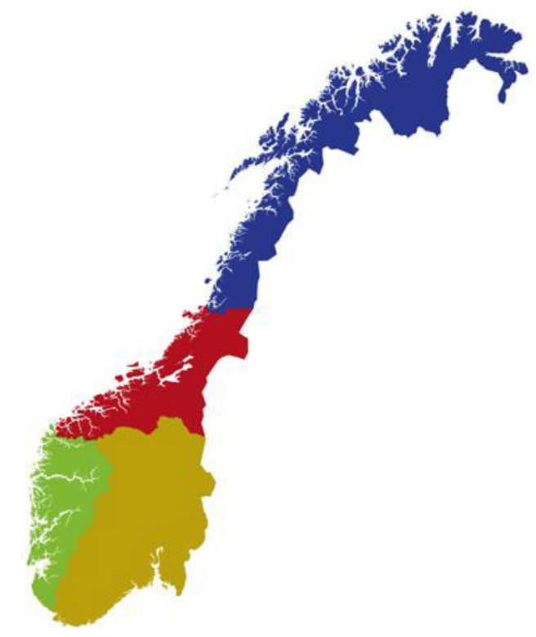





Norway
Population 5.4 million individuals
Ethnicity:
Norwegian 81.5% (includes about 60,000 Sami)
European 8.9%
Other 9.6%
Estimated MCI incidence in 70+ is 35.5%
Socioeconomic status is generally high
“Unlimited” healthcare is free for all
Image: Løhaugen, Gro CC, et al. Substance Abuse: Research and Treatment 9 (2015): SART-S23542.

Slide 4
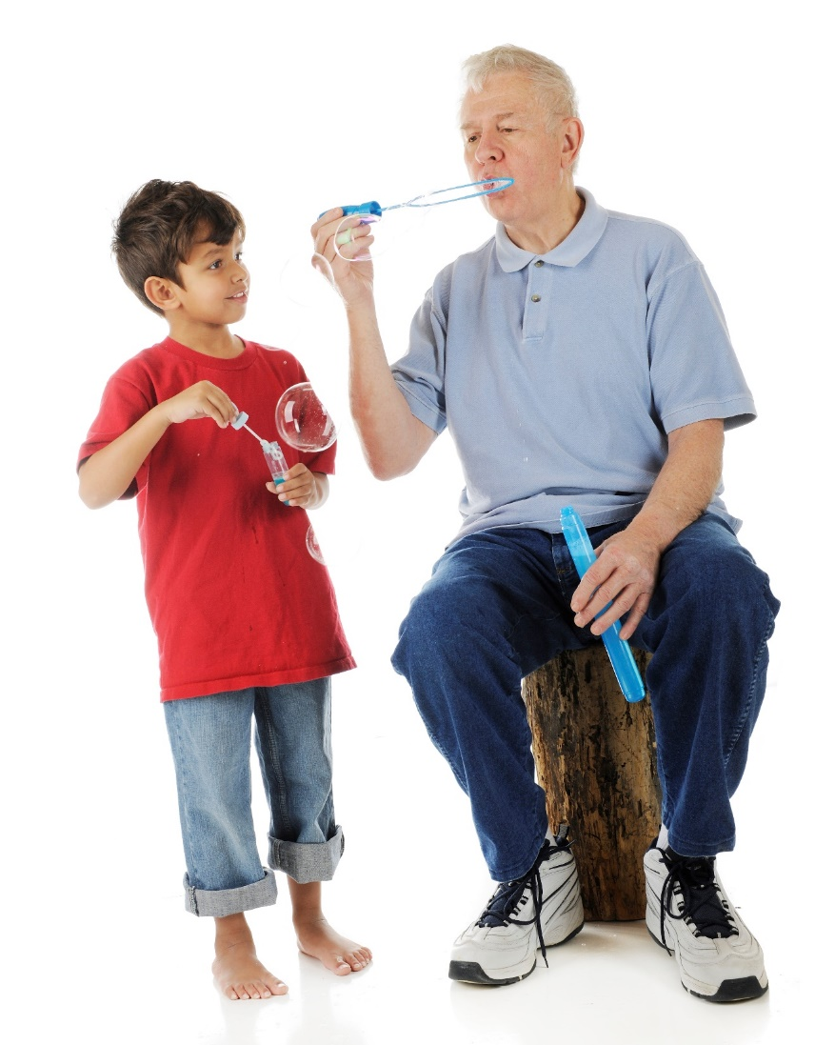
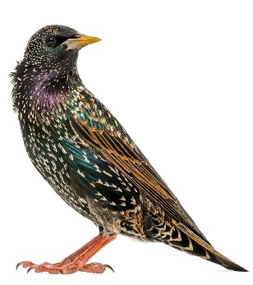
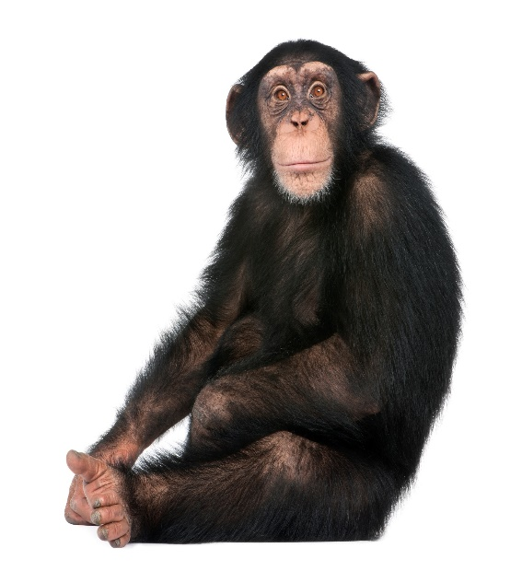
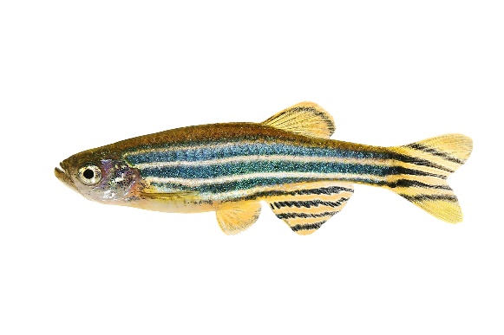
The brain is responsive to repeated stimuli
www.reactmci.no

Slide 5
Cognitive reserve framework
Cognitive reserve:
“adaptability that helps to explain differential susceptibility of cognitive abilities or day-to-day function to brain aging, pathology, or insult.”
Stern, Yaakov, et al. "Whitepaper: Defining and investigating cognitive reserve, brain reserve, and brain maintenance." Alzheimer's & Dementia 16.9 (2020): 1305-1311.
www.reactmci.no

Slide 6
Cognitive reserve framework
Cognitive reserve:
“adaptability that helps to explain differential susceptibility of cognitive abilities or day-to-day function to brain aging, pathology, or insult.”
Stern, Yaakov, et al. "Whitepaper: Defining and investigating cognitive reserve, brain reserve, and brain maintenance." Alzheimer's & Dementia 16.9 (2020): 1305-1311.
Is it possible to alter an individuals cognitive reserve by structured cognitive training in individuals with MCI?
www.reactmci.no

Slide 7

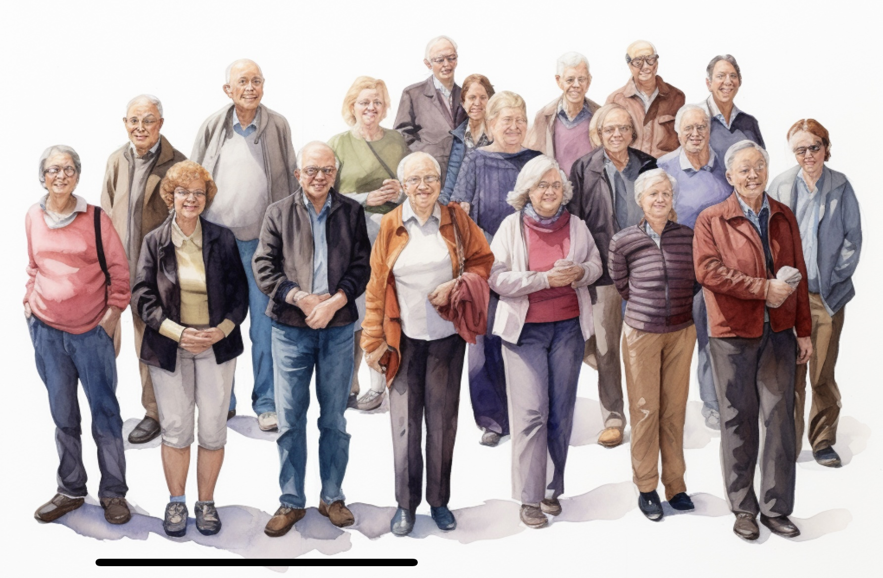
Memory Aid study
61 individuals with MCI
Recruitment 2013-2016
Double blinded multicentre RCT
Two arms: adaptive or non-adaptive computerized working memory training
REACT MCI study
Currently 145 individuals with MCI and their relatives
Recruitment 2021->
Double blinded multicentre RCT
Three arms: computerized working memory training vs active control
www.reactmci.no
Images: Midjourney AI

Slide 8
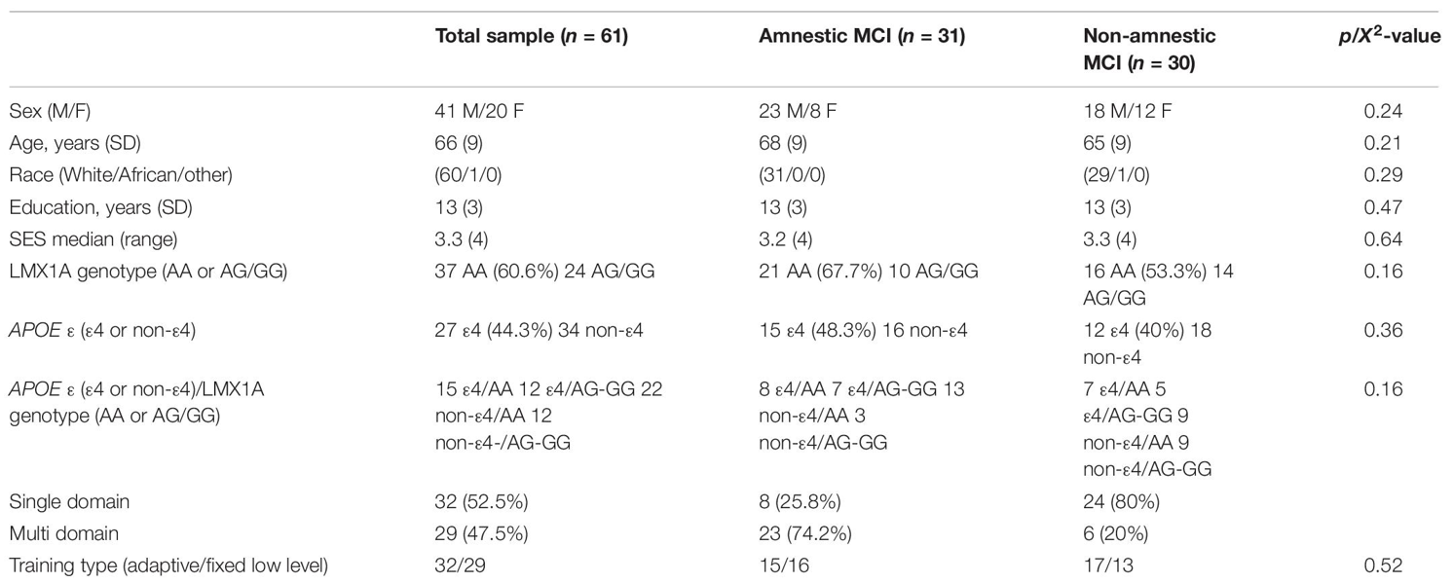
Memory Aid
Hernes, Susanne S., et al. "Working memory training in amnestic and non-amnestic patients with mild cognitive impairment: preliminary findings from genotype variants on training effects." Frontiers in Aging Neuroscience 13 (2021): 624253.

Slide 9

Is it possible to identify future high responders?
Dopamin transporter genes?
LMX1a?
ApoE
Glymphatic system function?
www.reactmci.no
Images: Midjourney AI

Slide 10
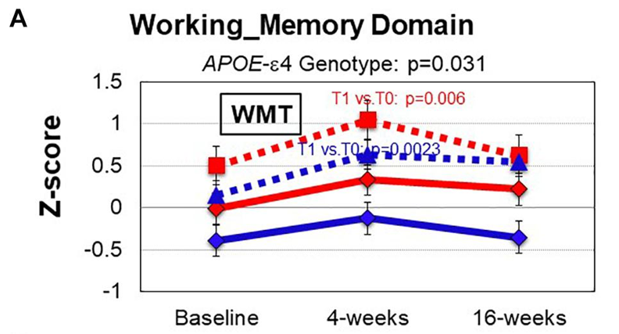
Hernes, Susanne S., et al. "Working memory training in amnestic and non-amnestic patients with mild cognitive impairment: preliminary findings from genotype variants on training effects." Frontiers in Aging Neuroscience 13 (2021): 624253.

Slide 11
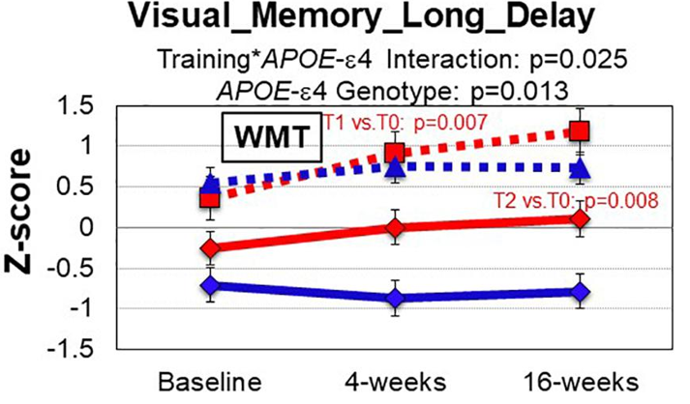
Hernes, Susanne S., et al. "Working memory training in amnestic and non-amnestic patients with mild cognitive impairment: preliminary findings from genotype variants on training effects." Frontiers in Aging Neuroscience 13 (2021): 624253.

Slide 12
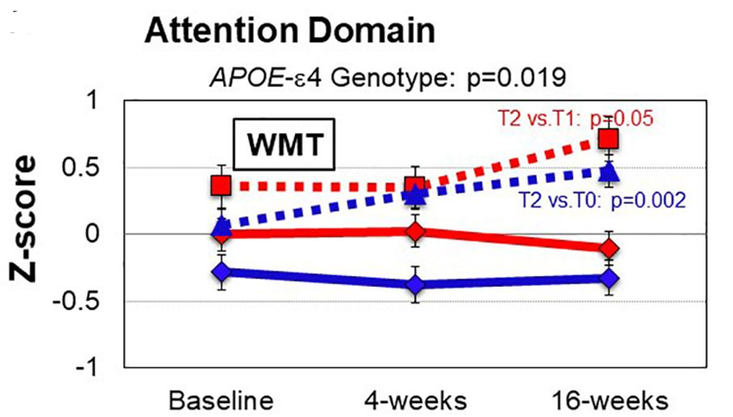
Hernes, Susanne S., et al. "Working memory training in amnestic and non-amnestic patients with mild cognitive impairment: preliminary findings from genotype variants on training effects." Frontiers in Aging Neuroscience 13 (2021): 624253.

Slide 13
REACT MCI – a double blind randomized trial
Baseline
3 months
6 months
12 months
24 months
48 months
I: Computerized WMT 5w/25s
I: Computerized WMT 5w/25s
Randomization
II: Computerized WMT 5w/25s
III: Generalized cognitive stimulation 5w/25s
Cognitive testing
QOL
Relatives stress
Health economics
Cognitive testing
MRI
Glymfatics

Slide 14
React MCI Workpacks
www.reactmci.no
Workpack 3
To investigate if WM training impact quality of life (QoL) and relatives
First results: Spring 26
Workpack 4
To investigate if WM training is a cost-effective approach in MCI
First results: Spring 27
Workpack 1
To investigate if a single period of WM training is sufficient to achieve effects on cognitive function after 6 months measured by spatial span backwards
First results: Spring 25
Workpack 2
To investigate if it is possible to identify high responders of WM training
Genes, glymfatics
First results: Spring 25

Slide 15
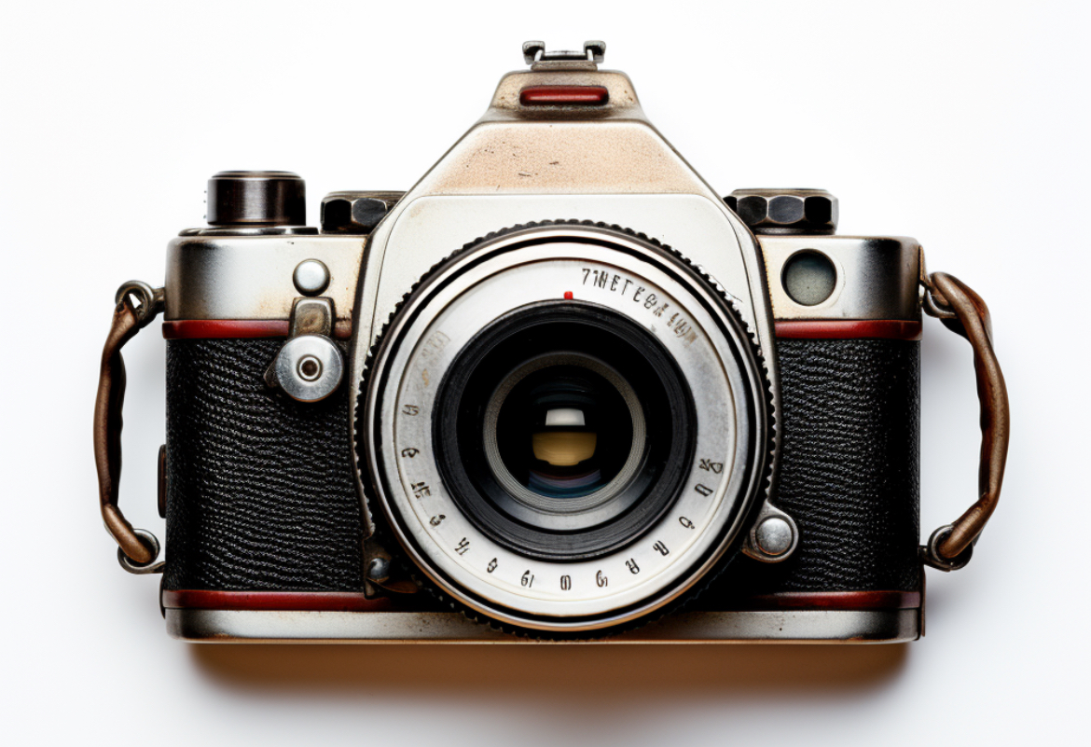
Baseline status participants 01.09.24
 | Prelim. sample n=144
Age years, SD | 68,5 (7,3)
Sex | 79 males/ 53 females
Education | 50% university or above/ 45 highschool or other/ 5% middle school
MMSE, SD | 26,23 (3,0)
Clinical dementia rating, median (range) | 1,0 (4,5)
Spatial span backwards, scaled score, mean (SD) | 10,7(3,1)
BMI, mean (SD) | 25,32 (4,0)
BP, mean | 143/84
History of:
Cerebrovascular disease | 11%
Myocardial infarction | 8%
Hypertention | 32%
Thyroid disease | 12%
www.reactmci.no

Slide 16
Clinical dementia rating scale - sum of boxes
www.reactmci.no
 | Base-line | 3 monhts | 6 months | 12 months
Mean | 1,5 | 1,5 | 1,89 | 1,7
SD | 1,2 | 1,6 | 1,8 | 1,9
Median | 1,0 | 1,0 | 1,0 | 1,0
Range | 4,5 | 8 | 9 | 6,5

Slide 17
EQ5D-5L VAS – patient and relatives scores
www.reactmci.no
Garratt, Andrew Malcolm, et al. "Norwegian population norms for the EQ-5D-5L: results from a general population survey." Quality of Life Research (2021): 1-10.

Slide 18
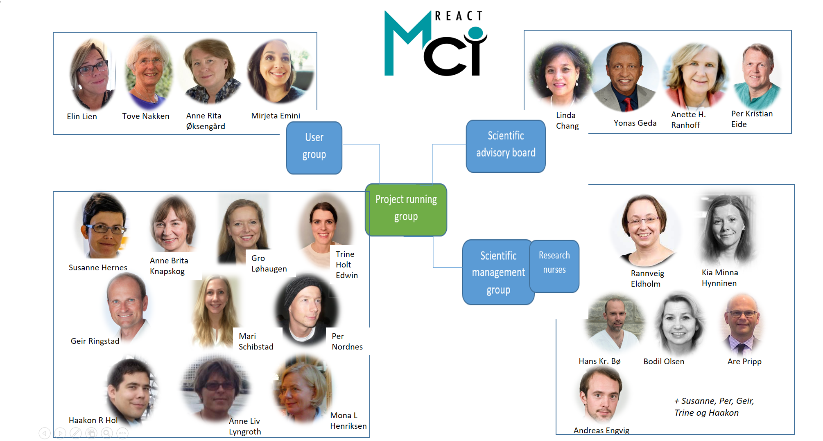


Thank you!

