Slide 1



White Matter Dementia Then . . . and Now
Christopher M. Filley, MD, FAAN, FANA, FANPA
Founding Director, Behavioral Neurology Section
Professor of Neurology and Psychiatry
University of Colorado School of Medicine
Senior Scientific Advisor, Marcus Institute for Brain Health

Slide 2
Objectives
Describe the origin of the concept of white matter dementia (WMD)
Review subsequent neuroscientific advances that inform and elaborate the notion of WMD
Consider the relevance of WMD to the pathogenesis of degenerative dementias
Discuss recent data on prevention and treatment of white matter disorders
Emphasize the importance of white matter in human behavior

Slide 3
White Matter Dementia: Clinical Disorders and Implications
*†Christopher M. Filley, *‡§Gary M. Franklin, ║Robert K. Heaton,
And *¶Neil L. Rosenberg
Departments of Neurology, Psychiatry, Preventive Medicine, and Biometrics, University of Colorado, School of Medicine, Denver, Colorado; Department of Psychiatry, University of California at San Diego, School of Medicine, San Diego, California; and Neurology and Research Services, Denver VA Medical Center, Denver, Colorado, U.S.A.
Neuropsychiatry, Neuropsychology, and Behavioral Neurology
1988: 1: 239-254

Slide 4
A Different Perspective
Neurologic tradition has not emphasized the role of white matter tracts in cognition and emotion
An appreciation of the function of white matter in health and disease is essential for a complete understanding of human behavior
Complementing our usual disease-specific approach, a transdiagnostic strategy allows us to think across disorders and gain new insights
I first got involved through the study of solvent abuse (“paint sniffing”)
But first, some background information . . .

Slide 5
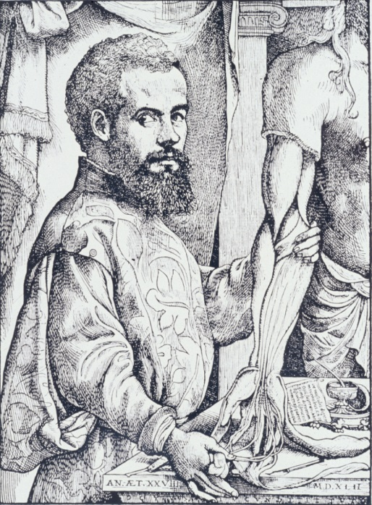
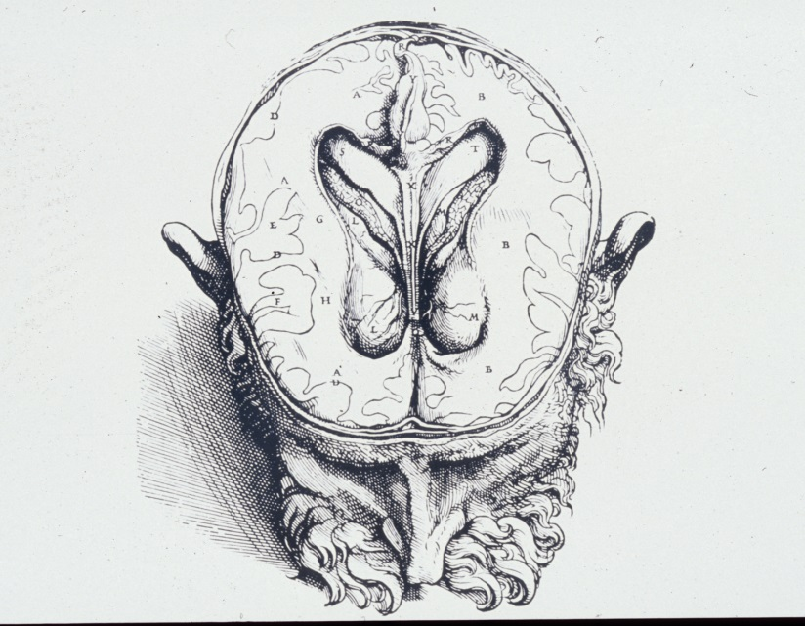
Early Anatomy
White matter was not recognized by physicians of antiquity
In 1543, Andreas Vesalius first identified this component of the brain
In the VIIth book of his masterwork, De Humani Corporis Fabrica, drawings clearly demarcate white matter from gray matter

Slide 6
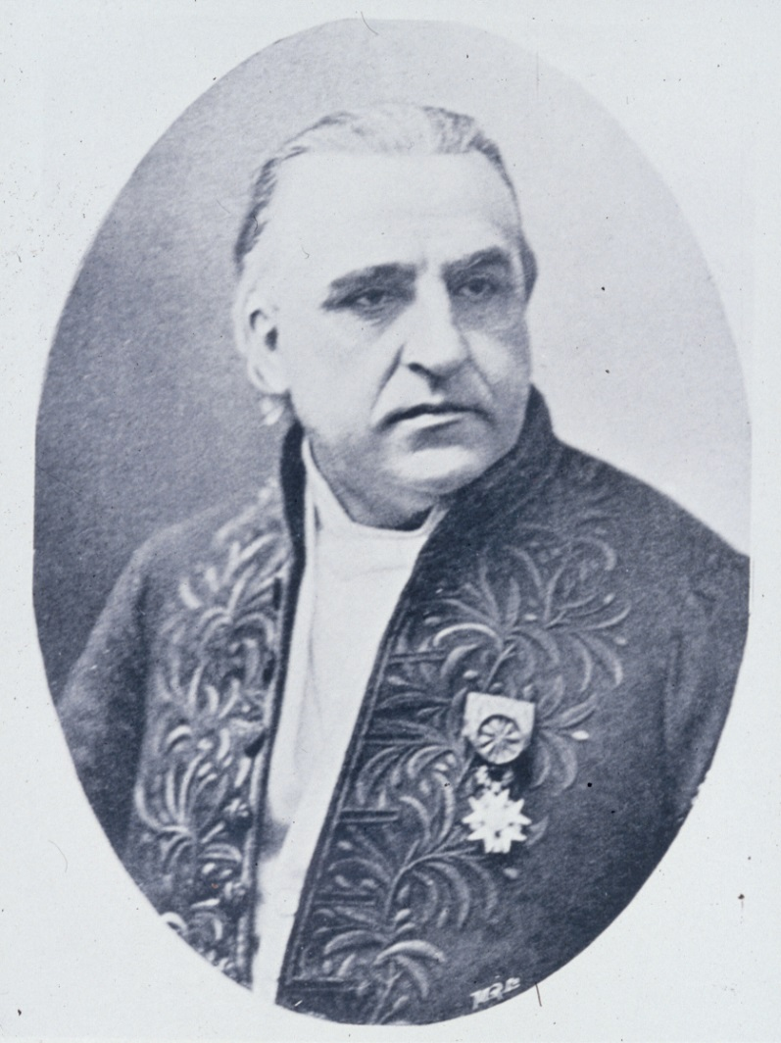
Classic Neurology
Jean Martin Charcot (1825-1893) pioneered research on the clinical manifestations of CNS white matter damage
Seminal studies at the Salpêtrière Hospital in Paris advanced the understanding of MS, including its effects on cognition and emotion

Slide 7
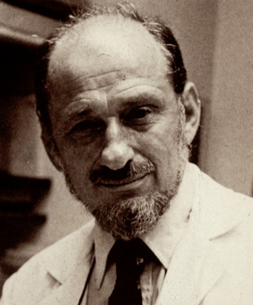
Norman Geschwind
The founder of behavioral neurology, Geschwind (1926-1984) promoted the idea of disconnection
“Disconnexion Syndromes in Animals and Man” (1965) discussed how focal white matter lesions disconnect cerebral areas and produce neurobehavioral syndromes

Slide 8
White Matter and Behavioral Neurology
Disorders of cerebral white matter occur at all ages and are readily detected by MRI
More than 100 diseases, injuries, and intoxications exist in which cerebral white matter is prominently or exclusively affected
Clinical reports in these conditions without exception reveal some evidence of cognitive and/or emotional disturbance
Focal neurobehavioral syndromes, neuropsychiatric disorders, and dementia can occur

Slide 9
Neurologists Hesitate to Attribute Cognitive Loss to White Matter Involvement
However
Corticocentrism: The Dominant Paradigm of
Cognitive Neuroscience
The cerebral cortex is the essential, if not unique, structural locus of higher functions
Why?

Slide 10
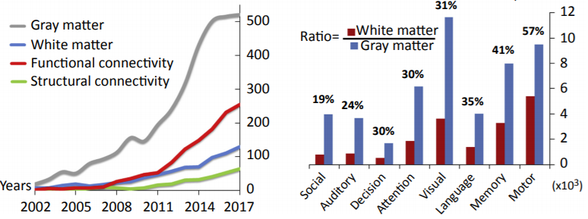
PubMed: White Matter vs. Gray Matter Left Panel - Social Neuroscience; Right Panel - Other Domains (Wang and Olson, 2018)

Slide 11
The First and Best Example of WMD: Toluene Leukoencephalopathy
We studied 14 toluene abusers (10M/4F, age 20-43), who had 24-252 months of heavy toluene exposure via paint sniffing (Filley et al. 1990)
MRI and neuropsychological data were analyzed blindly and then compared
Longer duration of toluene abuse predicted more severe MRI and cognitive abnormalities
Neuropsychological impairment correlated with severity of MRI white matter involvement (p<.01)

Slide 12
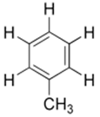
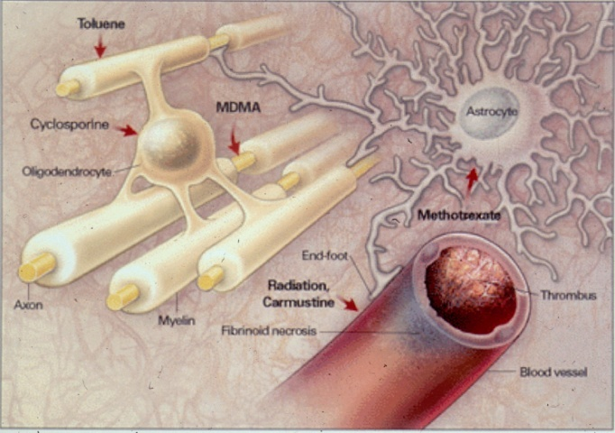
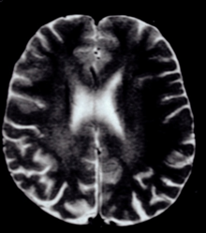
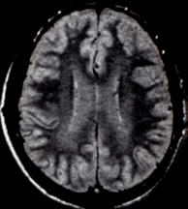
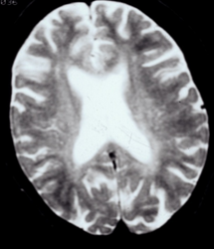
Toluene Leukoencephalopathy (Filley and Kleinschmidt-DeMasters, 2001)

Slide 13
Toxic Leukoencephalopathy Exhibits Dose-Related Neuropathology (Filley and Kleinschmidt-DeMasters, 2001)
A range of neuropathology exists within white matter, reflecting severity of intoxication
Intramyelinic edema myelin loss with preserved axons widespread myelin loss with axonal loss and necrosis
Imaging and cognitive changes develop in parallel with the neuropathology
Toxic leukoencephalopathy manifests a predictable sequence of progressive leukotoxicity

Slide 14
Toxic Leukoencephalopathy Spectrum
 | Mild | Moderate | Severe
Neurobehavioral Features | Confusion Inattention Forgetfulness Personality change | Somnolence Apathy Memory loss Dementia | Abulia Akinetic mutism Stupor Coma Death
MRI | Periventicular white matter hyperintensity | Diffuse white matter hyperintensity | Diffuse white matter hypodensity Necrotic areas
Neuropathology | Patchy intramyelinic edema and preserved myelin | Widespread edema with demyelination and preserved axons | Oligodendrocyte loss Axonal loss Necrosis

Slide 15
White Matter Disorders
Genetic
Demyelinative
Infectious
Inflammatory
Toxic
Metabolic
Vascular
Traumatic
Neoplastic
Hydrocephalic

Slide 16
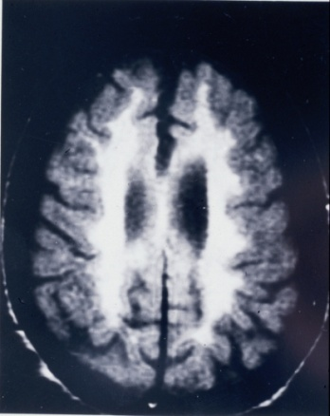
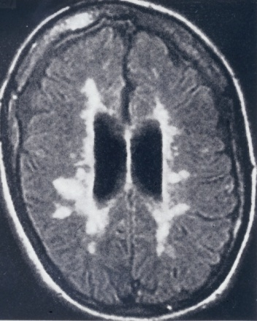
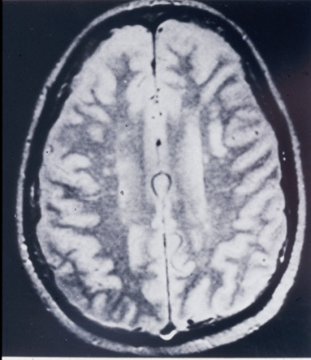
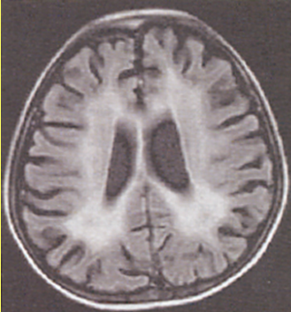
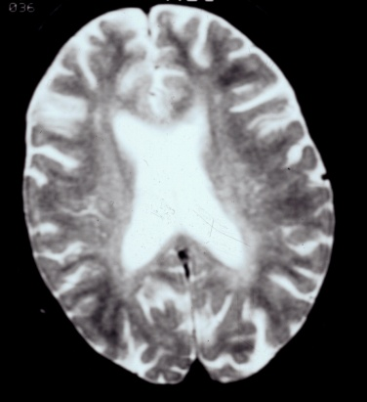
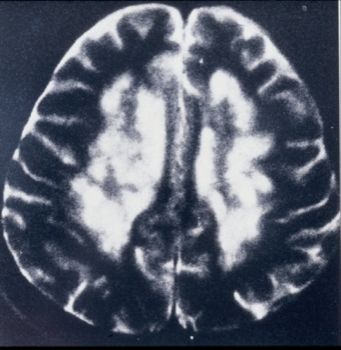
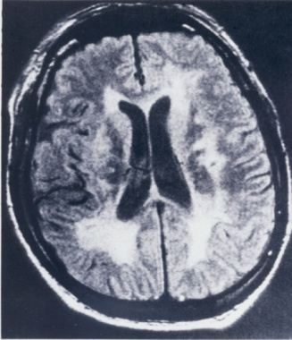
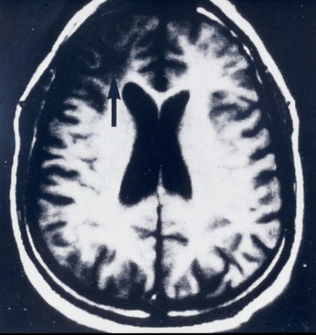
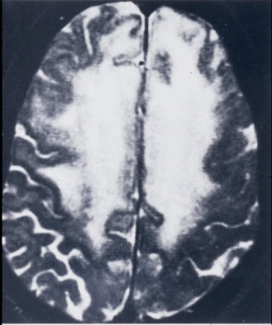
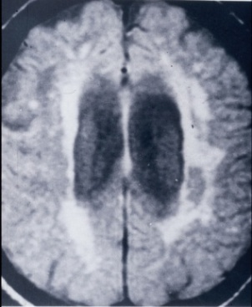
MRI of White Matter Disorders
MLD MS HIV SLE Toluene
↓B12 BD TBI Glioma NPH

Slide 17
Why Another Dementia Category?
We saw a need to call attention to the dementia that can occur with white matter involvement
Because dementia can develop in a wide variety of neurologic disorders affecting white matter, we wondered whether these disorders had a similar neurobehavioral profile, differing from that of both cortical dementia (e.g. AD) and subcortical (gray matter) dementia (e.g. HD, PD)

Slide 18
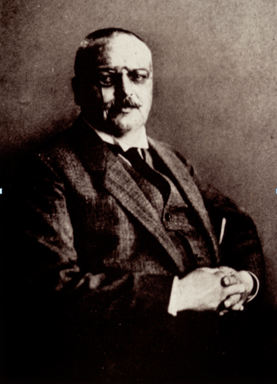

AD: The Classic Cortical Dementia
Cortical syndromes are widely accepted
as characteristic of AD:
Amnesia
Aphasia
Apraxia
Agnosia
(Geldmacher and Whitehouse, 1996)
However, does dementia arise only from damage in the thin layer of neurons in the cerebral cortex?

Slide 19
White Matter Dementia vs. Cortical Dementia (MS vs. AD) (Filley et al. 1989)
Probable AD and chronic-progressive MS (N=42 in each group) were compared with comprehensive neuropsychological testing
AD had significantly worse declarative memory encoding and verbal function, while MS had more impaired sustained attention and slower processing speed (p<.05)

Slide 20
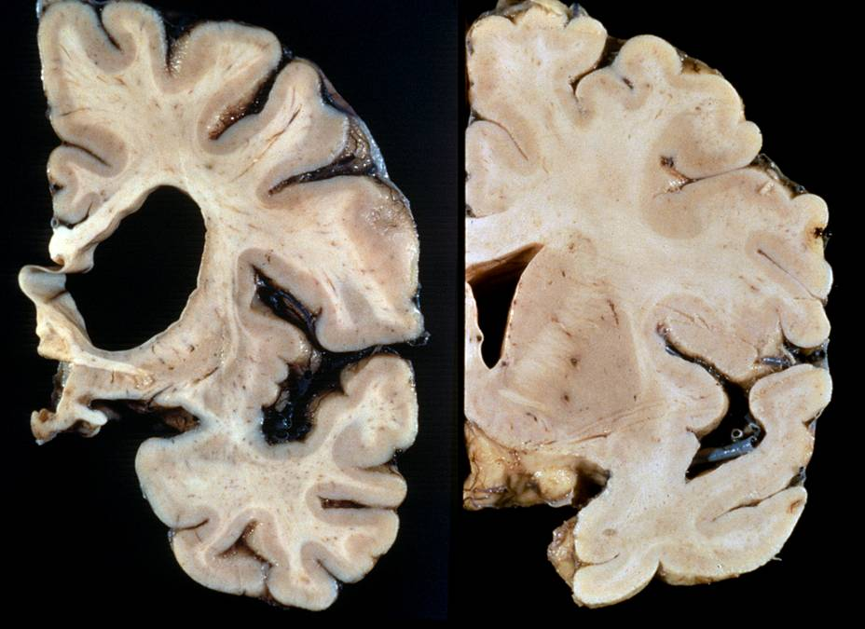
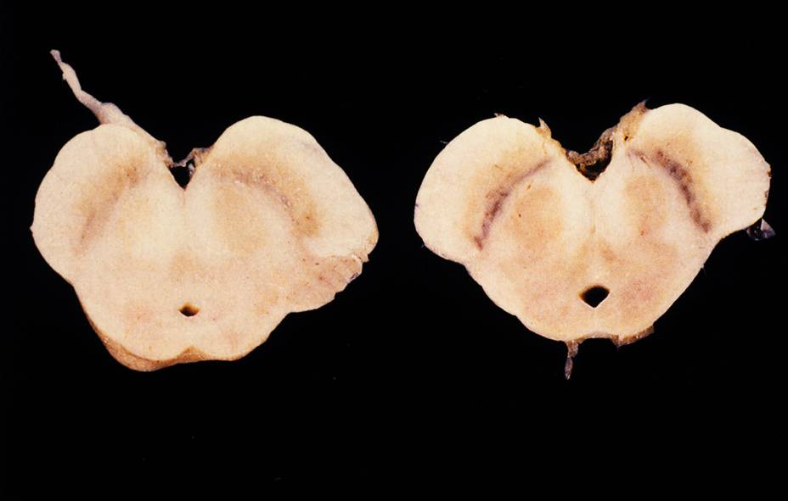
Huntington’s Disease and Parkinson’s Disease: Classic Subcortical Dementias
Memory retrieval deficit, normal language, cognitive slowing, psychiatric dysfunction
Subcortical dementia traditionally included diseases of white matter
My focus: the white matter half of the brain – between the cortical and subcortical gray matter – and its unique contributions to behavior
HD – caudate atrophy
PD – neuronal loss
in substantia nigra

Slide 21
White Matter Dementia vs. Subcortical Dementia (MS vs. HD) (Lafosse et al. 2007)
Clinically definite MS (N=19), genetically-verified HD (N=16), and normal controls (N=17) were compared on tests of attention and memory
With similar overall cognition, MS and HD had impaired sustained attention and declarative memory retrieval, but MS had normal procedural memory while HD did not (p<.05)

Slide 22
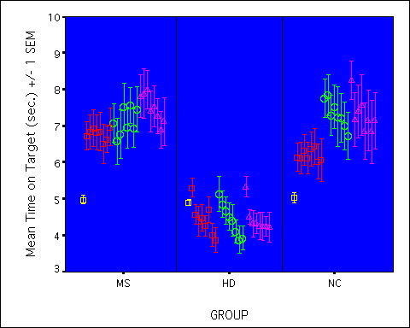
Procedural Memory in MS and HD: Rotary Pursuit

Slide 23
White Matter Dementia
A dementia syndrome resulting from diffuse or multifocal white matter damage
Cognitive slowing
Executive dysfunction
Sustained attention deficit
Memory retrieval deficit
Visuospatial impairment
Psychiatric disorder
Relatively preserved language
Normal extrapyramidal function
Normal procedural memory

Slide 24
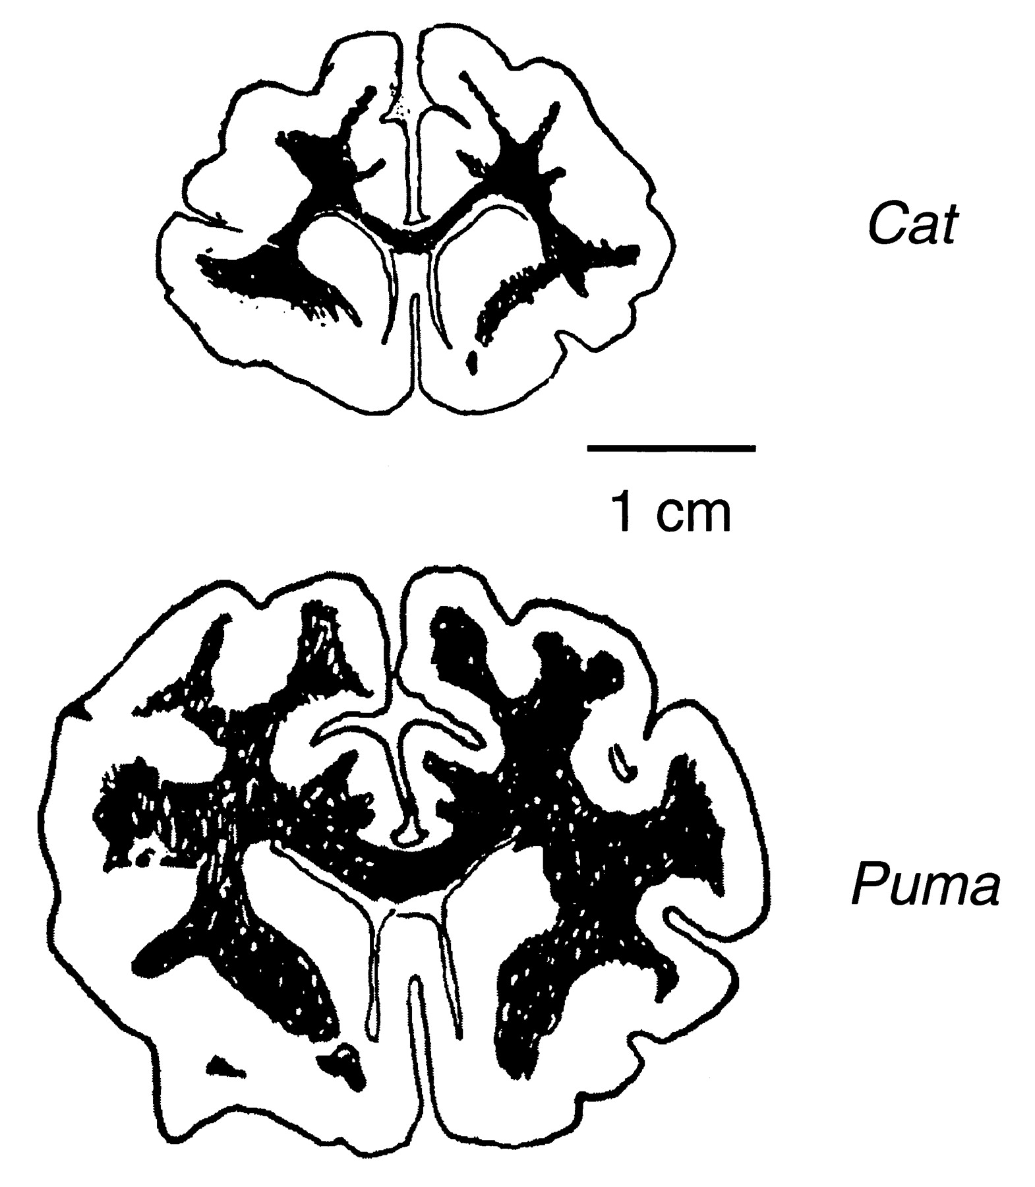
White Matter Has Expanded More in Evolution than Gray Matter (Zhang and Sejnowski, 2000)
A universal scaling law of 4:3 describes the relation of WM to GM volume over millions of years
As cortical GM expands, longer and faster conducting axons are needed to connect remote GM areas that are increasingly distant
Myelin adds width to axons, and, in general, WM tracts become thicker as brains become larger

Slide 25
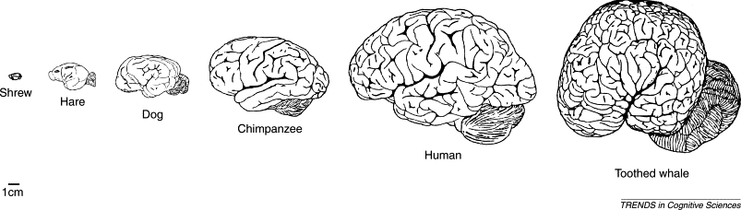
What Makes the Most Intelligent Brain?
Size matters, as humans have bigger brains than great apes, but size alone is not enough; whales and elephants have brains 2-6 x larger than humans
(Roth and Dicke, 2005)
Whales and elephants nearly match humans in number of cortical neurons, but their axons are thinly myelinated, and cortical areas are farther apart (Roth and Dicke, 2005)
Human intelligence likely results from:
1) larger numbers of cortical neurons,
and
2) extensive cerebral myelination increasing axonal conduction velocity
(Roth and Dicke, 2005)

Slide 26
Information Transfer Is As Important As Information Processing
Evolution produces higher intelligence via larger brains with more neurons, and WM expanding even more than GM
The “best” brains have the most neurons and the most myelination
Optimal cognition requires both computational capacity (neuronal cell bodies) and brain connectivity (axonal myelin)
WM complements information processing by enhancing information transfer

Slide 27
Is There Subtle White Matter Dysfunction Early in Disease Pathogenesis?
The first task was to establish that white matter lesions visible on conventional MRI could produce dementia; hence white matter dementia
These lesions are macrostructural, indicating widespread myelin and often axonal pathology
But white matter pathology likely begins before conventional MRI becomes positive
How can microstructural damage be detected, and what is its neurobehavioral significance?

Slide 28
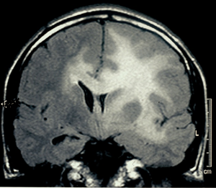
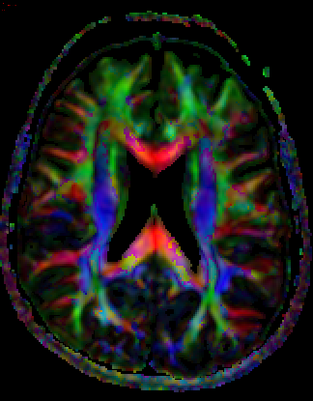
More Than Meets the Eye
Standard MRI lesions are obvious, but new methods can disclose new data; DTI and MRS have proven most useful for examining the normal-appearing white matter (NAWM)
Conditions In Which NAWM Has Been Found Abnormal
MLD
Phenylketonuria
Neurofibromatosis
Tuberous sclerosis
Myotonic dystrophy
FXTAS
Multiple sclerosis
HIV infection
SLE
Alcoholism
Hypoxia
Leukoaraiosis
Traumatic brain injury
Glioma
NPH
Aging
Autism
ADHD
Depression
Bipolar disorder
Schizophrenia
Alzheimer’s Disease
MRI: Gliomatosis cerebri
DTI: Normal white matter

Slide 29
NAWM and Cognition in SLE
We used 3T MRI and MRS in SLE patients without overt neurologic or psychiatric disorder as a model for early white matter neuropathology (Filley et al. 2009)
MRS: high choline (Ch) inflammation, demyelination; low N-acetyl aspartate (NAA) axonal pathology
Neuropsychology: White matter cognitive score (WMCS) based mainly on PASAT performance
High left frontal NAWM Ch correlated with low WMCS
Slowed processing speed, inattention, and executive dysfunction appear to reflect damaged frontal NAWM
Mild cognitive dysfunction in SLE may result from microstructural inflammatory myelinopathy

Slide 30
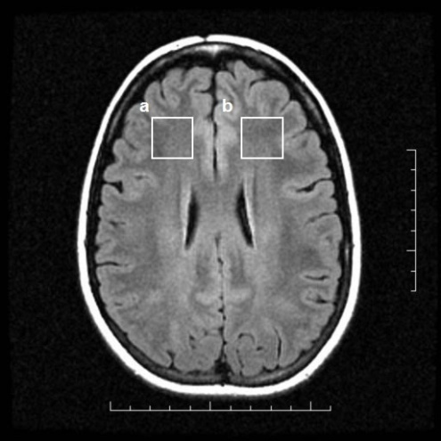
White Matter-Behavior Correlations
 | Correlations with WMCS
 | Correlation Coefficient | P
Total WM volume | 0.27 | 0.04
WM lesion volume | -0.07 | 0.63
WM lesion number | -0.08 | 0.56
Left frontal Ch/Cr | -0.29 | 0.04
Right frontal Ch/Cr | -0.14 | 0.32
Right + left frontal Ch/Cr | -0.25 | 0.08

Slide 31
Cognitive Sequelae of NAWM Changes
Transdiagnostic study showed that NAWM changes cause problems similar to, but milder than, those seen with diffuse or multifocal MRI WM lesions
Processing speed, executive function, sustained attention, and memory retrieval are most affected; language is typically spared
This profile is essentially the same as that of WMD (Filley et al. 1988; Filley, 1998; Schmahmann et al. 2008), but deficits are milder

Slide 32
Mild Cognitive Dysfunction (MCD)
A syndrome of cognitive slowing, inattention, and executive dysfunction associated with insidious white matter pathology
In contrast to mild cognitive impairment (MCI):
MCD applies to wide age range and many disorders
MCD reflects white matter involvement (not gray)
MCD displays a distinctive cognitive profile
We focused on frontal white matter because it is 1) commonly affected clinically, and 2) most convenient to examine with neuroimaging
MCD-SLE may be a model for early stages of all WM disorders (Kozora and Filley, 2011), preceding WMD and potentially enabling early treatment

Slide 33
Schematic Relationship Between White Matter and Cognition
White Matter Dementia
Mild Cognitive Dysfunction
Cognitive
Decline
Normal Cognition

Slide 34
The Relevance of WMD to Degenerative Dementia
White matter lesions are clearly important for vascular dementia
But white matter damage may also be relevant to the pathogenesis of Alzheimer’s Disease and chronic traumatic encephalopathy
From this perspective, cortical proteins can be seen as evidence of pathology that originates in white matter years before proteins appear

Slide 35
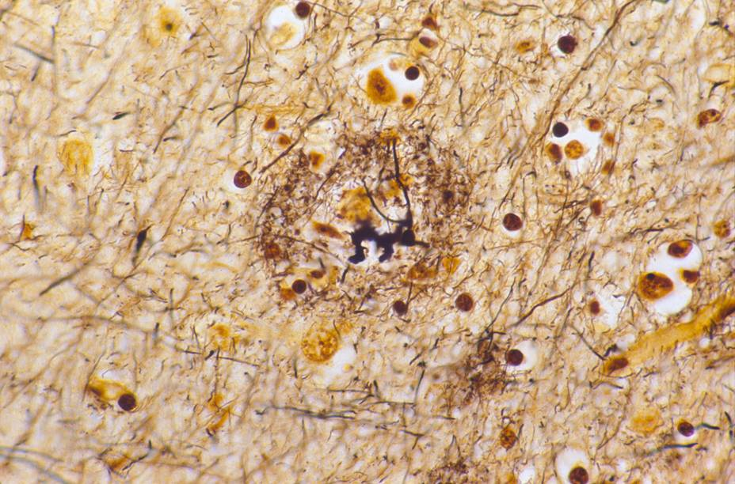
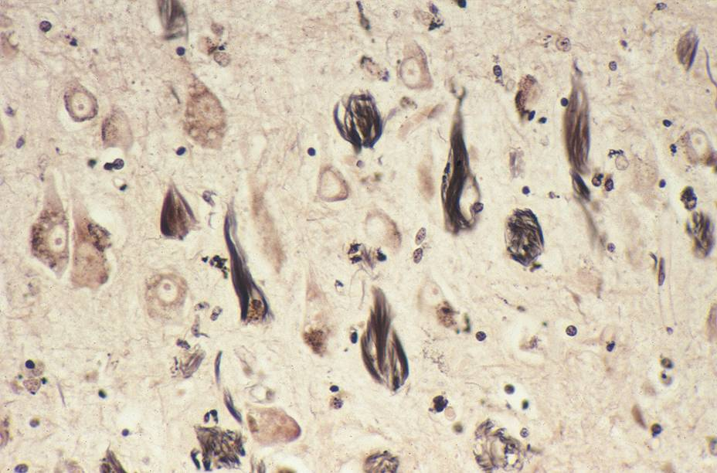
Corticocentrism and Dementia
Cortical pathology has been foundational in AD, launching the amyloid hypothesis
Much precedent suggests that plaques/tangles explain AD: MS plaques, viral inclusions, tumors, atherosclerosis, etc. all clearly explain other neurologic diseases
“If plaques and tangles look bad, they must be bad”
Classic dementia histology (plaques, tangles, Pick bodies, Lewy bodies) almost irresistibly draws attention to the cortex

Slide 36
But Even Alzheimer Had His Doubts
“ . . . plaques are not the cause of senile dementia
but only an accompanying feature of
senile involution of the central nervous system.”
- Alois Alzheimer, 1911
We now know that many normal elders
have sufficient cortical plaques and tangles
to qualify as having AD (Davis et al. 1999)

Slide 37
Circular Reasoning?
The cortex is the only region that matters for cognition
Plaques and tangles in the cortex explain dementia in AD

Slide 38
Doubts About Anti-Amyloid Drugs
The amyloid cascade hypothesis has dominated AD research for decades, but just 2/44 clinical trials of anti-amyloid drugs have been positive, within the range of statistical probability
Even aducanumab and lecanemab remain controversial – their efficacy is similar to that of donepezil, a drug whose impact is imperceptible to most patients and families, and a recent meta-analysis of 14 AD RCTs concluded that “amyloid reduction strategies do not substantially improve cognition” (Ackley et al. 2021)
Anti-amyloid drugs are associated with unexplained brain volume loss – amyloid removal explains < 1/1000th of this atrophy (Ayton, 2021)
How much of this field is driven by commercial interest and patient advocacy, not by the best science?

Slide 39
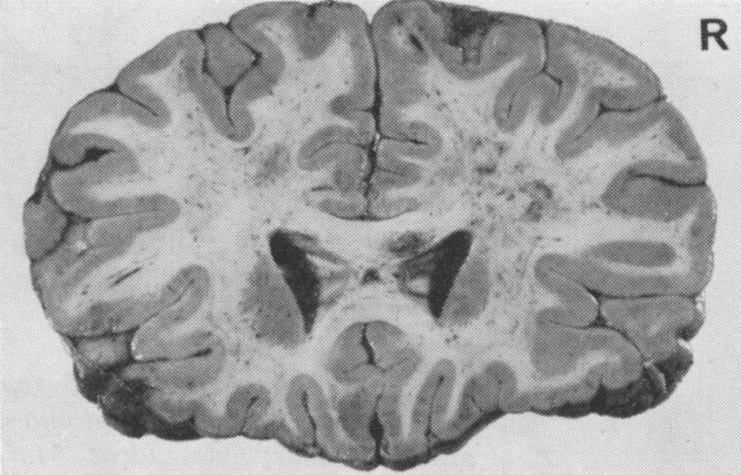
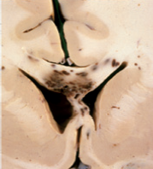
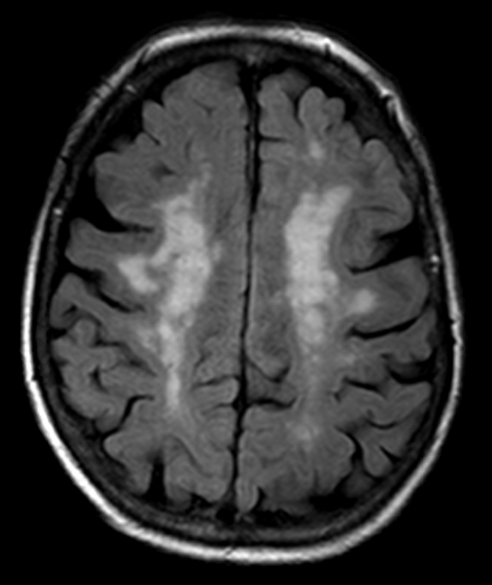
The Special Vulnerability of White Matter
Caplan, 1995
Strich, 1970
Sharp Scott,
and Leech, 2014
TBI - Diffuse Axonal Injury
Vascular Disease
Filley, 2021

Slide 40
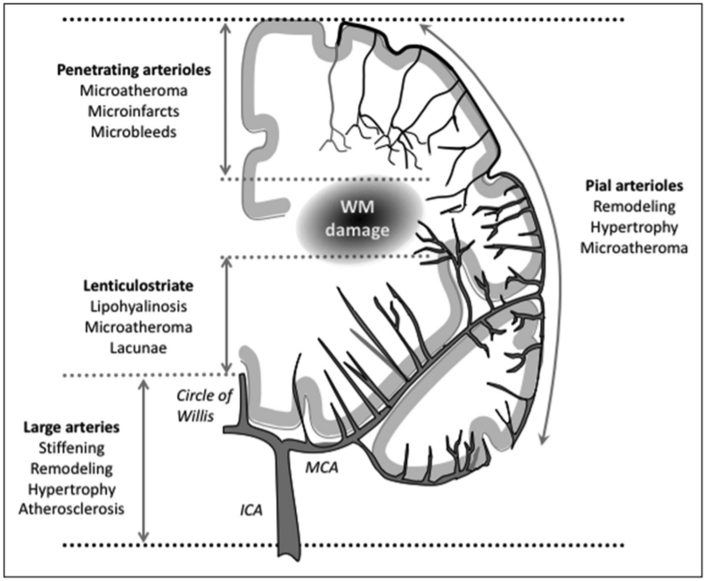
White Matter, Vascular Dementia, and AD
White matter has a precarious blood supply, as it is perfused by penetrating arterioles whose small caliber can be further compromised in aging by atherosclerosis and lipohyalinosis (Brown and Thore, 2011; Iadecola and Gottesman, 2019)
Hypertension is a powerful risk factor for leukoaraiosis
Much evidence links vascular disease with AD, and the two are very often comorbid
Iadecola and Gottesman, 2019

Slide 41
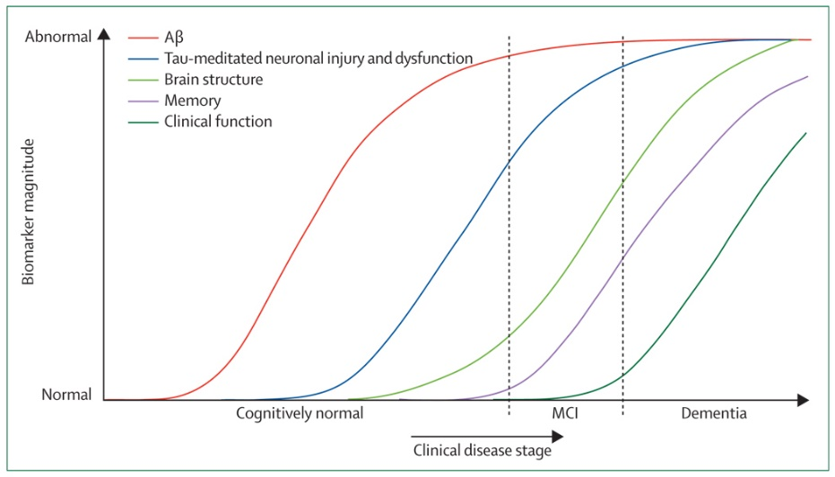
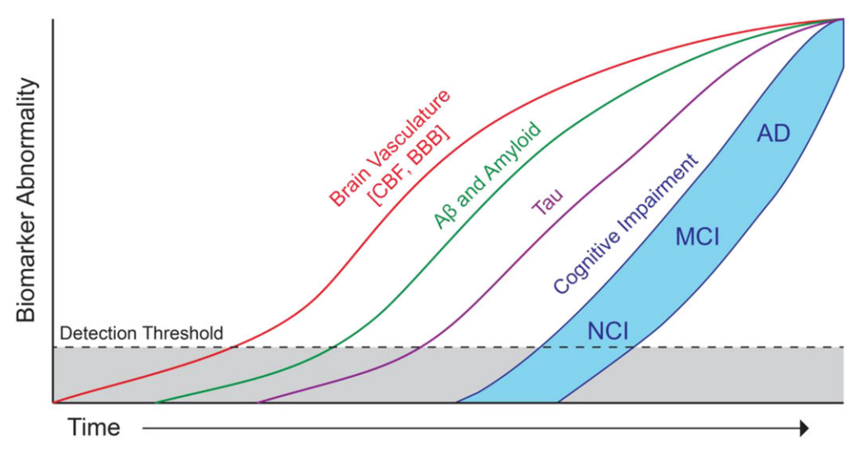
Etiopathogenesis of Alzheimer’s Disease: A Revised Perspective
Jack et al. 2010
Sweeney et al. 2018

Slide 42
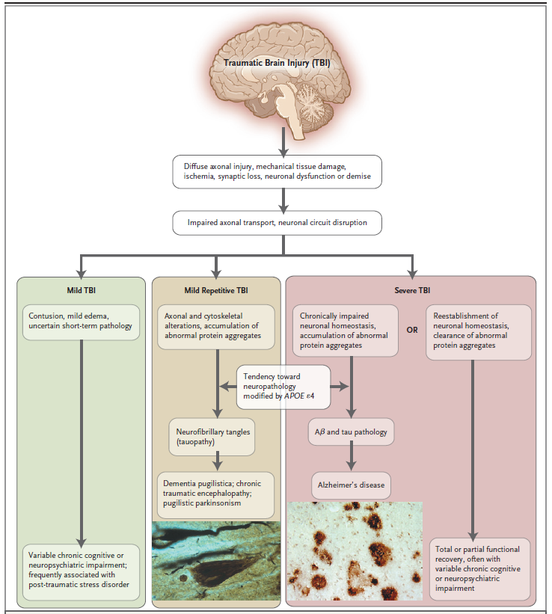
White Matter, TBI, and Degenerative Dementia
From DAI to Cognitive Loss and Dementia
DeKosky et al. 2010

Slide 43
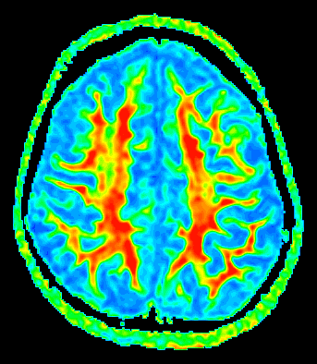
An Emerging Concept
Might it be possible to treat white matter and reverse its pathology?

Slide 44
Evolving Views of White Matter
White matter has traditionally been seen as a primarily supportive tissue, static and inert, with little potential for repair
However, evidence is accumulating that white matter is a dynamic tissue with its own capacity for growth and remodeling
In particular, myelin has attracted much scrutiny as a brain substance with substantial plasticity
The idea of treating white matter dysfunction is gaining increasing attention and support

Slide 45
Can Treatment Improve White Matter?
In MLD, MS, AIDS dementia complex, SLE, toluene leukoencephalopathy, B₁₂ deficiency, TBI, neoplasia, hydrocephalus, and leukoaraiosis, treatment targeting white matter has shown clinical benefit (Filley, 2021)
These examples all involved patients whose treatment was initiated early, or who had less severe damage, implying that irreversible changes had not occurred
What do we know about early vs. late neuropathology?

Slide 46
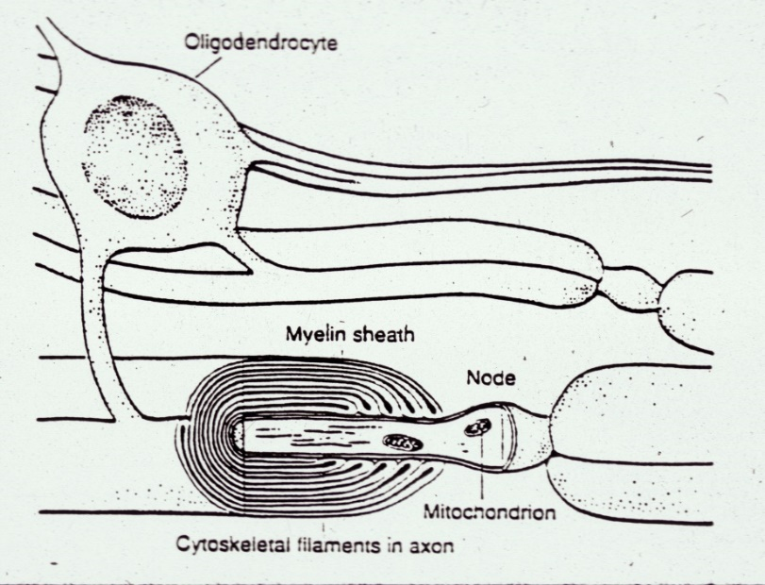
Axonal Loss Worsens Prognosis in White Matter Disorders
Trapp et al. (1998) established that transected axons were the pathologic correlate of irreversible neurologic impairment in MS
Medana and Esiri (2005) extended this concept to ischemia, HIV and other infections, leukodystrophies, CPM, and TBI
Axonal loss typically occurs later in the disease, or with more severe damage

Slide 47
A Focus on Myelin
Recovery of CNS axons is presently not a viable option, as spontaneous axonal regrowth after transection is minimal (Filous and Schwab, 2019)
Evidence suggests that restoration of myelin is more feasible, and has greater potential for clinical benefit
Two clinically-relevant processes are promising for restoring myelin:
1) reperfusion of white matter tracts
2) exploiting plasticity by stimulating oligodendroctyes

Slide 48
A Quick Look at Remyelination in Multiple Sclerosis
This idea has long been studied
Despite much work, no clinical trial of remyelinative therapy has been positive in MS (Lubetski et al. 2020)
Obstacles to success include axonal loss, damage to oligodendrocytes, and ongoing neuroinflammation (Lubetski et al. 2020)
Still, some 50 drugs have been identified as potential candidates for remyelination in MS (Lubetski et al. 2020)

Slide 49
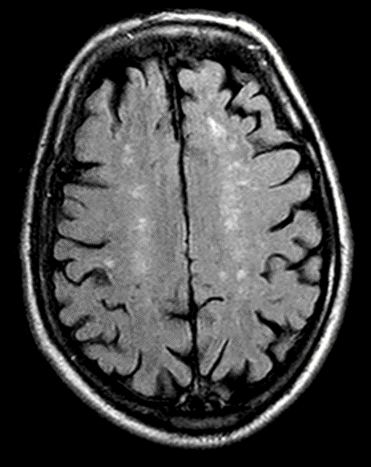
Restoring Ischemic White Matter
An obvious goal is to reverse leukoaraiosis (LA) . . .
In LA, attention to vascular risk factors is a plausible strategy to reduce white matter lesion burden

Slide 50
Regression of Leukoaraiosis Occurs In A Substantial Percentage of People
A large meta-analysis concluded that about 1/3 of people 18-80, including healthy and diseased, have WMH regression over a period of about two years (Jochems et al. 2022)
No factors were found to explain this phenomenon, but because “ . . . WMH progression is the main focus of most articles and regression is regarded as an accidental finding or even an error . . . ”, the etiology of regression has not been thoroughly studied

Slide 51
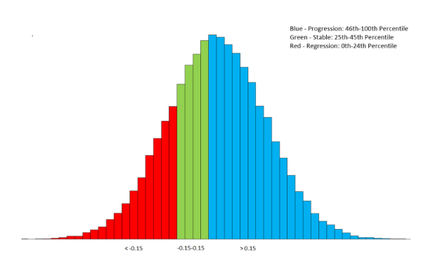
Leukoaraiosis Regression Can Be Associated With Better Cognition
Al-Janabi et al. (2019) followed 351 non-demented ADNI participants over 2 years and found LA regression in ~25% that was associated with better memory and less brain atrophy; resolution of reversible ischemic changes was thought most likely
Al-Janabi et al. 2019

Slide 52
Treating Hypertension Has A Protective Effect on Leukoaraiosis
A recent systematic review and meta-analysis concluded that, in people 70 years or older, antihypertensive medication reduced the progression of WMH over a period of 28-47 months (van Middelaar et al. 2018)
This effect was driven by lowering of systolic blood pressure and not by the specific class of antihypertensive medication

Slide 53
What These Data Imply
LA, presumably of vascular origin in most cases, typically spares axons, and can be considered “incomplete infarction” from arteriolar narrowing (Pantoni and Garcia, 1997) that leads to reversible perivascular edema and ischemic demyelination
Up to 33% of LA patients can show regression over months to years
Blood pressure control may reduce LA volume through reperfusion of white matter
Cognitive improvement may be observed
Dementia risk may also be reduced

Slide 54
What About Other Insults to White Matter?
Hypertension
Diabetes
Obesity
Smoking
Hyperlipidemia
Metabolic syndrome
Unhealthy diet
Physical inactivity
Sleep disturbance
Traumatic brain injury
Depression
Cognitive inactivity
Toxic insults
Critical illness
Delirium
Low education
Low SES
Stress
Treating hypertension as a means of reducing white matter pathology has some support
Many other acquired factors also impact the white matter and can impair cognition
Medical intervention or prevention to target damaged white matter may be helpful in a wide range of settings

Slide 55
Plasticity
In gray matter, mechanisms include 1) synaptogenesis, 2) dendritic branching, 3) axon sprouting, 4) neurogenesis, and 5) angiogenesis
In white matter, a major focus has been on activity-dependent myelination
Human studies are investigating plasticity of white matter microstructure, as early changes in NAWM are presumed most amenable to intervention
The capacity of the brain
to change with experience

Slide 56
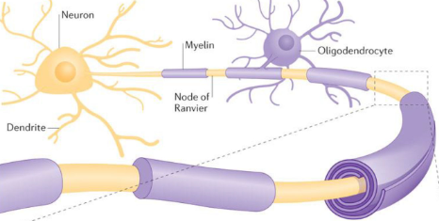
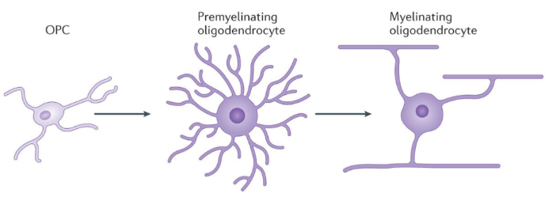
Oligodendrocytes
Glial cells of the central nervous system (CNS) responsible for the myelination of axons
Arising from the oligodendrocyte precursor cell (OPC), a single oligodendrocyte can myelinate up to 50 axons
These cells participate in white matter plasticity
Fields, 2015

Slide 57

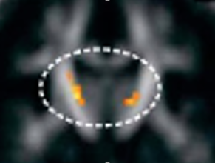
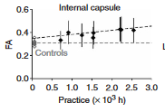
White Matter Plasticity: A Seminal Study in Humans
Piano players have increased corticospinal tract and corpus callosum integrity proportional to the number of hours spent in practice (Bengtsson et al. 2005)

Slide 58
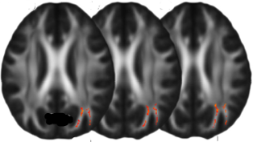
White Matter Plasticity: An Interventional Study
Healthy adults who had six weeks of training in how to juggle developed increased FA in the right parietal white matter (Scholz et al. 2009)

Slide 59
White Matter Plasticity: More Evidence from Humans
Education is associated with bilateral medial temporal and association tract integrity in older people (Teipel et al. 2009)
Learning a second language increased FA in language-related tracts of the left and right hemispheres, and the genu of the corpus callosum (Schlegel et al. 2012)
Visuomotor skill learning increased myelination in white matter contralateral to the trained limb (Lakhani et al. 2016)
6 months of dance instruction increased FA in the fornix of healthy older adults (Burzynska et al. 2017)
Children with 6-7 hours of weekly violin or viola training for two years had greater corpus callosum volume compared to children in sports or in no structured program (Habibi et al. 2018)

Slide 60
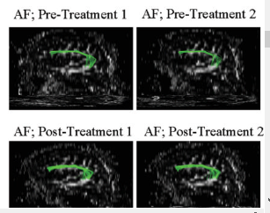
White Matter Plasticity After Stroke
In patients with Broca’s aphasia after stroke, Melodic Intonation Therapy increased the size of the right arcuate fasciculus – both in number of fibers and the volume of the tract – while improving language (Schlaug et al. 2009)
Right Arcuate Fasciculus

Slide 61

What’s Going on Here?

Slide 62
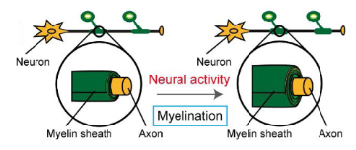
Neural Activity Stimulates Myelination
Kato and Wake, 2021

Slide 63
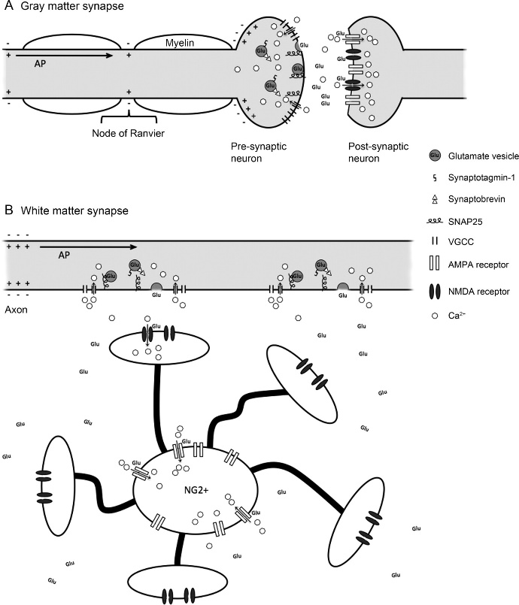
Activity-Dependent Myelination
White matter has synapses
Action potentials stimulate glutamatergic transmission at axo-oligodendroglial synapses, which is followed by increased myelin synthesis along the distal axon (Wake et al. 2011)
Alix and de Jesus Domingues, 2011

Slide 64
Reperfusion and Plasticity: The Big Picture
A case has been made for the potential of non-invasive clinical interventions to heal white matter
Lesions may be macroscopic, as in LA, or microstructural, in the NAWM
Pathology in the NAWM is crucial to recognize because the disorder is most amenable to treatment at this stage
The example of LA, which is preceded by microstructural damage, suggests that intervention can be effective both before and after MRI is abnormal
Plasticity in white matter has been shown in both healthy people and patients, and may be widely applicable

Slide 65
A Reasonable Clinical Approach
White matter disorders are common in clinical practice and often affect neurobehavioral function
Standard treatment of an identified white matter disorder is indicated when the diagnosis is secure
The highly prevalent condition LA can be treated with attention to vascular risk factors as appropriate – hypertension is most important – and regression of WMH may occur in some cases, with the possibility of cognitive improvement
In any case where white matter is a component of the clinical picture, the idea of plasticity can inform thinking about how to offer advice and counsel

Slide 66
Broader Implications
Dementia remains a staggering medical and societal problem that is irreversible in most cases
Given the limited efficacy of treatment based on eradication of cortical proteins, a leukocentric approach to cognitive decline and dementia merits focused attention (Bartzokis, 2011; Brickman, 2013; Filley and Fields, 2016)
Connectivity dysfunction may be critical in the pathogenesis of many dementia syndromes

Slide 67

Disconnectivity Increases Dementia Risk
In the Rotterdam study, 4,415 non-demented people (mean age 64) were followed for 7 years after brain DTI; the risk of developing all-cause dementia, and of Alzheimer’s Disease, was increased in those with lower FA and higher MD in multiple tracts (Cremers et al. 2020)
Vascular and/or inflammatory mechanisms were postulated
Cremers et al. 2020

Slide 68
Protection of White Matter in the Prevention of Dementia
Even in the absence of a specific white matter disorder, patients – and all of us – may benefit from long-term protection of white matter
Much evidence suggests that early white matter involvement – often years before overt clinical manifestations – may be important for later cognitive dysfunction and the development of dementia

Slide 69


The Corticocentric View of Behavior Needs Revision
Cognitive loss does not always mean GM disease; the WM half of the brain cannot be neglected
Lesion method research supports a role for WM distinct from the operations of GM
The relative impact of GM and WM lesions needs more study; many patients have both kinds of lesions
Connectivity is central in modern neuroscience; we now speak of the connectome, disconnection, and even the connectotype of each individual

Slide 71
White Matter May Be More Important Than Gray Matter for Cognition
Recent studies of stroke (Corbetta et al. 2015, Griffis et al. 2019, Reber et al. 2021) have found that cognitive loss is more strongly related to tract damage than to cortical lesions
Theibaut de Schotten and Forkel (The emergent properties of the connected brain. Science 2023): “The prediction of long-term symptoms is now preferentially based on brain disconnections. This paradigm shift will reshape our brain maps and challenge current brain models.”

Slide 72
Conclusions
WMD has proven a useful model for studying the neuroanatomic basis of cognition and dementia
The central role of white matter and connectivity in cognition and emotion is increasingly evident
WMD informs thinking about dementias such as VaD, AD, and CTE, helping justify medical and public health measures targeting multiple risk factors
Treatment of white matter and its disorders via reperfusion and plasticity may prove transformative
White matter matters for behavioral neurology as its importance equals, and at times surpasses, that of gray matter; a paradigm shift may be underway

