Slide 1

Trajectories of occupational cognitive demands and risk of mild cognitive impairment and dementia in later life:
-The HUNT4 70+ Study
Results from the REFAWOR project (Cognitive Reserve Work and Family)
Trine Holt Edwin M.D, PhD
Postdoctoral fellow, Geriatric Dep. Oslo University Hospital
Under review. Funded by the NIH. No conflict of interest
Notes:
Hi, my name is Trine Holt Edwin and I’m a postdoctoral fellow at Oslo University hospital. I will present to you the paper Trajectories of occupational cognitive demands and risk of mild cognitive impairment and dementia in later life. This is part of the REFAWOR project which is a collaboration between Norwegian researches and American researchers at UPENN and Colombia. The Refawor project focus on cognitive reserve work and family. This paper is currently under review and I have no conflict of interest

Slide 2

Background
Cognitive reserve theory
Cognitively-stimulating activities may delay the onset of MCI and dementia
We hypothesize that those employed in occupations with higher cognitive demands have a lower risk of MCI and dementia
Stern et al., 2023
Notes:
The cognitive reserve hypothesis posits that cognitive abilities acquired through education and other cognitively-stimulating activities throughout the lifespan can delay the onset of MCI and dementia. We therefore hypothesize that those employed in occupations with higher cognitive demands would have a lower risk of MCI and dementia

Slide 3

Method
HUNT
Large, ongoing population-based health survey in Norway
All adults living in the area of Nord-Trøndelag were invited to participate
HUNT1 (1984–1986), HUNT2 (1995–1997), HUNT3 (2006–2008), and HUNT4 (2017-2019)
Participants in the HUNT4 70+ were clinically assessed
Cognitively healthy
MCI
Dementia
Occupational histories from the ages 30-65 years from Norwegian administrative registries
Trajectories of occupational cognitive demands
Notes:
In the present study we used data from HUNT which is a large, ongoing population-based health survey in Norway. HUNT has four waves dating back to the 1980s and all adults living in the area of Nord-Trøndelag were invited to participate. In the fourth wave participants over the age of 70 years also underwent a cognitive assessment. They were thereafter classified as cognitively healthy, MCI or dementia.
To assess the participants occupational cognitive demands, we retrieved information from national registries about their held occupations at the ages of 30-65 years
Further we constructed Trajectories of occupational cognitive demands based on these occupational data

Slide 4
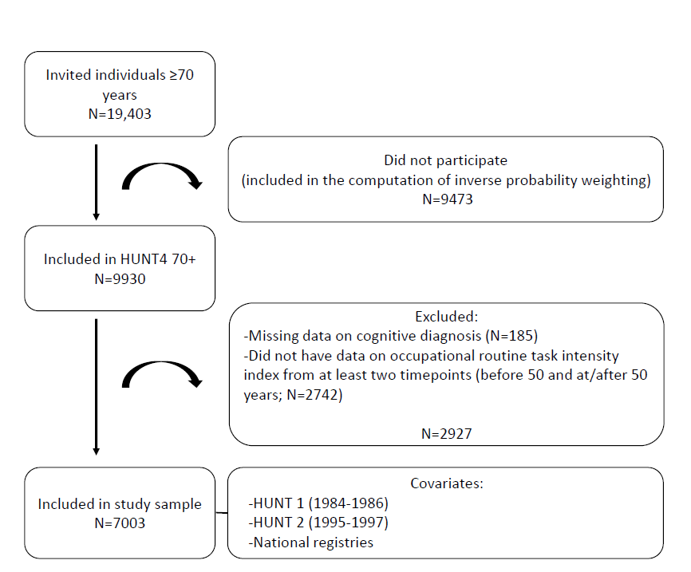
Flow chart of the study population
-The HUNT Study, Norway
70+ sub-study of the fourth wave of the Trøndelag Health Study (HUNT4 70+, 2017-2019)
Occupational cognitive demands retrieved between the ages of 33 and 65
305 unique occupations
Notes:
Here is the flow chart of the study population. 7003 participants were included, all of which were cognitively assessed after the age of 70 and all had a registered occupation at least once before the age of 50 and at least once after.
This gave us over 300 unique occupations

Slide 5
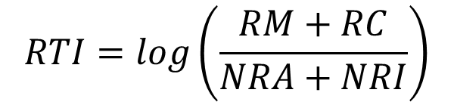
Routine task intensity (RTI) index
Indicator of the extent of work-related cognitive demands
Selected job characteristics attained from O*NET
Routine Manual
Routine Cognitive
Non-Routine Analytical
Non-Routine Interpersonal
Capture both routine and non-routine cognition
Focusing on executive functions like problem-solving and creativity
Lower RTI indicates more cognitively demanding occupation
The index was standardized to make it easier to understand and compare
$$RTI=log\left(\frac{RM+RC}{NRA+NRI}\right)$$
Notes:
As an indicator of the extent of work-related cognitive demands we computed the Routine task intensity index based on Selected job characteristics attained from O*NET. The RTI capture both routine and non-routine cognition, focusing on executive functions like problem-solving and creativity

Slide 6
Group-based trajectory modeling
Model fit (BIC), closer to zero =better fit
Posterior probability of group membership > 0.7
Odds of correct classification (OCC) > 5
High RTI
E.g. helpers, cleaners, vehicle mechanics
Intermediate-high RTI
E.g. Store clerks, retail
Intermediate-low RTI
E.g. crop and animal producers, child care
Cognitively stimulating
Low RTI
E.g. teachers
Nagin & Odgers, 2010
Notes:
To construct the trajectories of occupational cognitive demands we applied the Group-based trajectory modeling and found that these four groups’ best represented our data.
Lower RTI indicates more cognitively demanding occupation. As you see here, in the low RTI group there were mainly teachers. While in the High RTI group there were mainly cleaners and vehicle mechanics

Slide 7
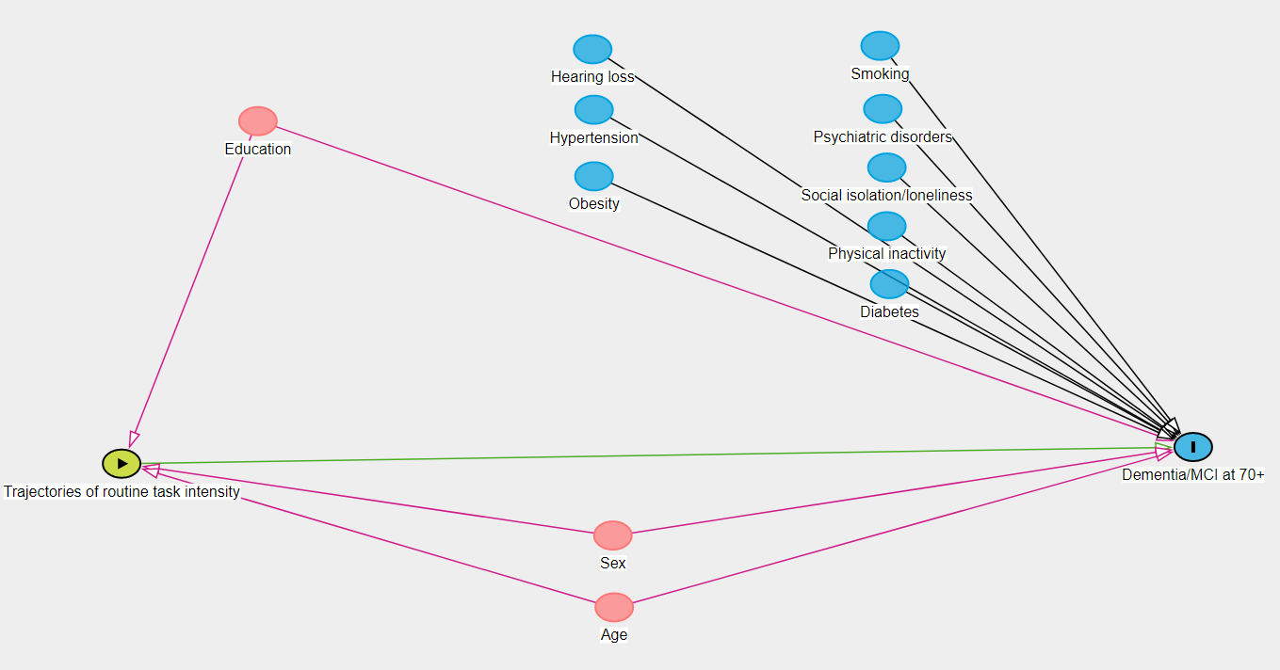
DAG
Early life (<45 years)
Midlife (age 45-65 years)
Later life (>65 years)
Income
HUNT1 (1984-1986): participants age 35-70
HUNT2 (1995-1997) participants age 46-81
HUNT4 70+, 2017-2019
Participants age in 2018 69-104 years
Livingston et al., 2020
Notes:
The health and lifestyle variables were collected from previous HUNT surveys and we included variables that were available according to the Lancet commission on risk factors for dementia

Slide 8
Table 1. Study sample characteristics (N=7003) grouped by trajectories of occupational routine task intensity (RTI). Data are not imputed
 | Low RTI (N=1431) | Intermediate-low RTI (N=1578) | Intermediate-high RTI (N=2601) | High RTI (N=1393)
National administrative registry variables
Age in 2018, mean (SD) | 77.6 (6.5) | 77.1 (6.0) | 77.3 (5.9) | 77.2 (6.1)
Sex (women), N (%) | 606 (42.4) | 968 (61.3) | 1,533 (58.9) | 381 (27.4)
Education, N (%)
Primary | 81 (5.7) | 211 (13.4) | 653 (25.1) | 485 (34.8)
Secondary | 298 (20.8) | 803 (50.9) | 1,777 (68.3) | 900 (64.6)
Tertiary | 1,052 (73.5) | 564 (35.7) | 171 (6.6) | 8 (0.6)
Married, N (%) | 1,279 (89.4) | 1,394 (88.3) | 2,259 (86.9) | 1,201 (86.2)
Retirement age, mean (SD) | 66.0 (3.4) | 65.7 (4.1) | 65.2 (4.4) | 64.5 (4.1)
Income at ages 45-55, EUR, mean (SD) | 61,243 (23,718) | 51,700 (28,269) | 44,440 (22,300) | 49,878 (18,082)
HUNT 1 and/or HUNT2 health and lifestyle variables
Hypertension, N (%) | 652 (45.6) | 706 (44.7) | 1,240 (47.7) | 761 (54.6)
Obesity, N (%) | 157 (11.0) | 237 (15.0) | 364 (14.0) | 213 (15.3)
Diabetes, N (%) | 24 (1.7) | 36 (2.3) | 44 (1.7) | 24 (1.7)
Psychiatric disorder, N (%) | 32 (2.2) | 29 (1.8) | 60 (2.3) | 35 (2.5)
Loneliness, N (%) | 66 (4.6) | 72 (4.6) | 127 (4.9) | 68 (4.9)
Hearing impairment, N (%) | 75 (5.2) | 71 (4.5) | 121 (4.7) | 135 (9.7)
Smoking, N (%) | 249 (17.4) | 368 (23.3) | 795 (30.6) | 444 (31.9)
Insufficient leisure-time PA, N (%) | 448 (31.3) | 624 (39.5) | 1,077 (41.4) | 579 (41.6)
HUNT 4 70+ Clinical diagnosis
MCI, n (%) | 385 (26.9) | 497 (31.5) | 941 (36.2) | 583 (41.9)
Dementia, N (%) | 158 (11.0) | 196 (12.4) | 345 (13.3) | 203 (14.6)
Notes:
This is a busy slide, I know. Briefly it shows the study sample characteristics according to the four trajectory groups. As you see the groups differed on sex, level of education, income and on some of the health and life-style variables, as well as on cognitive diagnosis

Slide 9
Association of trajectories of occupational RTI and risk of MCI and dementia
Multinominal logistic regression to estimate the relative risk ratios (RRRs) for MCI and dementia by the four trajectories
With 95% confidence intervals (CI)
“no cognitive diagnosis” is the base outcome
Multiple imputation (MI) with 20 iterations and inverse probability weighting (IPW) applied
Model 1: Adjusted for age and sex
Model 2: Adjusted for age and sex + education
Model 3 (sensitivity model): Adjusted for age, sex and education + income, hypertension, obesity, diabetes, psychiatric impairment, hearing loss, feeling of loneliness, smoking status, and physical inactivity
Notes:
To assess the risk for MCI and dementia according to the trajectory groups we performed Multinominal logistic regression models with low RTI as the base. To account for missing not at random and non-participation in HUNT we used Multiple imputation and probability weighting
Model 3 with all the health and lifestyle variables were considered a sensitivity analysis since it included both confounders and mediators

Slide 10
Results
Rather stable levels of occupational cognitive demands throughout the working lives
Lower risk of MCI and dementia for those with more cognitively stimulating occupations
The results were attenuated by adjusting for education
Cognitively stimulating
Notes:
First of all we found that the participants had rather stable levels of occupational cognitive demands throughout the working lives
Moreover, we found that in the model adjusted by age, sex and education there were lower risk of both MCI and dementia for those with more cognitively stimulating occupations.
These results were attenuated by adjusting for education, but were still significant showing a 37% higher risk of dementia in the high RTI group compared to the low RTI group

Slide 11
Sensitivity analysis (controlling confounders and mediators)
The relationship between low occupational cognitive demands and MCI was attenuated
For dementia the relationship was no longer statistically significant, although RRR were of the same magnitude.
Model 3: Sensitivity analyses adjusting for age, sex, education, income, hypertension, obesity, diabetes, psychiatric impairment, hearing impairment, feeling of loneliness, smoking status, and physical inactivity
Notes:
In the sensitivity model, including all health and life style related factors (both confounders and mediatiors) we found that there was still a significant lower risk of MCI for those with more cognitively stimulating occupations
For dementia the relationship was no longer statistically significant, although point estimates were of the same magnitude

Slide 12

Discussion
Cognitively stimulating occupations may postpone or be protective of late life cognitive decline
Support the cognitive reserve hypothesis
Cognitive abilities acquired through both education and occupation appear to offer resilience
Notes:
Our results support the cognitive reserve hypothesis stating that Cognitively stimulating occupations may postpone later life cognitive decline. Moreover, our results shows that cognitive abilities acquired through both education and occupation appear to offer resilience

Slide 13

Questions or comments?

