Slide 1
PHYSIOLOGICAL COGNITIVE CHANGES IN AGING AND HOW TO PREVENT COGNITIVE DECLINE
Nicoletta Caputi, PhD

Slide 2

“Leaving No One Behind In An Ageing World”
Department of Economic and Social Affairs of the United Nations Secretariat, 2023

Slide 3
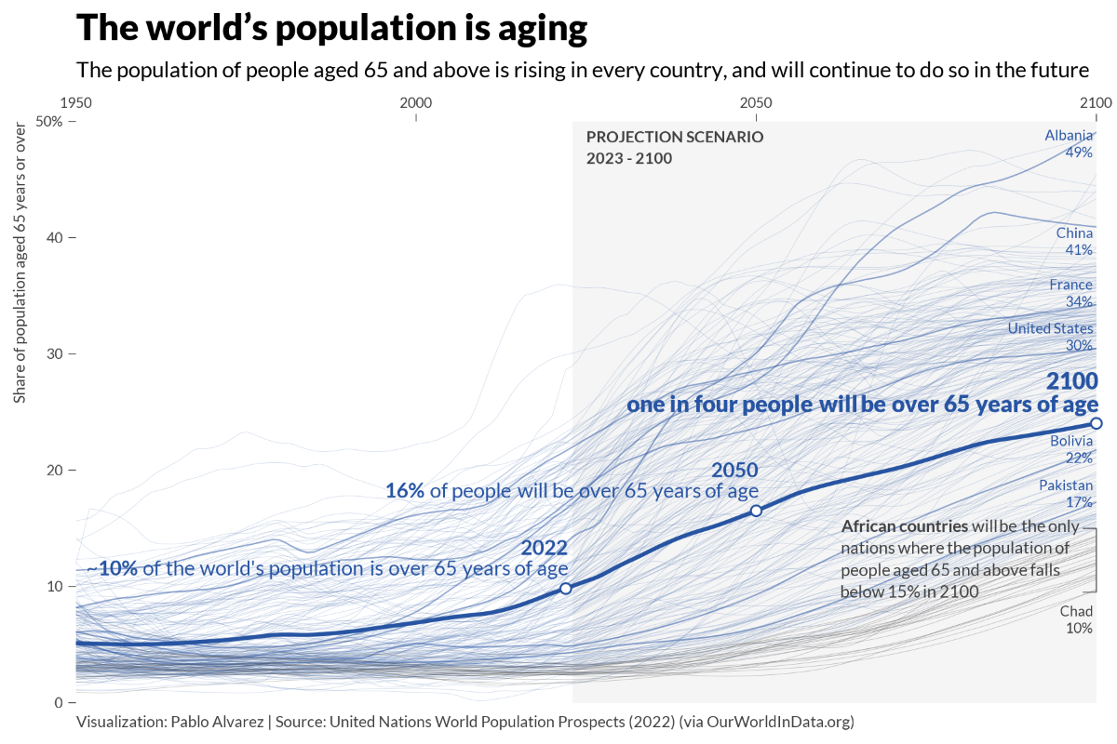

Slide 4

The Aging Brain

Slide 5
Age-related alterations
Small changes in dendritic branching and spine density (Burke and Barnes, 2006)
Region specific:
frontal circuits vs medial temporal lobe dysfunction
corpus callosum

Slide 6
Working memory
Young and older adults recruit different brain regions in order to perform the same task.
Differences in brain activation are most prominent in prefrontal and parietal regions.
The recruitment of brain regions in older adults is compensatory.

Slide 7
Executive functions
difficulties in selecting task-appropriate information and inhibiting task-irrelevant responses
increased executive demands compared to young adults
deactivation in the default mode network

Slide 8
Long-term memory
Increase of autobiographical and procedural memories, and vocabulary
Episodic memory and bilateral PFC activation
Hippocampal differences

Slide 9
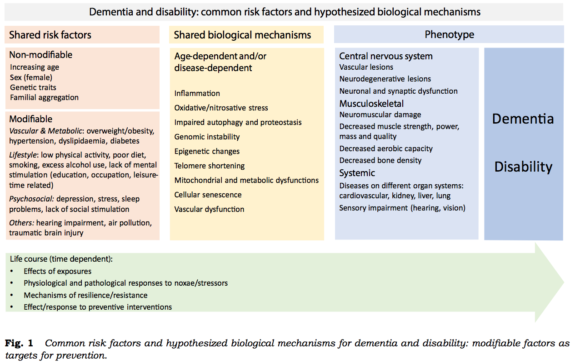
Risk factors
Lisko et al., 2021

Slide 10
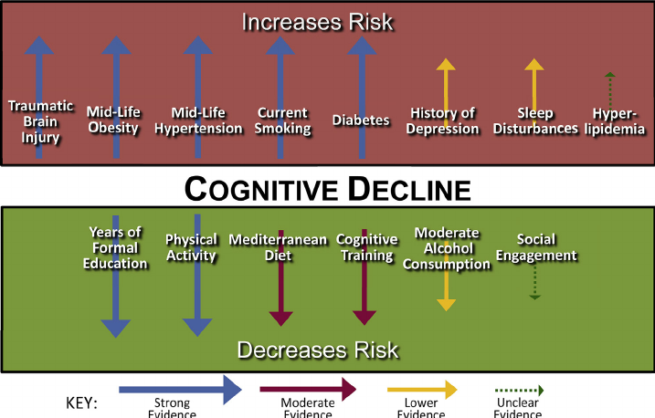

Slide 11

© World Health Organization 2019
Physical activity interventions
Nutritional interventions
Tobacco cessation interventions
Interventions for alcohol use disorders
Cognitive interventions
Social activity
Weight management
Management of hypertension
Management of diabetes
Management of dyslipidaemia
Management of depression
Management of hearing loss

Slide 12

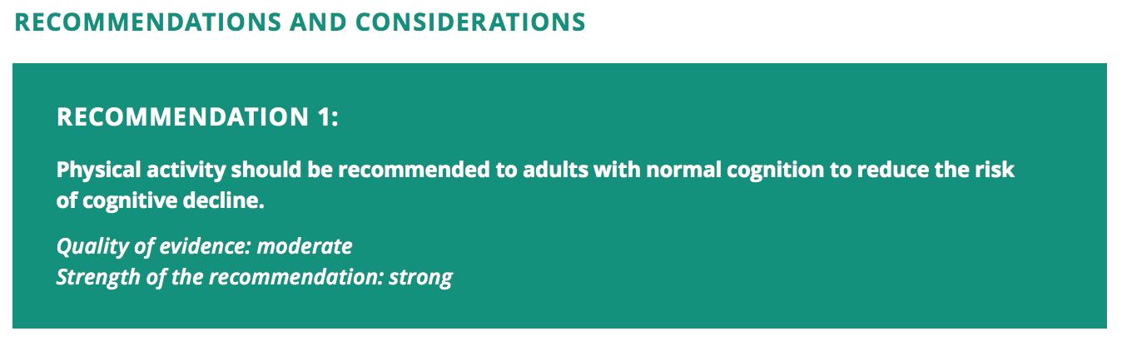
Physical activity interventions

Slide 13
Physical activity interventions
about 3% of all dementia cases could be prevented by increasing levels of physical activity (Liang et al. 2020)
older people who are more physically active can maintain cognition for a longer time than sedentary people (Livingstone, 2017)

Slide 14
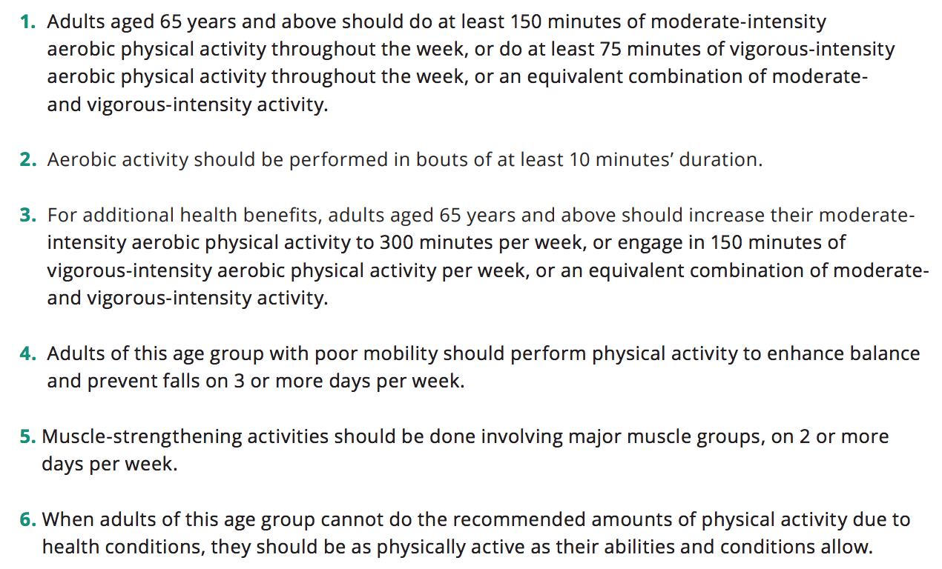
WHO’s Global recommendations on physical activity for health (2010)

Slide 15

Nutritional interventions

Slide 16
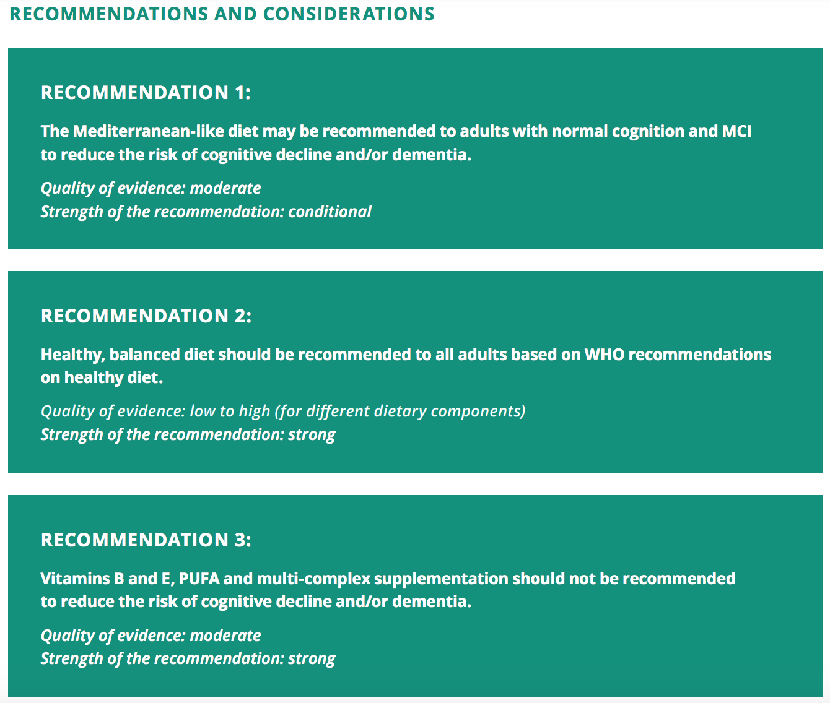

Slide 17
Mediterranean diet
high adherence associated with decreased risk of MCI and AD and with better episodic memory and global cognition (Loughrey et al., 2017), but modest adherence is not (Singh et al., 2014; Wu & Sun, 2017).
Foods and nutrients:
fruit and vegetables (Jiang et al., 2017; Wu et al., 2017) and fish (Bakre et al., 2018; Zhang et al., 2016) are most consistently associated with decreased risk of dementia.
Higher fish consumption has been linked to lower memory decline among healthy participants in many studies (Samieri et al., 2018)
nuts, olive oil and coffee (Solfrizzi et al., 2017).
folate, vitamin E, carotenes, vitamin C and vitamin D (Balion et al., 2012; Dangour et al., 2010; Rafnsson et al.,2013; Travica et al., 2017), but findings are inconsistent.

Slide 18
Dietary Approaches to Stop Hypertension (DASH)
has consistently shown significant lowering of various CV outcomes
Nurses’ Health Study: greater adherence to long-term DASH score associated with improvements in global cognition and verbal memory.

Slide 19
MedDiet-DASH Intervention for Neurodegenerative Delay (MIND Diet)
the MedDiet, DASH, and MIND diets reduce middle-age CV risk factors that are also risk factors for AD, including vascular disease, hypertension, stroke, diabetes, and obesity
the MIND diet combining elements of the MedDiet and DASH has been associated with reduced risk of cognitive impairment and incident AD (Morris et al., 2015)

Slide 20
Tobacco cessation interventions
Tobacco as major risk factor
Tobacco cessation has also been associated with reduced depression, anxiety and stress, and improved mood and quality of life compared with continuing to smoke (Taylor et al., 2014)

Slide 21
Interventions for alcohol use disorders
There is extensive evidence on excessive alcohol as a risk factor for dementia and cognitive decline (Langballe et al., 2015; Sachdeva et al., 2016; Zhou et al., 2014).
there are still contrasting results regarding the protective effects of low/moderate alcohol consumption on the risk of cognitive impairment and dementia.

Slide 22
Sleep
decreased sleep duration and quality, reduced sleep efficiency, increased sleep fragmentation, and diurnal sleepiness
aging-related poor sleep quality is associated with a worsening in cognitive functions, e.g., [Gadie et al., 2017], specifically associated with excessive diurnal sleepiness and attentional and executive impairments [Martella et al., 2014, 2011] as well as general cognitive impairment.

Slide 23

Dr. Yaakov Stern

Slide 24
Active Model – Cognitive Reserve
Lesion
Brain Reserve Capacity
Lesion
Functional
Impairment
Patient 1
Patient 2
Stern, 2002

Slide 25
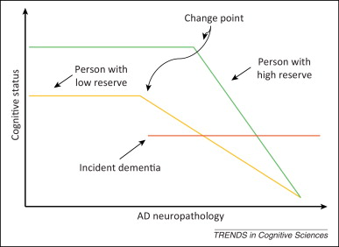

Slide 26
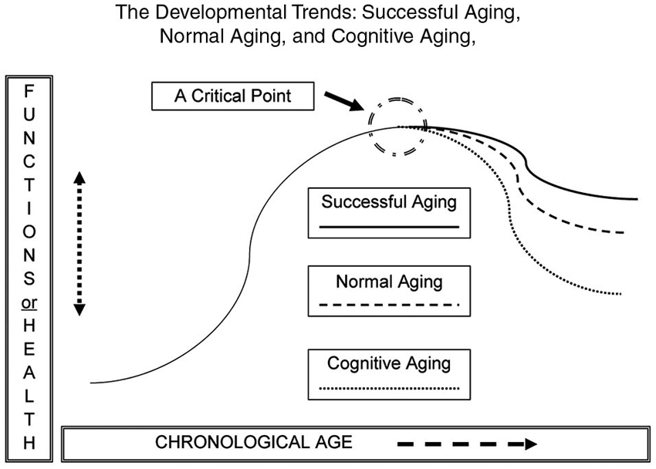

Slide 27
Social Engagement
association between poor social engagement and dementia risk = 55% increased risk
high cognitive reserve was related to a 47% reduced relative risk of MCI or dementia (Nelson et al, 2021)

Slide 28
Conclusions
The optimal preventive effect may be obtained by addressing several risk factors at the same time.
The existence of potentially modifiable risk factors means that prevention of dementia is possible through a public health approach, including the implementation of key interventions that delay or slow cognitive decline or dementia.

Slide 29
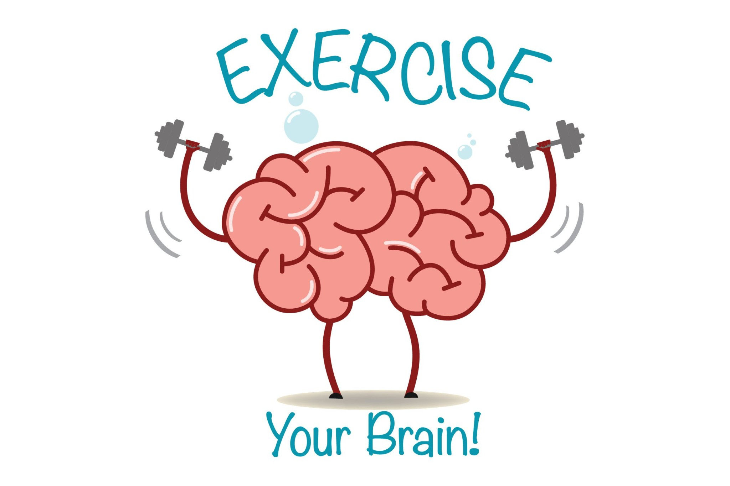
Thank you for your attention!

