Slide 1
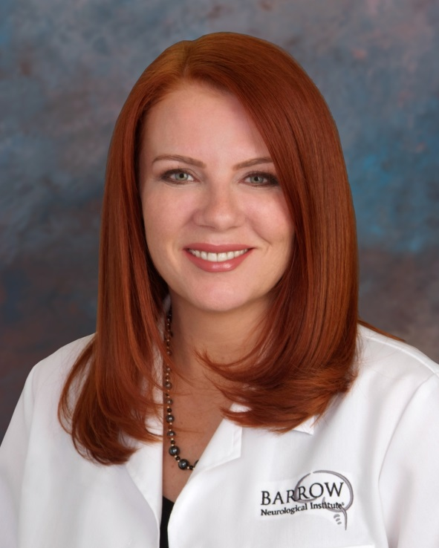
Addressing the Growing Alzheimer’s Crisis
Challenges and Opportunities
Anna D. Burke, MD
Karsten Solheim Chair for Dementia
Director
Alzheimer’s and Memory Disorders Division

Slide 2
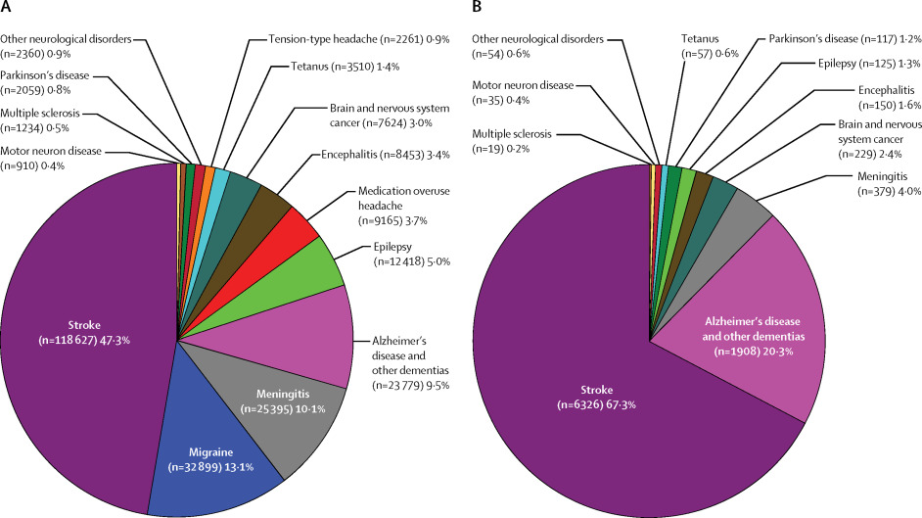
The Global Burden of Neurological Disease
Estimates are for (A) disability-adjusted life-years and (B) deaths
Lancet Neurol 2017;16:877-97
Notes:
Worldwide, 2 neurological diseases that most significantly affect disability and are most highly linked with mortality are stroke and AD.

Slide 3
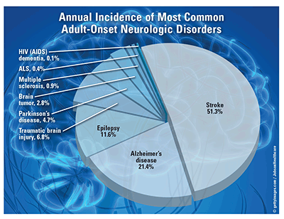
Annual Incidence of Most Common Adult-Onset Neurological Disorders (in the US)
US Pharm. 2018;43(1):24
Notes:
AD is the 2nd most common neurological disease in the US after stroke

Slide 4

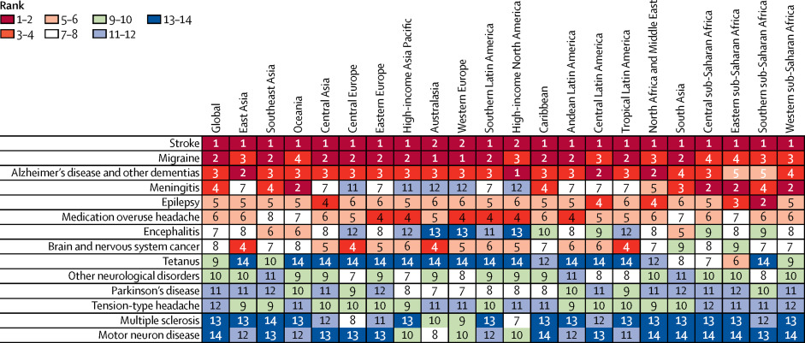
Disability Adjusted Life Years
Lancet Neurol 2017;16:877-97
Notes:
And adjusted for life years, AD is the most common cause of disability. It reduces the number of quality years we have impacting not just the length of our lives but more importantly the quality

Slide 5
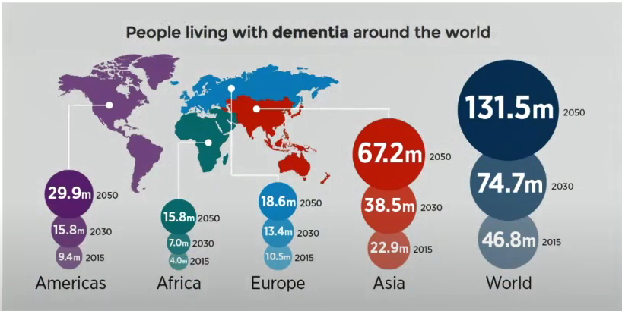
Notes:
Over age 85 population is the fastest growing population and the greatest at risk for dementia As you can see though the US and the americas are certainly affected, this is a global problem and Asia is in fact most significantly impacted.

Slide 6

In Recent Years, AD-related Mortality has Increased Dramatically
From 2000 to 2013, deaths attributed to Alzheimer's disease increased 71%, while those attributed to the number one cause of death—heart disease—decreased 14%

Slide 7
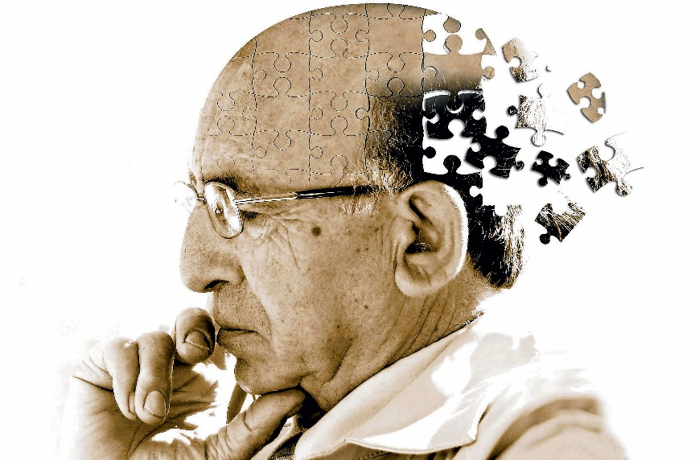
Alzheimer’s Crisis
Most common cause of dementia
About 6.5 million people affected now in US
By the year 2050, up to 14 million Americans are expected to have AD
Every 65 seconds someone in the United States develops Alzheimer’s
Alzheimer’s is the 4th leading cause of death in the United States
50% of caregivers will become ill or depressed

Slide 8
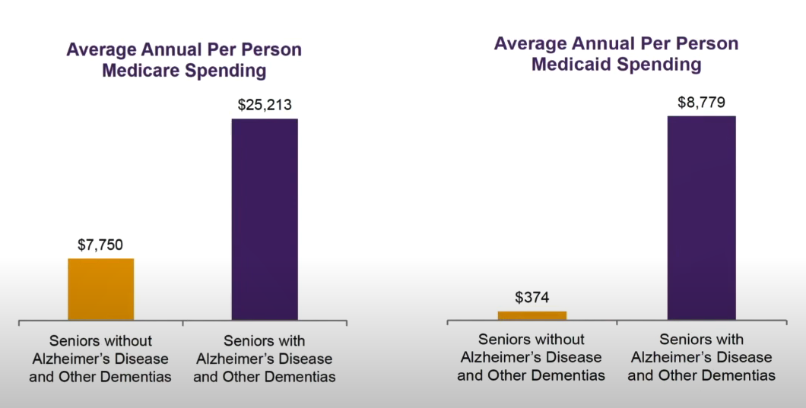
Annual Cost of Care
Alzheimer’s Association 2020

Slide 9
The US currently spends $236 billion per year on dementia care
Worldwide in 2018 $1 trillion was estimated to be spent on dementia
By 2030, it is estimated to cost $2 trillion worldwide
If dementia were an economy, it would be the 18th largest in the world
Care is fragmented and inefficient
Care for dementia patients also relies heavily on unpaid/ informal caregivers
Less informal caregivers will be available with time.
Notes:
Dementia as an economy is larger than google and apple combined;
The current value of unpaid care for dementia patients is estimated to be 9x the annual revenue of McDonalds

Slide 10
Population Health and Quality of Care in the Primary Care setting for Vulnerable Elders
ACOVE Quality Indicators of 38-44% indicate poor quality of care:
Cognitive evaluation if positive screen (25%)
Medication Review (9%)
Caregiver Supports (29%)
Assessment of Neuropsychiatric Sx (45%)
Poor referral to community Based Resources
Wenger et al. Ann Internal Med 2003
Notes:
The Assessing Care of Vulnerable Elderly (ACOVE) indicators reflect the most comprehensive examination ever conducted of the quality of medical care provided to elders
But we know that the majority of dementia care happens in the primary care setting

Slide 11

Unmet Needs of Caregivers
Depression/ Caregiver Burden
14% reported moderate to severe depression
36% reported high stress
Low Self-Efficacy
21% knew how to access services
36% felt confident handling dementia related problems
26% had a healthcare professional who helped them work through dementia issues
Jennings et al JAGS 2015
Notes:
Journ of the American Geriatric Society from UCLA study of dementia caregivers

Slide 12
US National Plan to Address Alzheimer’s Disease (NAPA)- 2013 US DHHS
Prevent and effectively treat AD by 2025
Enhance quality and efficiency
Expand the support for people with AD and their families
Enhance public awareness and engagement
Improve data to track progress

Slide 13
Barriers and Challenges
POPULATION
Stigma
Limited culturally diverse resources
Paucity of access to education
Variable access to consistent healthcare
Fear of loss of liberties
Healthcare is difficult to navigate
Healthcare System
Cognitive Specialist
Shortage
Caregiver shortage
Lack of standardized diagnostic & treatment algorithms
Lack of incentives for PCPs to screen & diagnose
Diagnostic nihilism
Healthcare System
(Administration)
Conflicting reimbursement structures
Applying standard chronic illness model to AD
Fragmentation of ambulatory care paths
Lack of case management supports & infrastructure
Public Policy
Conflicting reimbursement structures
Lack of investment in medicare/ medicaid
Lack of reimbursement for diagnostics
Lack of Incentive to build geriatric healthcare workforce

Slide 14
POPULATION
Stigma
Limited culturally diverse resources
Paucity of access to education
Variable access to consistent healthcare
Fear of loss of liberties
Healthcare is difficult to navigate
Normalizing cognitive aging
Educational campaigns/ Patient stories
Increasing dementia literacy
Decoupling dementia and mental illness
Increasing diversity in geriatric healthcare workforce
Moving to a proactive rather than reactive care model
Improve patient and caregiver experience
Notes:
Health literacy_ degree to which an individual has the capacity to obtain, process, and understand basic health information and services needed

Slide 15
Dementia Capable Healthcare Systems
A healthcare system that provides individualized, coordinated, and integrated medical and psychosocial care for patients AND care partners delivered by a team of clinicians, staff, and healthcare administrators (Borson, Chodosh 2014)
*Dementia CAPABLE systems should ideally also aim to be dementia FRIENDLY

Slide 16
A 2023 Alz Assoc report found:
  PCPs shared that they hesitate to initiate conversations about cognitive decline and will wait until family members bring it to their attention.
  PCPs expressed concern about how people will be cared for if an assessment uncovers Alzheimer's disease or other dementia in light of specialist shortages and few referral options.
  Importantly, PCPs view family members as influential and critical partners in care, often relying on them to initiate conversations about memory and thinking problems they observe in their loved ones, making the role of caregivers ever more significant.
  Emergency medicine specialists see the most patients age 60 or older, as compared to geriatricians, neurologists and neuropsychologists, yet specialists said their neurology and geriatrician colleagues could most effectively diagnose Alzheimer's disease (79% and 68%, respectively).
Healthcare System
Cognitive Specialist
Shortage
Caregiver shortage
Lack of standardized diagnostic & treatment algorithms
Lack of incentives for PCPs to screen & diagnose
Diagnostic nihilism
Notes:
Clinical workflows need to transform, or patients will continue to be diagnosed at advanced stages of AD when there is little benefit from current Alzheimer's treatments. Many support programs and clinical trial opportunities will have passed, and families will have lost precious time for planning, including what matters most to the patient. Health systems will also be unprepared for the arrival of advances in diagnostics and therapeutics for AD.

Slide 17
Dementia in Primary Care
Typical PCP panel includes ~1300-2000 patients
  13% are 65 y/o or older (260 patients)
    10% have ADRD (26 patients)
      50% are diagnosed (13 patients)
In 2020 the USPSTF concluded that the current evidence is insufficient to assess the balance of benefits and harms of screening for cognitive impairment in older adults
Over 50% of patients with confirmed dementia reported no history of clinical cognitive evaluation by their PCP (Kotagal et al 2015)
Borson S, Chodosh J 2014
Notes:
Even though dementia is not uncommon in the general population, PCPs do not have comfort in diagnosing/ managing or incentive to do more
U.S. Preventive Services Task Force (USPSTF)

Slide 18
90% of dementia care will be delivered in the primary care setting.
PCP face time with patients averages 7-15 minutes
Clinical workflows need to transform to improve early diagnosis and management
Looking at alternative models (AI, technology) and creation of standardized diagnostic/ treatment models/ BBBM to improve PCP comfort, diagnosis, and management.
Financial incentives for physicians to enter the geriatric field (ex. loan forgiveness, increased reimbursement for management of patients with AD/ADRD)
Increasing/ funding case management supports to reduce care fragmentation
Healthcare System
Cognitive Specialist
Shortage
Caregiver shortage
Lack of standardized diagnostic & treatment algorithms
Lack of incentives for PCPs to screen & diagnose
Diagnostic nihilism
Notes:
Clinical workflows need to transform, or patients will continue to be diagnosed at advanced stages of AD when there is little benefit from current Alzheimer's treatments. Many support programs and clinical trial opportunities will have passed, and families will have lost precious time for planning, including what matters most to the patient. Health systems will also be unprepared for the arrival of advances in diagnostics and therapeutics for AD.

Slide 19
Misalignment of incentives for physicians, hospitals, and healthcare systems
ACO vs standard fee for service model have different incentives/ disincentives
Classic chronic illness model (ex. diabetes) is insufficient for dementia
Care model would better reflect SMI model of multidisciplinary, wrap-around, community based approach
Increase case management supports and reimbursement
Reduce bureaucratic burden linked to care delivery
Standardize case manager education
Healthcare System
(Administration)
Conflicting reimbursement structures
Applying standard chronic illness model to AD
Fragmentation of ambulatory care paths
Lack of case management supports & infrastructure

Slide 20
Persons with undiagnosed dementia are twice is likely to be admitted to the hospital than those without known dementia (Maslow, 2006).
20% of hospital admissions in individuals with dementia are preventable (Public Health England 2015).
40% of patients over the age of 70 admitted to the hospital have dementia (Sampson 2009)
63% of Medicare cost for ADRD are for inpatient hospitalizations (Mukadam 2011)
Top 10% of Medicare beneficiaries with ADRD account for 50% of total health expenditures and ⅓ of drug expenditures (Lin 2009)
Dementia increases the length of stay by 6-30 days (Erkinjuntti 1986; Wancata 2003)
Dementia is associated with increased readmission rates, mortality, and increased risk of institutionalization (Fogg 2018; Mollers 2019; King 2006)
Detection rates for dementia in the hospital setting are low (37-46%) (Harwood 1997; Joray 2004)
Why Care?
Healthcare System
(Administration)
Conflicting reimbursement structures
Applying standard chronic illness model to AD
Fragmentation of ambulatory care paths
Lack of case management supports & infrastructure
Notes:
Preventable hosp (falls, dehydration, med management)
Require more nursing time as they often develop NPS and delirium

Slide 21
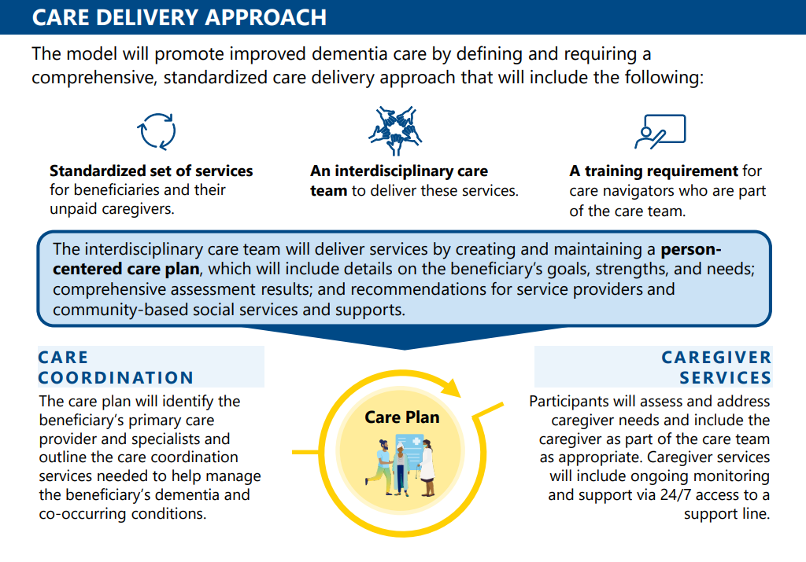
Guiding an Improved Dementia Experience (GUIDE) Model

Slide 22
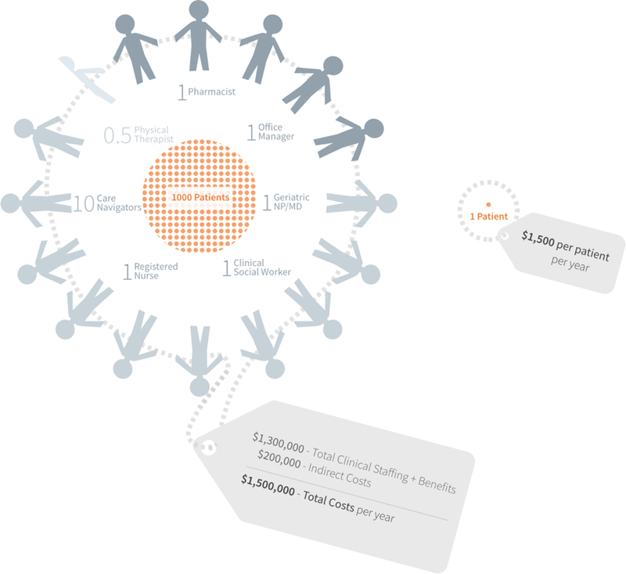
Dementia Independent Care Unit for Tailored Chronic Care Management
Estimated implementation costs of $270 million in year 1 were calculated assuming an individual patient panel size of 1000 patients
Estimated total operating costs of $6.5 billion for year 2 were calculated as the annual cost of dementia team care ($1540 PMPY) multiplied by the estimated point prevalence of individuals with AD
If nationally implemented, estimate high net annual savings would to be $6.8 billion for the estimated 4 million persons in the US with moderate to severe dementia in year 2.
Net annual savings of approximately $10 million were estimated with more limited reduction in costs for inpatient utilization (7.5%), medical providers (4%), skilled nursing facilities (7.5%), and prescriptions (5%).
Bott et al Am J Ger Psych 2019
Notes:
The Stanford Clinical Excellence Center
Similar cost saving have been found by UCSF and UCLA

Slide 23
Similarly, a utilization and cost outcomes comparison for 1082 fee-for-service (FFS) Medicare patients enrolled in the UCLA ADC program between July 1, 2012 and December 31, 2015 with 2166 similar dementia patients not participating in the ADC program revealed that at 3 ½ years, participants in UCLA’s program had lower total Medicare costs of care ($2404 per year) relative to a comparison group of persons with dementia receiving usual care (Jennings et al 2018).
UCLA ADC program participants were 40 percent less likely to be admitted to a nursing home for long-term care(Jennings et al 2018).
UCSF compared the Medicare costs of 780 patients with dementia. The patients were randomized 2:1 to receive Care Ecosystem telemedicine support – which included medical and practical assistance – or their usual care for a 12-month period. The average per patient monthly Medicare cost for those in the Care Ecosystem was $526 lower than for those receiving usual care

Slide 24
Public Policy
Conflicting reimbursement structures
Lack of investment in medicare/ medicaid
Lack of reimbursement for diagnostics
Lack of Incentive to build geriatric healthcare workforce
Redefining the standard cognitive care model
Improve reimbursement for cognitive care visits
Approve coverage for early detection technology (amyloid PET, biomarker, etc.)
Financial incentives for physicians to enter the geriatric field (ex. loan forgiveness, increased reimbursement for management of patients with AD/ADRD)
Increasing/ funding case management supports
Fund community care supports (Adult Day programs, in home care, respite, etc.)

Slide 25
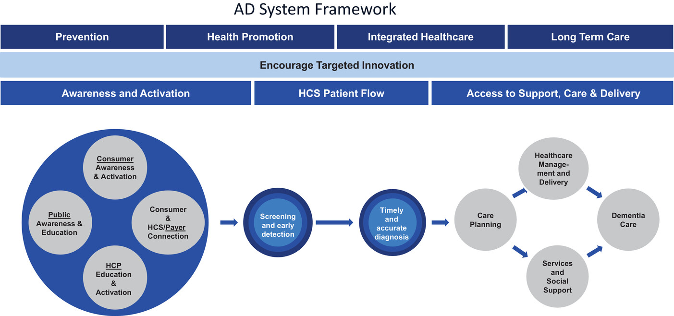
Ball et al. Alz and Dem 2022
Notes:
DAC; Prevention, Health Promotion, Integrated Healthcare and Long-Term Care
Development of Dementia Capable Systems

Slide 26


