Slide 1
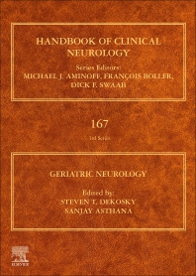

Slide 2
Maurice Chevalier: Getting old is not so bad if you consider the alternative
Yes, provided you remain in good shape

Slide 3
Earth and Wind: Air Pollution & Cognitive Changes
Dr. François Boller
Dr. Yamane Makke
Dr. Melinda C Power
George Washington University

Slide 4


Slide 5
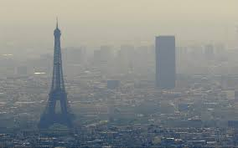

Slide 6


Slide 7
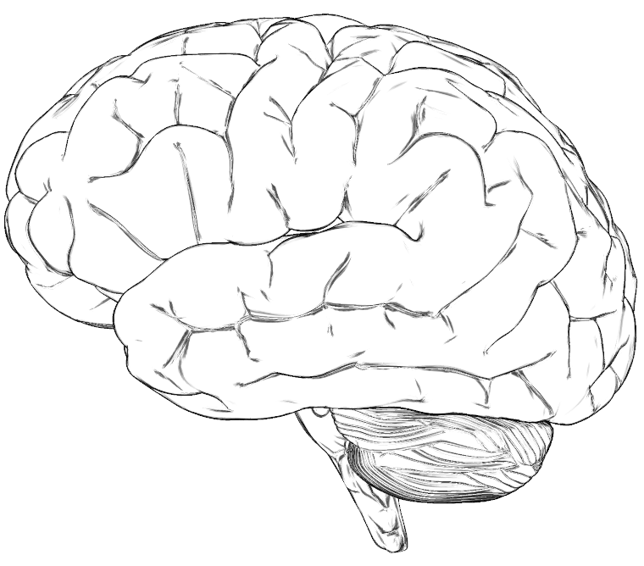
Air Pollutants and Brain Health Potential Mechanisms
Air pollution
Neuroinflammation, Oxidative Stress
Neurotransmitter Levels
Protein Aggregation
Systemic Inflammation
Subclinical cerebrovascular disease
Blood brain barrier disruption
CNS Dysfunction
Adapted from Block (2009) Trends in Neuroscience

Slide 8
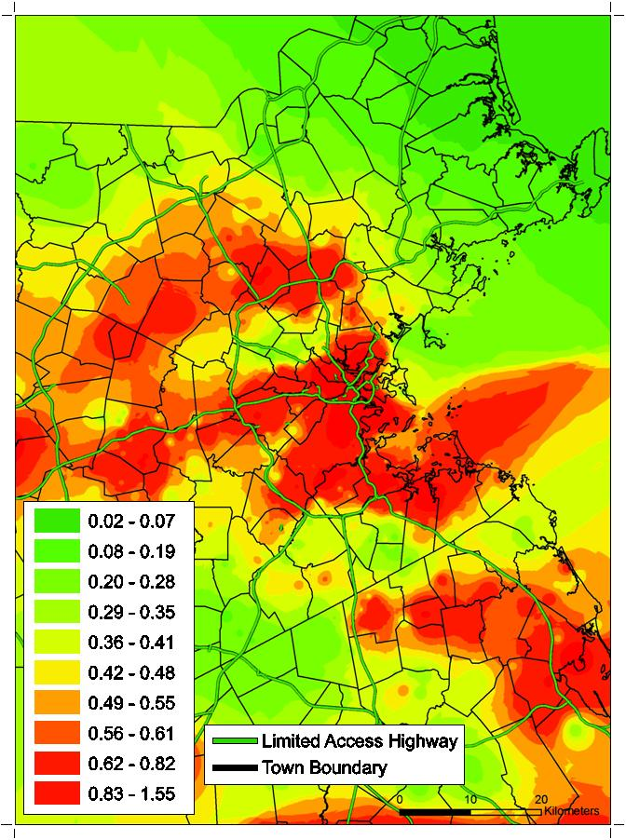
Example: PM and Cognitive Status
Higher exposure to traffic-related air pollution is associated with worse overall cognitive test performance
Association per doubling in 1-year average residential black carbon exposure
 | Low MMSE Score (<25)
OR (95% CI) | 1.3 (1.1, 1.6)
 | Global Cognitive Z-Score
Beta (95% CI) | -0.05 (-0.10, -0.0006)
Adjusted for age, education, first language, computer experience, physical activity, alcohol consumption, diabetes, dark fish consumption, census-level SES measures, and part-time resident status
Power et al. (2011) Environmental Health Perspectives

Slide 9
Traffic-Related Air Pollution and Cognitive Function in a Cohort of Older Men
The results of the study suggest an adverse effect of traffic-related air pollution on global cognitive functions in older men
Power et al. (2011) Environmental Health Perspectives

Slide 10
AIr pollution can be considered a risk factor for dementia. Ideally. through large scale modifications, we could reduce the global burden of dementia

